Slide 1


BALLARI INSTITUTE OF TECHNOLOGY &
MANAGEMENT
Autonomous Institute under VTU, Ballari-Hospet Road, Allipur, Ballari-583 104 Karnataka ,India
Department of Artificial Intelligence & Machine Learning
A Mini Project on
Sign Speak(Sign Language Detection)
Presented by
Bhavana Joshi | 3BR22AI025
Bhavya Jain | 3BR22AI027
Akash Kulkarni | 3BR22AI042
G Sahethi | 3BR22AI045
Dr. B.M Vidyavathi
Head of the Department
Dept. of AIML
Mini project Guide
Ms.Sahana Prasad
Teaching Ass, Dept. of AIML
Mini Project Coordinator
Asha Jyothi
Ass Professor, Dept. of AIML
01-Jan-2025
SignSpeak, Dep of AIML
Slide 1 of 47

Slide 2
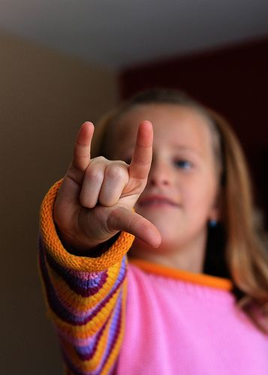

SignSpeak
01-Jan-2025
SignSpeak, Dep of AIML
Slide 2 of 47

Slide 3
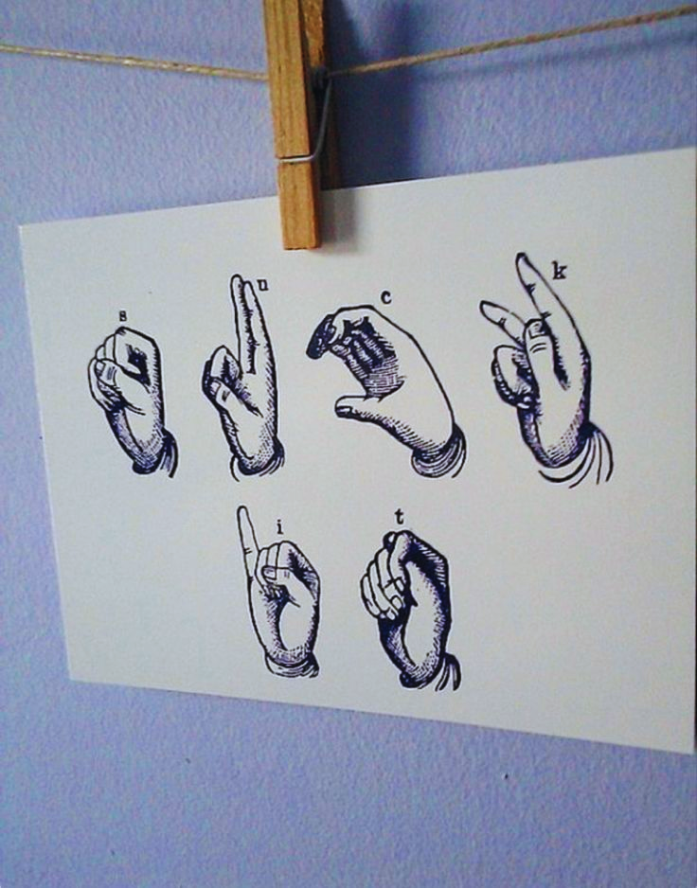
ABSTRACT
Sign Speak aims to create a web-based application that converts American Sign Language(ASL) gestures into text and audio using computer vision and machine learning techniques(CNN) to recognize hand gestures from video inputs. It addresses communication challenges faced by people who rely on sign language to communicate with non-signers.
01-Jan-2025
SignSpeak, Dep of AIML
Slide 3 of 47

Slide 4
Contents
1 | Introduction | 8 | System Flowchart/Methodology
2 | Problem Statement | 9 | Design
3 | Scope of the Project | 10 | Test cases
4 | Objectives | 11 | Results
5 | Literature Survey | 12 | Outputs
6 | Requirements | 13 | References
7 | Implementation Plan
01-Jan-2025
SignSpeak, Dep of AIML
Slide 4 of 47

Slide 5
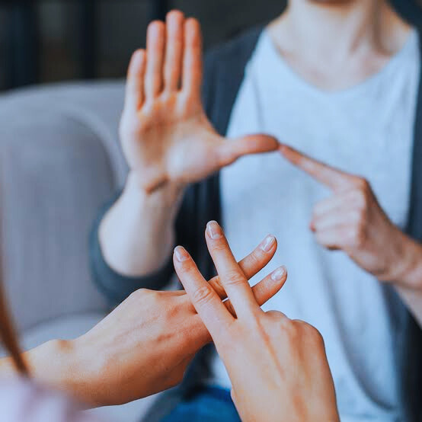
INTRODUCTION
American sign language is a predominant sign language Since the only disability D&M people have been communication related and they cannot use spoken languages hence the only way for them to communicate is through sign language.
Communication is the process of exchange of thoughts and messages in various ways such as speech, signals, behavior and visuals.
Deaf and Mute(D&M) people make use of their hands to express different gestures to express their ideas with other people.
Gestures are the nonverbally exchanged messages and these gestures are understood with vision. This nonverbal communication of deaf and dumb people is called sign language.
01-Jan-2025
SignSpeak, Dep of AIML
Slide 5 of 47

Slide 6
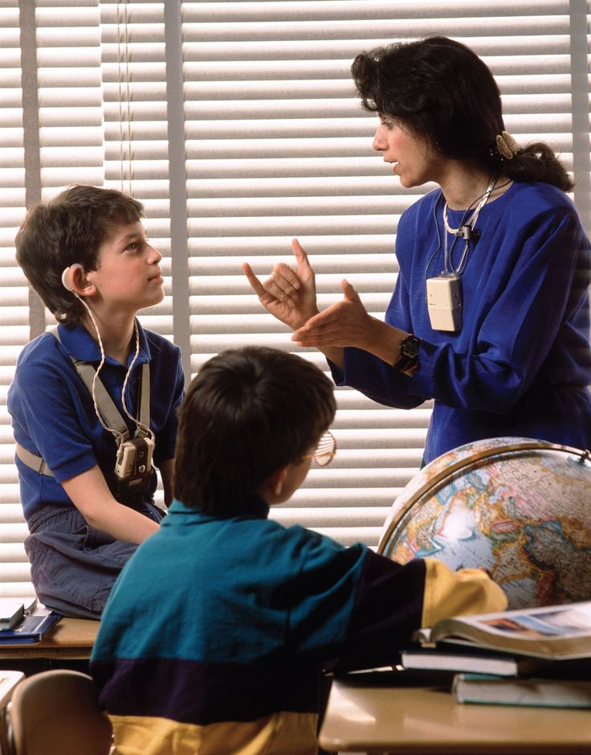
PROBLEM STATEMENT
To develop Web-based application and integrate with Sign Language Detection System which has been developed using machine learning algorithms, specifically Convolutional Neural Networks (CNN), to detect and interpret hand gestures, translating them into text and voice outputs.
01-Jan-2025
SignSpeak, Dep of AIML
Slide 6 of 47

Slide 7
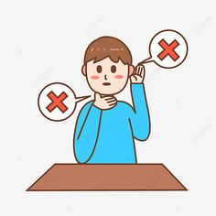


SCOPE OF THE PROJECT
This System will be Beneficial for Both Deaf/Mute People and the People Who do not understands the Sign Language.
After gesture recognition what he/she is trying to say it gives the output in the form of Text as well as Speech format.
Developing a web-based application for all the users
01-Jan-2025
SignSpeak, Dep of AIML
Slide 7 of 47

Slide 8

Objectives
To develop a Web-based machine learning model using HTML, CSS, and Java script and add tutorial section which makes users to integrate through the website.
To take an image of a hand gesture in ASL and display the output in text format, the system uses advanced image recognition techniques.
To create a computer software and train a model using CNN, which converts the recognized text into audio, the system employs TTS (text-to-speech) technology.
01-Jan-2025
SignSpeak, Dep of AIML
Slide 8 of 47

Slide 9
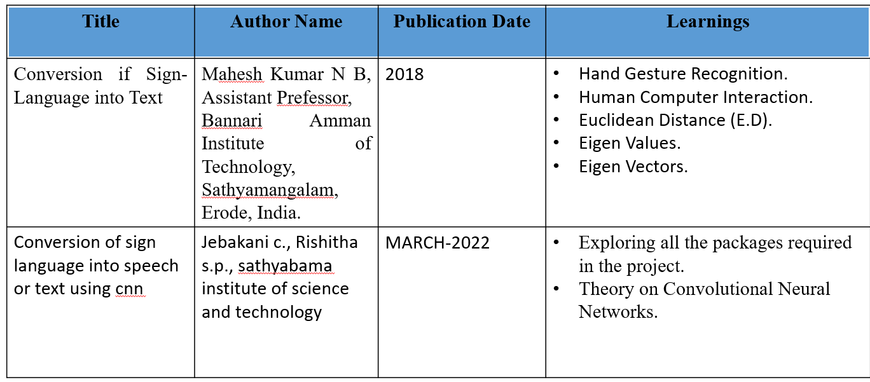
Literature Survey
01-Jan-2025
SignSpeak, Dep of AIML
Slide 9 of 47

Slide 10
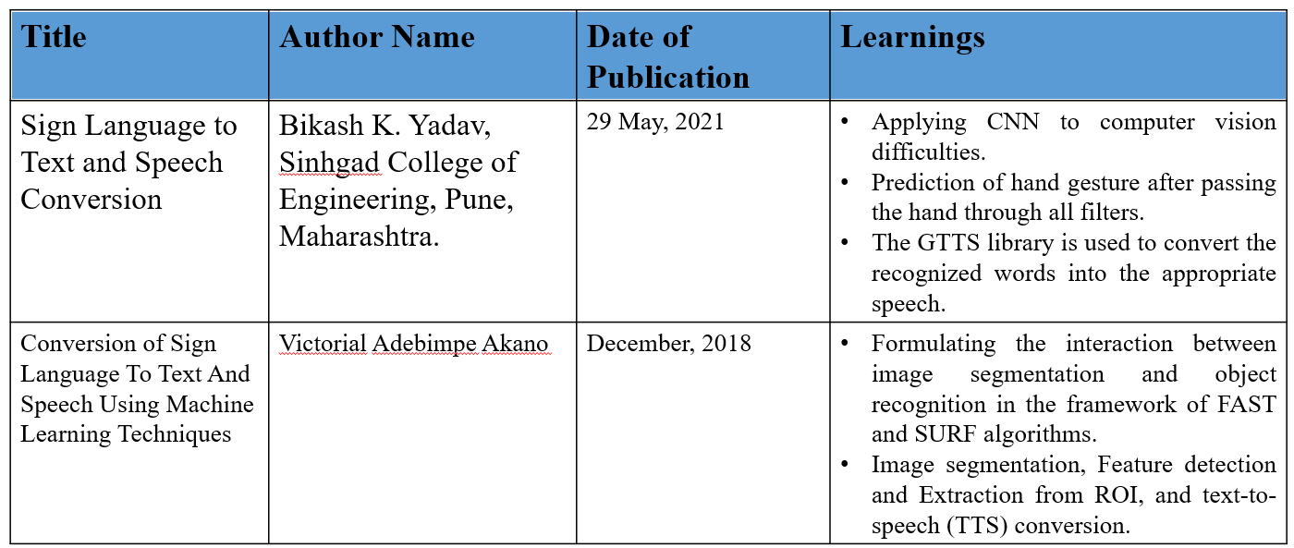
01-Jan-2025
SignSpeak, Dep of AIML
Slide 9 of 47

Slide 11

01
Software Requirements
02
Hardware Requirements
REQUIREMENTS
03
Functional Requiremnets
04
Non Functional Requirements
01-Jan-2025
SignSpeak, Dep of AIML
Slide 11 of 47

Slide 12
Software Requirements
•Operating System: Windows 10 and Above
•GUI: Tkinter
•IDEs: Visual Studio Code
•Programming Language: Python 3.10.0
•Python libraries: OpenCV, NumPy, Keras, mediapipe, Tensorflow, pyttsx3, pandas.
Hardware Requirements
•Webcam
•GPU:NVIDIA GPU with CUDA support (GTX 1660,RTX 2060)
•RAM: Minimum 8GB (16GB+ recommended)
•Storage: SSD with 256GB+
01-Jan-2025
SignSpeak, Dep of AIML
Slide 12 of 47

Slide 13
Functional Requirements
Image Capture and Upload
Gesture Recognition
Text Output
Audio Output
Sentence Formation
User Interface(Sign up and Login page, Tutorials, etc…,)
Non Functional Requirements
Performance
Accuracy
Scalability
Reliability
01-Jan-2025
SignSpeak, Dep of AIML
Slide 13 of 47

Slide 14

IMPLEMENTATION PLAN
01-Jan-2025
SignSpeak, Dep of AIML
Slide 14 of 47

Slide 15


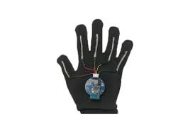
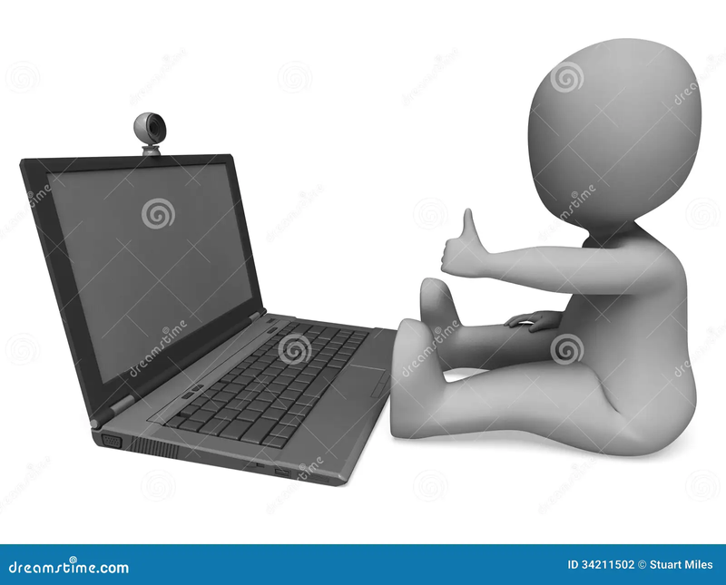
DATA ACQUISITION
The different approaches to acquire data about the hand gesture can be done in the following ways:
It uses electromechanical devices to provide exact hand configuration, and position. Different glove-based approaches can be used to extract information. But it is expensive and not user friendly.
In vision-based methods, the computer webcam is the input device for observing the information of hands and/or fingers. The Vision Based methods require only a camera, thus realizing a natural interaction between humans and computers without the use of any extra devices, thereby reducing costs.
figure2
figure1
01-Jan-2025
SignSpeak, Dep of AIML
Slide 15 of 47

Slide 16
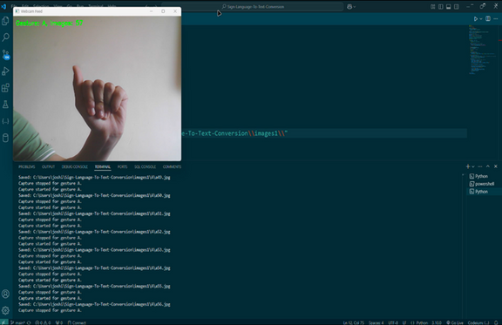
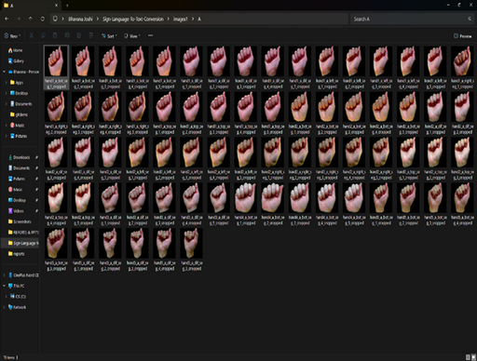
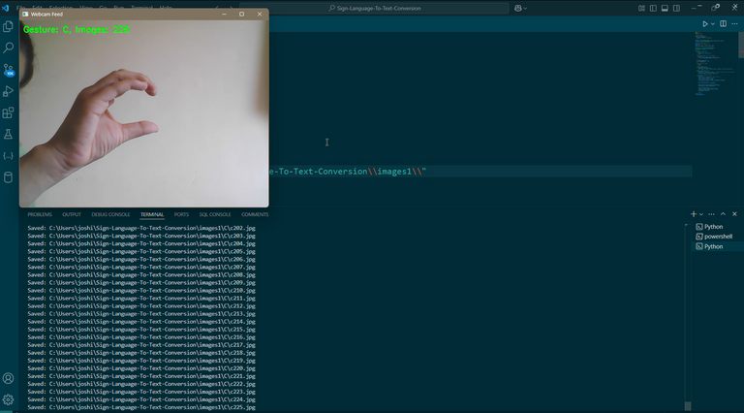
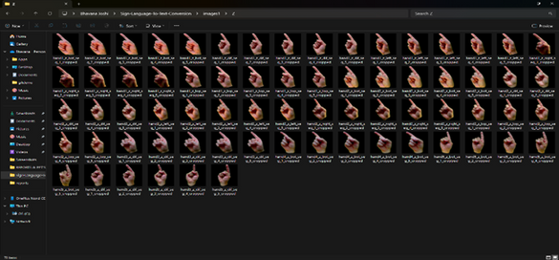
DATA PREPROCESSING AND FEATURE EXTRACTION
In this approach firstly we take images of all gestures using webcam and store them in an appropriate folder.
For hand detection, firstly we detect hand from image that is acquired by webcam.
So, after finding the hand from image we get the region of interest (Roi) then we cropped that image and saved the RGB image to the respective folder using OpenCV library.
We have collected images of different signs of different angles for sign letters A to Z.
collecting gestures for all the letters and storing them in a appropriate folder
figure 3
01-Jan-2025
SignSpeak, Dep of AIML
15
Slide 16 of 47

Slide 17
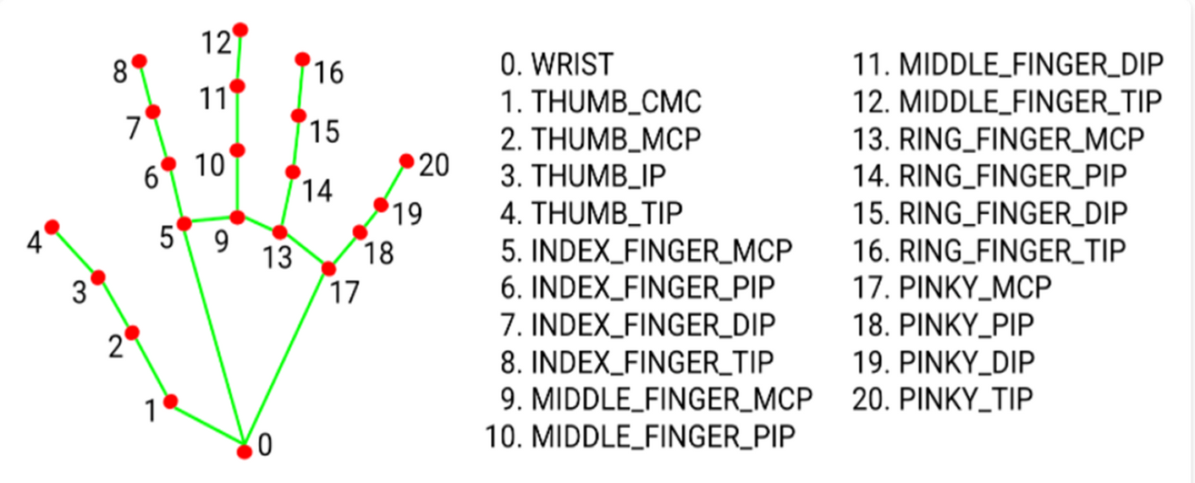
In this method there are many loop holes like your hand must be ahead of clean soft background and that is in proper lightning condition then only this method will give good accurate results but in real world we don’t get good background everywhere and we don’t get good lightning conditions too.
So to overcome this situation we try different approaches then we reached at one interesting solution in which firstly we detect hand from frame using Mediapipe and get the hand landmarks of hand present in that image then we draw and connect those landmarks in simple white image.
Media Pipe Land Marking System
figure 4
SignSpeak, Dep of AIML
16
01-Jan-2025
SignSpeak, Dep of AIML
Slide 17 of 47

Slide 18
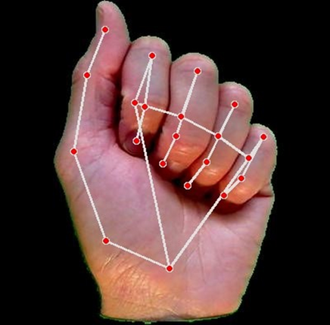
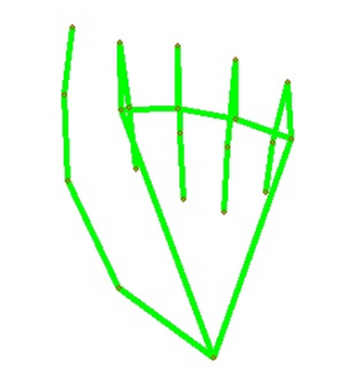
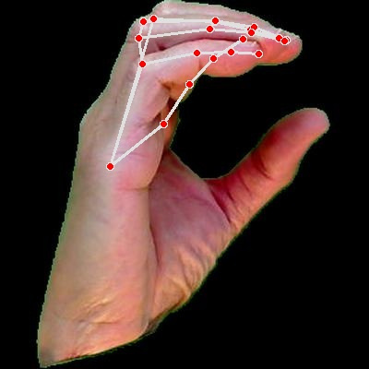
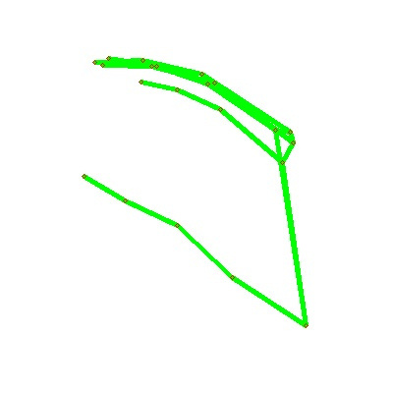
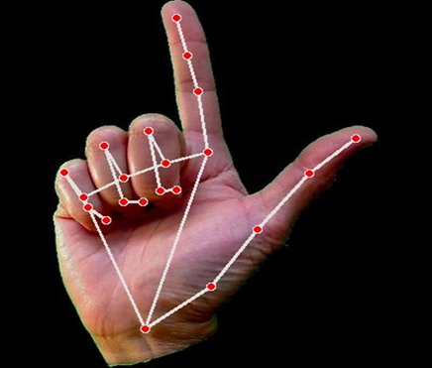
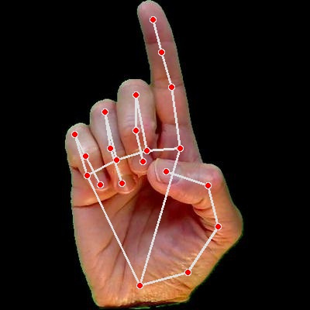
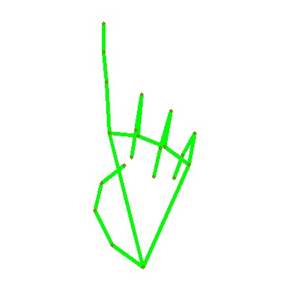
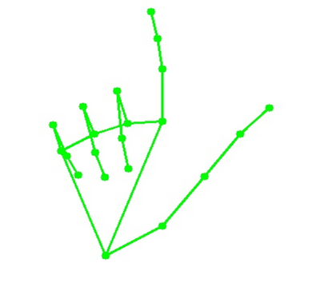
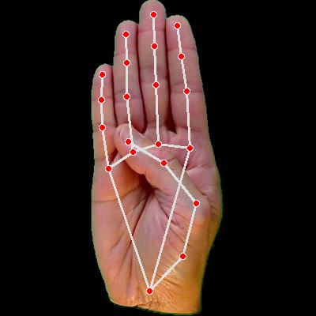
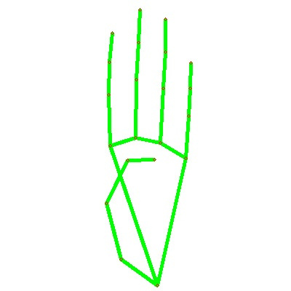
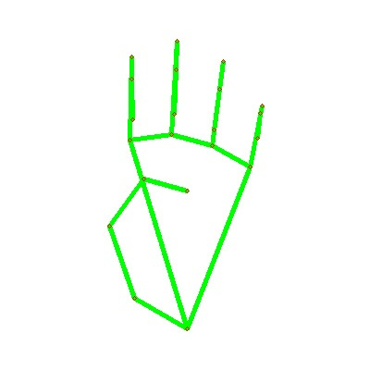
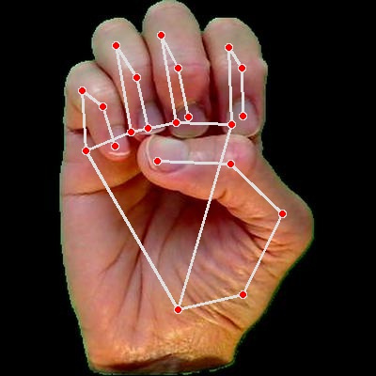
Drawing hand gesture for each and eveery skeleton images
17
01-Jan-2025
SignSpeak, Dep of AIML
Slide 18 of 47

Slide 19
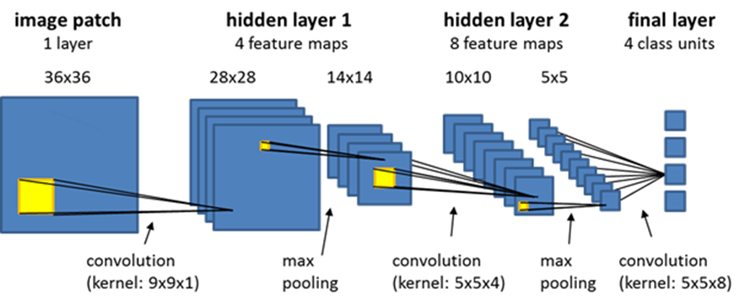
GESTURE CLASSIFICATION
Convolutional Neural Network (CNN)
CNN is a class of neural networks that are highly useful in solving computer vision problems.
They found inspiration from the actual perception of vision that takes place in the visual cortex of our brain.
They make use of a filter/kernel to scan through the entire pixel values of the image and make computations by setting appropriate weights to enable detection of a specific feature.
CNN is equipped with layers like convolution layer, max pooling layer, flatten layer, dense layer, dropout layer and a fully connected neural network layer.
These layers together make a very powerful tool that can identify features in an image.
The starting layers detect low level features that gradually begin to detect more complex higher-level features
figure 4
18
01-Jan-2025
figure 5
SignSpeak, Dep of AIML
Slide 19 of 47

Slide 20
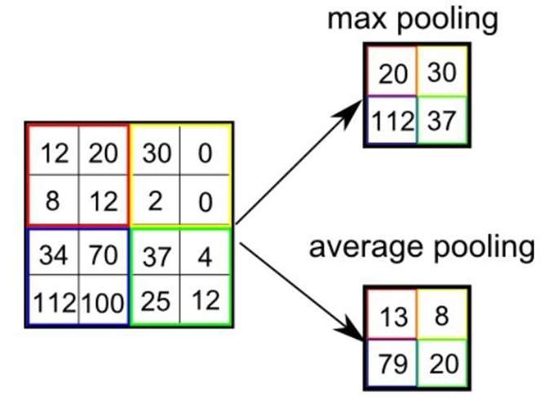
Pooling Layer:
We use pooling layer to decrease the size of activation matrix and ultimately reduce the learnable parameters.
There are two types of pooling:
a. Max Pooling:
In max pooling we take a window size [for example window of size 2*2], and only taken the maximum of 4 values.
Well lid this window and continue this process, so well finally get an activation matrix half of its original Size.
b. Average Pooling:
In average pooling we take average of all Values in a window.
figure 6
19
01-Jan-2025
SignSpeak, Dep of AIML
Slide 20 of 47

Slide 21
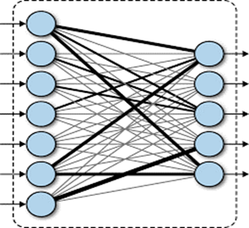
Fully Connected Layer:
In convolution layer neurons are connected only to a local region, while in a fully connected region, well connect the all the inputs to neurons.
figure 7
20
01-Jan-2025
SignSpeak, Dep of AIML
Slide 21 of 47

Slide 22
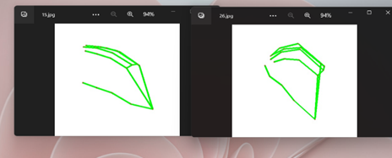
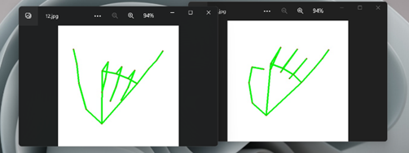
The preprocessed 180 images/alphabet will feed the tensorflow.keras CNN model.
Because we got bad accuracy in 26 different classes thus, We divided whole 26 different alphabets into 8 classes in which every class contains similar alphabets:
[c,o]
figure 8
[y,j]
21
figure 9
01-Jan-2025
SignSpeak, Dep of AIML
Slide 22 of 47

Slide 23
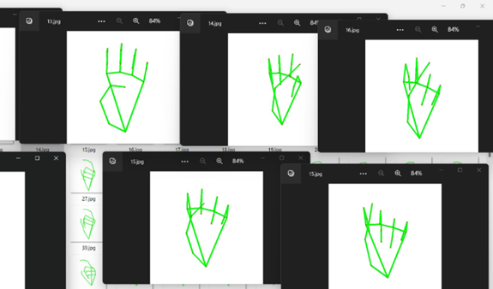
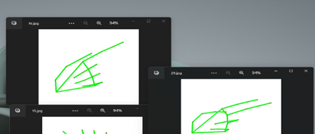
[a,e,m,n,s,t]
figure 10
[g,h]
22
figure 11
01-Jan-2025
SignSpeak, Dep of AIML
Slide 23 of 47

Slide 24
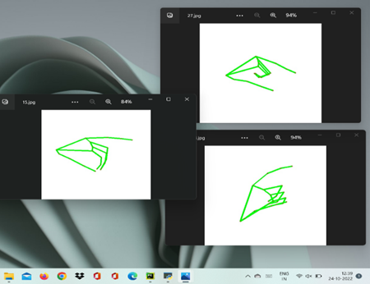
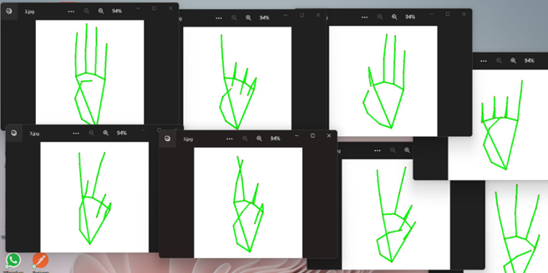
[p,q,z]
figure 12
[b,d,f,I,u,v,k,r,w]
figure 13
23
01-Jan-2025
SignSpeak, Dep of AIML
Slide 24 of 47

Slide 25
All the gesture labels will be assigned with a probability. The label with the highest probability will treated to be the predicted label.
So when model will classify [aemnst] in one single class using mathematical operation on hand landmarks we will classify further into single alphabet a or e or m or n or s or t.
Text and Speech Translation
The model translates known gestures into words.
We have used pyttsx3 library to convert the recognized words into the appropriate speech.
The text-to-speech output is a simple workaround, but it's a useful feature because it simulates a real-life dialogue.
24
01-Jan-2025
figure 5
SignSpeak, Dep of AIML
Slide 25 of 47

Slide 26
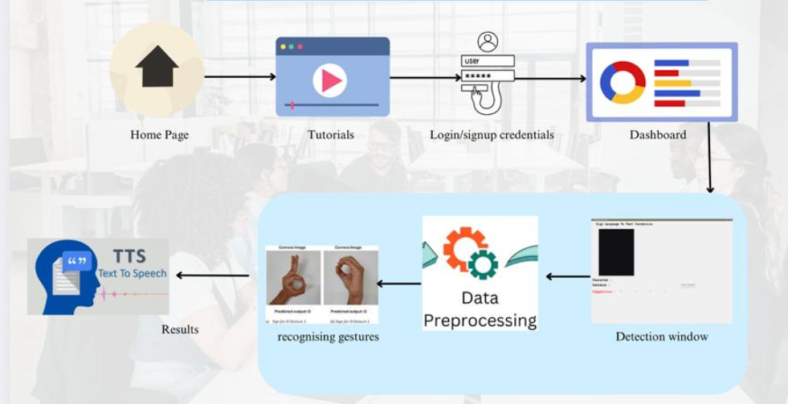
SYSTEM FLOWCHART/ METHODOLOGY
25
01-Jan-2025
figure 5
SignSpeak, Dep of AIML
Slide 26 of 47

Slide 27
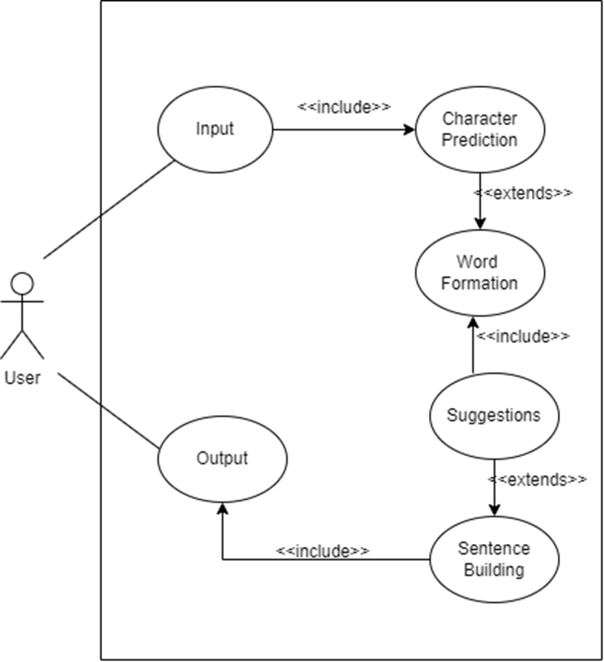
DESIGN
Use case diagram
26
figure 13
01-Jan-2025
SignSpeak, Dep of AIML
Slide 27 of 47

Slide 28
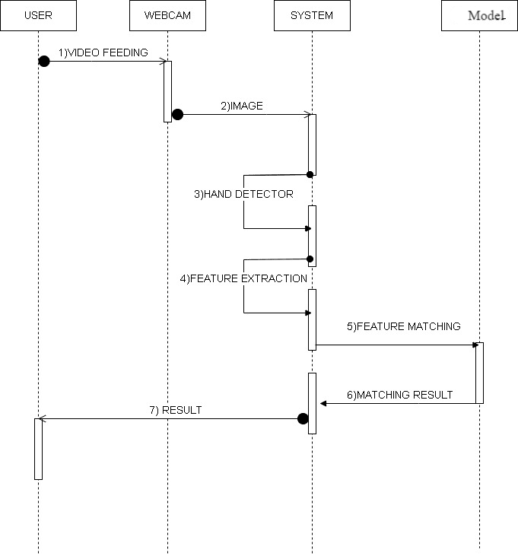
Sequence diagram
27
figure 14
01-Jan-2025
SignSpeak, Dep of AIML
Slide 28 of 47

Slide 29
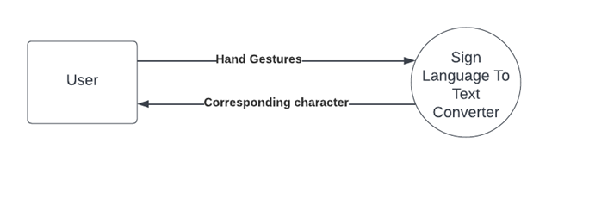
Level 0 Data Flow Diagram
28
figure 14
01-Jan-2025
SignSpeak, Dep of AIML
Slide 29 of 47

Slide 30
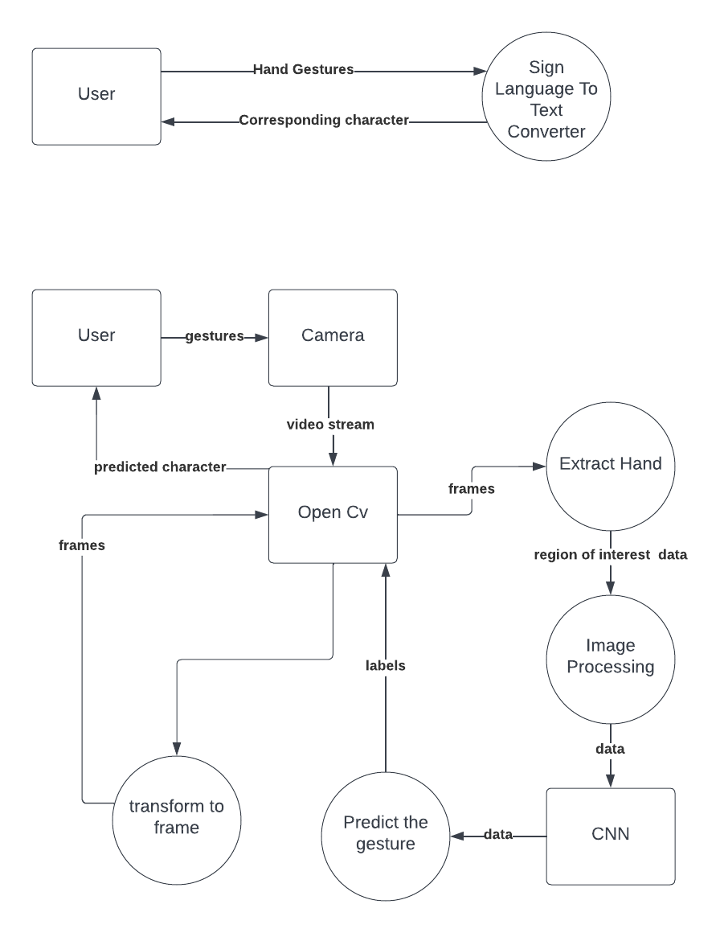
Level 1 Data Flow Diagram
28
figure 14
01-Jan-2025
SignSpeak, Dep of AIML
Slide 30 of 47

Slide 31
TEST CASES
TC ID | Test Case Description | Input/Action | Expected Result
TC-001 | Verify navigation to all pages | Click on navigation links (e.g., Home, Detect, Collect Data) | TC-001 Verify navigation
TC-002 | Check unexpected actions | Random clicks, or rapid repeated clicks | Website doesn’t crash; appropriate messages are shown
TC-003 | Check the representation of results | use real-time input | Detected letters/words/sentences displayed accurately on the screen
TC-004 | Test TTS output clarity | Input detected sentence for TTS | Voice output matches displayed text with proper clarity
29
01-Jan-2025
SignSpeak, Dep of AIML
Slide 31 of 47

Slide 32
TC ID | Test Case Description | Input/Action | Expected Result
TC-005 | Login with valid credential | Valid username and password | User is redirected to the dashboarD
TC-006 | Login with invalid credential | Invalid username or password | Error message "Invalid credentials"
TC-007 | Sign up with valid details | Valid username, email, password | Account is created, redirected to login page
TC-008 | Sign up with invalid details | Missing or invalid details (e.g., empty fields) | Error message "Please fill in all fields"
30
01-Jan-2025
SignSpeak, Dep of AIML
Slide 32 of 47

Slide 33
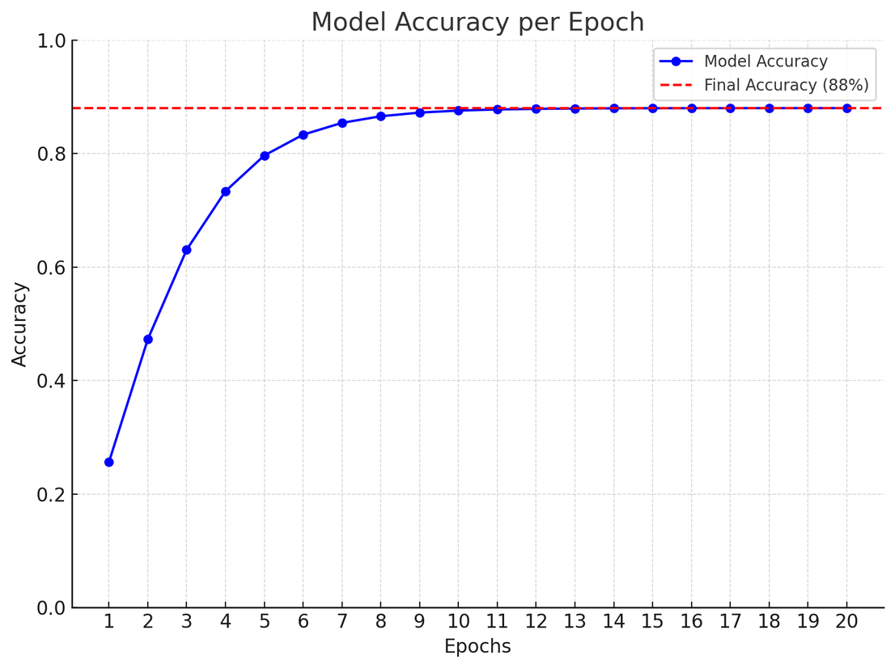
Graph on validation accuracy
RESULTS
88%
Accuracy score
31
01-Jan-2025
SignSpeak, Dep of AIML
Slide 33 of 47

Slide 34
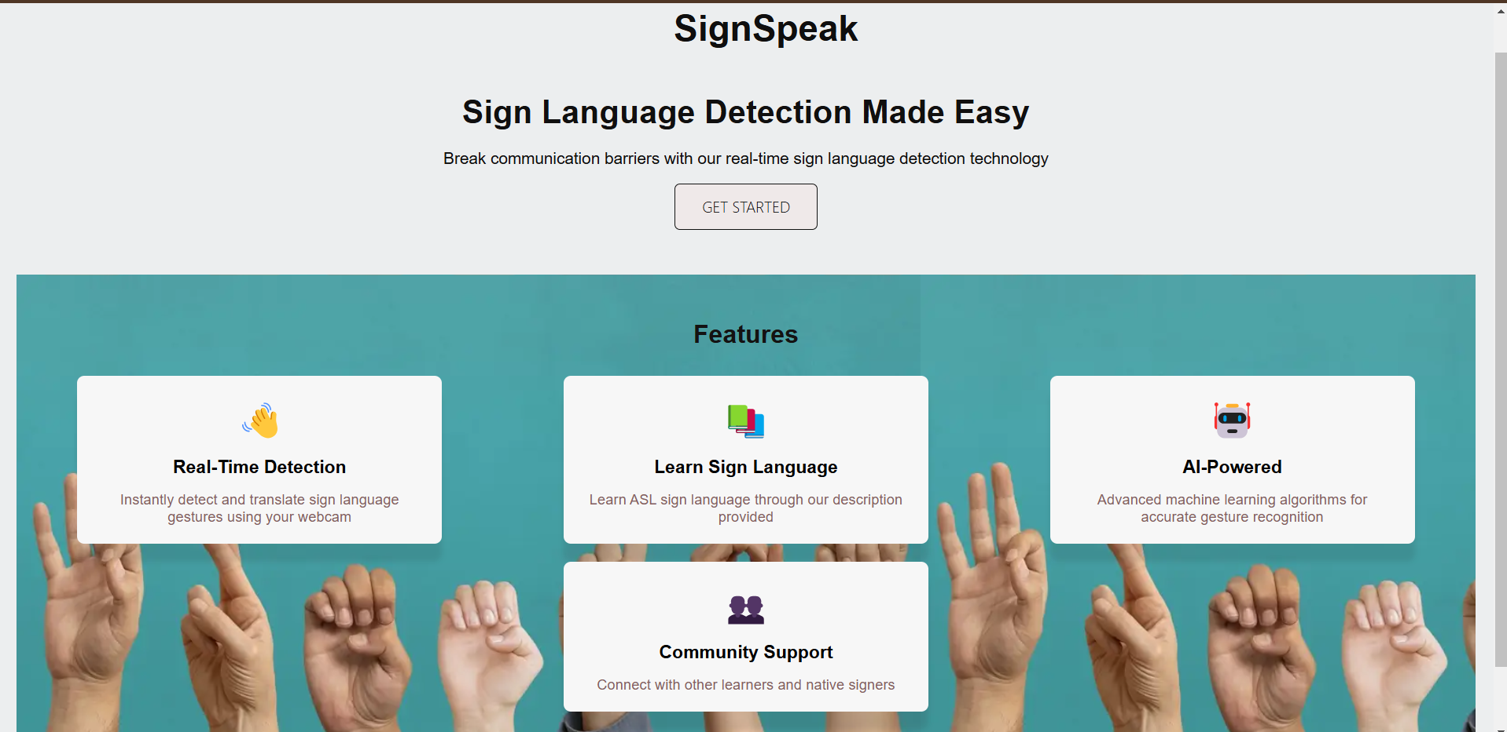
OUTPUTS
Home Page
32
01-Jan-2025
SignSpeak, Dep of AIML
Slide 34 of 47

Slide 35
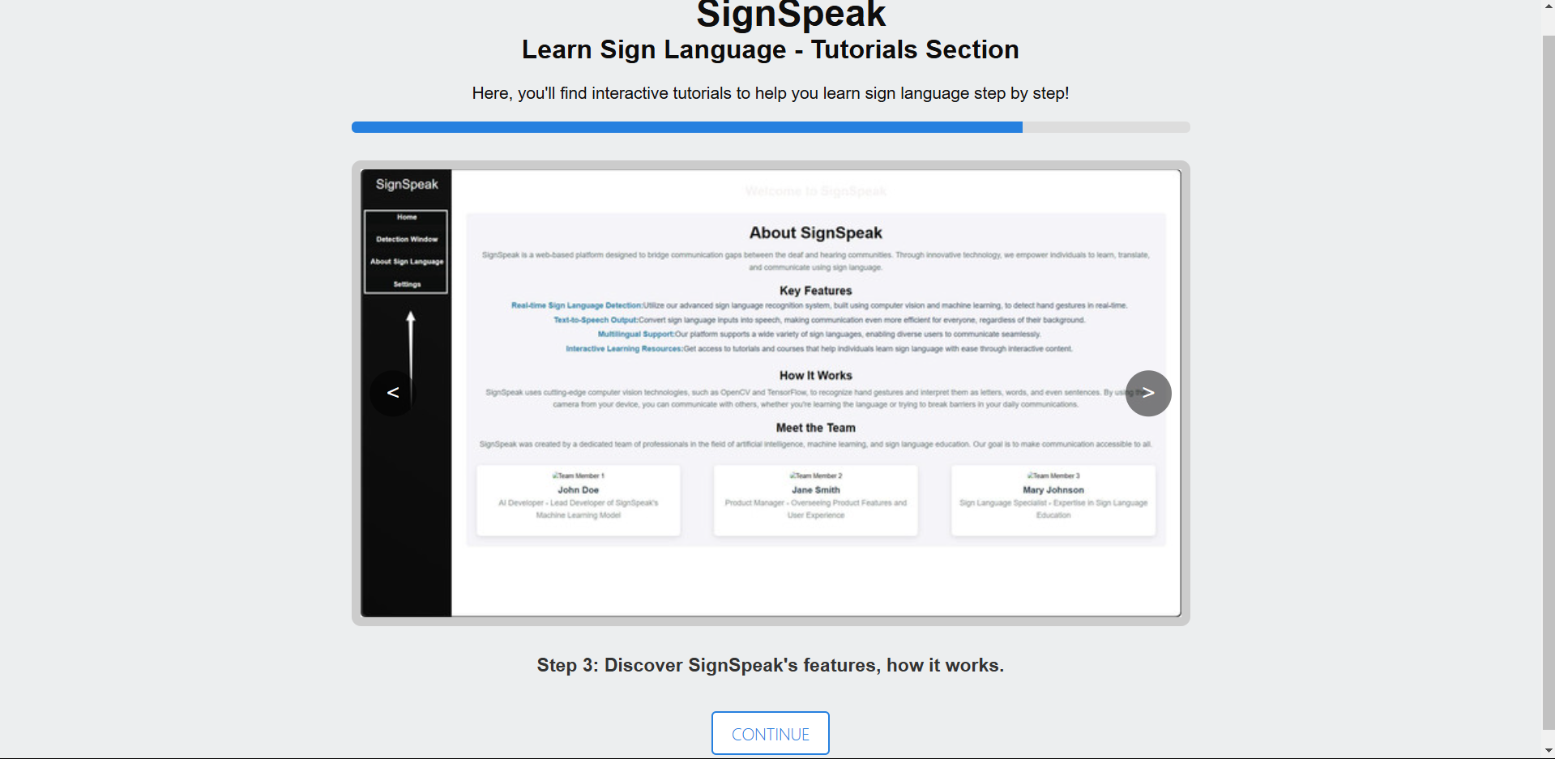
Tutorials Page
01-Jan-2025
SignSpeak, Dep of AIML
Slide 35 of 47

Slide 36
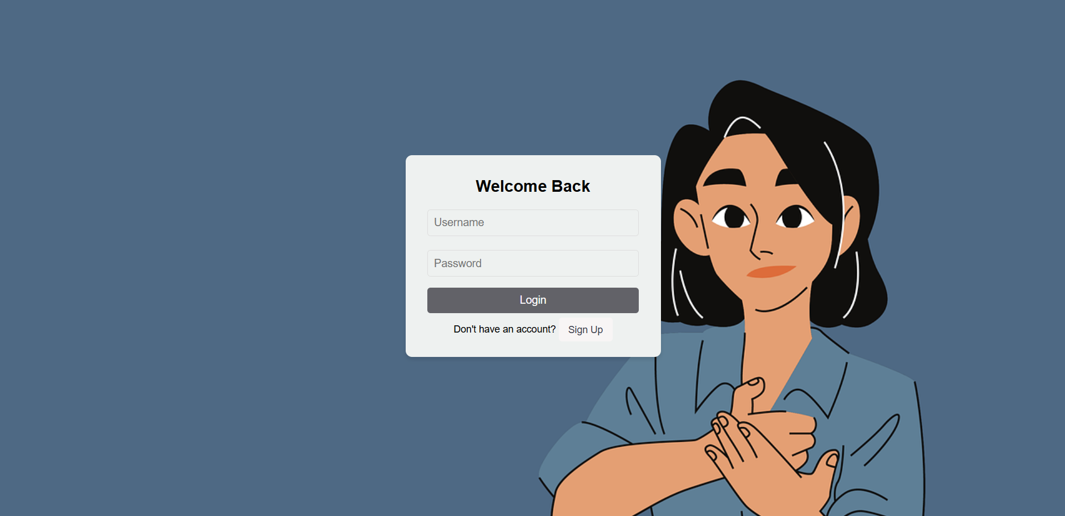
Login Page
01-Jan-2025
SignSpeak, Dep of AIML
Slide 36 of 47

Slide 37
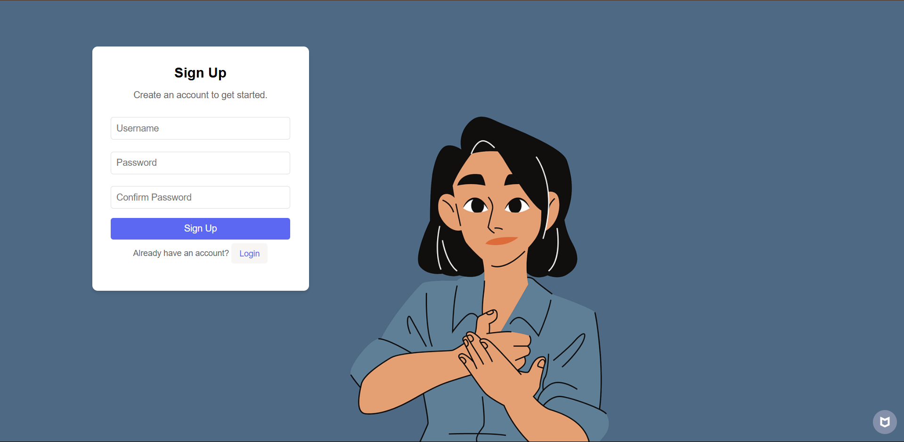
SignUp Page
01-Jan-2025
SignSpeak, Dep of AIML
Slide 37 of 47

Slide 38
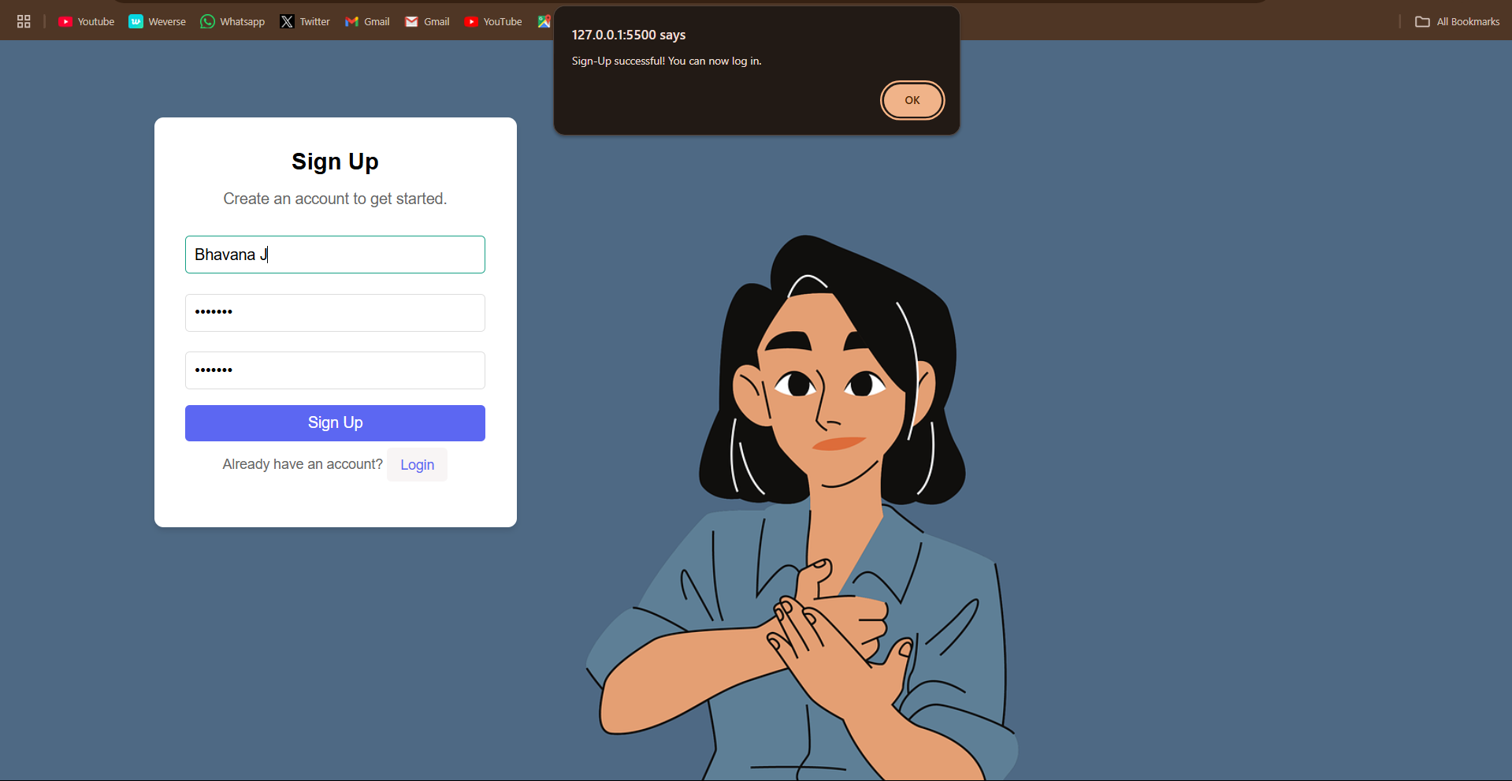
After signUp
01-Jan-2025
SignSpeak, Dep of AIML
Slide 38 of 47

Slide 39
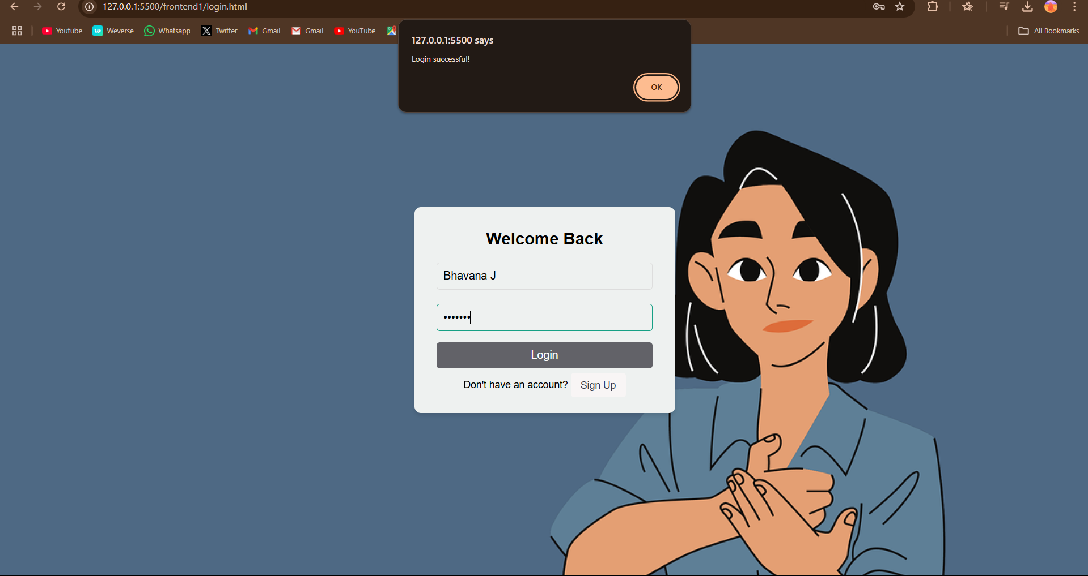
After Login
01-Jan-2025
SignSpeak, Dep of AIML
Slide 39 of 47

Slide 40
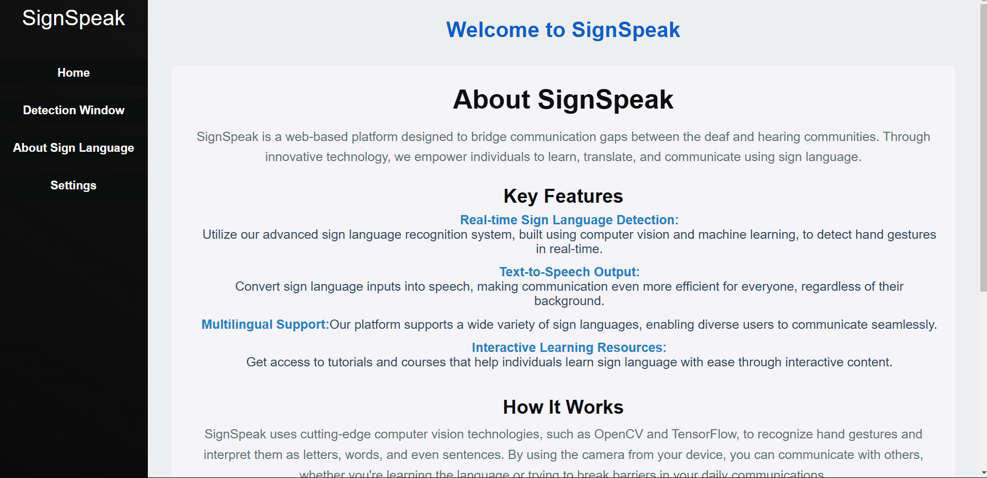
Main Dashboard Home Page
01-Jan-2025
SignSpeak, Dep of AIML
Slide 40 of 47

Slide 41
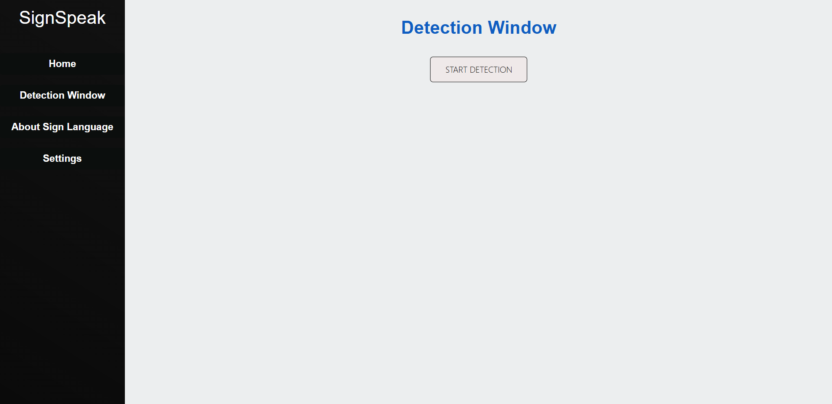
Main Dashboard Detection Page
01-Jan-2025
SignSpeak, Dep of AIML
Slide 41 of 47

Slide 42
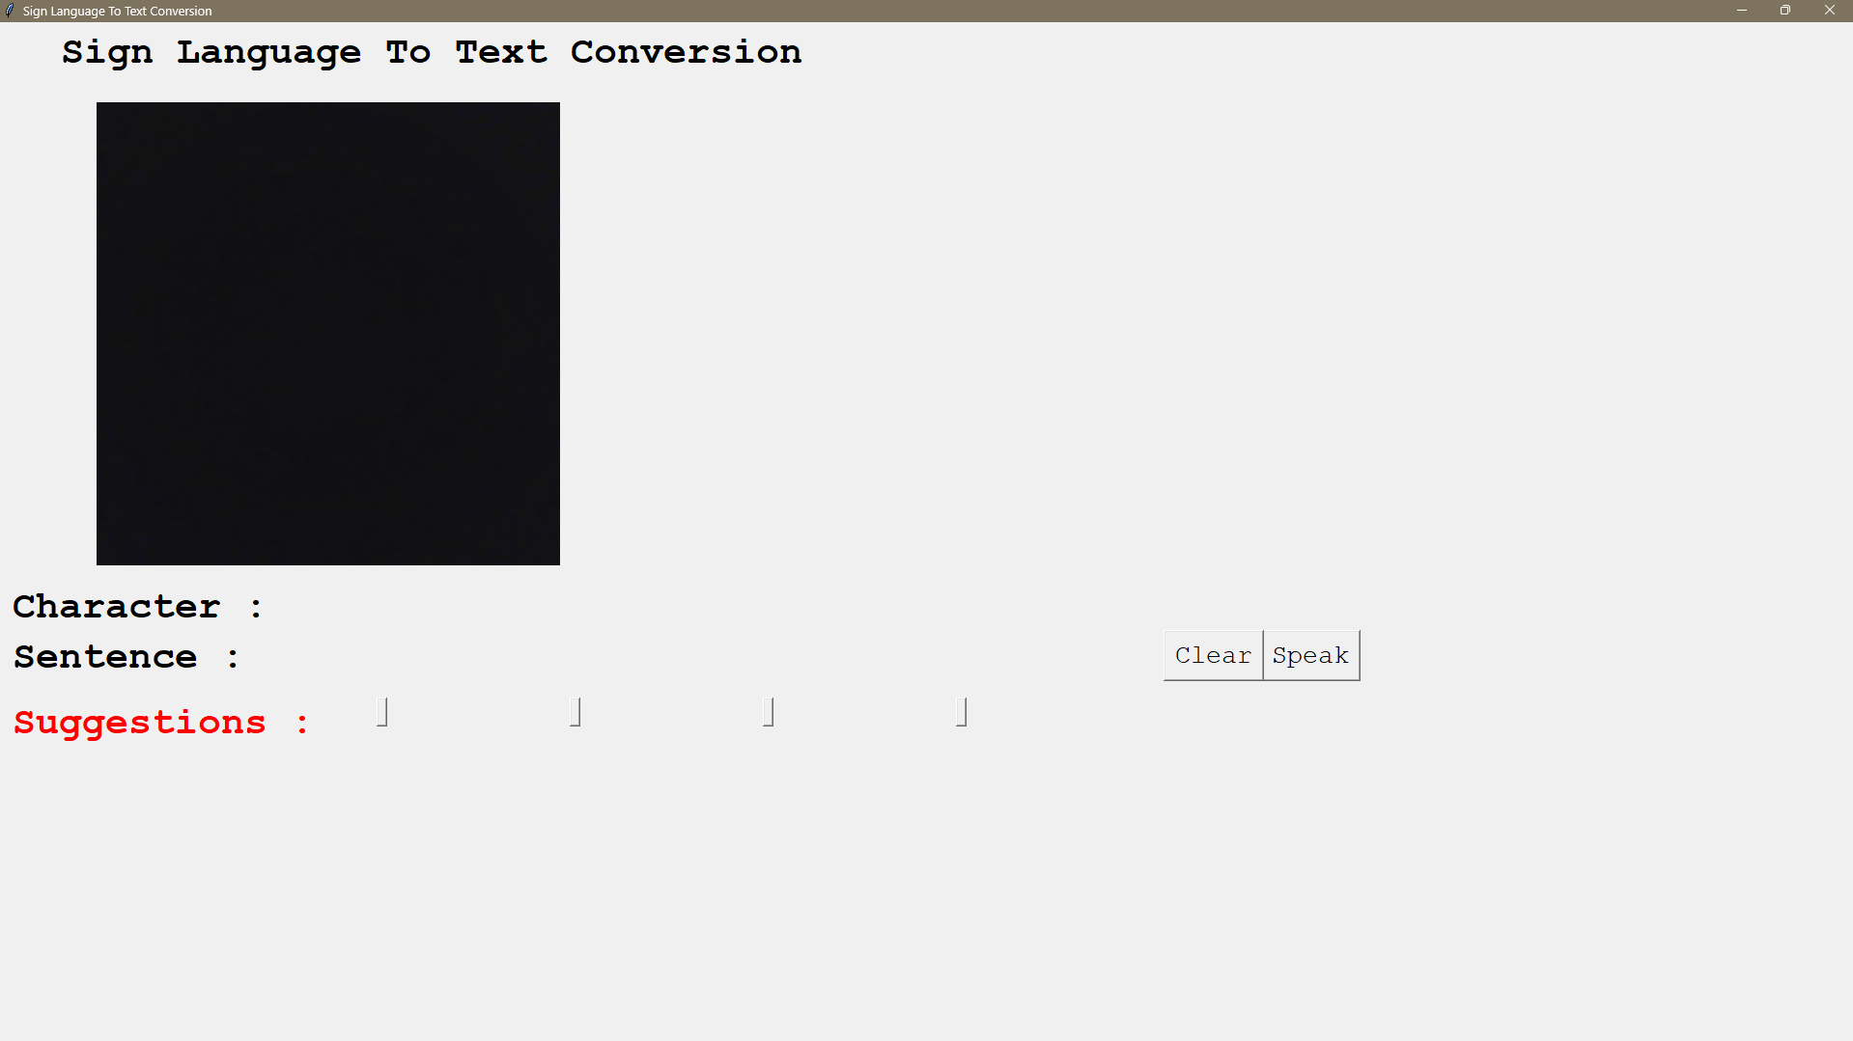
Start the detection window by pressing start detection button
01-Jan-2025
SignSpeak, Dep of AIML
Slide 42 of 47

Slide 43

Main Dashboard About Page
01-Jan-2025
SignSpeak, Dep of AIML
Slide 43 of 47

Slide 44

Main Dashboard Settings Page
01-Jan-2025
SignSpeak, Dep of AIML
Slide 44 of 47

Slide 45
References
[1] Convolutional Neural Networks, https://www.geeksforgeeks.org/introduction-convolution-neural-network/
[2] Sign Language to Text and Speech Conversion, https://www.ijariit.com/manuscript/sign-language-to-text-and-speech-conversion/
[3] Conversion of Sign Language To Text And Speech Using Machine Learning Techniques, https://www.researchgate.net/publication/335433017_Conversion_of_Sign_Language_To_Text_And_Speech_Using_Machine_Learning_Techniques
[4] Conversion of Sign Language into Text, https://www.ripublication.com/ijaer18/ijaerv13n9_90.pdf
[5] CONVERSION OF SIGN LANGUAGE INTO SPEECH OR TEXT USING CNN, https://sist.sathyabama.ac.in/sist_naac/documents/1.3.4/1822-b.e-cse-batchno-111.pdf
Aaron Loeb
Alfredo Torres
Daniel Gallego
Olivia Wilson
CEO & Founder
Project manager
CEO & Founder
Marketing Head
33
01-Jan-2025
SignSpeak, Dep of AIML
Slide 45 of 47

Slide 46
Conclusion
Finally, we are able to predict any alphabet[a-z] with 97% Accuracy (with and without clean background and proper lightning conditions) through our method.
And if the background is clear and there is good lightning condition then we got even 99% accurate results.
In Future work we will make one android application in which we implement this algorithm for gesture prediction
Aaron Loeb
Alfredo Torres
Daniel Gallego
Olivia Wilson
CEO & Founder
Project manager
CEO & Founder
Marketing Head
33
01-Jan-2025
SignSpeak, Dep of AIML
Slide 46 of 47

Slide 47


THANK YOU!
34
01-Jan-2025
SignSpeak, Dep of AIML
Slide 47 of 47

