Slide 1
HACKATHON PROJECT • AI*01
UNIASSIST AI
College Knowledge RAG Assistant
Your college knowledge, one question away.
TEAM SYNAPSE AI
Abhiram Joshi • Karthik Shivappa Umachagi
Shivashankar S Jatti • Somesh S Belludi
AIML | First Year | A3 Division
LIVE PROJECT ↗
uniassistai.lovable.app

Slide 2
The Problem
College information is available — but often hard to find.
Scattered information
Time-consuming search
Trust & verification
Rules, notices, calendars and handbooks live across multiple documents.
Students may need to open several PDFs or ask multiple people.
A useful answer should show where the information came from.
The opportunity
Make college knowledge searchable through natural-language questions, while keeping answers traceable to official documents.
02

Slide 3
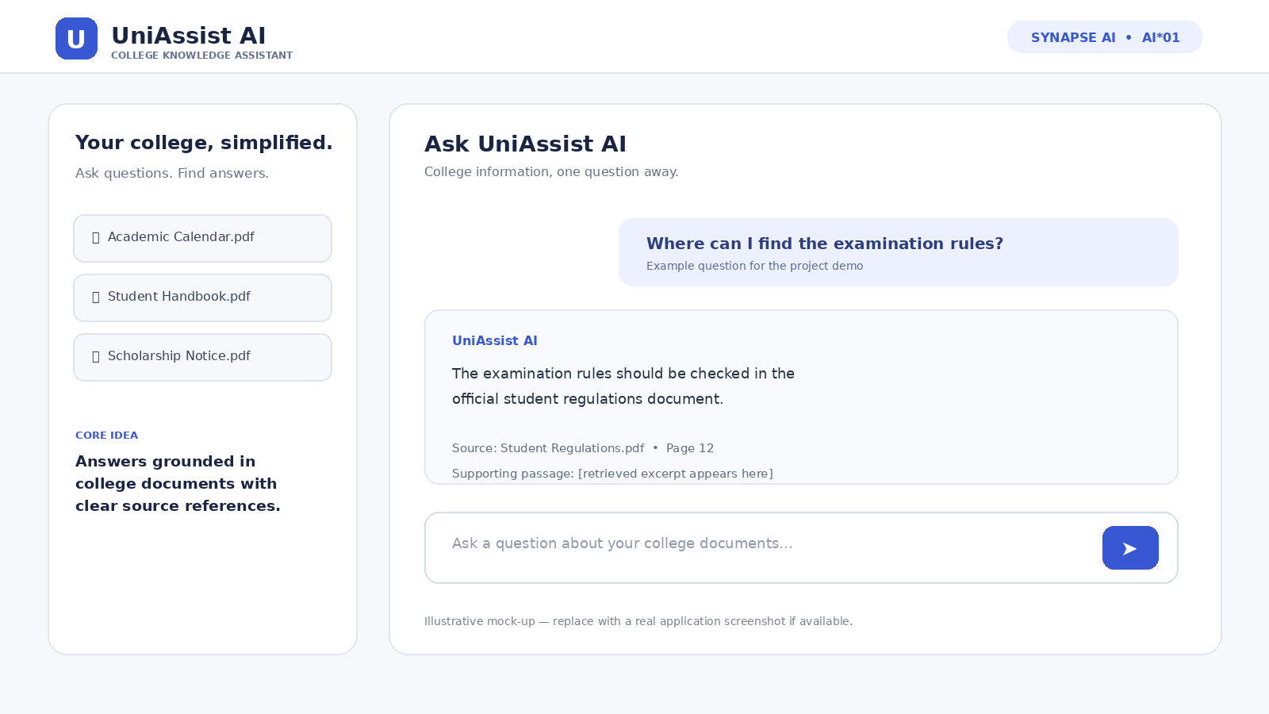
Our Solution: UniAssist AI
A single conversational entry point for college documents.
Ask in plain language
• Ask about academic rules, notices, scholarships and student services.
• Retrieve relevant passages from a college knowledge base.
• Generate a concise answer grounded in the retrieved content.
• Show source document and page details where available.
• Acknowledge when the available documents do not contain the answer.
Illustrative interface mock-up, not a captured live screenshot.
03

Slide 4
Live Project
Open the running project during the presentation.
Live URL
https://uniassistai.lovable.app
Demo focus
Ask a question with a known answer, then verify the source.
Before evaluation
Use authentic, authorized college documents and test citations.
Note: replace the illustrative mock-up with a real screenshot from your app if possible.
04

Slide 5
How RAG Works
Retrieval-Augmented Generation connects answers to a document knowledge base.
1. Documents
2. Extract & chunk
3. Retrieve
4. Generate
5. Cite sources
PDFs, notices,
handbooks
→
Clean text into
small passages
→
Find relevant
passages
→
LLM answers using
retrieved context
→
Show document
and page details
Reliability principle
If the retrieved documents do not support an answer, the assistant should say it cannot verify the information instead of guessing.
05

Slide 6
Core Features & User Value
Focus on features that can be demonstrated and verified.
Natural-language Q&A
Document-grounded answers
Source references
Students ask questions in everyday language.
Responses use relevant retrieved passages.
Help users check the original information.
Document categories
Graceful fallback
Responsive access
Organize academics, exams, scholarships and placements.
Admit when information is missing or ambiguous.
Designed for desktop and mobile use.
06

Slide 7
System Architecture
A reference architecture — confirm the exact stack against your implementation.
User
Frontend
Backend
Retriever
LLM
Sources
Question
→
Lovable UI
→
API / orchestration
→
BM25 and/or vector search
→
Grounded response
→
Answer + citations
Document ingestion (separate flow)
Authorized upload → text extraction → chunking → indexing → searchable knowledge base
Security: keep API keys server-side and restrict access to private documents.
07

Slide 8
Technology Stack
List only the tools that are actually present in your codebase.
Frontend
Retrieval
Lovable-generated web interface; responsive chat experience.
Current demo describes browser-based BM25 retrieval; verify current behaviour.
Backend / AI
Knowledge source
Connect or document the real API, model and data services used.
College PDFs, notices and handbooks with source metadata.
Be transparent: separate implemented features from planned enhancements in your final submission.
08

Slide 9
Testing & Reliability
Show judges evidence that the assistant retrieves the right information.
Known answer
Correct answer + correct citation
Paraphrased question
Retrieve the same relevant passage
Missing information
Say the answer cannot be verified
Conflicting notices
Ask for clarification or identify the latest valid source
Report measured results only after running your test set; do not invent accuracy percentages.
09

Slide 10
Impact & Future Scope
A scalable starting point for a more accessible campus knowledge experience.
Potential impact
Future scope
• Less time searching documents
• Easier access to official information
• Better answer traceability
• Multilingual queries
• Voice input
• Portal integration
• Automated notice indexing
Success measure
Can a student get a correct, source-backed answer to a real college question in a few steps?
10

Slide 11
Team SYNAPSE AI
A four-member team building a practical AI solution for campus knowledge.
Abhiram Joshi
Karthik Shivappa Umachagi
Team Leader • Integration & presentation
Frontend & user experience
Shivashankar S Jatti
Somesh S Belludi
RAG & document processing
Testing & documentation
Department: AIML | Year: First Year | Division: A3 | Problem ID: AI*01
11

Slide 12
SYNAPSE AI • AI*01
One question. One intelligent assistant.
Verified college knowledge.
UniAssist AI aims to turn scattered college documents into accessible, searchable knowledge — with answers that users can verify.
https://uniassistai.lovable.app
Thank you • Questions & Answers
TEAM SYNAPSE AI

