Slide 1

"The IPL has been designed to entice an entire new generation of sports fans into the grounds throughout the country. The dynamic Twenty20 format has been designed to attract a young fan base, which also includes women and children."
— Lalit Modi during the launch of the IPL.

Slide 2
Introduction
IPL is a professional T20 cricket league in India.
Double round-robin league and Playoffs format.
With its inception in 2008, there have been eleven seasons of the IPL tournament.
The Orange Cap is presented to the leading run scorer and the Purple Cap is presented to the leading wicket-taker.
Most runs: Suresh Raina [IND] - 4985
Most wickets: Lasith Malinga [SL] - (154)

Slide 3
Data Wrangling
Installing packages for importing required libraries and load data from the CSV file.
Dropping variables such as venue, umpire1, umpire2, umpire3 and id.
Sorting the dataframe according to the Season and reseting the index values to start from index 1.
Renaming Rising Pune Supergiant to Rising Pune Supergiants

Slide 4
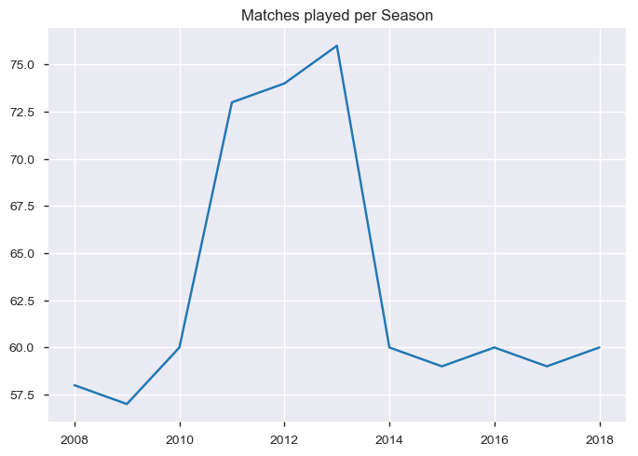
Matches played per Season
Season | No. of Matches
2008 | 58
2009 | 57
2010 | 60
2011 | 73
2012 | 74
2013 | 76
2014 | 60
2015 | 59
2016 | 60
2017 | 59
2018 | 60

Slide 5
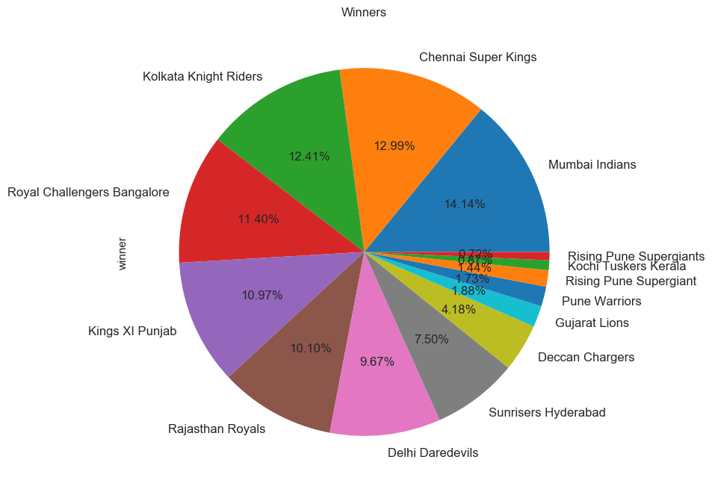
Top Winners
Teams | No. of Wins
Mumbai Indians | 98
Chennai Super Kings | 90
Kolkata Knight Riders | 86
Royal Challengers Bangalore | 79
Kings XI Punjab | 76
Rajasthan Royals | 70
Delhi Daredevils | 67
Sunrisers Hyderabad | 52
Deccan Chargers | 29
Rising Pune Supergiants | 15
Gujarat Lions | 13
Pune Warriors | 12
Kochi Tuskers Kerala | 6

Slide 6
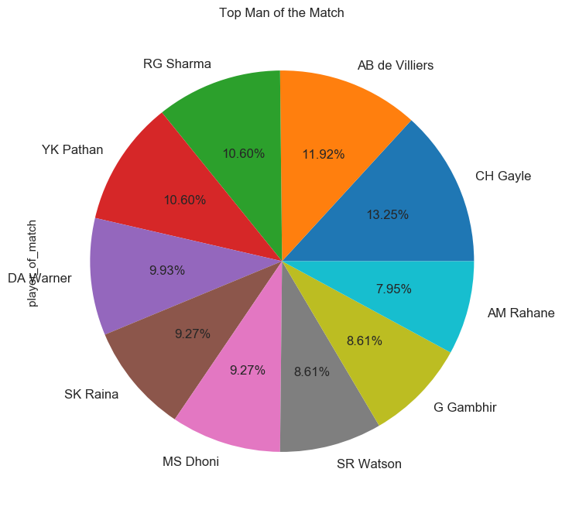
Man of the Match (Top 10)
Players | No. of times
CH Gayle | 20
AB de Villiers | 18
RG Sharma | 16
YK Pathan | 16
DA Warner | 15
SK Raina | 14
MS Dhoni | 14
SR Watson | 13
G Gambhir | 13
AM Rahane | 12
215 unique players have won the Man of the Match

Slide 7
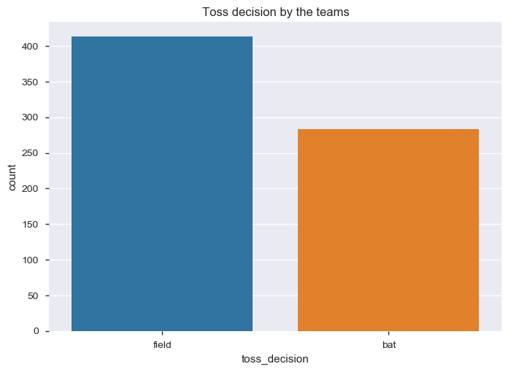
Toss decisions
Most teams favoured to field first.
Out of the 696 instances, Fielding was chosen 413 times (59%) and Batting was chosen 283 times (41%)

Slide 8
Match Winners vs. Toss Winners
A total of 357 (51%) instances favoured the toss winners to win the match.
Out of the 357 instances:
184 instances where in the toss winners elected to bat first.
223 instances where in the toss winners elected to field first.
The above values justify the teams favouring to field first.

Slide 9
Wins due to interrupted play (DLS)
A total of 19 matches resulted in the winner being declared by updating the target using the DLS method.
Out of the 19 instances:
6 instances were when the toss winners elected to bat first
4 times the DLS worked in favour of the toss winners
13 instances were when the toss winners elected to field first
7 times the DLS worked in favour of the toss winners

Slide 10
Match Winners vs. Toss Winners (DLS)
Match Winners | No. of times
Kolkata Knight Riders | 4
Royal Challengers Bangalore | 3
Rising Pune Supergiants | 2
Sunrisers Hyderabad | 2
Chennai Super Kings | 2
Delhi Daredevils | 2
Kings XI Punjab | 2
Rajasthan Royals | 1
Kochi Tuskers Kerala | 1
Toss Winners | No. of times
Kolkata Knight Riders | 4
Rising Pune Supergiants | 3
Delhi Daredevils | 3
Sunrisers Hyderabad | 2
Chennai Super Kings | 2
Kings XI Punjab | 2
Royal Challengers Bangalore | 1
Rajasthan Royals | 1
Kochi Tuskers Kerala | 1

Slide 11
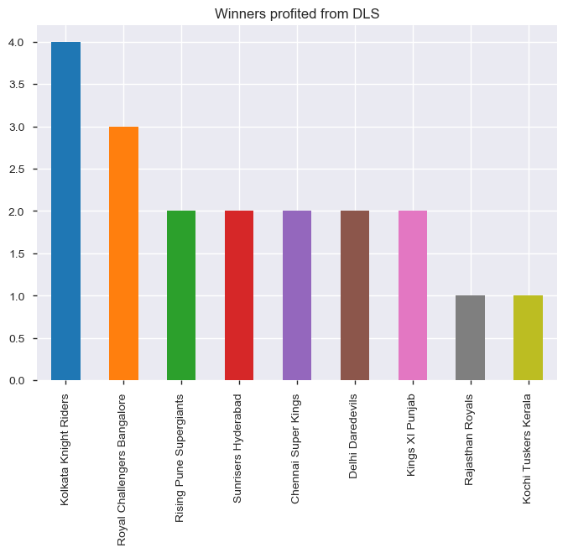
Match Winners (DLS)

Slide 12
DLS per season
4 instances of DLS used in 2016
3 instances in 2009, 2011 and 2018
2 instances in 2008 and 2015
1 instance in 2014 and 2017
0 instances in 2010, 2012 and 2013
Season | No. of times
2008 | 2
2009 | 3
2010 | 0
2011 | 3
2012 | 0
2013 | 0
2014 | 1
2015 | 2
2016 | 4
2017 | 1
2018 | 3

Slide 13
Winner vs. Venue (Home advantage)
Let us take the example of Mumbai Indians winning in Mumbai
According to the dataset, Mumbai Indians have won 48 matches on their home ground, i.e. around 49% of their total wins.
Therefore Mumbai Indians have almost a 50 – 50 chance of winning on their home ground.

Slide 14
Winner vs. Venue (Home advantage)
Next let us take the example of Chennai Super Kings winning in Chennai.
According to the dataset, Chennai Super Kings have won 34 matches on their home ground, i.e. around 38% of their total wins.
Therefore Chennai Super Kings have a winning advantage of 62% on away ground.

Slide 15
Tie and No result
Tie – 2 instances in 2013 and 1 in 2009, 2010, 2014, 2015 and 2017.
No result: 2 instances in 2015 and 1 in 2011.
Season | Tie | No result
2008 | 0 | 0
2009 | 1 | 0
2010 | 1 | 0
2011 | 0 | 1
2012 | 0 | 0
2013 | 2 | 0
2014 | 1 | 0
2015 | 1 | 2
2016 | 0 | 0
2017 | 1 | 0
2018 | 0 | 0

Slide 16
The End

