Slide 1

Are Marriages Made In Heaven?
Course: DCS 530
By : Aniruddha Joshi
Date: Aug 12, 2023

Slide 2
Predict
The question we will try to address in this project if there is a way to predict the divorce?
Dataset reference: https://gssdataexplorer.norc.org/

Slide 3
Dependent and Independent Variables
Dependent Variable : Divorce
Independent Variables
Numeric /Float variables | Category variables
hrs1 : number of hours worked in a week | wrkslf: r self-emp or works for somebody.
childs : number of children. | Marital : Marital status
age : age of respondent | Spwrksta: Spouse labor force status
educ : highest year of school completed | Spdeg : spouses' highest degree
incomeUSD : total family income | sex : respondents' sex
 | race : race of respondent
 | Family16 : living with parents when 16 yrs old
 | relig16 : religion in which raised
 | hapmar : happiness of marriage.

Slide 4
Numeric Variables
Hours worked (hrs1): number of hours worked last week. To check if couples have a time for each other.
No of children (childs): number of children. To check if the number of children helps couple to stay together.
Age (age): age of respondent. Is there any age factor in divorce.
Education (educ): highest year of school completed. Is education playing any role for couple to stay together.
Income (incomeUSD): Income in USD
 | hrs1 | childs | age | educ | incomeUSD
count | 41266 | 72129 | 71621 | 72127 | 63439
mean | 41 | 2 | 47 | 13 | 25948
std | 14 | 2 | 18 | 3 | 9403
min | 0 | 0 | 18 | 0 | 1011
25% | 37 | 0 | 32 | 12 | 19058
50% | 40 | 2 | 44 | 12 | 30941
75% | 48 | 3 | 60 | 16 | 33204
max | 88 | 8 | 89 | 20 | 35500

Slide 5
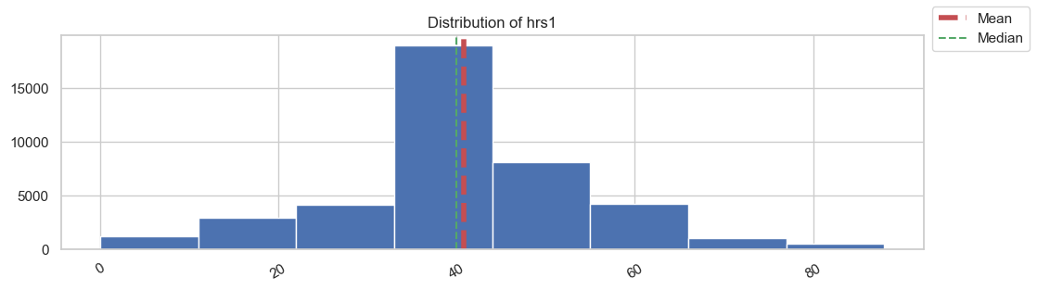
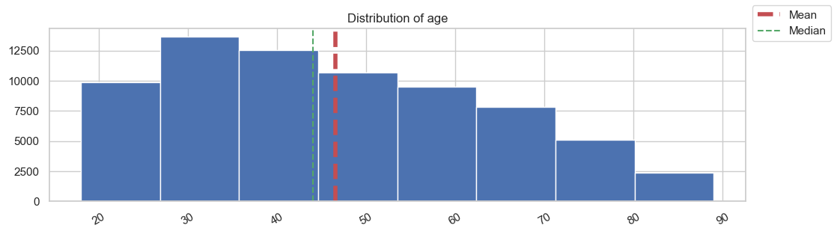
Histograms
Hrs1: the hours distribution is slightly right skewed. Its almost normally distributed
Age: the age is right skewed with mean greater than median

Slide 6
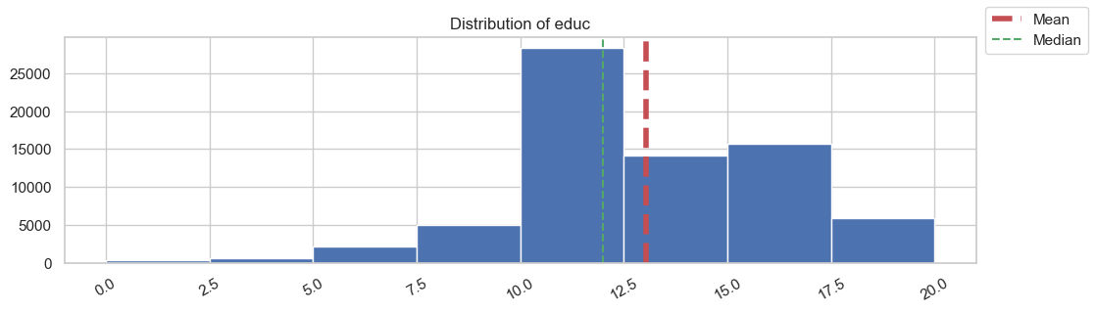
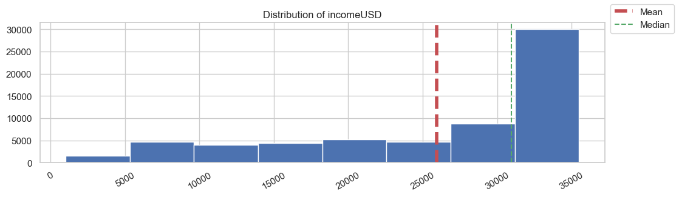
Histograms
edu: the education distribution is right skewed.
Income: the income USD is left skewed with mean is lesser than the median

Slide 7
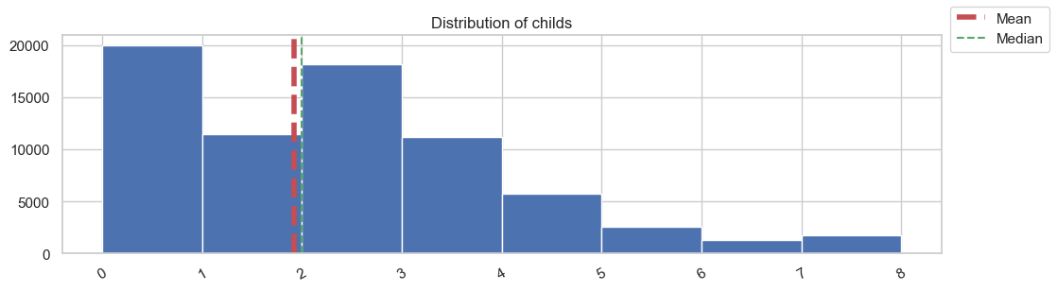
Histograms
childs: no. of children data is slightly right skewed.

Slide 8
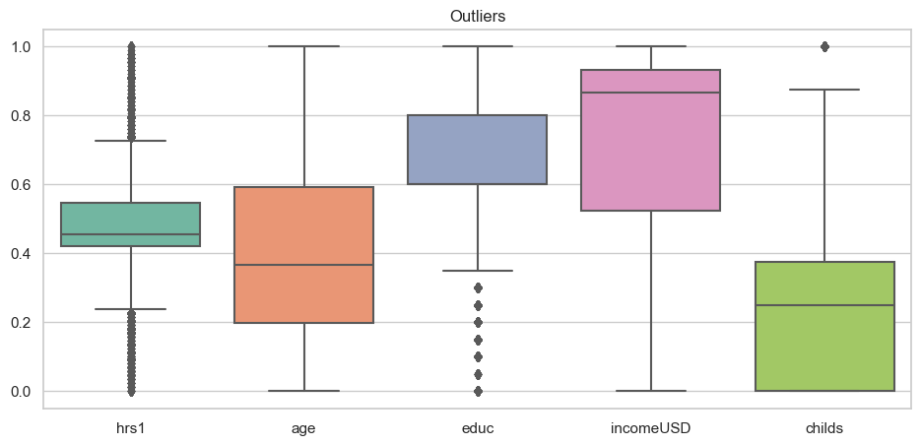
Outliers
The outliers are present in hrs1, educ and child
The outliers can be handled by either removing them completely from data sets or setting their values to NaN.

Slide 9
Mean, Mode, Spread And Tail
Statistic | Hours Worked (hrs1) | Age | Education (educ) | Income (USD) | Number of Children (childs)
Mean | 41 | 47 | 13 | 25948 | 2
Mode | 40 | 30 | 12 | 32323 | 0
Standard Deviation | 14 | 18 | 3 | 9403 | 2
Minimum | 0 | 18 | 0 | 1011 | 0
25th Percentile | 37 | 32 | 12 | 19058 | 0
Median (50th Percentile) | 40 | 44 | 12 | 30941 | 2
75th Percentile | 48 | 60 | 16 | 33204 | 3
Maximum | 88 | 89 | 20 | 35500 | 8
5th Percentile | 15 | 22 | 8 | 7086 | 0
95th Percentile | 64 | 78 | 18 | 35034 | 5

Slide 10
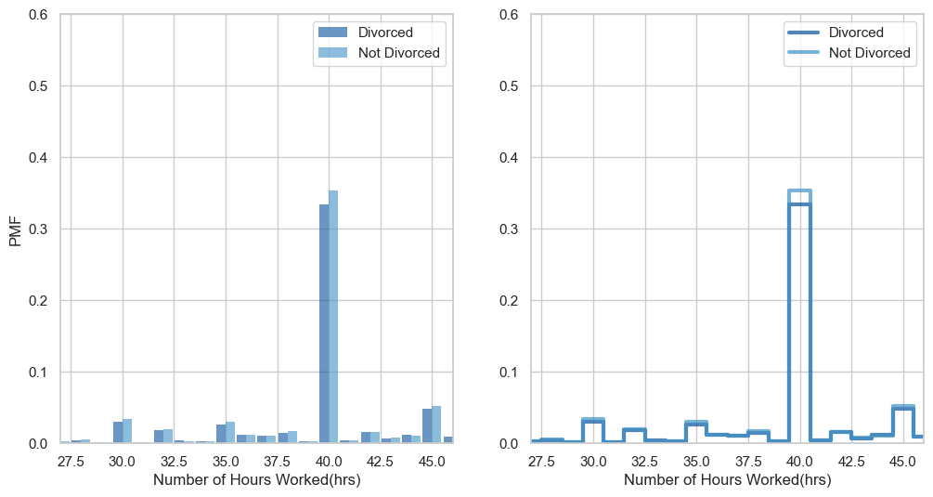
PMF : Comparing variable
Comparing same variable based on two scenario Divorce and Not divorce

Slide 11
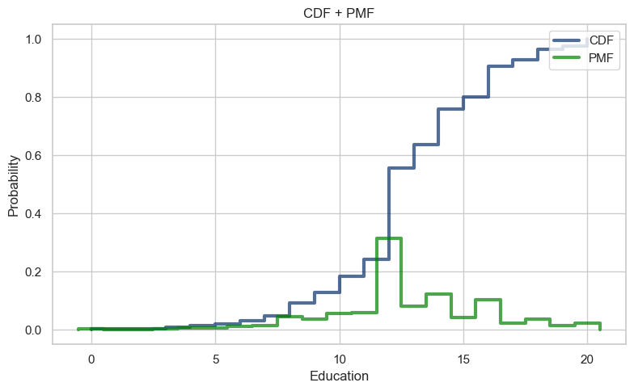
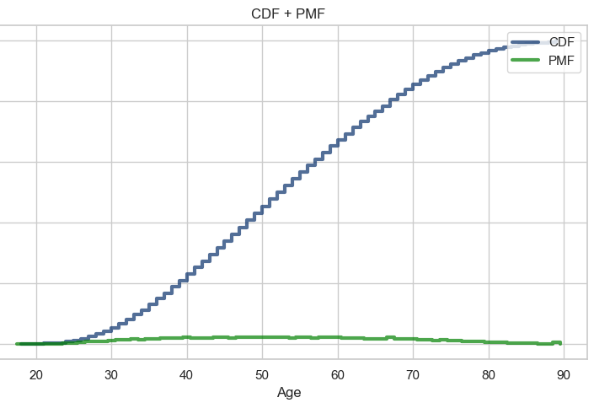
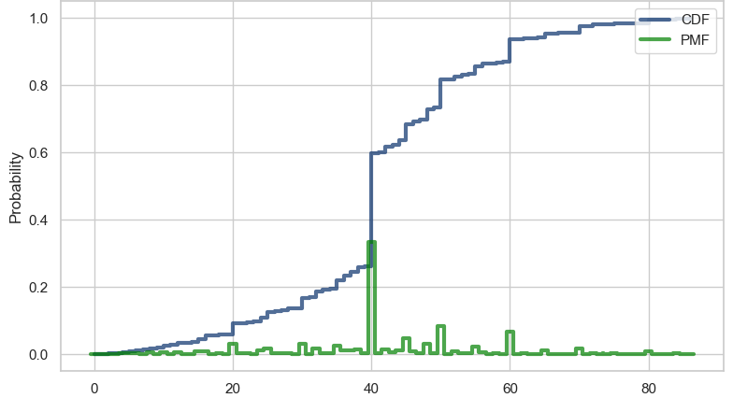
CDF and PMF
CDF tells us about how the data is distributed. In the example here (hours worked) it shows the there is 60% chance of a person getting divorce who is working less than 42 hours per week.
A randomly selected person working less than 20 hours is expected to have 10% chances of divorce.

Slide 12
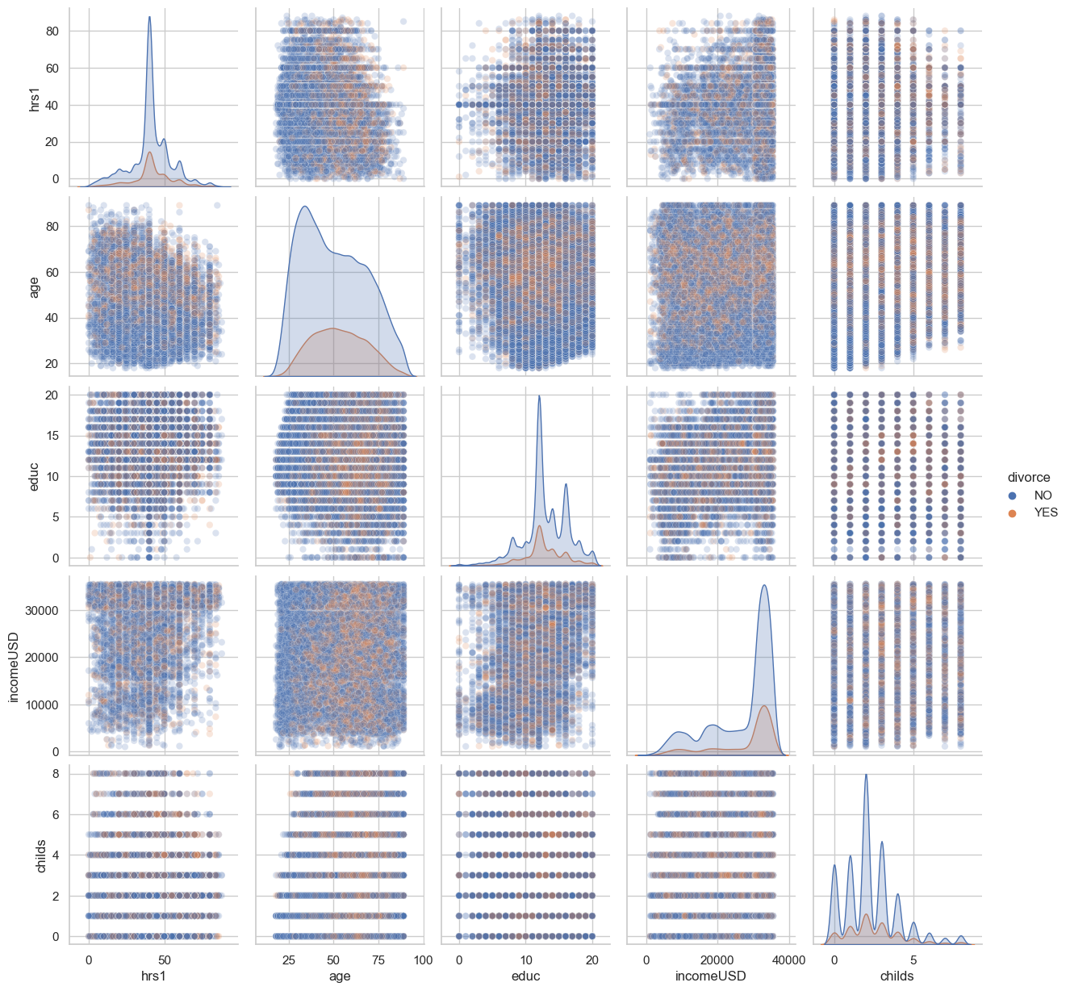
Scatterplots
The scatter plot shows the plots between different variables for all population
Blue = Not divorced
Orange = Divorced

Slide 13
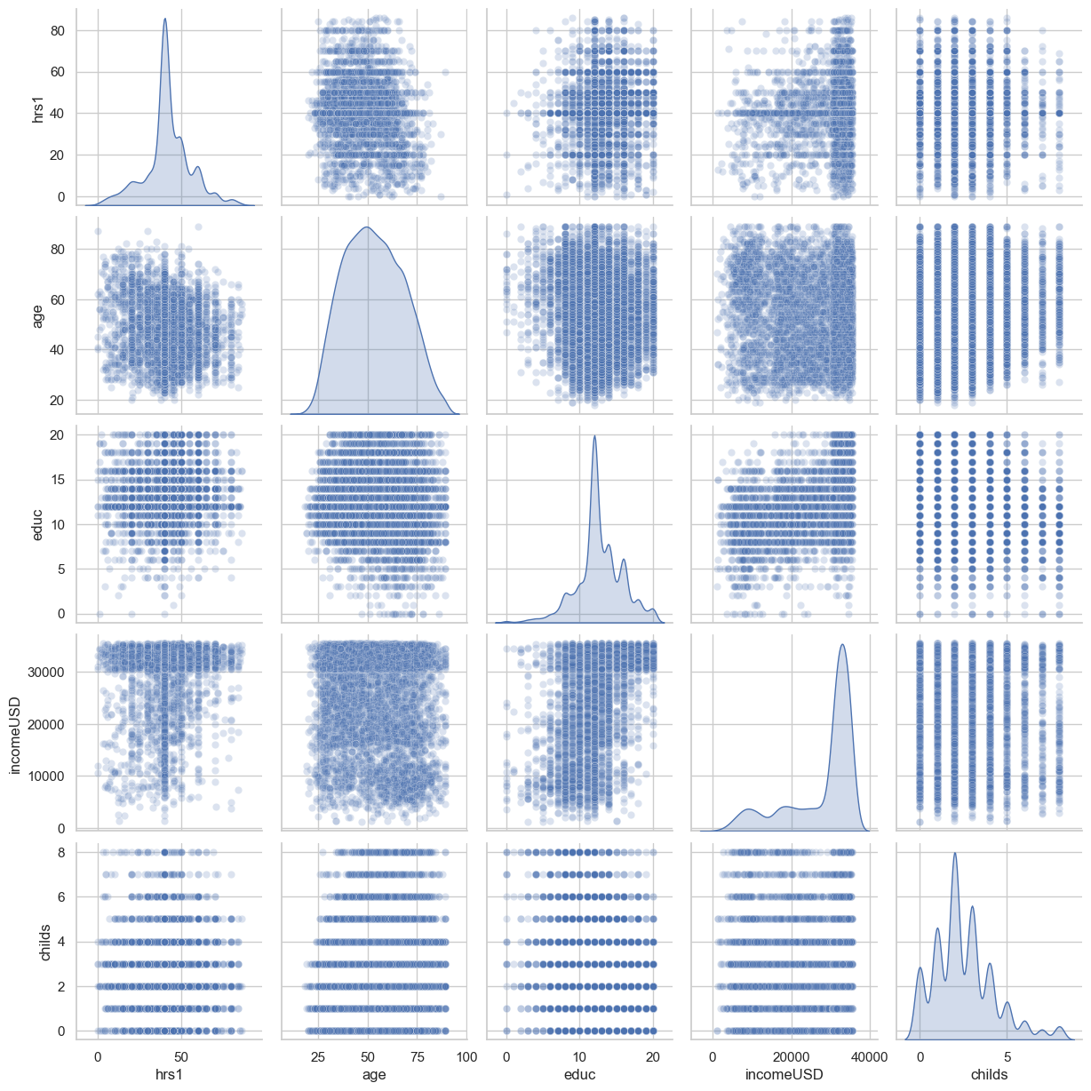
Scatterplots
Scatter plots with transparency, by setting alpha to 0.2
This is specifically for the divorce population

Slide 14
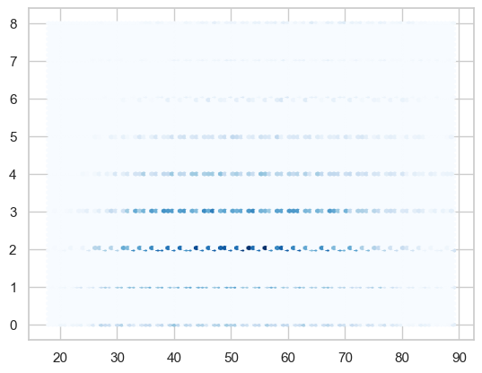
Scatterplots
No. of Childrens
Scatterplot of number of children vs age for divorced population
The graph shows high divorced rate for couples with two to three childrens.
Age

Slide 15
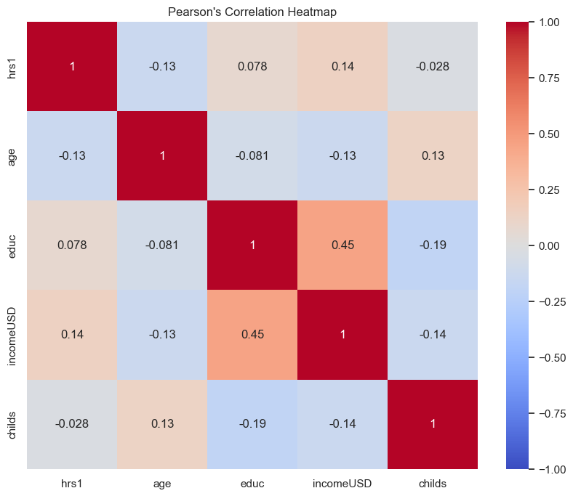
Pearson Correlation map
For the divorced population, the Pearson's co-relation map shows positive correlation with
Income and education
Income and number of hours worked
Negative correlation
Education vs number of Childrens
Income vs Childrens

Slide 16
The Null Hypothesis 1
The Null hypothesis 1: There is no correlation between divorce and the number of children
Used Chi-Square method for testing:
The results are:
Chi-Square: 212.3517343739779
p-value: 1.5873059852030754e-41
Degrees of Freedom: 8
“Reject the null hypothesis. There is a significant correlation between divorce and the number of children.”

Slide 17
The Null Hypothesis 2
The Null hypothesis 2: There is no correlation between divorce and the number of hours worked in a week
Used Chi-Square method for testing:
The results are:
Chi-Square: 103.43880050111484
p-value: 0.12476633823367769
Degrees of Freedom: 88
“Fail to reject the null hypothesis. There is no significant correlation between divorce and the number of hours worked.”

Slide 18
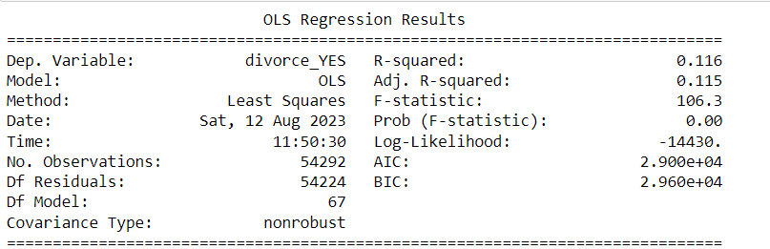
Logistic Regression
Applying logistic regression
Dependent variable: Divorce
Independent variables
Age
Education
No. of Childrens
Hours worked per week
Income USD
Spouse working status
Religion
Education level
Race
Marriage happiness
Accuracy: 87%
R-square: 0.115

