Slide 1
TEAM:-ATEX
HealthTech
Team Members:-
Divanshu Joshi(TL)
Deepayan Paul
Ujjwal Kumar
Shivam Sharma

Slide 2
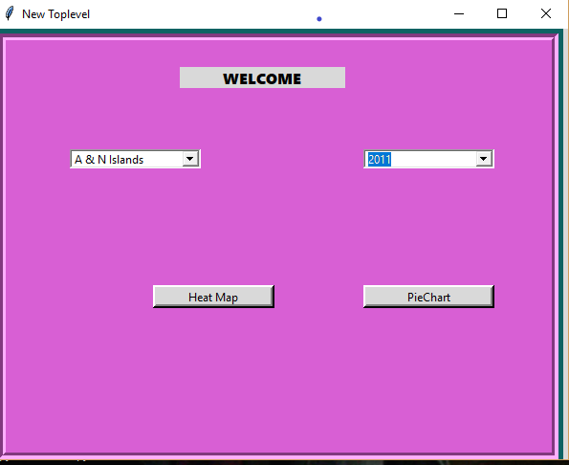
CONSOLE APPLICATION
A console application is
designed using python which will show the death count of different states in a particular year. It will also show how many people died and the disease from which they died.
It will also display the disease from which the maximum number of people died in a particular year

Slide 3
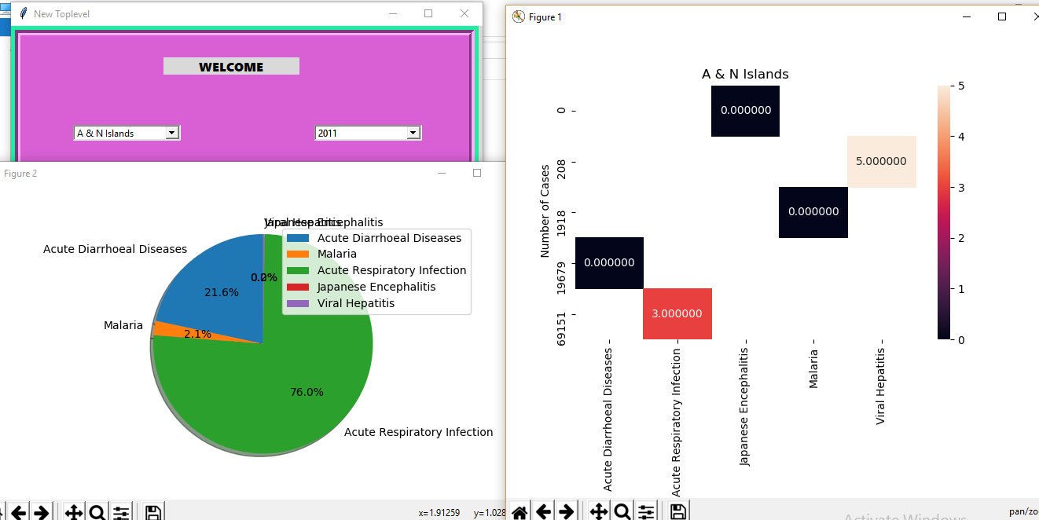
HEATMAP AND PIECHART
We have used heatmap to show the diseases and the number of people who died.
The pieplots show you what percentage of people have died from which disease

Slide 4
Predictive Analytics
The dataset provided had to be cleaned and then the prediction had to be performed on it.
So the dataset was cleaned and preprocessed to be used as the dataset for our machine learning algorithm that we would apply here.
Since we had to predict the number of deaths occuring therefore only a regression model could be used.

Slide 5
Regression Models
Regression models are classic machine learning algorithms which are used in statisctics mostly.
Regression models produce a response which is numerical
,they generate numeric response value, therefore we choose a regression algorithm to solve our problem since we wanted to predict the number of deaths occuring.
The RandomForest Model has been used here to predict the values .The code has been written on spyder.
The dataset has been created after preprocessing and cleaning

Slide 6
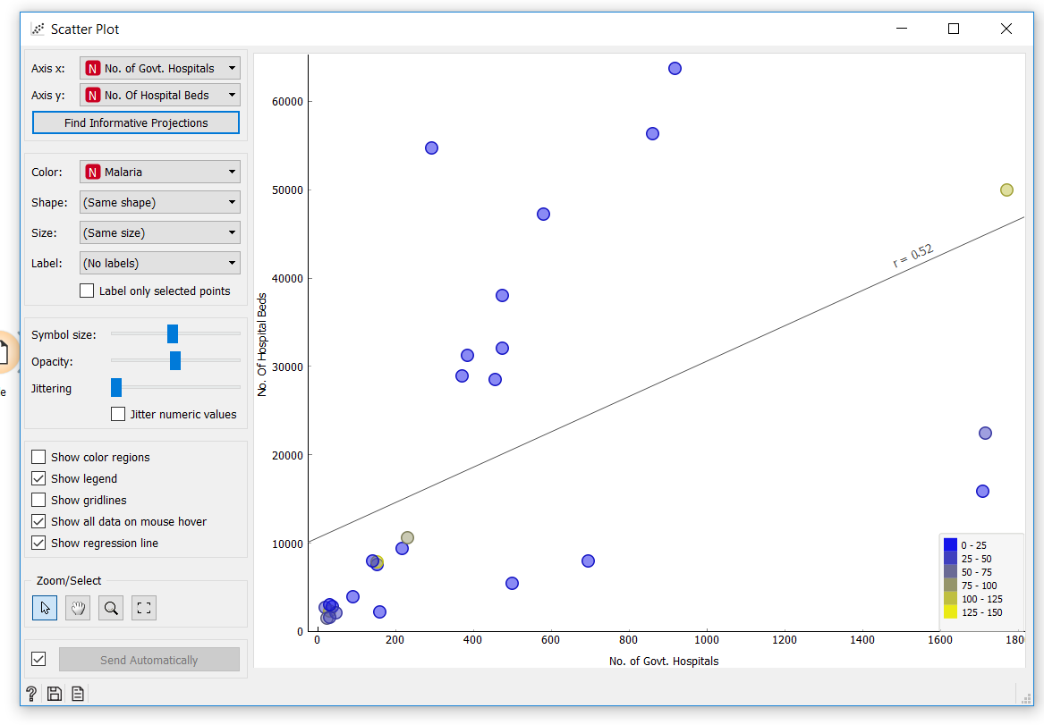

Slide 7
