Slide 1
Extreme Programming & Pair Programming

Slide 2
Extreme Programming (XP)
Formulated in 1999 by Kent Beck, Ward Cunningham and Ron Jeffries
Agile software development methodology (others: Scrum, DSDM)
Developed in reaction to high ceremony methodologies

Slide 3
XP: Why?
Previously:
  Get all the requirements before starting design
  Freeze the requirements before starting development
  Resist changes: they will lengthen schedule
  Build a change control process to ensure that proposed changes are looked at carefully and no change is made without intense scrutiny
  Deliver a product that is obsolete on release

Slide 4
XP: Embrace Change
Recognize that:
  All requirements will not be known at the beginning
  Requirements will change
Use tools to accommodate change as a natural process
Do the simplest thing that could possibly work and refactor mercilessly
Emphasize values and principles rather than process

Slide 5
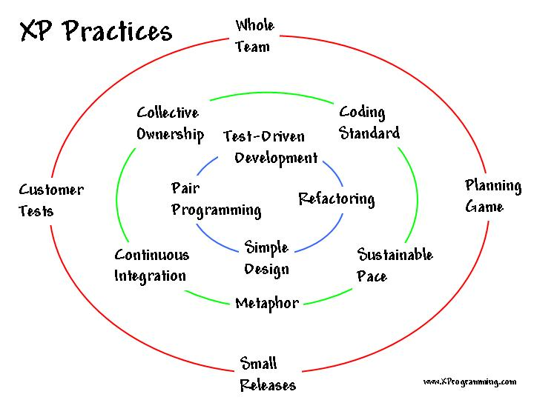
XP Practices
(Source: http://www.xprogramming.com/xpmag/whatisxp.htm)

Slide 6
XP Values
Communication
Simplicity
Feedback
Courage

Slide 7
XP Criticism
Unrealistic--programmer centric, not business focused
Detailed specifications are not written
Design after testing
Constant refactoring
Customer availability
12 practices are too interdependent

Slide 8
The Way Forward?
‘High ceremony’ software engineering methodologies in disfavor
Agile software development methodologies in increasing use, but with significant criticism
Formal methods will never have a significant impact until they can be used by people that don’t understand them. T. Melham

Slide 9
Pair Programming Overview
Two programmers work side-by-side at one computer
Continuously collaborate on same design, algorithm, code, test, etc.
Continuous informal review

Slide 10
Two guys working on the same task
Both have the same target
Both have different expertise
One executes the task , other watches for external factors, evaluates the situation,
Corrects him and validates success after execution
Two guys working as a team

Slide 11
Share everything
Two programmers are assigned to jointly produce one artifact
One person typing or writing, the other continuously reviewing
Both equal participants
Both partners own everything

Slide 12
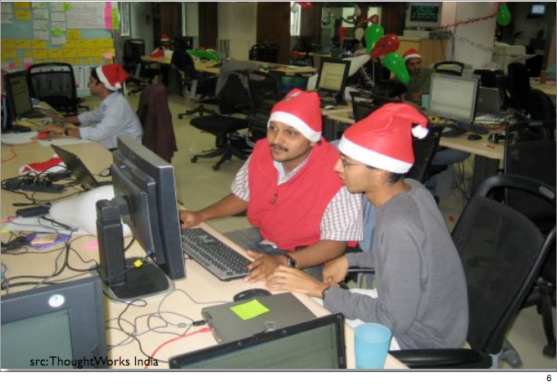


Slide 13
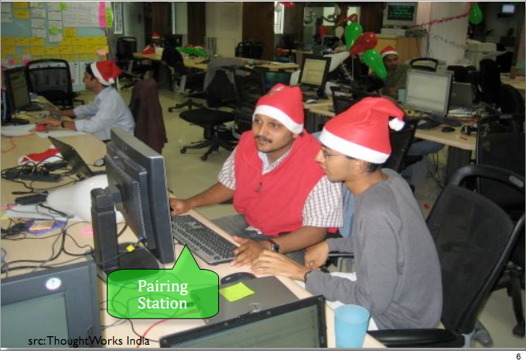

Slide 14
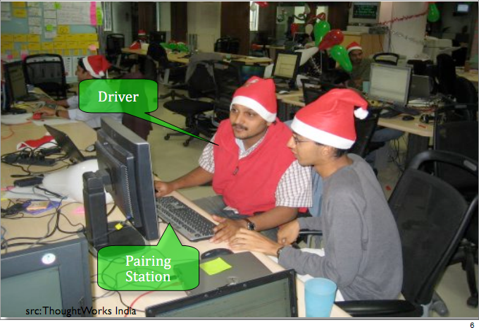

Slide 15
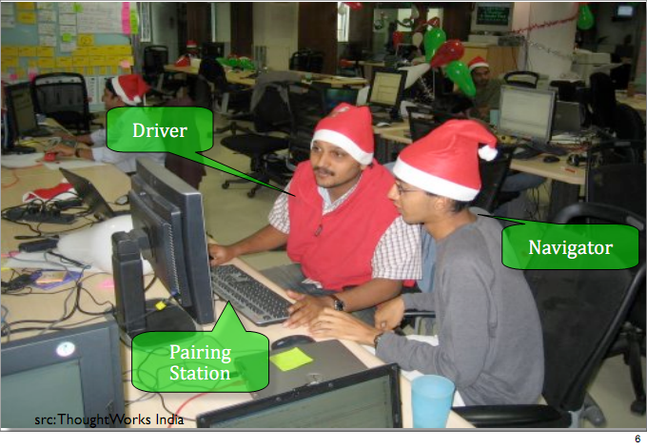

Slide 16
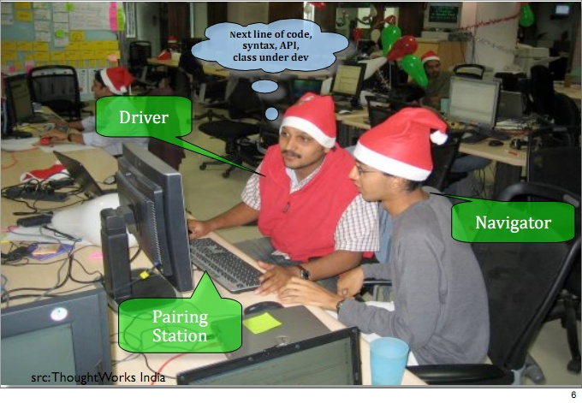

Slide 17
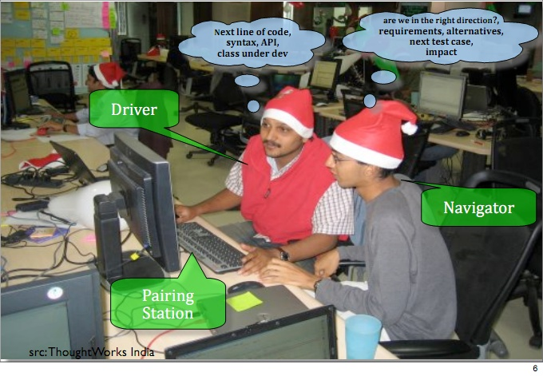

Slide 18
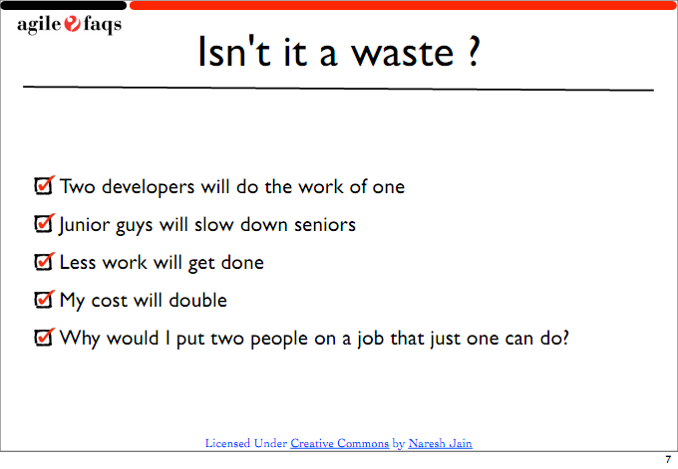

Slide 19
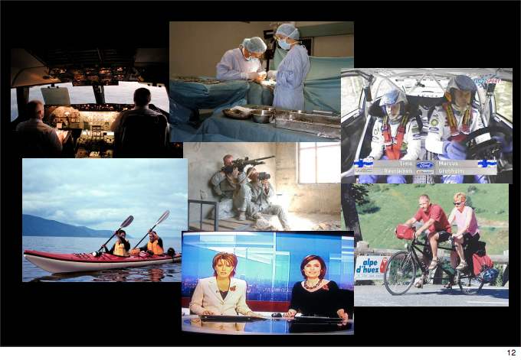

Slide 20
How does it Help?
Continuous Review.
Less Defects caught early.
Better Problem Solving.
More Economical.
“Pair-Pressure” ensures timely delivery.
Rapid Hands-on Approach to Learning.
Better Induction of new Team Members.

Slide 21
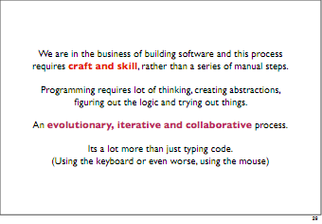

Slide 22
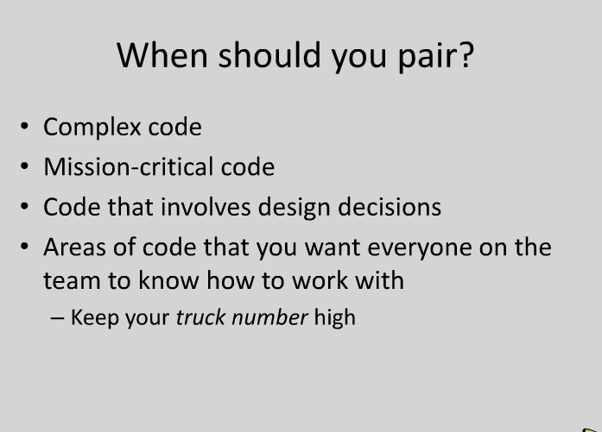

Slide 23
What is NOT pair programming?
Splitting up the work
Taking turns doing the work
One person doing all the work
Being located in different places
Sitting at different computers
(Exception – it’s ok to use remote shared desktop technology, such as VNC, if absolutely necessary)

