Slide 1
Instructions:
You may change these slides as you see fit. You may add or remove slides.
Notes:
Please tell us about the challenges you may have faced, what you would have done differently and how you would have solved these problems if you had more time.
Mention all design considerations and talk about why you chose to implement certain advanced features.

Slide 2

Rosépedia
Joshua Fu
jfu047@aucklanduni.ac.nz
Notes:
Please enter project details and your details here.

Slide 3
A bit about myself
Second year Software Engineering student from the University of Auckland
Love to learn
Used to play badminton professionally for Auckland
Small suggestion to MSA
Near-future goal: Create a web app for the family farm
Distance future goal: create a business
Notes:
This section is NOT assessed. We just want to get to know you ☺.

Slide 4
User Experience
Use of whitespace, less is more
Large buttons
Custom theme for consistent look and feel
ExpansionPanel
Use of contrasting colours
Notes:
User Experience

Slide 5

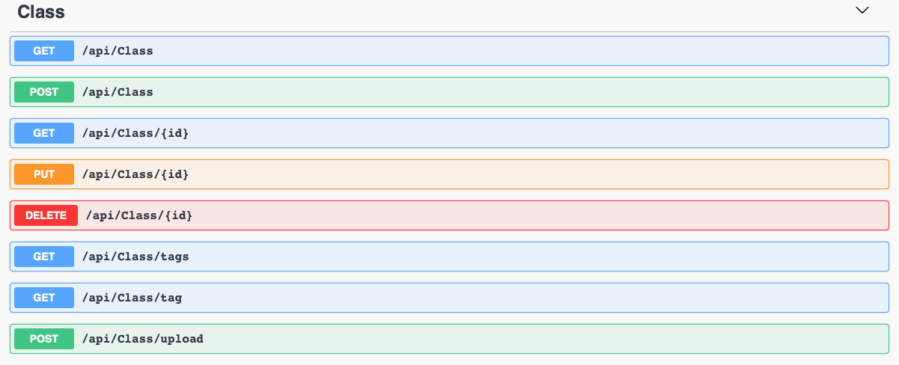
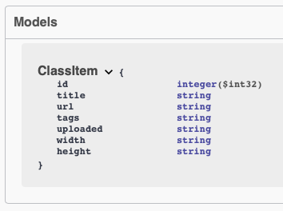
Database
Notes:
Talk about your database, what schema you used and what data you used
Swagger UI asset to render the database

Slide 6
API
Facebook share, users can share the web app on social media
Databank, the backend of Rosépedia
Notes:
Advanced features…

Slide 7
Azure setup
Blob storage
Web app service
Notes:
Explain your Azure features here

Slide 8
Advanced Features
Facial authentication
Automated assistance
Accessibility
Social media integration
Custom theme complete with favicon and logo
Notes:
Advanced features…

Slide 9
Advanced Considerations
Speech to text
App Insight
Testing
Notes:
Advanced considerations…

Slide 10
Challenges/Problems
Time pressure
New environment
Microphone and Camera concurrency issue
Notes:
Advanced considerations…

Slide 11
Future Improvements
Better model
Concurrency
Different layout
Mandatory/ pre-filled fields
More use of Material-UI
Refactor code and adopt Test-driven Development

Slide 12
Demonstration

Slide 13
Final Comments
Thank you MSA team for helping us through these exciting projects and for making them possible.
Notes:
Any final things you want to tell us

