Slide 1


Department of Aerospace Engineering Indian Institute of Technology Kanpur
Physics Informed Neural Network for High-Speed Fluid Dynamics
Supervisor
Dr. Rakesh Kumar
Professor
Department of Aerospace Engineering
Presented by
Anubhav Joshi
Akash Singh
Master of Technology (Aerospace Engineering)

Slide 2
Contents
1
Introduction
3
PINNs for High-Speed Fluid Dynamics
4
Failure and Challenges
5
Conclusion and Future Work
2
Methodology

Slide 3








Introduction
What is Physics-Informed Machine Learning?
It is the process by which the prior knowledge stemming from the observational, empirical, physical and mathematical understanding of the underlaying model can be leveraged to improve the performance of the ML algorithms.
Build scientifically accurate predictive models.
Accelerate the training of the ML models with increase in data efficiency.
Increase interpretability to make ML model robust and trustworthy.
Observational Bias
Learning Bias
$$⋮$$
$$⋮$$
INPUT
OUTPUT
Training the model on the data that reflect the underlying physical principle in the first place, which requires vast amount of data.
Enforce physics through penalty constraints in the loss function during model training.
$$⋮$$
$$⋮$$
$$⋮$$
$$⋮$$
$$⋮$$
$$⋮$$
PINN

Slide 4







Methodology
${PDE≔ u}_{t}+𝒩[u]$ $BC≔u\left(0,t\right)=g(t)$ $IC≔u\left(x,0\right)=h(x)$
Physics Part
$$\frac{∂\hat{u}}{∂x}$$
$$x$$
Residuals
$$f_{1}≔{\hat{u}}_{t}+𝒩\left[\hat{u}\right]$$
$${ f}_{2}≔\hat{u}\left(x,0\right)−h$$
$$f_{3}≔\hat{u}\left(0,t\right)−g$$
$$\hat{u}$$
$$\frac{∂\hat{u}}{∂t}$$
INPUT
$$t$$
I
$>$Tolerance
Or
Max Iter.
Loss
NO
DONE
YES

Slide 5
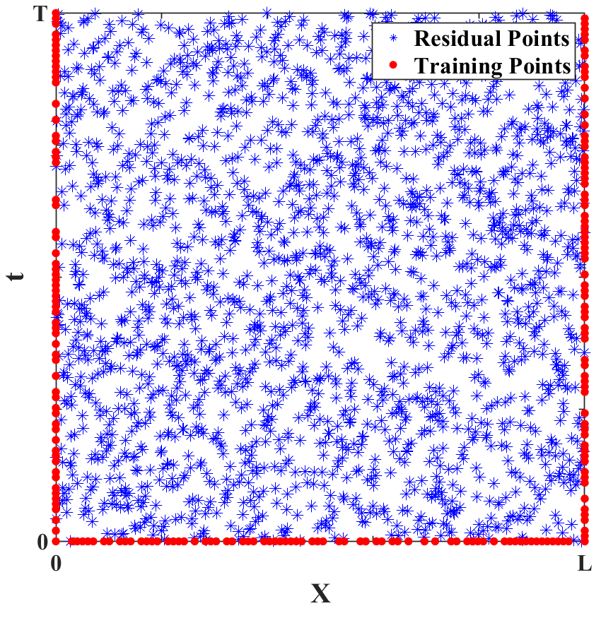
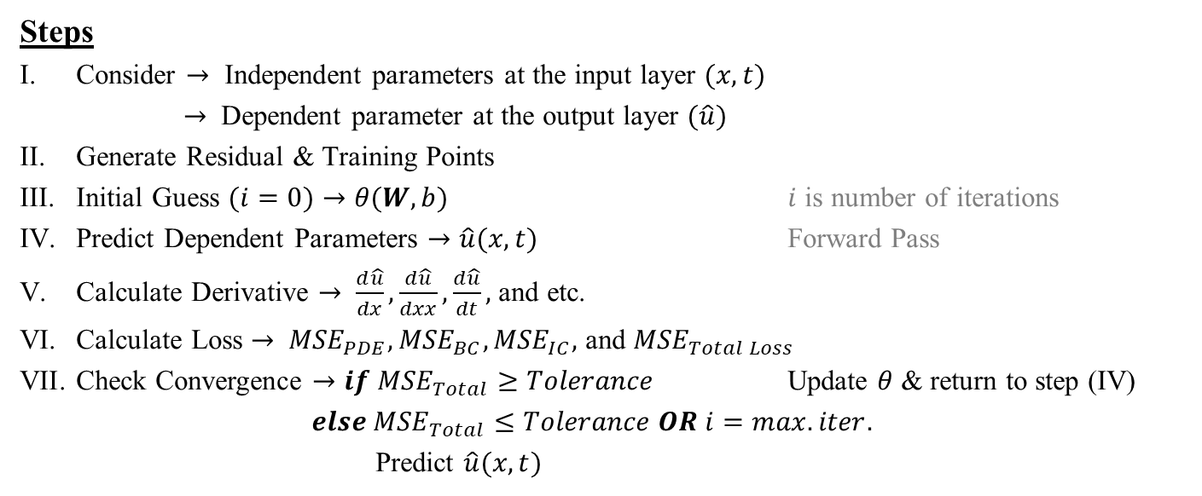
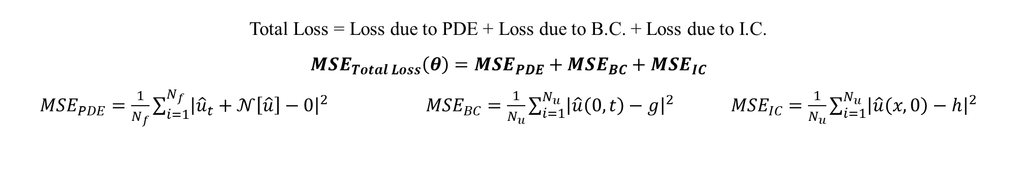
Methodology
${PDE≔ u}_{t}+𝒩[u]$ $BC≔u\left(0,t\right)=g(t)$ $IC≔u\left(x,0\right)=h(x)$
Total Loss = Loss due to PDE + Loss due to B.C. + Loss due to I.C.
$${MSE}_{Total Loss}\left(θ\right)={MSE}_{PDE}+{MSE}_{BC}+{MSE}_{IC}$$
${MSE}_{PDE}=\frac{1}{N_{f}}\sum_{i=1}^{N_{f}}{{\left|{\hat{u}}_{t}+𝒩\left[\hat{u}\right]−0\right|}^{2}}$ ${MSE}_{BC}=\frac{1}{N_{u}}\sum_{i=1}^{N_{u}}{{\left|\hat{u}\left(0,t\right)−g\right|}^{2}}$ ${MSE}_{IC}=\frac{1}{N_{u}}\sum_{i=1}^{N_{u}}{{\left|\hat{u}\left(x,0\right)−h\right|}^{2}}$
Steps
Consider $→$ Independent parameters at the input layer $(x, t)$
$→$ Dependent parameter at the output layer $(\hat{u})$
Generate Residual & Training Points
Initial Guess $(i=0)→θ(W,b)$ $i$ is number of iterations
Predict Dependent Parameters $→\hat{u}(x,t)$ Forward Pass
Calculate Derivative $→ \frac{d\hat{u}}{dx},\frac{d\hat{u}}{dxx},\frac{d\hat{u}}{dt},$ and etc.
Calculate Loss $→ {MSE}_{PDE}, {MSE}_{BC}, {MSE}_{IC},$ and ${MSE}_{Total Loss}$
Check Convergence $→if {MSE}_{Total}≥Tolerance$ Update $θ$ & return to step (IV)
$else {MSE}_{Total}≤Tolerance OR i=max. iter.$
Predict $\hat{u}(x,t)$
Fig. Distribution of training and residual points
[2] Kumar, Siddharth. (2017). On weight initialization in deep neural networks.

Slide 6
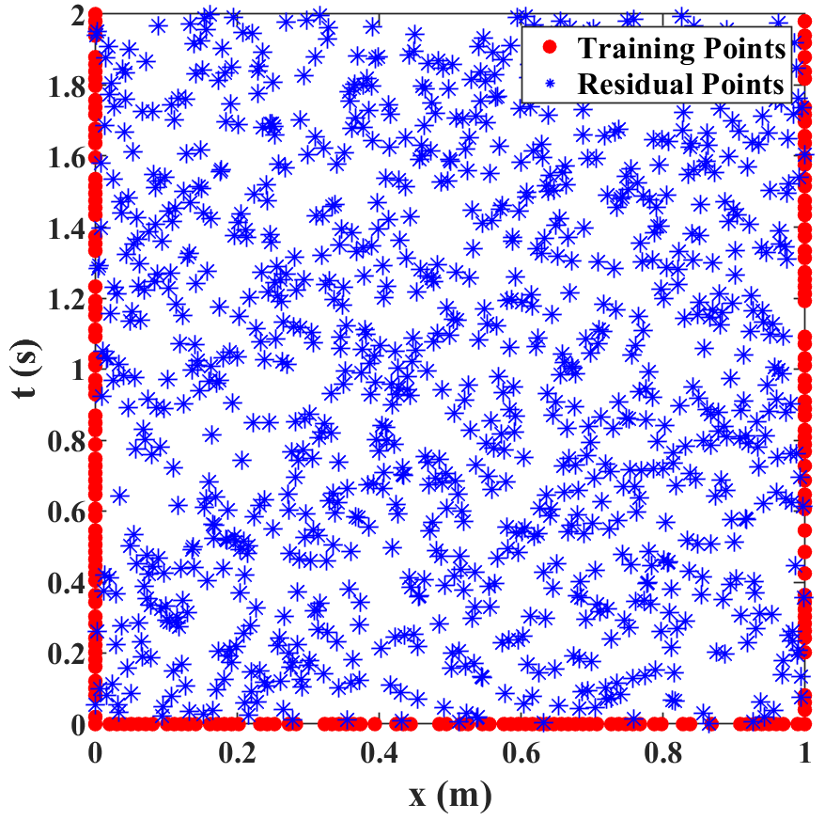
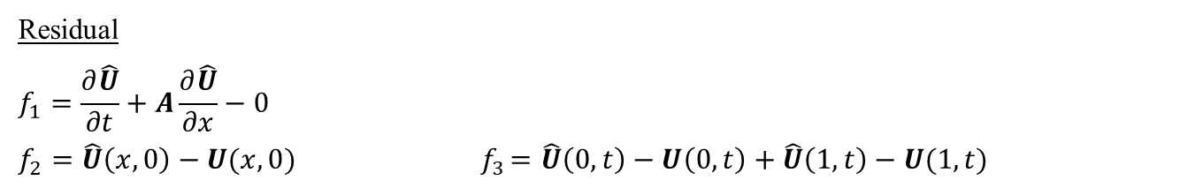
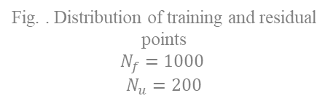
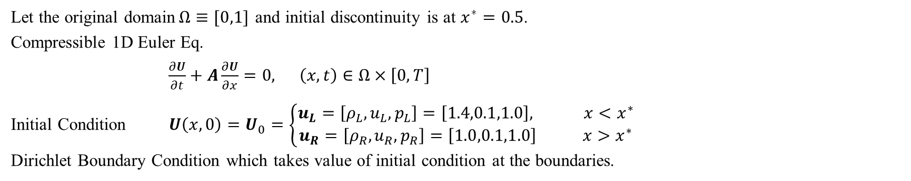
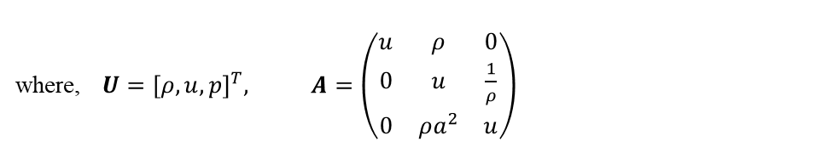
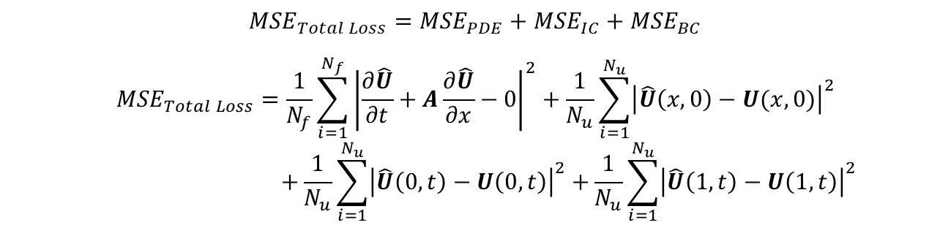

PINNs for High-Speed Fluid Dynamics
1D Euler Eq.:- Single Contact Discontinuity
Let the original domain$Ω≡[0,1]$ and initial discontinuity is at $x^{∗}=0.5$.
Compressible 1D Euler Eq.
$\frac{∂U}{∂t}+A\frac{∂U}{∂x}=0, \left(x,t\right)∈Ω×\left[0,T\right]$
Initial Condition $U\left(x,0\right)=U_{0}=\left\{\begin{aligned}u_{L}=\left[ρ_{L},u_{L},p_{L}\right]=\left[1.4,0.1,1.0\right], x<x^{∗} \\ u_{R}=\left[ρ_{R},u_{R},p_{R}\right]=\left[1.0,0.1,1.0\right] x>x^{∗}\end{aligned}\right.$
Dirichlet Boundary Condition which takes value of initial condition at the boundaries.
where, $U={[ρ,u,p]}^{T}, A=\left(\begin{matrix}u & ρ & 0 \\ 0 & u & \frac{1}{ρ} \\ 0 & ρa^{2} & u\end{matrix}\right)$
$$a=\sqrt{\frac{γp}{ρ}}$$
Residual
$$f_{1}=\frac{∂\hat{U}}{∂t}+A\frac{∂\hat{U}}{∂x}−0$$
$$f_{2}=\hat{U}\left(x,0\right)−U(x,0){ f}_{3}=\hat{U}\left(0,t\right)−U\left(0,t\right)+\hat{U}\left(1,t\right)−U(1,t)$$
$${MSE}_{Total Loss}={MSE}_{PDE}+{MSE}_{IC}+{MSE}_{BC}$$
$${MSE}_{Total Loss}=\frac{1}{N_{f}}\sum_{i=1}^{N_{f}}{{\left|\frac{∂\hat{U}}{∂t}+A\frac{∂\hat{U}}{∂x}−0\right|}^{2}+\frac{1}{N_{u}}\sum_{i=1}^{N_{u}}{{\left|\hat{U}\left(x,0\right)−U(x,0)\right|}^{2}}}$$
$$+\frac{1}{N_{u}}\sum_{i=1}^{N_{u}}{{\left|\hat{U}\left(0,t\right)−U\left(0,t\right)\right|}^{2}+}\frac{1}{N_{u}}\sum_{i=1}^{N_{u}}{{\left|\hat{U}\left(1,t\right)−U\left(1,t\right)\right|}^{2}}$$
Fig. . Distribution of training and residual points
$$N_{f}=1000$$
$N_{u}=200$

Slide 7
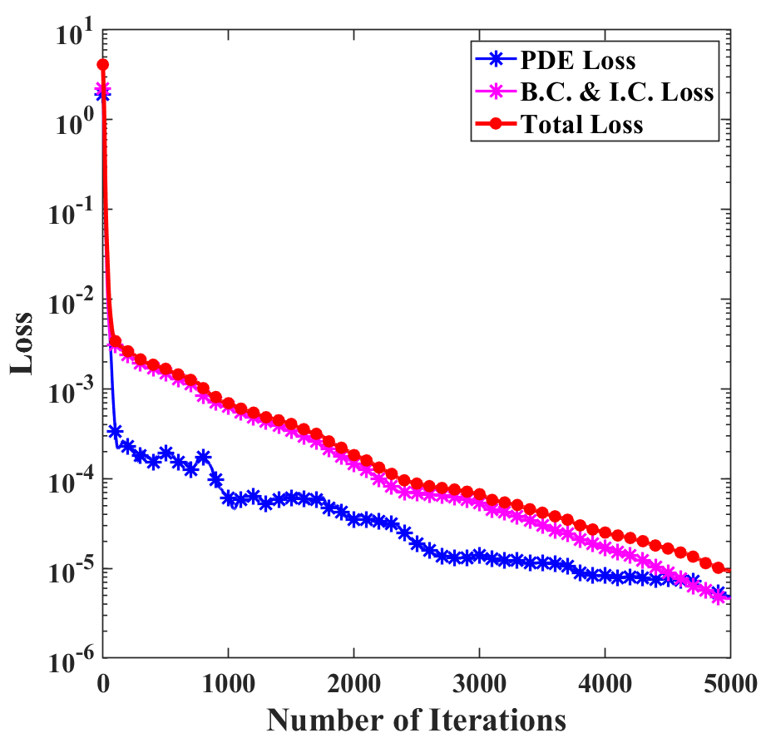
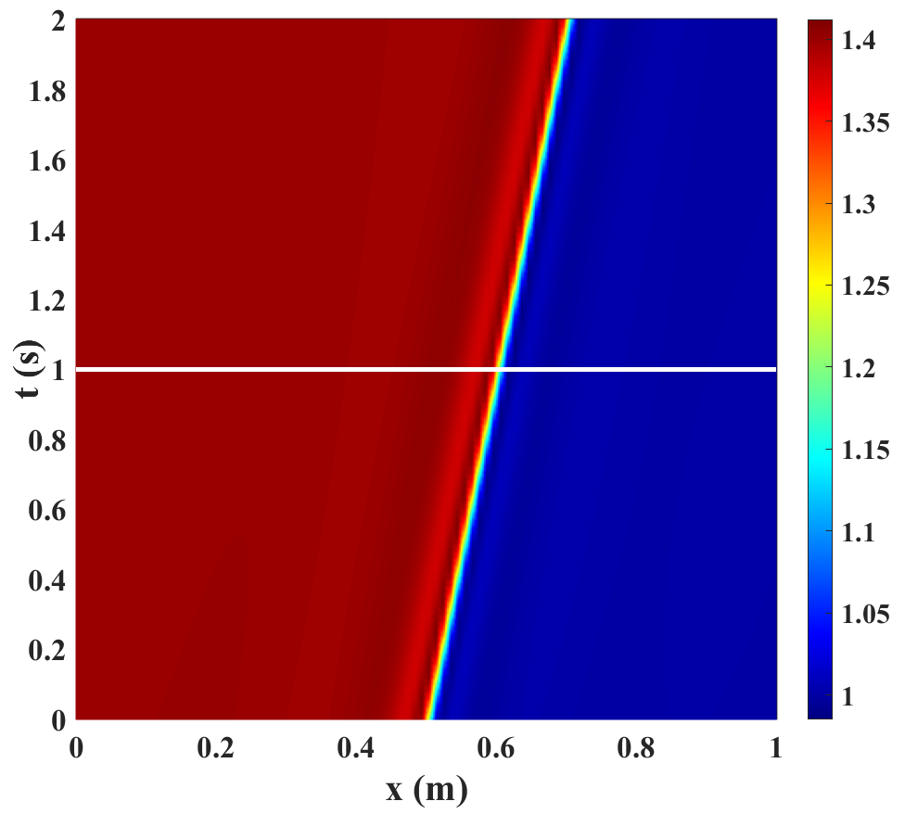
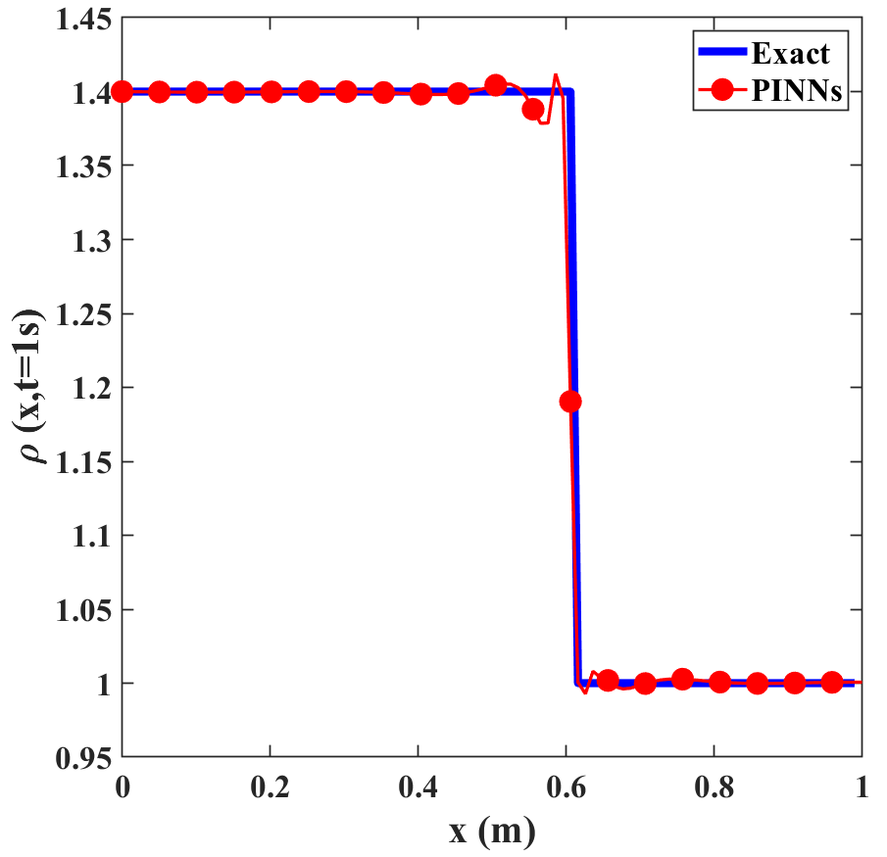







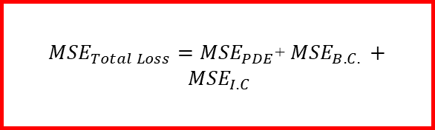
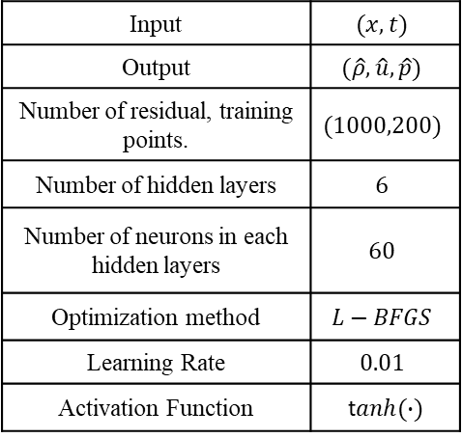



Single Contact Discontinuity
Input | $$(x, t)$$
Output | $$(\hat{ρ},\hat{u},\hat{p})$$
Number of residual, training points. | $$(1000,200)$$
Number of hidden layers | $$6$$
Number of neurons in each hidden layers | $$60$$
Optimization method | $$L−BFGS$$
Learning Rate | $$0.01$$
Activation Function | t$anh(∙)$
$$\frac{∂\hat{u}}{∂x}$$
Physics Part for Single Contact Discontinuity
$$x$$
$$\frac{∂^{2}\hat{u}}{{∂x}^{2}}$$
${MSE}_{Total Loss}={MSE}_{PDE}$+ ${MSE}_{B.C. }+ {MSE}_{I.C}$
$$(\hat{ρ},\hat{u},\hat{p})$$
$$⋯$$
$$\frac{∂^{2}\hat{u}}{{∂t}^{2}}$$
$$t$$
I
$$>{10}^{−6}$$
$$OR$$
$$iter=5000$$
Loss
NO
YES
DONE
Fig. Variation of loss function with number of iterations
Fig. Predicted Density $\left(\hat{ρ}\right)$ using PINNs
Fig. Predicted Density $\left(\hat{ρ}\right)$ at $t=1s$.
$L_{2}$ error $1.6×{10}^{−3}$.

Slide 8
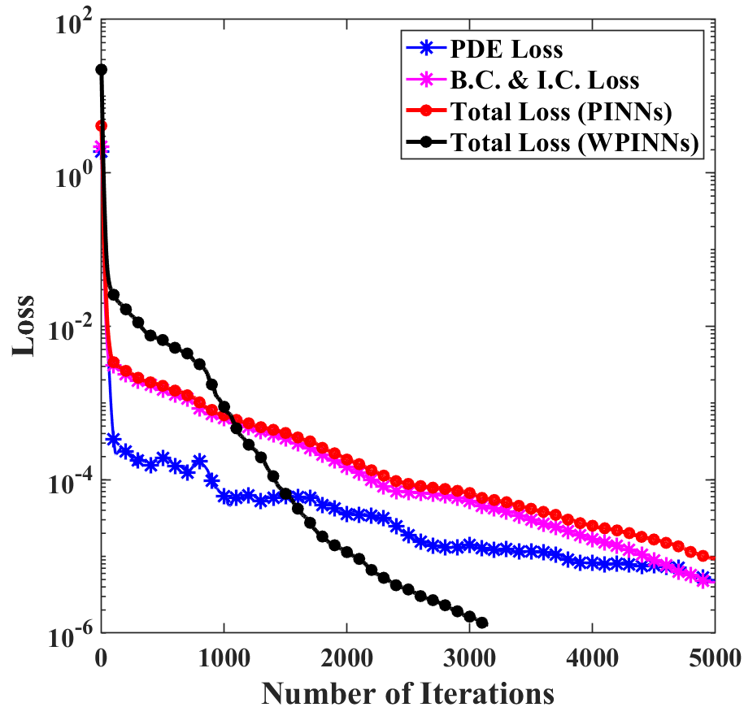
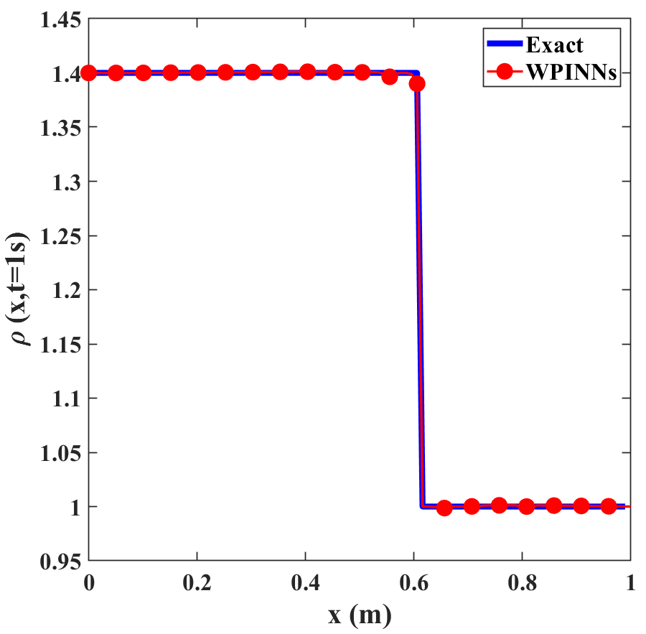
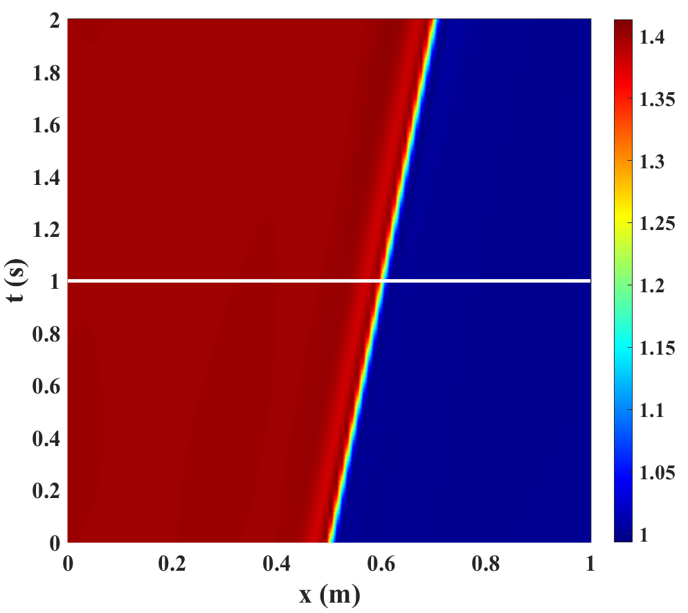
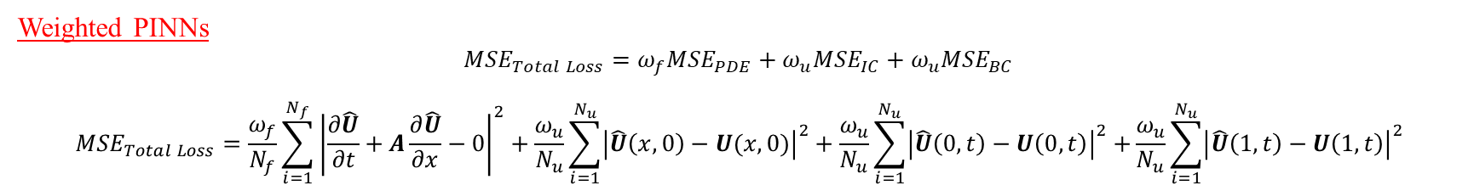
Single Contact Discontinuity
Weighted PINNs
$${MSE}_{Total Loss}={ω_{f}MSE}_{PDE}+{ω_{u}MSE}_{IC}+ω_{u}{MSE}_{BC}$$
$${MSE}_{Total Loss}=\frac{ω_{f}}{N_{f}}\sum_{i=1}^{N_{f}}{{\left|\frac{∂\hat{U}}{∂t}+A\frac{∂\hat{U}}{∂x}−0\right|}^{2}+\frac{ω_{u}}{N_{u}}\sum_{i=1}^{N_{u}}{{\left|\hat{U}\left(x,0\right)−U(x,0)\right|}^{2}}}+\frac{ω_{u}}{N_{u}}\sum_{i=1}^{N_{u}}{{\left|\hat{U}\left(0,t\right)−U\left(0,t\right)\right|}^{2}+}\frac{ω_{u}}{N_{u}}\sum_{i=1}^{N_{u}}{{\left|\hat{U}\left(1,t\right)−U\left(1,t\right)\right|}^{2}}$$
Fig. Predicted Density $\left(\hat{ρ}\right)$ using PINNs. $L_{2}$ error $1.6×{10}^{−3}$
Fig. Predicted Density $\left(\hat{ρ}\right)$ using WPINNs. $L_{2}$ error $2.2×{10}^{−4}$

Slide 9
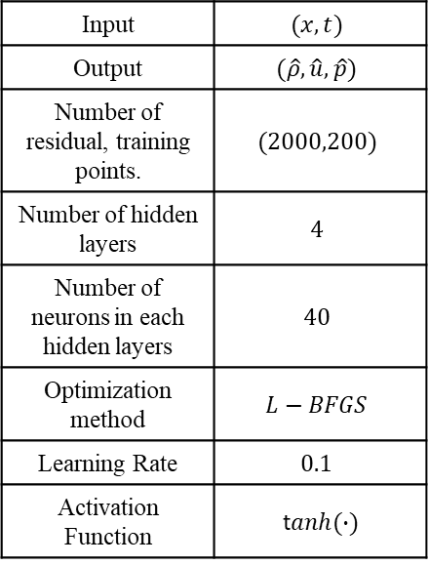
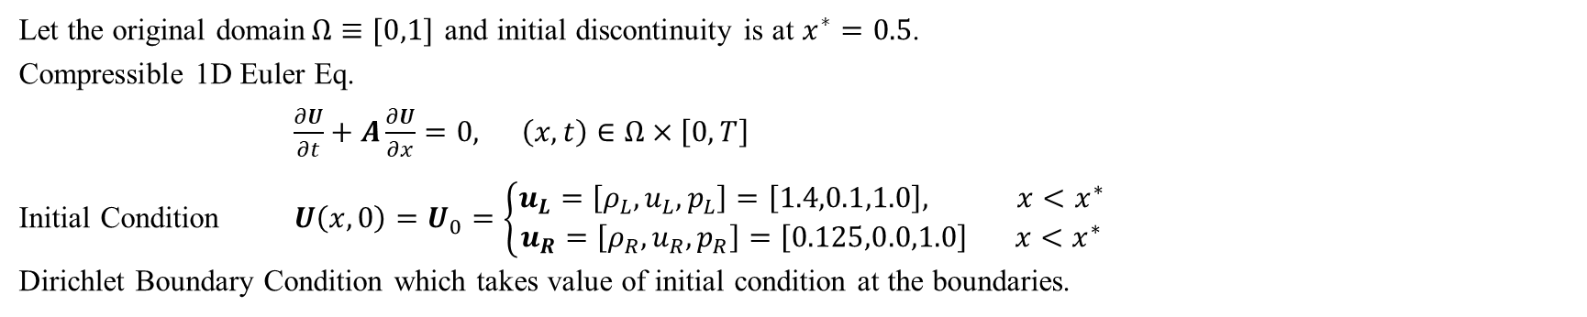
PINNs for High-Speed Fluid Dynamics
1D Euler Eq.:- Sod Shock Tube Problem
Let the original domain$Ω≡[0,1]$ and initial discontinuity is at $x^{∗}=0.5$.
Compressible 1D Euler Eq.
$\frac{∂U}{∂t}+A\frac{∂U}{∂x}=0, \left(x,t\right)∈Ω×\left[0,T\right]$
Initial Condition $U\left(x,0\right)=U_{0}=\left\{\begin{aligned}u_{L}=\left[ρ_{L},u_{L},p_{L}\right]=\left[1.4,0.1,1.0\right], x<x^{∗} \\ u_{R}=\left[ρ_{R},u_{R},p_{R}\right]=\left[0.125,0.0,1.0\right] x<x^{∗}\end{aligned}\right.$
Dirichlet Boundary Condition which takes value of initial condition at the boundaries.
Input | $$(x, t)$$
Output | $$(\hat{ρ},\hat{u},\hat{p})$$
Number of residual, training points. | $$(2000,200)$$
Number of hidden layers | $$4$$
Number of neurons in each hidden layers | $$40$$
Optimization method | $$L−BFGS$$
Learning Rate | $$0.1$$
Activation Function | t$anh(∙)$
Residual
$$f_{1}=\frac{∂\hat{U}}{∂t}+A\frac{∂\hat{U}}{∂x}−0$$
$$f_{2}=\hat{U}\left(x,0\right)−U(x,0){ f}_{3}=\hat{U}\left(0,t\right)−U\left(0,t\right)+\hat{U}\left(1,t\right)−U(1,t)$$
$${MSE}_{Total Loss}={MSE}_{PDE}+{MSE}_{IC}+{MSE}_{BC}$$
$${MSE}_{Total Loss}=\frac{1}{N_{f}}\sum_{i=1}^{N_{f}}{{\left|\frac{∂\hat{U}}{∂t}+A\frac{∂\hat{U}}{∂x}−0\right|}^{2}+\frac{1}{N_{u}}\sum_{i=1}^{N_{u}}{{\left|\hat{U}\left(x,0\right)−U(x,0)\right|}^{2}}}$$
$$+\frac{1}{N_{u}}\sum_{i=1}^{N_{u}}{{\left|\hat{U}\left(0,t\right)−U\left(0,t\right)\right|}^{2}+}\frac{1}{N_{u}}\sum_{i=1}^{N_{u}}{{\left|\hat{U}\left(1,t\right)−U\left(1,t\right)\right|}^{2}}$$

Slide 10
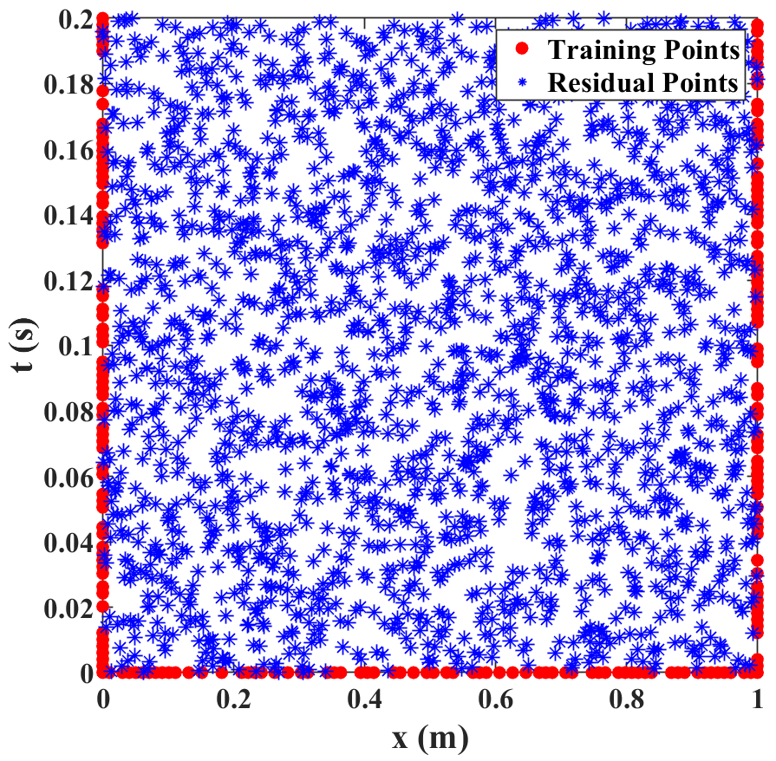
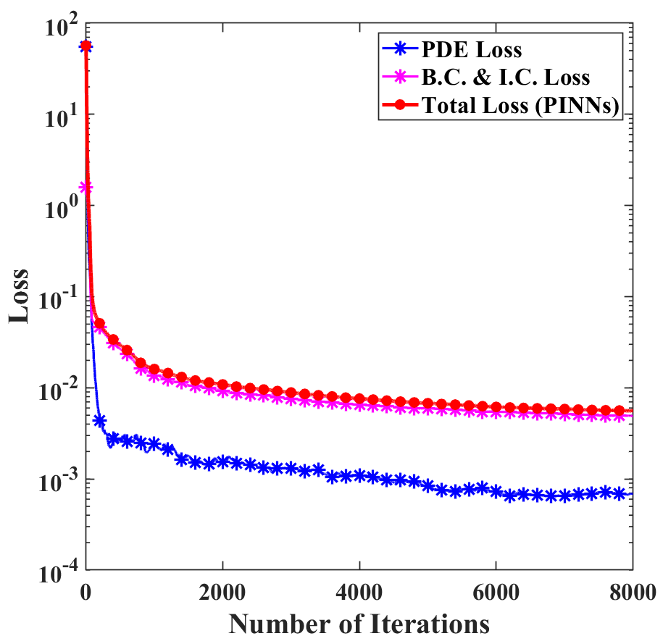
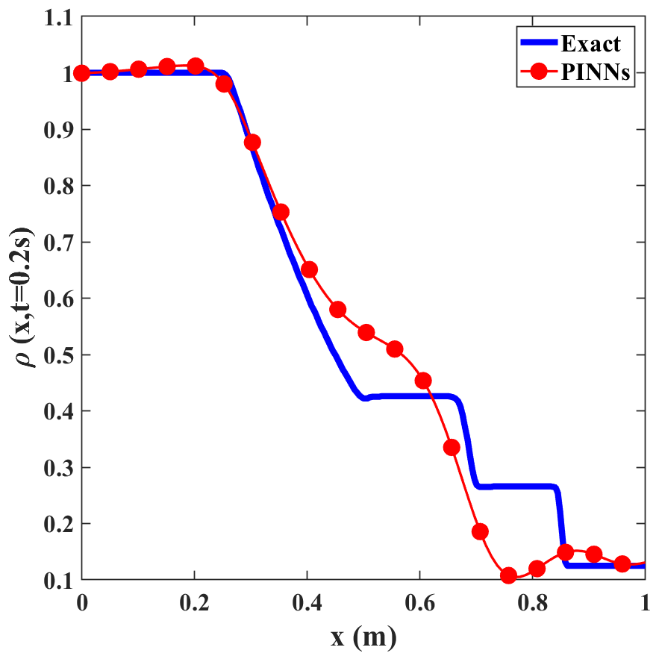



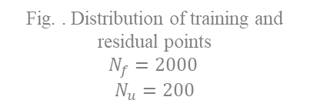
Sod Shock Tube Problem
$$\frac{∂\hat{u}}{∂x}$$
Physics Part for Sod Shock Tube Problem
$$x$$
$$\frac{∂^{2}\hat{u}}{{∂x}^{2}}$$
${MSE}_{Total Loss}={MSE}_{PDE}$+ ${MSE}_{B.C. }+ {MSE}_{I.C}$
$$(\hat{ρ},\hat{u},\hat{p})$$
$$⋯$$
$$\frac{∂^{2}\hat{u}}{{∂t}^{2}}$$
$$t$$
I
$$>{10}^{−5}$$
$$OR$$
$$iter=8000$$
Loss
NO
YES
Fig. . Distribution of training and residual points
$$N_{f}=2000$$
$N_{u}=200$
DONE
Fig. Variation of loss function with number of iterations
Fig. Predicted Density $\left(\hat{ρ}\right)$ at $t=0.2s$.
$L_{2}$ error $1.0×{10}^{−1}$.

Slide 11
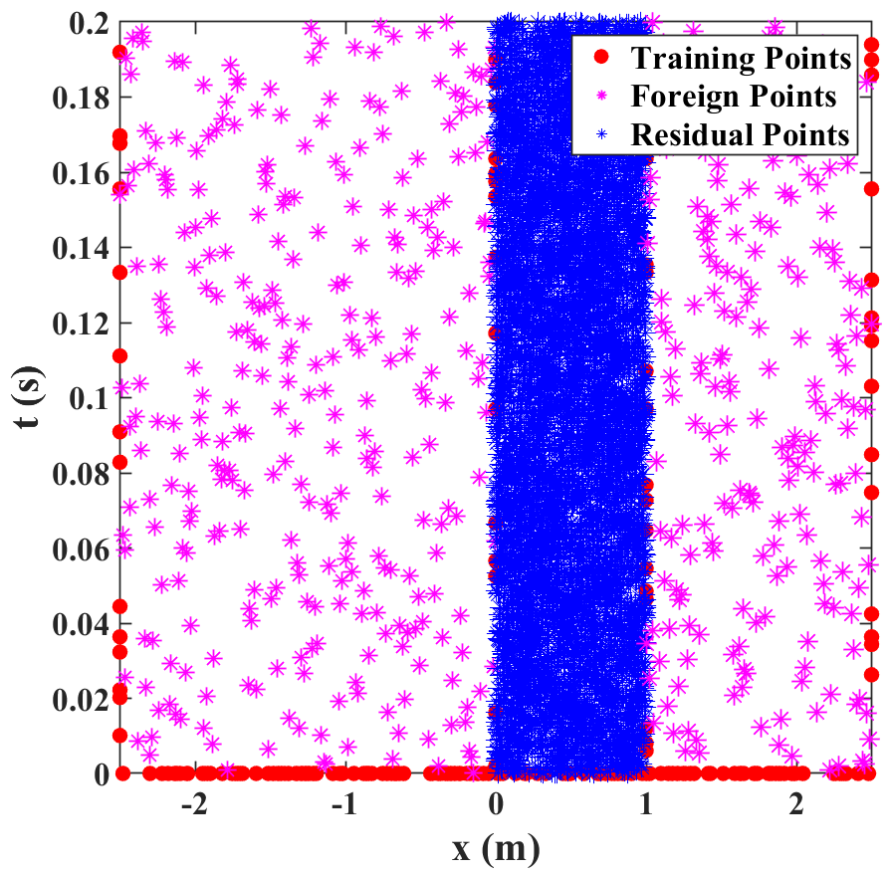
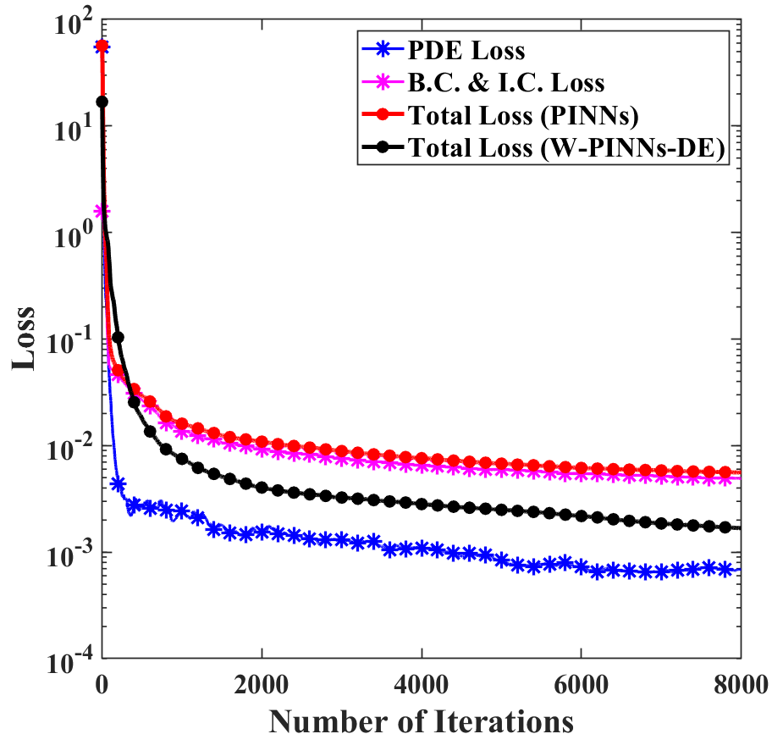
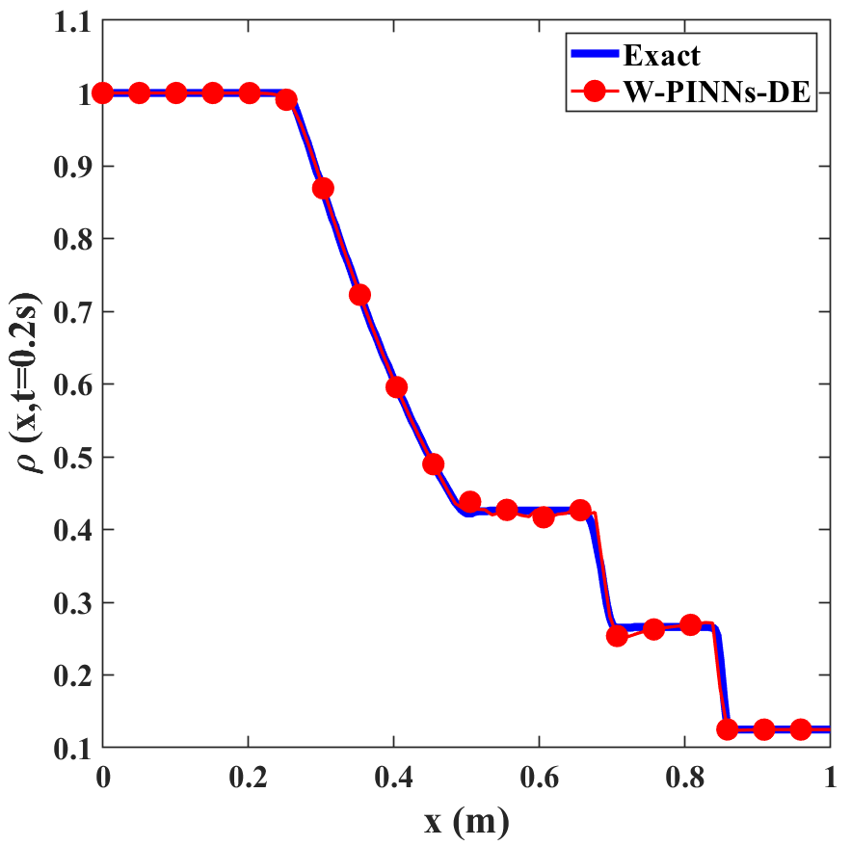
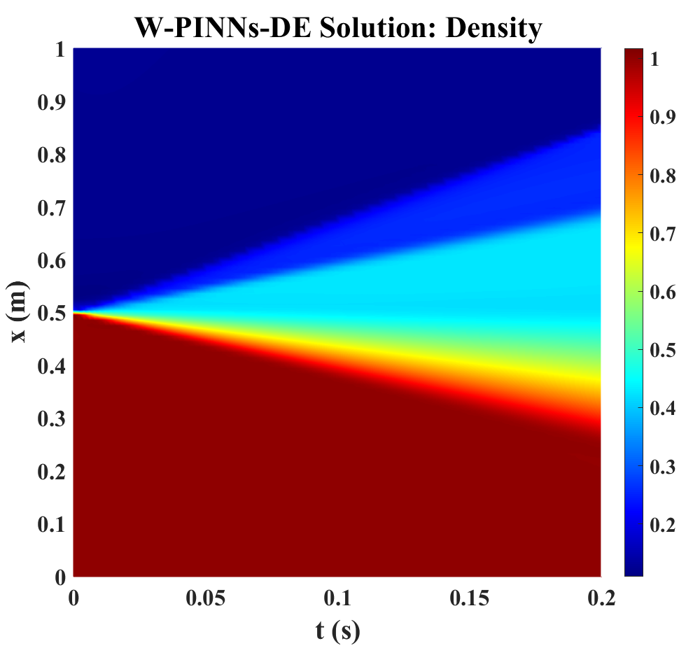
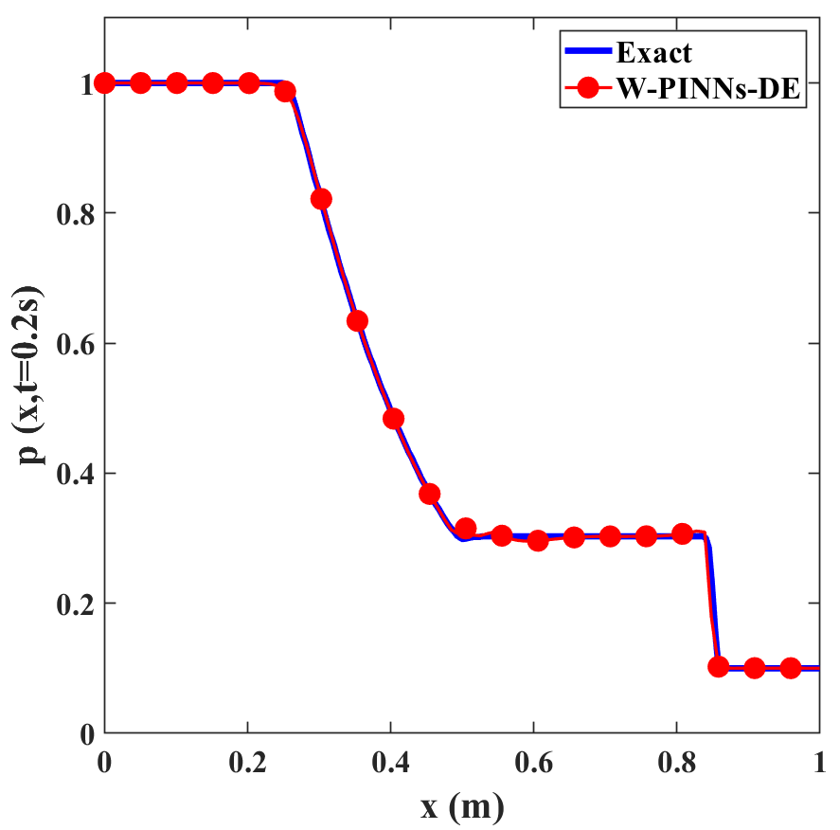
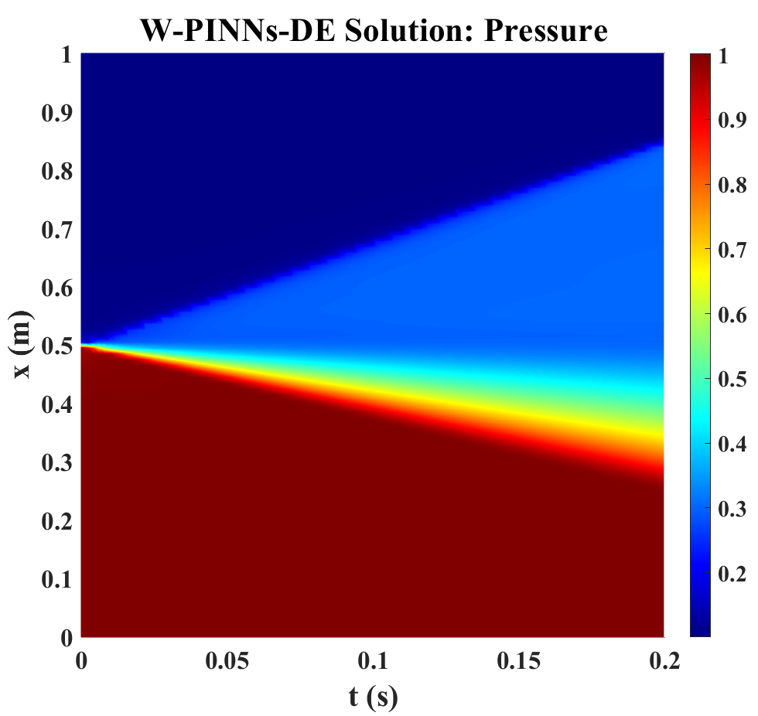
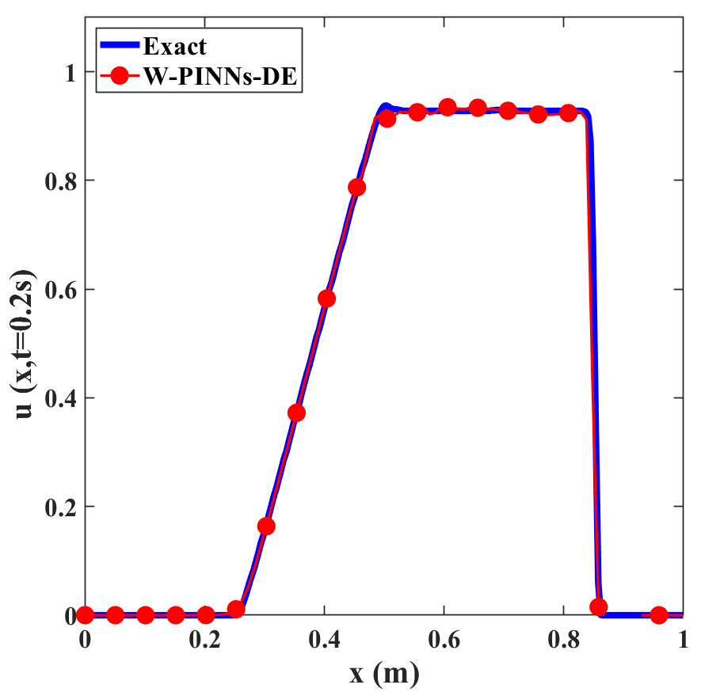
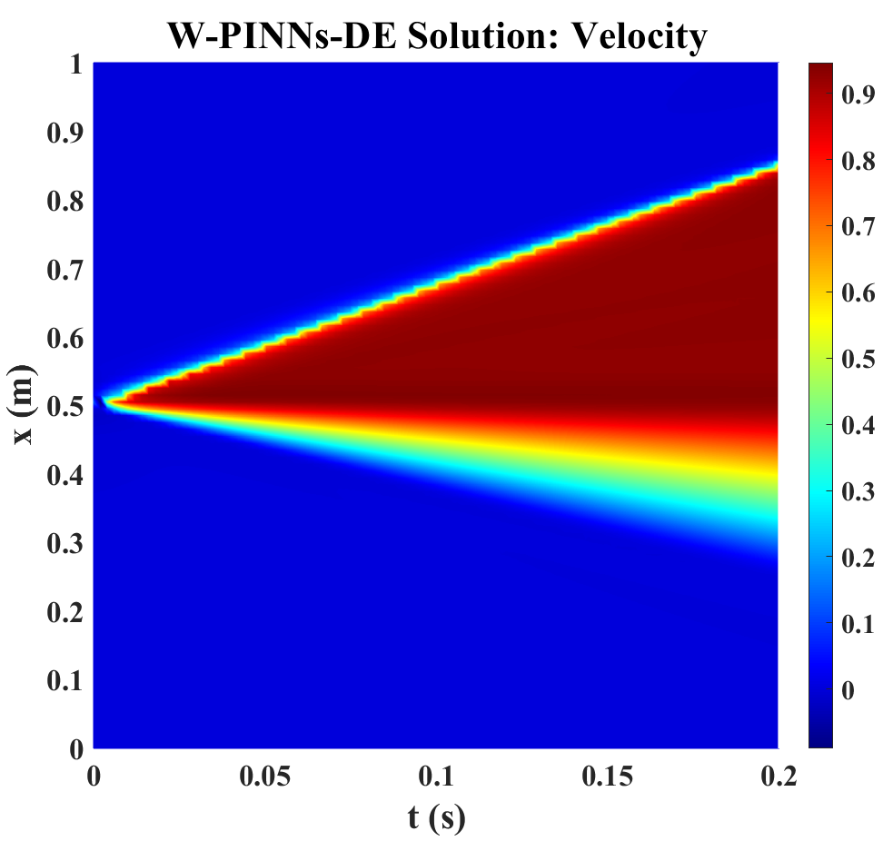
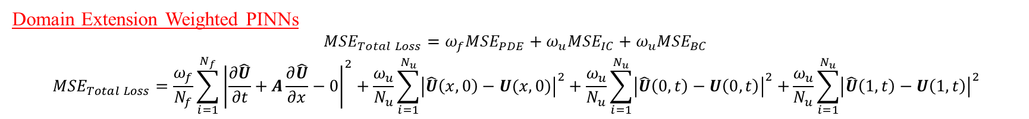
Sod Shock Tube Problem
Domain Extension Weighted PINNs
$${MSE}_{Total Loss}={ω_{f}MSE}_{PDE}+{ω_{u}MSE}_{IC}+ω_{u}{MSE}_{BC}$$
$${MSE}_{Total Loss}=\frac{ω_{f}}{N_{f}}\sum_{i=1}^{N_{f}}{{\left|\frac{∂\hat{U}}{∂t}+A\frac{∂\hat{U}}{∂x}−0\right|}^{2}+\frac{ω_{u}}{N_{u}}\sum_{i=1}^{N_{u}}{{\left|\hat{U}\left(x,0\right)−U(x,0)\right|}^{2}}}+\frac{ω_{u}}{N_{u}}\sum_{i=1}^{N_{u}}{{\left|\hat{U}\left(0,t\right)−U\left(0,t\right)\right|}^{2}+}\frac{ω_{u}}{N_{u}}\sum_{i=1}^{N_{u}}{{\left|\hat{U}\left(1,t\right)−U\left(1,t\right)\right|}^{2}}$$
Fig. Distribution of residual and training points in $Ω_{new}$. Variation of loss with Iter.
Fig. Predicted Density $\left(\hat{ρ}\right)$ using WPINNs-DE. $L_{2}$ error $3.9×{10}^{−2}$
Fig. Predicted Pressure $\left(\hat{p}\right)$ using WPINNs-DE. $L_{2}$ error $4.4×{10}^{−2}$
Fig. Predicted Velocity $\left(\hat{v}\right)$ using WPINNs-DE. $L_{2}$ error $2.3×{10}^{−2}$

Slide 12
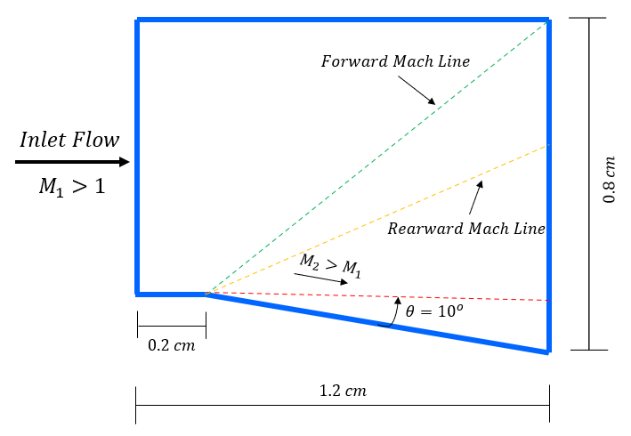
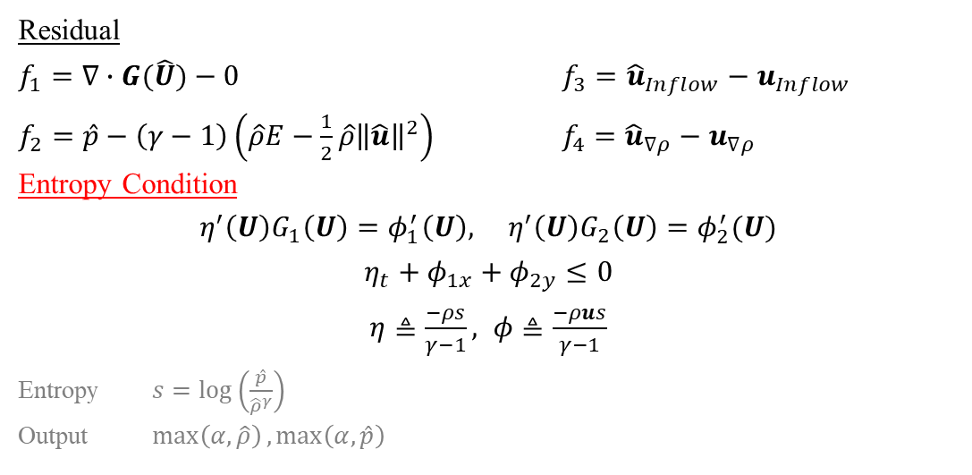

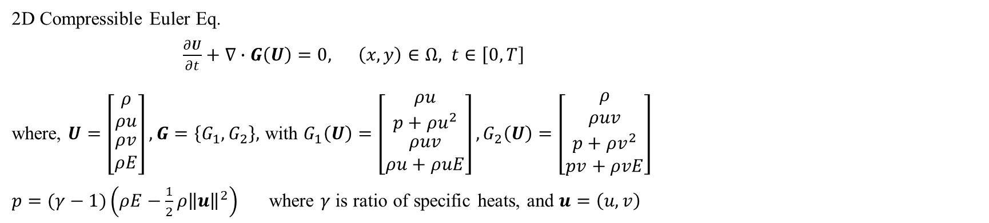
PINNs for High-Speed Fluid Dynamics
2D Euler Eq.:- Expansion Fan Problem
2D Compressible Euler Eq.
$\frac{∂U}{∂t}+∇∙G\left(U\right)=0, \left(x,y\right)∈Ω, t∈\left[0,T\right]$
where, $U=\left[\begin{matrix}\begin{matrix}ρ \\ ρu\end{matrix} \\ ρv \\ ρE\end{matrix}\right], G=\left\{G_{1},G_{2}\right\},$ with $G_{1}\left(U\right)=\left[\begin{matrix}\begin{matrix}ρu \\ p+ρu^{2}\end{matrix} \\ ρuv \\ ρu+ρuE\end{matrix}\right],G_{2}\left(U\right)=\left[\begin{matrix}\begin{matrix}ρ \\ ρuv\end{matrix} \\ p+ρv^{2} \\ pv+ρvE\end{matrix}\right]$
$p=(γ−1)\left(ρE−\frac{1}{2}ρ{\left\|u\right\|}^{2}\right)$ where $γ$ is ratio of specific heats, and $u=\left(u,v\right)$
Turning angle is ${10}^{o}$
Mach Number is $2$
$$u_{∞}=678.1\frac{m}{s}$$
$$v_{∞}=0 m/s$$
$$p_{∞}=1.01 ×{10}^{5} Pa$$
$$T_{∞}=286.1 K$$
Residual
$f_{1}=∇∙G(\hat{U})−0$ $f_{3}={\hat{u}}_{Inflow}−u_{Inflow}$
$f_{2}=\hat{p}−\left(γ−1\right)\left(\hat{ρ}E−\frac{1}{2}\hat{ρ}{\left\|\hat{u}\right\|}^{2}\right)$ $f_{4}={\hat{u}}_{∇ρ}−u_{∇ρ}$
Entropy Condition
$η^{′}\left(U\right)G_{1}\left(U\right)=φ_{1}^{′}\left(U\right), η^{′}\left(U\right)G_{2}\left(U\right)=φ_{2}^{′}(U)$
$η_{t}+φ_{1x}+φ_{2y}≤0$
$η≜\frac{−ρs}{γ−1}, φ≜\frac{−ρus}{γ−1}$
Entropy $s=\log\left(\frac{\hat{p}}{{\hat{ρ}}^{γ}}\right)$
Output $\max\left(α,\hat{ρ}\right),\max\left(α,\hat{p}\right)$
Fig. Domain
Notes:
Boundary conditions

Slide 13
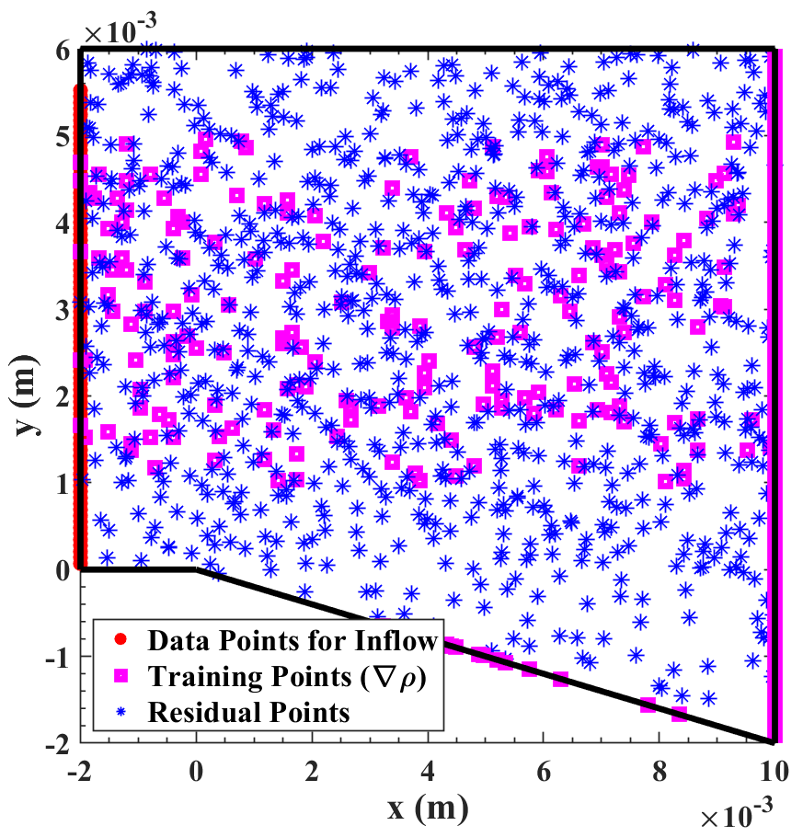
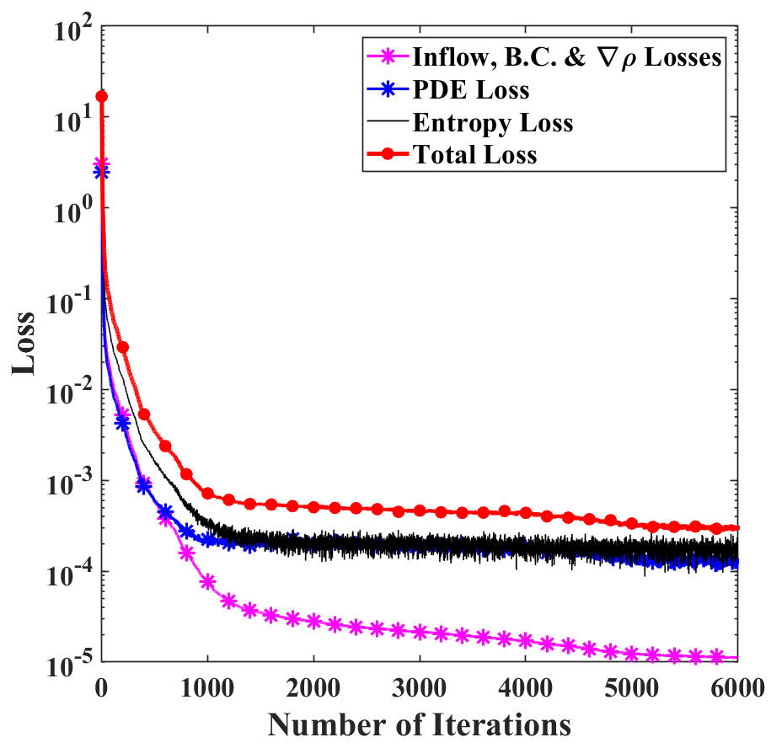





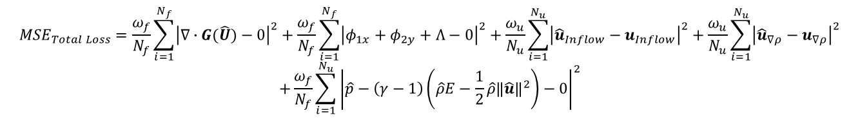



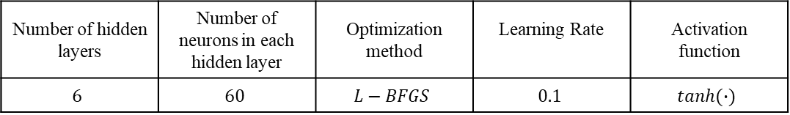



Expansion Fan Problem
$${MSE}_{Total Loss}=\frac{ω_{f}}{N_{f}}\sum_{i=1}^{N_{f}}{{\left|∇∙G(\hat{U})−0\right|}^{2}+\frac{ω_{f}}{N_{f}}\sum_{i=1}^{N_{f}}{{\left|φ_{1x}+φ_{2y}+Λ−0\right|}^{2}}+\frac{ω_{u}}{N_{u}}\sum_{i=1}^{N_{u}}{{\left|{\hat{u}}_{Inflow}−u_{Inflow}\right|}^{2}}+\frac{ω_{u}}{N_{u}}\sum_{i=1}^{N_{u}}{{\left|{\hat{u}}_{∇ρ}−u_{∇ρ}\right|}^{2}}}$$
$$+\frac{ω_{f}}{N_{f}}\sum_{i=1}^{N_{u}}{{\left|\hat{p}−\left(γ−1\right)\left(\hat{ρ}E−\frac{1}{2}\hat{ρ}{\left\|\hat{u}\right\|}^{2}\right)−0\right|}^{2}}$$
Number of hidden layers | Number of neurons in each hidden layer | Optimization method | Learning Rate | Activation function
$$6$$ | $$60$$ | $$L−BFGS$$ | $$0.1$$ | $$tanh(∙)$$
$$max(α,\hat{p})$$
$$∇∙$$
Physics Part for 2D Euler Equation
Fig. Distribution of Residual Points
$$x$$
$${MSE}_{Total Loss}=\underset{Euler Equation}{\underbrace{\frac{∂U}{∂t}+∇∙G\left(U\right)=0}}$$
$$+\underset{Entropy Condition}{\underbrace{η_{t}+φ_{1x}+φ_{2y}≤0}}$$
$$\hat{u}$$
$$∇^{2}∙$$
$$⋯$$
$$\hat{v}$$
$$y$$
I
$$max⁡(α,\hat{ρ})$$
$$>{10}^{−5}$$
$$OR$$
$$iter=8000$$
Loss
NO
YES
Fig. Variation of Loss with Number of Iterations
DONE

Slide 14
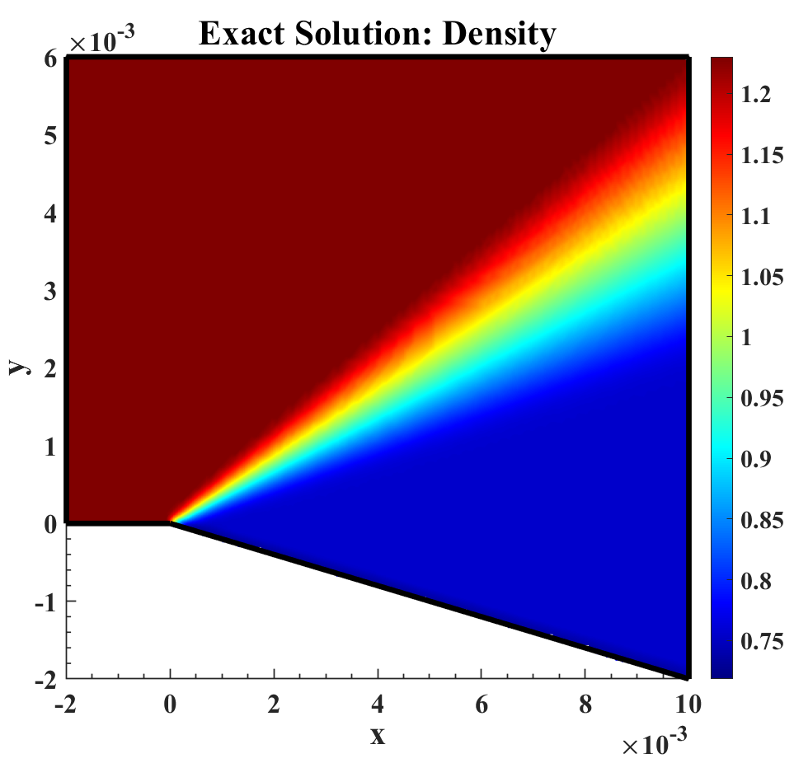
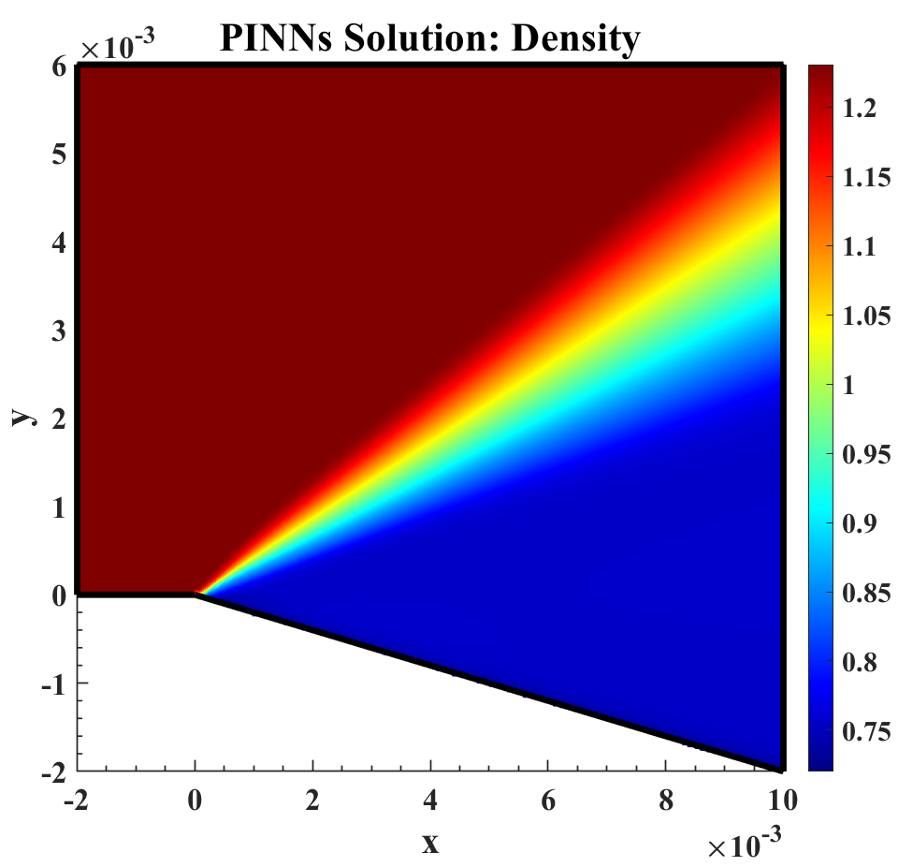
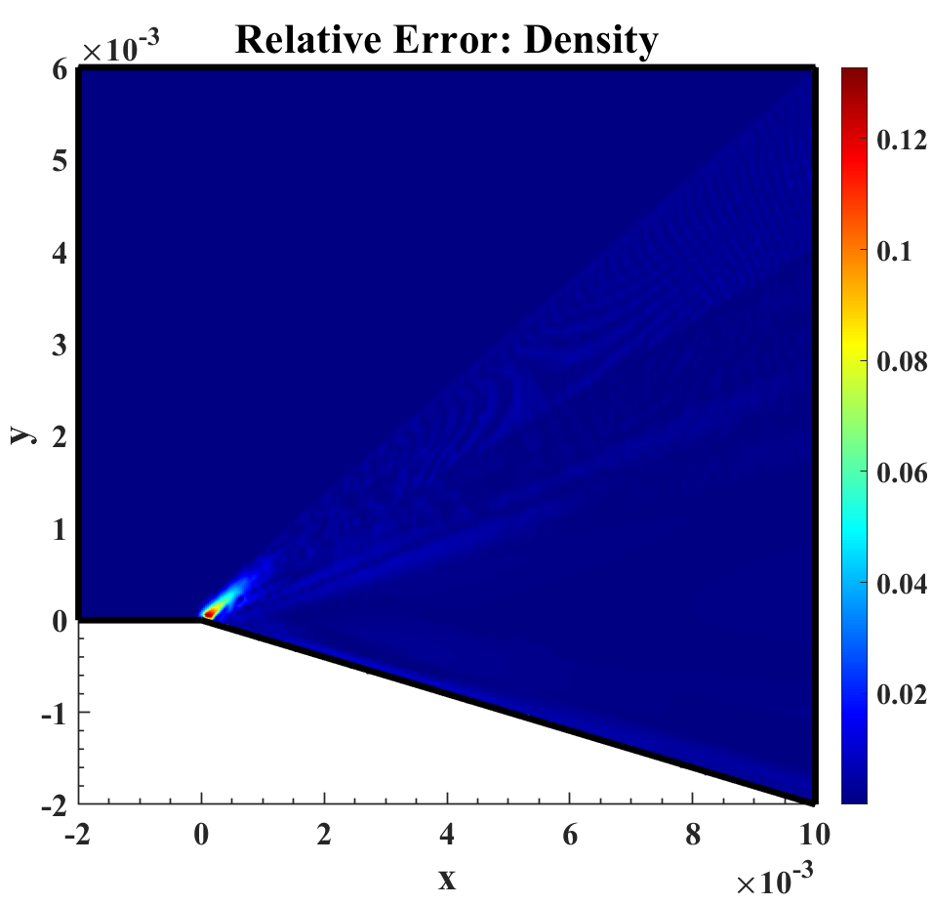
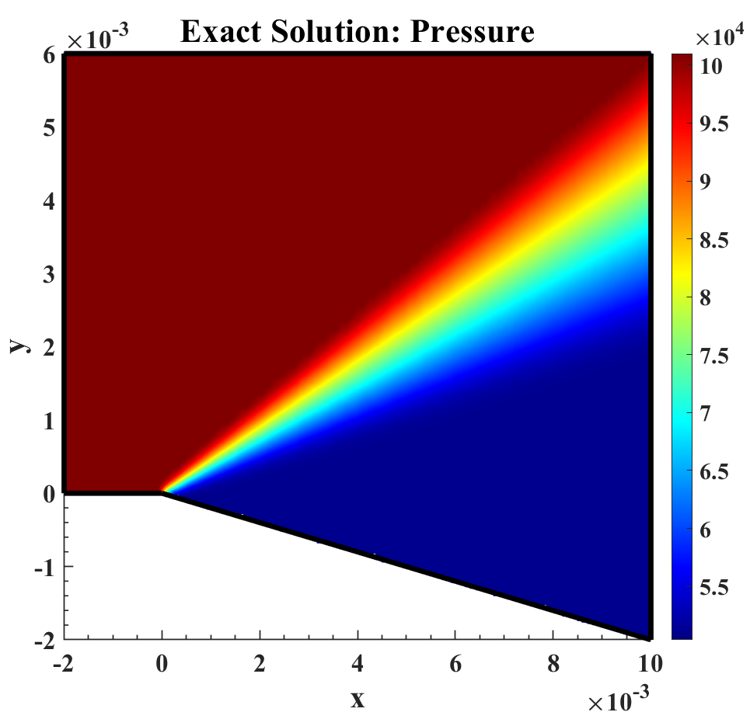








Expansion Fan Problem
Density $(\hat{ρ})$ | $$2.01×{10}^{−2}$$
Velocity $(\hat{u})$ | $$2.02×{10}^{−2}$$
Velocity $(\hat{v})$ | $$2.01×{10}^{−3}$$
Pressure $(\hat{p})$ | $$1.81×{10}^{−3}$$
Relative $L_{2}$ Error
Fig. Exact Solutions
Fig. PINNs Solutions
Fig. Relative $L_{2}$ Error

Slide 15



PINNs for High-Speed Fluid Dynamics
Oblique Shock Problem
2D Compressible Euler Eq.
$\frac{∂U}{∂t}+∇∙G\left(U\right)=0, \left(x,y\right)∈Ω, t∈\left[0,T\right]$
where, $U=\left[\begin{matrix}\begin{matrix}ρ \\ ρu\end{matrix} \\ ρv \\ ρE\end{matrix}\right], G=\left\{G_{1},G_{2}\right\},$ with $G_{1}\left(U\right)=\left[\begin{matrix}\begin{matrix}ρu \\ p+ρu^{2}\end{matrix} \\ ρuv \\ ρu+ρuE\end{matrix}\right],G_{2}\left(U\right)=\left[\begin{matrix}\begin{matrix}ρ \\ ρuv\end{matrix} \\ p+ρv^{2} \\ pv+ρvE\end{matrix}\right]$
$p=(γ−1)\left(ρE−\frac{1}{2}ρ{\left\|u\right\|}^{2}\right)$ where $γ$ is ratio of specific heats, and $u=\left(u,v\right)$
Wedge angle is ${10}^{o}$
Mach Number is $2$
$$u_{∞}=678.1\frac{m}{s}$$
$$v_{∞}=0 m/s$$
$$p_{∞}=1.01 ×{10}^{5} Pa$$
$$T_{∞}=286.1 K$$
Residual
$f_{1}=∇∙G(\hat{U})−0$ $f_{3}={\hat{u}}_{Inflow}−u_{Inflow}$
$f_{2}=\hat{p}−\left(γ−1\right)\left(\hat{ρ}E−\frac{1}{2}\hat{ρ}{\left\|\hat{u}\right\|}^{2}\right)$ $f_{4}={\hat{u}}_{∇ρ}−u_{∇ρ}$
Entropy Condition
$η^{′}\left(U\right)G_{1}\left(U\right)=φ_{1}^{′}\left(U\right), η^{′}\left(U\right)G_{2}\left(U\right)=φ_{2}^{′}(U)$
$η_{t}+φ_{1x}+φ_{2y}≤0$
$η≜\frac{−ρs}{γ−1}, φ≜\frac{−ρus}{γ−1}$
Entropy $s=\log\left(\frac{\hat{p}}{{\hat{ρ}}^{γ}}\right)$
Output $\max\left(α,\hat{ρ}\right),\max\left(α,\hat{p}\right)$
Fig. Domain
Notes:
Boundary Conditions

Slide 16



Oblique Shock Problem
$${MSE}_{Total Loss}=\frac{ω_{f}}{N_{f}}\sum_{i=1}^{N_{f}}{{\left|∇∙G(\hat{U})−0\right|}^{2}+\frac{ω_{f}}{N_{f}}\sum_{i=1}^{N_{f}}{{\left|φ_{1x}+φ_{2y}+Λ−0\right|}^{2}}+\frac{ω_{u}}{N_{u}}\sum_{i=1}^{N_{u}}{{\left|{\hat{u}}_{Inflow}−u_{Inflow}\right|}^{2}}+\frac{ω_{u}}{N_{u}}\sum_{i=1}^{N_{u}}{{\left|{\hat{u}}_{∇ρ}−u_{∇ρ}\right|}^{2}}}$$
$$+\frac{ω_{f}}{N_{f}}\sum_{i=1}^{N_{u}}{{\left|\hat{p}−\left(γ−1\right)\left(\hat{ρ}E−\frac{1}{2}\hat{ρ}{\left\|\hat{u}\right\|}^{2}\right)−0\right|}^{2}}$$
Number of hidden layers | Number of neurons in each hidden layer | Optimization method | Learning Rate | Activation function
$$6$$ | $$60$$ | $$L−BFGS$$ | $$0.1, 0.01$$ | $$tanh(∙)$$
$$max(α,\hat{p})$$
$$∇∙$$
Physics Part for 2D Euler Equation
Fig. Distribution of Residual Points
$$x$$
$${MSE}_{Total Loss}=\underset{Euler Equation}{\underbrace{\frac{∂U}{∂t}+∇∙G\left(U\right)=0}}$$
$$+\underset{Entropy Condition}{\underbrace{η_{t}+φ_{1x}+φ_{2y}≤0}}$$
$$\hat{u}$$
$$∇^{2}∙$$
$$⋯$$
$$\hat{v}$$
$$y$$
I
$$max⁡(α,\hat{ρ})$$
$$>{10}^{−5}$$
$$OR$$
$$iter=8000$$
Loss
NO
YES
DONE
Fig. Variation of Loss with No. of Iter.

Slide 17











Oblique Shock Problem
Density $(\hat{ρ})$ | $$1.12×{10}^{−2}$$
Velocity $(\hat{u})$ | $$1.02×{10}^{−2}$$
Velocity $(\hat{v})$ | $$1.04×{10}^{−2}$$
Pressure $(\hat{p})$ | $$5.14×{10}^{−3}$$
Relative $L_{2}$ Error
Fig. Exact Solutions
Fig. PINNs Solutions
Fig. Relative $L_{2}$ Error

Slide 18









Failure and Challenges
NN Hyperparameter Tunning
Activation Function
Training Algorithms
Learning Rate
Number of Layers and Neurons
Inequality Hyperparameter $\left(Λ\right)$
Weights in W-PINNs
Noise Dataset
Fig. Variation of Loss function for Sod shock tube problem using W-PINNs
Fig. Variation of Loss function for Sod shock tube problem using W-PINNs-DE
Fig. Predicted pressure $(\hat{p})$ for Sod Shock Tube Problem
Fig. Predicted Velocity $(\hat{u})$ for Sod Shock Tube Problem
Fig. Predicted Density $(\hat{ρ})$ for Sod Shock Tube Problem

Slide 19

Conclusion and Future Work
In this thesis, we have solved low and high-speed fluid dynamics problems using Physics-Informed Neural Network.
We have solved variety of low speed problems as:
1D & 2D Heat conduction equation with relative $L_{2}$ error $7.729×{10}^{−4}$.
Lid-driven cavity problem with relative $L_{2}$ error $O({10}^{−2})$.
Hagen-Poiseuille problem with relative $L_{2}$ error $O({10}^{−5})$.
2D Burger’s equations with relative $L_{2}$ error $O({10}^{−3})$.
We have also solved Lid-driven cavity and Hagen-Poiseuille problem by solving Navier-Stokes equation. We have also simplified the equations while considering the assumptions as loss function terms.
Our major focus are on solving high-speed fluid flow problems where shock/discontinuity is present.
We have solved variety of high speed problems as:
1D Single contact discontinuity with relative $L_{2}$ error $O({10}^{−4})$.
1D Sod shock tube problem with relative $L_{2}$ error $O({10}^{−3})$.
Expansion fan problem with relative $L_{2}$ error $O({10}^{−3})$.
Oblique shock problem with relative $L_{2}$ error $O({10}^{−3})$.
At last we have used low and high-fidelity data to predict the multi-fidelity results using PINNs model.
In the future, we plan to address more complex problems, such as the shock wave reflection, shock boundary layer interaction. We will also try to solve the complete Navier-Stokes equation using PINNs.

Slide 20
References
Frank, Michael, Dimitris Drikakis, and Vassilis Charissis. "Machine-learning methods for computational science and engineering." Computation 8, no. 1 (2020): 15.
Ling, Julia, Andrew Kurzawski, and Jeremy Templeton. "Reynolds averaged turbulence modelling using deep neural networks with embedded invariance." Journal of Fluid Mechanics 807 (2016): 155-166.
Kutz, J. Nathan. "Deep learning in fluid dynamics." Journal of Fluid Mechanics 814 (2017): 1-4.
Jiang, Chao, Ricardo Vinuesa, Ruilin Chen, Junyi Mi, Shujin Laima, and Hui Li. "An interpretable framework of data-driven turbulence modeling using deep neural networks." Physics of Fluids 33, no. 5 (2021).
Raissi, Maziar, Paris Perdikaris, and George Em Karniadakis. "Physics informed deep learning (part i): Data-driven solutions of nonlinear partial differential equations." arXiv preprint arXiv:1711.10561 (2017).
Raissi, Maziar, Paris Perdikaris, and George Em Karniadakis. "Machine learning of linear differential equations using Gaussian processes." Journal of Computational Physics 348 (2017): 683-693.
Raissi, Maziar, and George Em Karniadakis. "Hidden physics models: Machine learning of nonlinear partial differential equations." Journal of Computational Physics 357 (2018): 125-141.
Raissi, Maziar, Alireza Yazdani, and George Em Karniadakis. "Hidden fluid mechanics: Learning velocity and pressure fields from flow visualizations." Science 367, no. 6481 (2020): 1026-1030.
Raissi, Maziar, Paris Perdikaris, and George E. Karniadakis. "Physics-informed neural networks: A deep learning framework for solving forward and inverse problems involving nonlinear partial differential equations." Journal of Computational physics 378 (2019): 686-707.

Slide 21
Thank You

