Slide 1





Digital Portfolio
STUDENT NAME:JOSHIKA.M REGISTER NO AND NMID : asunm1711222410472 DEPARTMENT:B.SC AI 2ND Year COLLEGE : S.A COLLEGE OF ARTS & SCIENCE UNIVERSITY : MADRAS UNIVERSITY
1

Slide 2
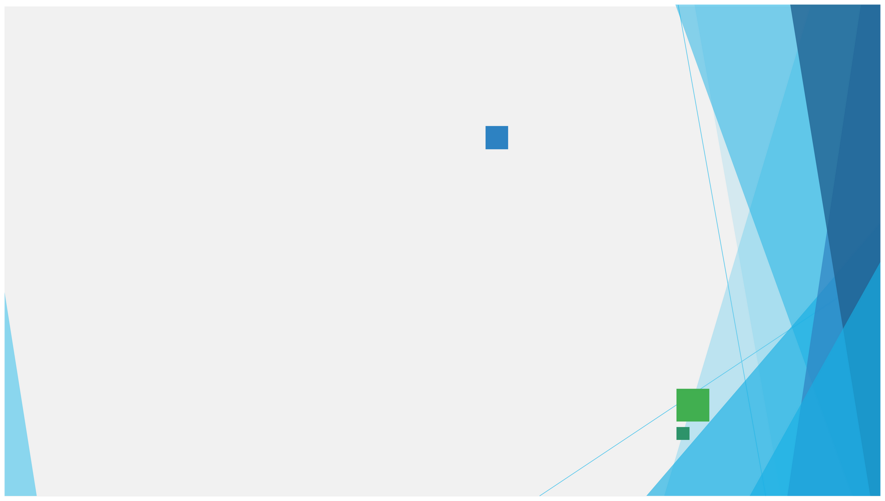
PROJECT TITLE:
“
CURRENTACADEMICPORFOLIO”
*Current Academic portfolio usingHTML, CSS, and
Javascript.
*Digital portfolio of current academic records
*Personal Academic portfolio-Joshika M
2

Slide 3


AGENDA
1. Problem Statement 2. Project Overview 3. End Users 4. Tools and Technologies 5. Portfolio design and
Layout
6. Features and Functionality
7. Results and Screenshots 8. Conclusion
9. Github Link
3/21/2024 AnnualReview
3

Slide 4



PROBLEM STATEMENT
Intoday’s digitalworld, students often struggle to present their academic achievements,
skills,and certifications inan organized and professional way. Traditional paper-based resumes and certificates are not interactive and can easily be misplaced. Moreover, they do
not effectively highlight a student’s overall profile, including projects and personal goals.
Therefore, there is a need for a digital academic portfolio where students can showcase their education, skills, certifications, and projects in one place. This portfolio should be easily accessible, visually appealing, and interactive so that it can be shared with teachers, recruiters, and peers as proof of academic and personaldevelopment.
4

Slide 5

PROJECT OVERVIEW:
TheCurrentAcademicPortfolio isaweb-based application developed using HTML, CSS, and JavaScript. It
servesasadigitalresumefor students,allowing them to present their academic achievements, skills, certifications, and projects in an interactive and professional manner.
Theportfolioisdividedintomultiplesectionssuch as:
About Me –A brief introduction of the student. Education –Academic qualifications. Skills –Technical and professional skills. Certificates –Achievements and certifications.
Projects – Mini/major projects completed.
Contact –A form to reach the student. This project provides an organized, accessible, and visually appealing platform for students to showcase their profile, making it useful for internships, job opportunities, and academicpurpose.
5

Slide 6
WHOARETHEEND USERS?
1.
Students
* To showcase their academic achievements, skills, certificates, and projects. *To use as a digital resume for internships and job applications. 2. Teachers / Mentors * To evaluate a student’s academic progress, skills, and project work. * To guide students in improving their professional profile.
3. Recruiters / Employers
* To easily view the student’s qualifications, skills, and certifications.
* To assess suitability for internships or job opportunities.
4. Peers / Academic Institutions * To collaborate, share achievements, and maintain digital academicrecords.
6

Slide 7


TOOLS AND TECHNIQUES
Visual Studio Code (VS Code)–For coding and editing the project.
Web Browser (Google Chrome/Edge/Firefox) –For testing and running the portfolio.
GitHub / Localhost –For hosting and deployment .
MS PowerPoint / Canva–For preparing project documentation and presentations.
TechnologiesHTML5 –For structuring the web pages.
CSS3 –For styling, layouts, and responsive design. JavaScript –For adding interactivity and formvalidation.
7

Slide 8

POTFOLIO DESIGN AND LAYOUT
🔹1. Header & Navigation Bar
Positioned at thet op ofthe page. Contains the portfolio title (Student Name) and navigation links. Links allow smooth scrolling to different sections: About, Education, Skills, Certificates, Projects, and Contact. Background color: Green (#4CAF50) for professional appearance. 🔹2. About Section
Provides a short introduction of the student.
Includes name, course (BCA), and ambition (to become a teacher).
🔹3. Education Section
Displays academic qualifications in a list format.
Covers current and past education (BCA, 12th, 10th).Organized clearly for easy
understanding.
8

Slide 9
🔹
4. Skills Section
Skills are displayed in a grid-based card layout.
Each card contains one skill (HTML, CSS, JavaScript, Python, AI, UI/UX, DCA)
Hover effect is applied for interactivity
🔹
Highlights completed certifications in a card format.
5. Certificates Section
Eachcard hasa certificatenameand a short description.
Examples: AI, UI & UX Design, DCA
🔹
6. Projects Section
Lists mini/major projects completed.
Each project is shown in a card style with project name and short description.
Example: Portfolio Website, Library Management System

Slide 10
🔹
7. Contact Section
Includes a contact form with Name, Email, and Message fields.
Uses JavaScript validation to check inputs before submission.
Provides an easy way for recruiters/teachers to reach the student.
🔹
8. Footer
Placed at the bottom of the page.
Contains copyright info (© 2025 Joshika M| Student Portfolio).
Styled with a dark background for contrast.
🎨
Design Principles Followed
Responsive Design–Worksondesktop, tablet, and mobile.
Minimal & Professional Look –Simple fonts and clean color scheme.
Interactive Elements–Hover effects, smoothnavigation,formvalidation.
Organized Layout –Sections divided clearly for easynavigation.

Slide 11
FEATURES AND FUNCTIONALITY
🔹
1.Single PagePortfolio – Allstudentdetailsaredisplayedonasinglepagewith
Features
smooth navigation.
2. Responsive Design –Works well on desktop, tablet, and mobile devices. 3. Clean UI & Layout –Simple, card-based design for skills, certificates, and
projects.
4. Interactive Elements –Hover effects on cards, smooth scrolling navigation. 5. Contact Form –Allows visitors to send messages to the student. 6. Organized Sections –About, Education, Skills, Certificates, Projects, and Contact are clearly separated. 7. Custom Styling –Consistent color theme (green & white) for a
professional look.

Slide 12
🔹
1. NavigationBar –Links to different sections on the page.
2. About Section –Displays student introduction and ambition.
3. Education Section –Shows academic qualifications.
4. Skills Section –Lists technical/professional skills in card format.
5. Certificates Section –Highlights student certifications with
details.
Functionality
6. Projects Section –Displays mini/major projects with descriptions.
7. Contact Section –Input fields: Name, Email, Message.JavaScript
validation checks for empty fields before submission. Confirmation alert is shown on successful submission.

Slide 13
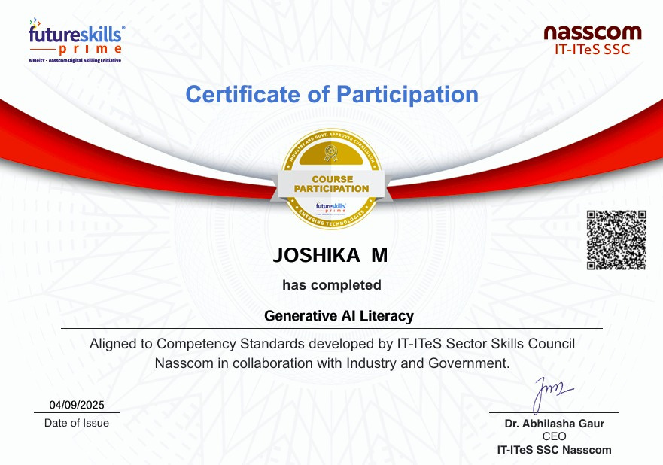
CERTIFICATES
GEN AI LITERACY

Slide 14
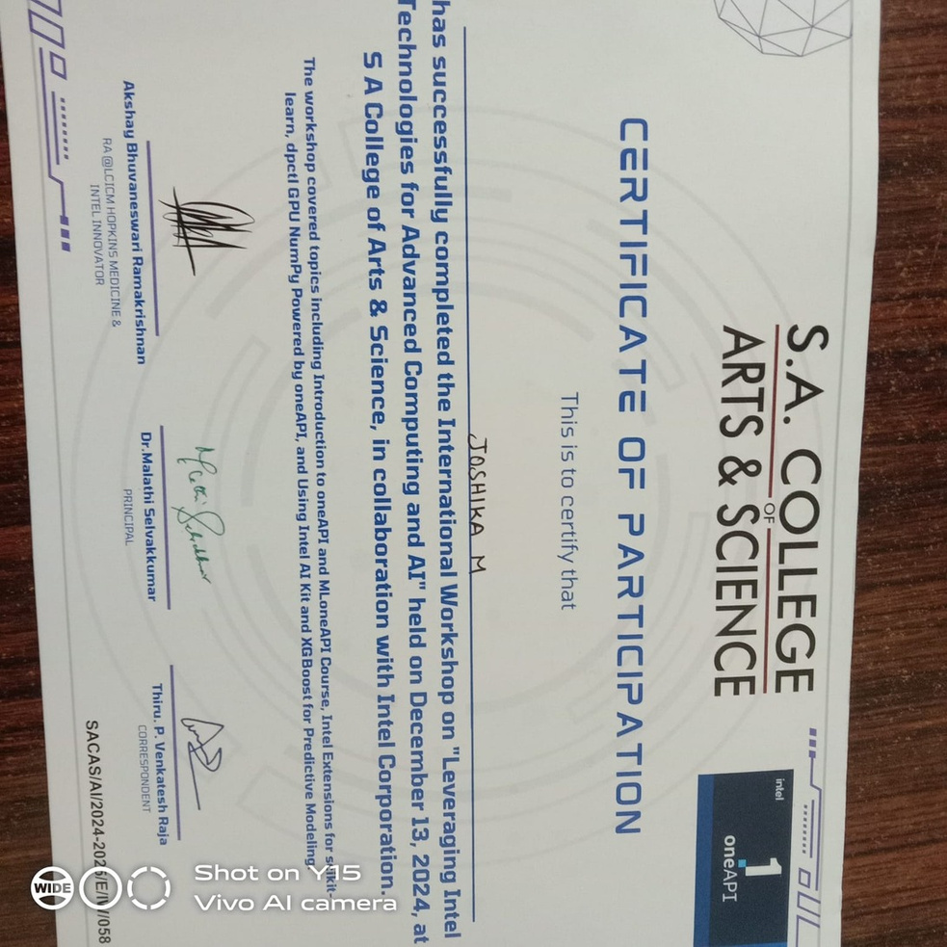

Slide 15
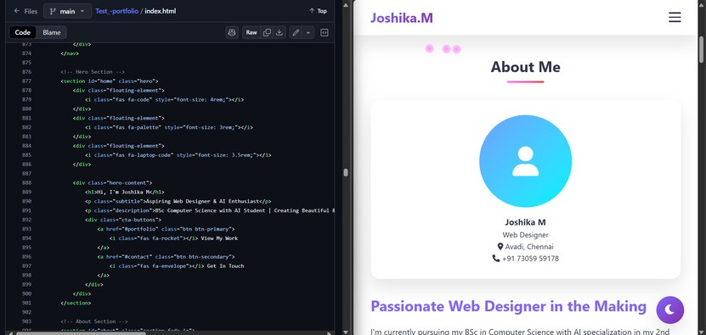
RESULTS AND SCREENSHOTS

Slide 16
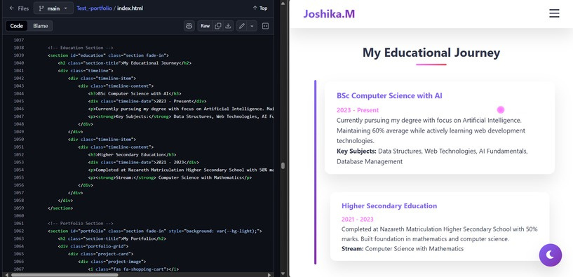

Slide 17
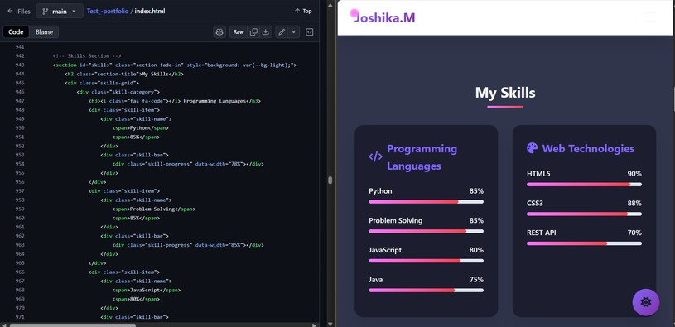

Slide 18
CONCLUSION:
TheCurrent Academic Portfolio project successfully demonstrates how
studentscan digitally showcase their academic qualifications, skills, certifications, and projects in a structured and professional way. Unlike traditional paper-based resumes, this portfolio is interactive, responsive, and easily accessible online, making it more effective for academic purposes, internships, and job opportunities.
ByusingHTML,CSS,andJavaScript,theprojectprovidesasimpleyet
modern platform where students can highlight their strengths and achievements. This enhances their chances of being recognized by teachers, recruiters, and peers.
Inconclusion,theprojectprovesthatdigitalportfoliosareanessential
tool for today’s students, enabling them to present themselves in a professional manner and stand out in the competitiveworld .
19

