Slide 1
Yelp Dataset- Kaggle
Sentiment Prediction Using User Review Text
Khajan Joshi
Yelp Dataset
1

Slide 2
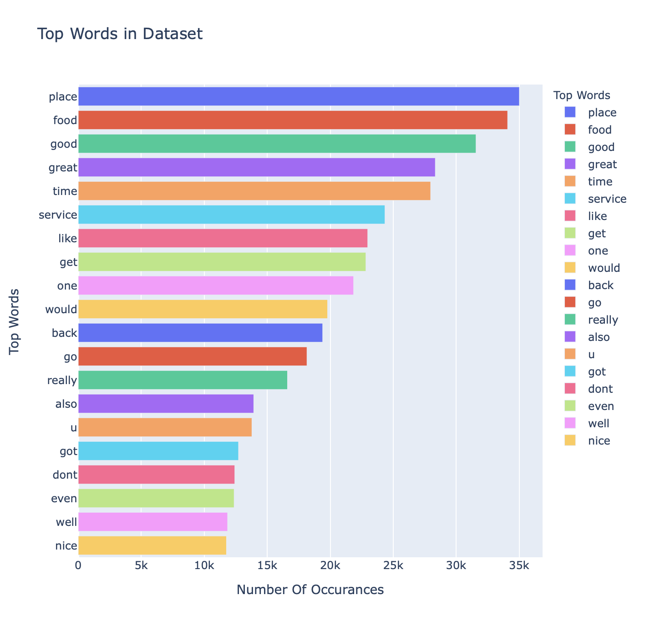
About the Dataset
This dataset contains over 6 million reviews of restaurants
Each review has a rating between 1 to 5
Reviews with 1 rating are negative and reviews with 5 rating are positive
Image taken from my Jupyter Notebook
Sec: Visualizing the top words in the data (fig_top)
Yelp Dataset
2

Slide 3
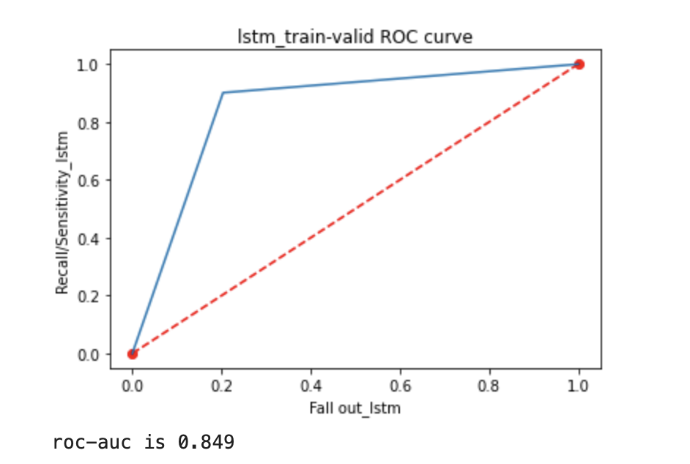
Goals
Overcoming noise in textual data
Text data has lots of noise (spelling errors, special characters, etc.), overcoming that is important in building better models
To predict sentiment of text
By training a machine learning model which can predict the sentiment based on the provided text
Image taken from my Jupyter Notebook
Sec: Evaluating the LSTM model
Yelp Dataset
3

Slide 4
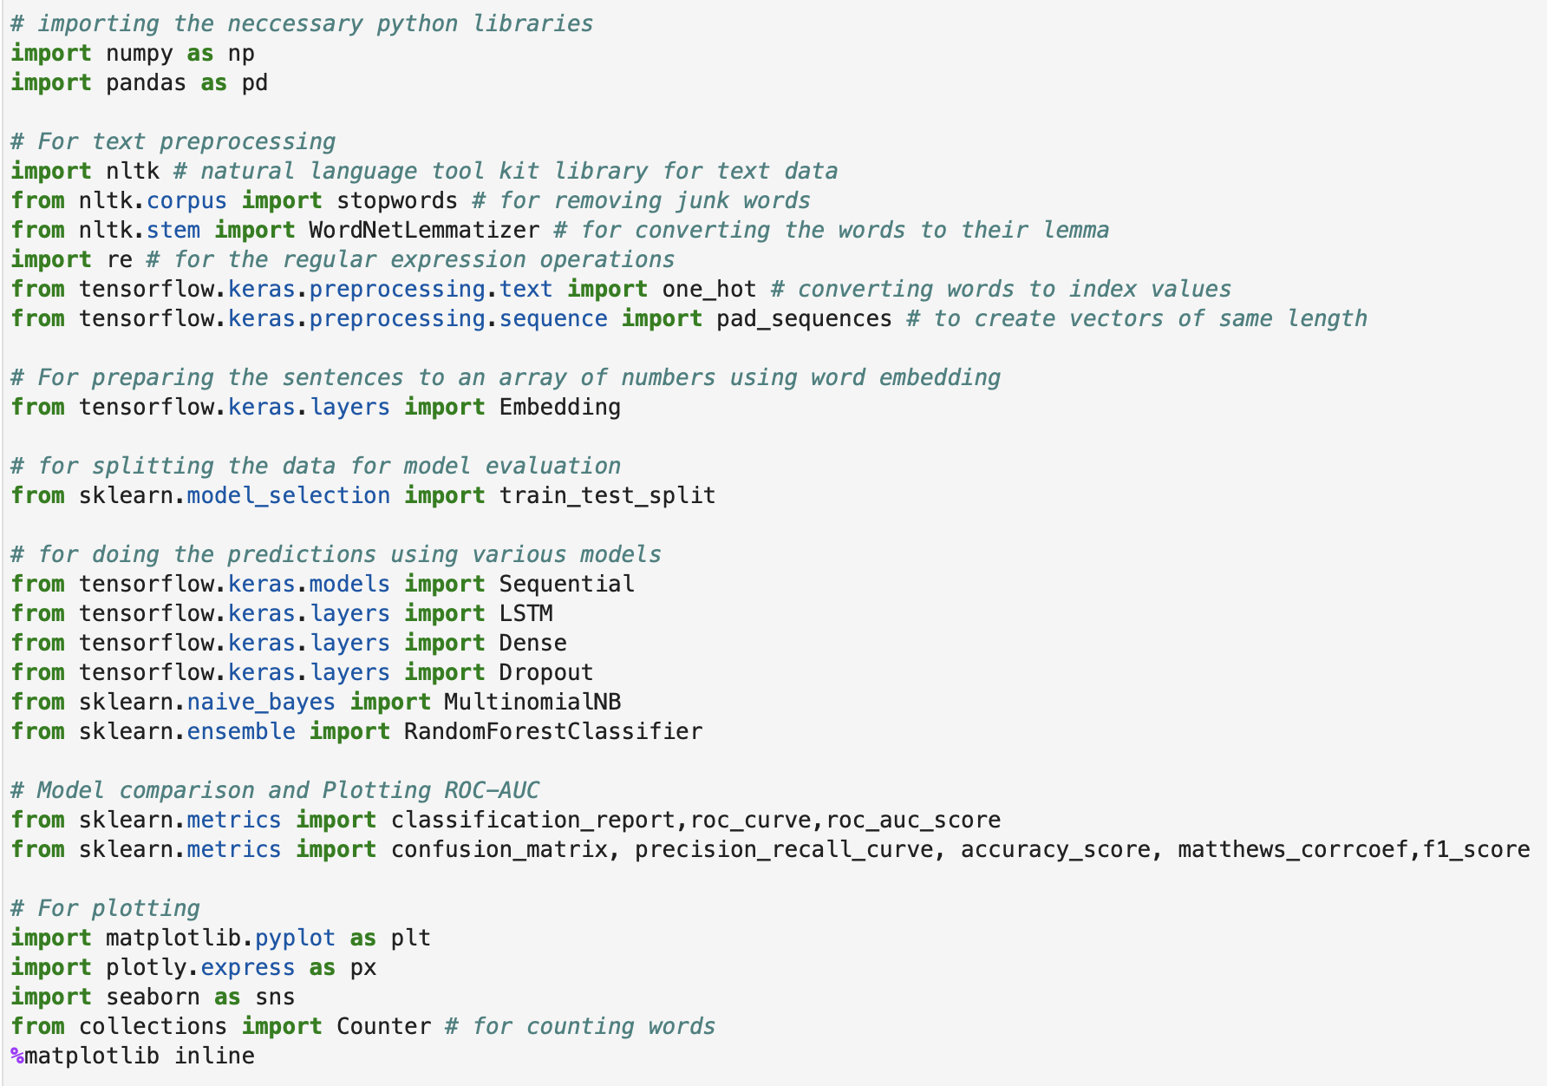
Packages Used
NUMPY
PANDAS
NLTK
Tensorflow
matplotlib
keras
seaborn
Yelp Dataset
4

Slide 5
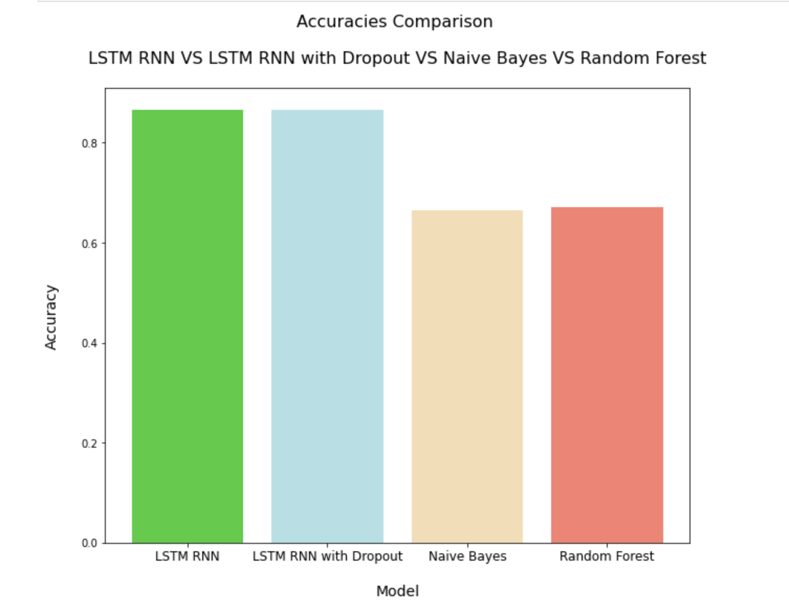
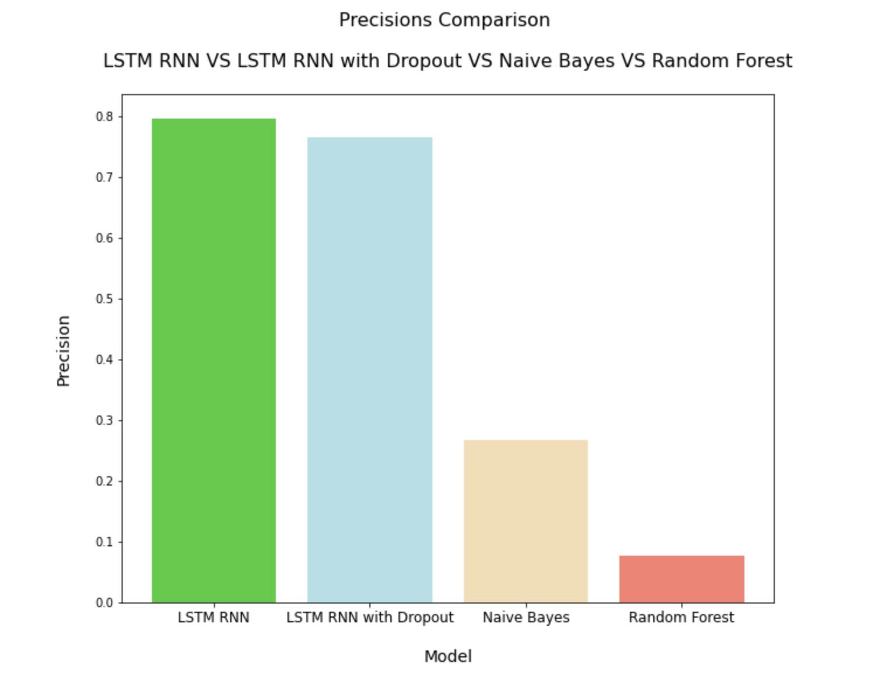
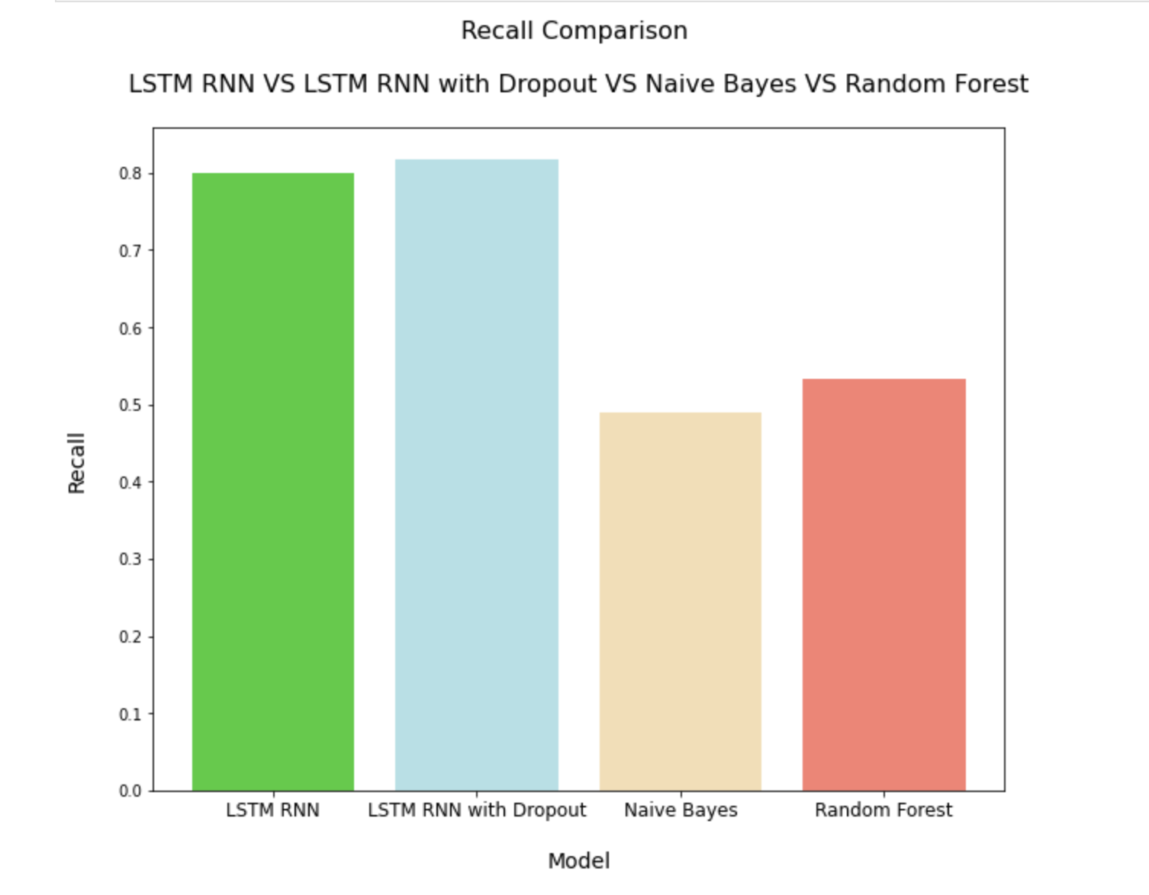
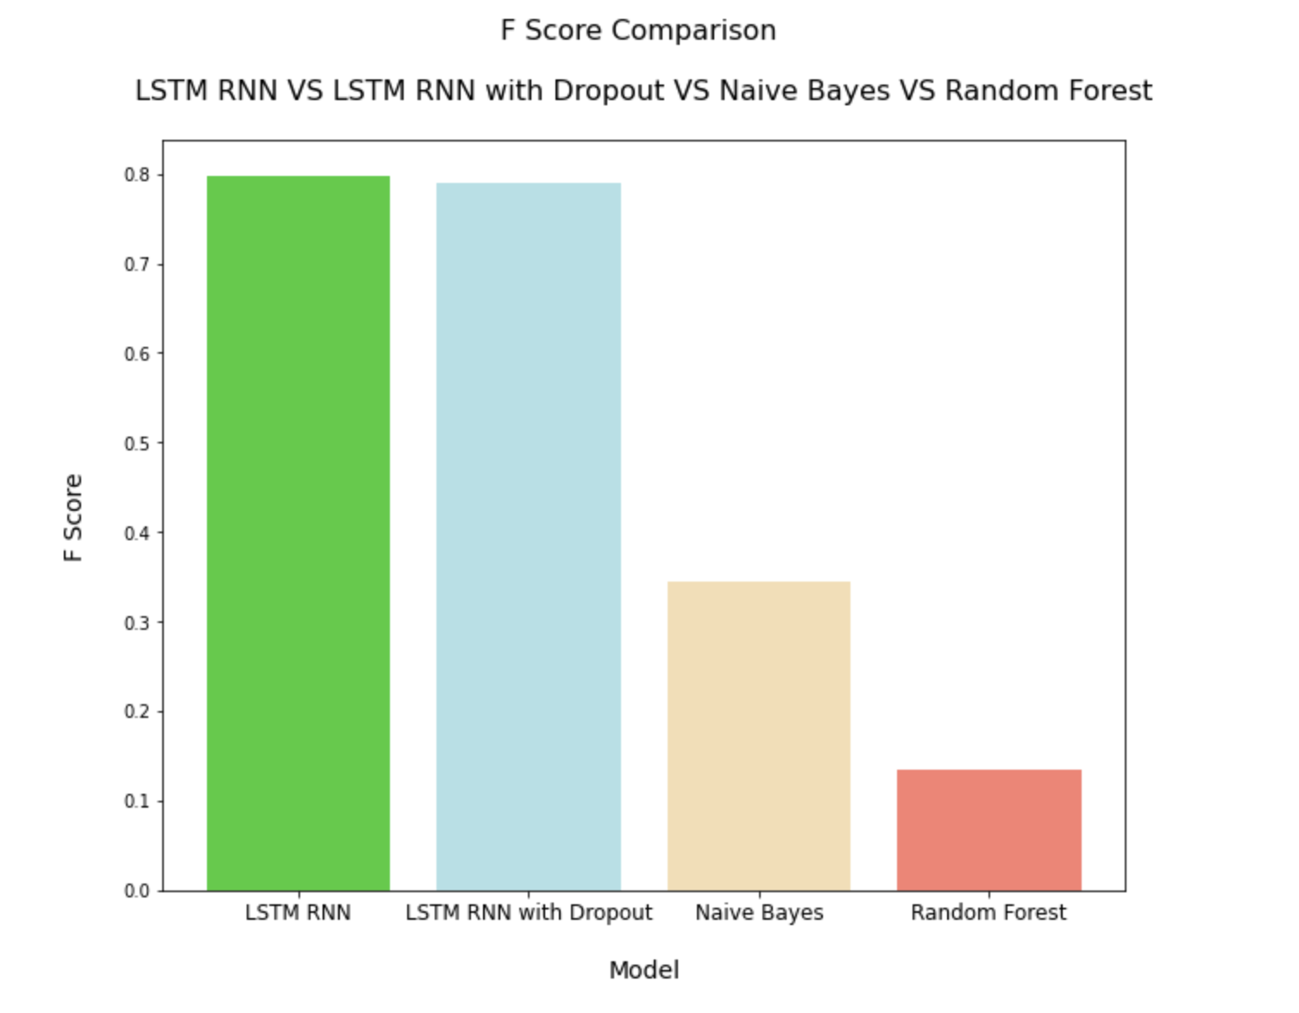
Model Comparisons
Yelp Dataset
5

Slide 6
Summary
Long Short-Term Memory (LSTM) Recurrent Neural Network (RNN) Model performed the best with close to 90% accuracy
Fine-tuning input parameters to the models may improve accuracies and performance
BERT model may further provide better results
Yelp Dataset from Kaggle
Yelp Dataset
6

Slide 7
References
Cluster Documents Using Word2Vec. Retrieved from https://datamuni.com/@dylanjcastillo/cluster-documents-using-word2vec
Artificial Intelligence - All in One (2019) Lecture 29 — Multinomial Naive Bayes A Worked Example — [ NLP || Dan Jurafsky || Stanford ]. Retrieved from https://www.youtube.com/watch?v=j1uBHvL6Yr0
Krish Naik (2020) Stock Price Prediction And Forecasting Using Stacked LSTM- Deep Learning. Retrieved from https://www.youtube.com/watch?v=H6du_pfuznE&list=PLZoTAELRMXVMdJ5sqbCK2LiM0HhQVWNzm&index=23
Sameera Bharadwaja (2015) Why is the Naive Bayes algorithm fast? Retrieved from https://www.quora.com/Why-is-the-Naive-Bayes-algorithm-fast
Jagan (2018) What's in a review? - Yelp ratings EDA. Retrieved from https://www.kaggle.com/jagangupta/what-s-in-a-review-yelp-ratings-eda
Susan Li (2018) Multi-Class Text Classification with Scikit-Learn. Retrieved from https://towardsdatascience.com/multi-class-text-classification-with-scikit-learn-12f1e60e0a9f
Natural Images
7

