Slide 1

Dependency Injection
Joshua Lewis
@joshilewis
Notes:
- Thank Chris, thank group for opportunity
Thanks for coming
Food for thought
Interactive
JCSE
Twitter
Still learning
Aim to understand why we use DI
No tools or advanced usage
Some Ruby-specific
Approach – real-world egs, lessons applied to code
I’m new to Ruby, expanded thinking

Slide 2
Expectations
Notes:
Q: Who not heard of DI?
Q: Who uses DI?
Q: Who doesn’t like DI?
Q: Who can’t write code without DI?
Q: Expectations

Slide 3
Short Video
Notes:
Show quick video
Won’t discuss straight away but keep in mind

Slide 4

Notes:
Start simple and unpack DI a bit
Q: What is a dependency?
A: Something you need to do your job
Words like ‘need’ or ‘require’ signify dependency
Can make a formal statement

Slide 5
We require certain resources to
function and fulfil our responsibilities
Notes:
We call these dependencies

Slide 6

Notes:
Q: Who needs food?
Q: Who grows their own food?
Q: Why not? You just said you need food, why don’t you grow your own?
It’s expensive: effort, time, skills, money
Not part of my purpose
Not a shallow dependency
Dependency chains
Eg human – food ~ soil, sunlight, water, expertise

Slide 7
We can consume a resource without
having to manage it
Notes:
I’ve been liberated
Statement: we consume resource without worrying about how it arrives
Important to distinguish between consuming and everything else
What is everything else

Slide 8

Notes:
Another example
If surgeon had to sterilise equipment, how much time for surgery?
Colin McRae looking at map while driving
Go further – shouldn’t manage

Slide 9
We shouldn’t have to worry about our
resources except for consuming them
Notes:
Q: Why is this?
A: Liberates, can spend time on other things
Don’t incur cost, effort, dependency chain
Not part of purpose/reason for being

Slide 10

Notes:
Now a tension: need something but can’t manage
Fortunately can go to shops in real world
How does it work out in code?

Slide 11
Class Exercise
Notes:
Now going to do a class exercise
Have a look at handout
Q: Who has seen code like this?
Q: Who has written code like this?

Slide 12
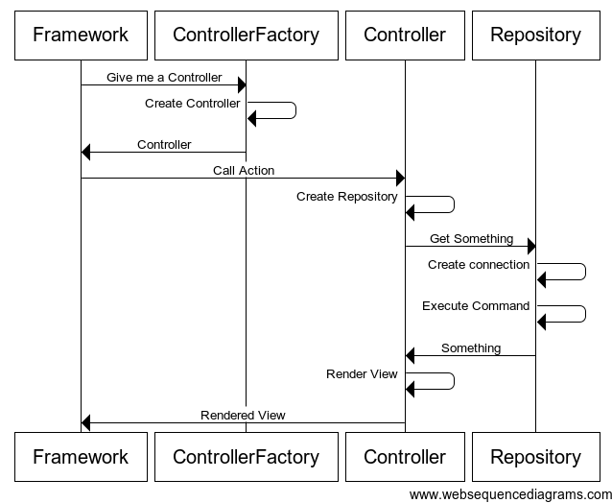
Notes:
This is Sequence Diag showing interaction of components
Can see creation of Repo in Controller and Connection in Repo

Slide 13

Notes:
Classes knowing little about collaborators
Isolate from change
SRP
ISP
Stronger than not managing:

Slide 14
A class should know nothing more
about its dependencies than how
to consume them
Notes:
This is ideal state
Not part of purpose
Too expensive
Exposed to more change
Cleanest code, nothing out-of-concern

Slide 15
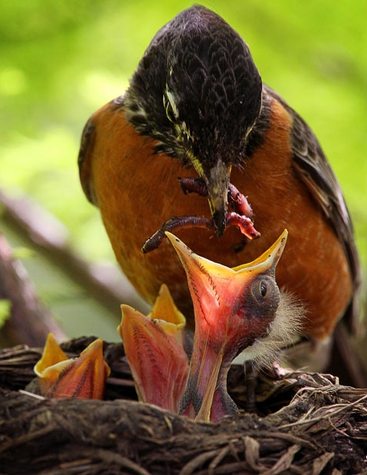
Notes:
Classes should be like baby birds:
Tell what they need and when
Someone else’s job to get it for them
Let’s look at some code

Slide 16
public ActionResult List()
{
ProductRepository repository = new ProductRepository();
IList<Product> productList = repository.GetAllProducts();
return View(productList);
}
public IList<Product> GetAllProducts()
{
SqlConnection connection = new SqlConnection("connString");
IList<Product> productList = ExecuteAllProductsCommand(connection);
return productList;
}
Notes:
This is code as-is
Problems?
Lets try to improve it step-by-step

Slide 17
public class ProductRepository
{
public IList<Product> GetAllProducts()
{
SqlConnection connection = ConnectionProvider.GetConnection();
IList<Product> productList = ExecuteAllProductsCommand(connection);
return productList;
}
}
Now a call to static method
Notes:
Now replaced call to ‘new’ with call to Static
Can delegate management, like connection opening, pooling etc to ConnectionProvider
Q: Problems?
Can’t test
Class still getting own dependency

Slide 18
public class ProductRepository
{
private readonly SqlConnection connection;
public ProductRepository(SqlConnection connection)
{
this.connection = connection;
}
public IList<Product> GetAllProducts()
{
IList<Product> productList = ExecuteAllProductsCommand();
return productList;
}
}
Notes:
Class now declaring what it needs
Make dependency explicit
Only thing we know about SqlConnection is how to use it
Less code, much cleaner
But how is ProductController affected?

Slide 19
public class ProductController : Controller
{
public ActionResult List()
{
SqlConnection connection = new SqlConnection(
"connecting string");
ProductRepository repository = new ProductRepository(connection);
IList<Product> productList = repository.GetAllProducts();
return View(productList);
}
}
Notes:
Now ProductController has to worry about its dependency’s dependency
This is bad

Slide 20
public class ProductController : Controller
{
private readonly ProductRepository repository;
public ProductController(ProductRepository repository)
{
this.repository = repository;
}
public ActionResult List()
{
IList<Product> productList = repository.GetAllProducts();
return View(productList);
}
}
Notes:
Now made dependencies explicit again
ProductController declares its dependencies
Only thing we know about Repository is how to use it
One more thing we can do: DIP

Slide 21
public interface IProductRepository
{
IList<Product> GetAllProducts();
}
public class ProductRepository : IProductRepository
{
}
Notes:
To satisfy DIP we’ll make Controller and Repository depend on an abstraction, IProductRepository
Personally not convinced this step is necessary, because Controller is insulated from implementation of Repository already

Slide 22
public class ProductController : Controller
{
private readonly IProductRepository repository;
public ProductController(IProductRepository repository)
{
this.repository = repository;
}
public ActionResult List()
{
IList<Product> productList = repository.GetAllProducts();
return View(productList);
}
}

Slide 23
So now we have baby bird classes,
how do we give them their worms?
Notes:
Classes should be concerned about how to use resources, nothing more
So how do they get their dependencies?
Dependency Injection is one way of achieving this
There may be other ways, especially in other languages, but DI best in static-typed languages like C# and Java

Slide 24
SqlConnection connection = new SqlConnection("connString");
For<SqlConnection>()
.Use(connection)
;
For<IProductRepository>()
.Use<ProductRepository>()
;
For<ProductController>()
.Use<ProductController>()
;
Notes:
This code shows declarative code showing container what classes to use when asked for types
Using StructureMap
Note that we don’t need to tell container how to create types, not what to use in specific cases, can work it out itself

Slide 25
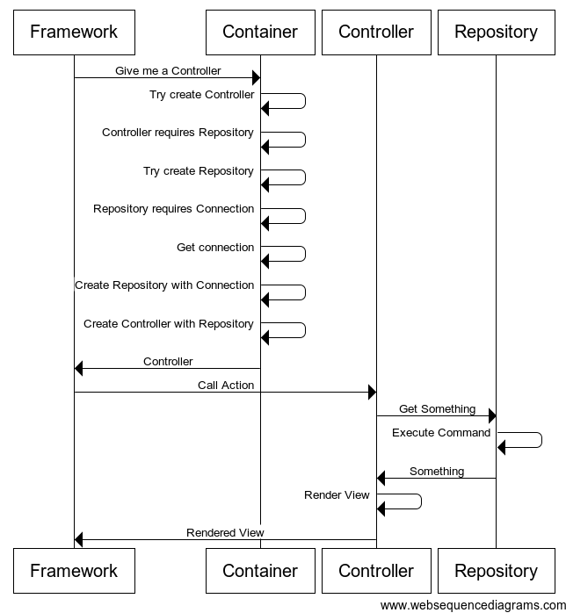
Notes:
- Sequence diagram showing how container resolves types with recursive calls

Slide 26
Disadvantages
Notes:
Q: What are the disadvantages?
1 big disadvantage: if don’t understand, works like magic, nothing ever newed up
Container config bloated and complicated

Slide 27
Intermediate and advanced usage
Notes:
Some intermediate and advanced usage scenarios
Eg opening and closing connection, Unit of Work pattern
Can wrap resources so that opening and closing done automatically
Lazy instantiation – depending on a delegate
Interception

Slide 28
Conclusion
Notes:
Classes should be like baby birds
Implies someone’s problem to manage and provide dependencies
DI one way of doing it
Particularly good way of doing it
Cost i.t.o runtime magic, but small for benefits

Slide 29
Thank You!

