Slide 1

TITLE
Web Scraping to Collect Reviews Data

Slide 2
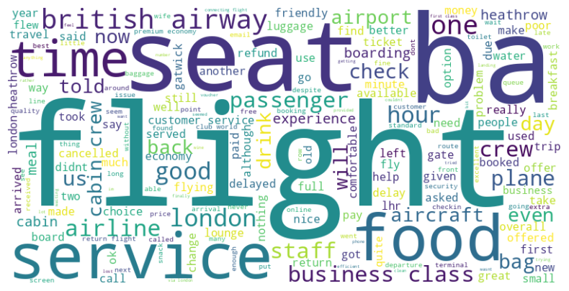
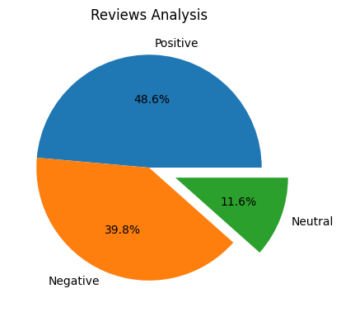
Insights from Customer Data
Website:https://www.airlinequality.com/ airline-reviews/britishairways/?sortby=post_date%3ADesc&pagesize=100
From Cleaning 2000 reviews , We get
Positive Reviews: 972
Negative Reviews : 797
Neutral Reviews : 231
WordCloud of Keywords

