Slide 1

TITLE
Training a ML Model

Slide 2
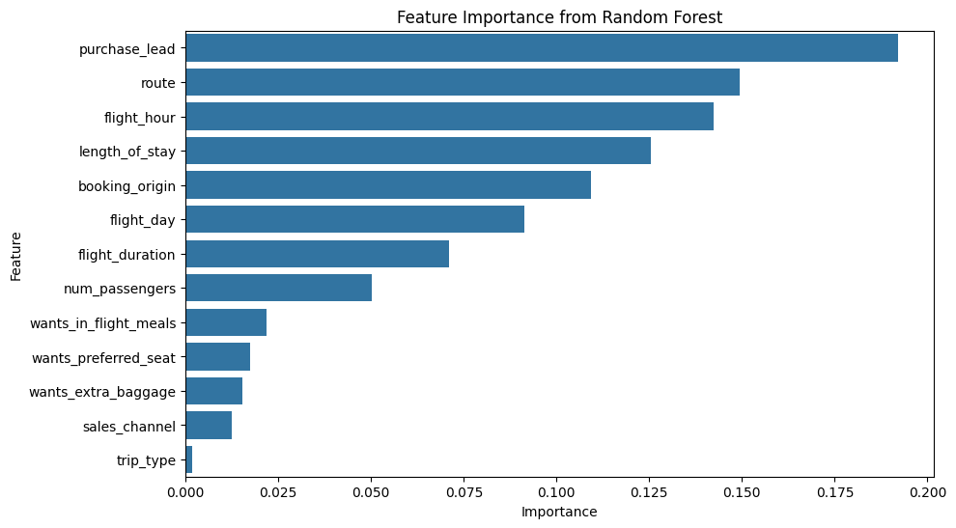

Insights from Customer Data
Booking dataset was preprocessed and split into training/testing sets.
A Random Forest Classifier was trained to predict booking completion.
Model achieved good performance with high accuracy and AUC score.
Feature importance showed key drivers of booking included route, fare type, and travel purpose.
ACCURACY: 85.62
AUC score: 0.774
Top 5 Factors that affect Customer
Booking
Purchase_lead
Route
Flight_hour
Length_of_stay
Booking Origin

