Slide 1
CHAT APPLICATION FOR CYBER BULLYING DETECTION
TOPIC NO : 4
TEAM NAME : MASS
TEAM MEMBERS : SOHAM CHITALIA
MILONI JOSHI
ADITI MEWADA
SHRADDHA SHALINGRAM

Slide 2
FEATURES
Naive Bayes Machine Learning Classifier to detect if a message is harrasment or not.
Chat Application developed using Python GUI (tkinter) and Python based Web Socket.
Integration of Twitter API to classify a Tweet as Cyber Bullying or not, along with a personal notification sent to the user.
Cyber Bulling comments Dataset (Kaggle)
Real time web scrapping of latest Cyber Bullying news (https://timesofindia.indiatimes.com/topic/cyberbullying)
Email.js API used in the contact form so that users can directly contact helpline agencies that are ready to collaborate.

Slide 3
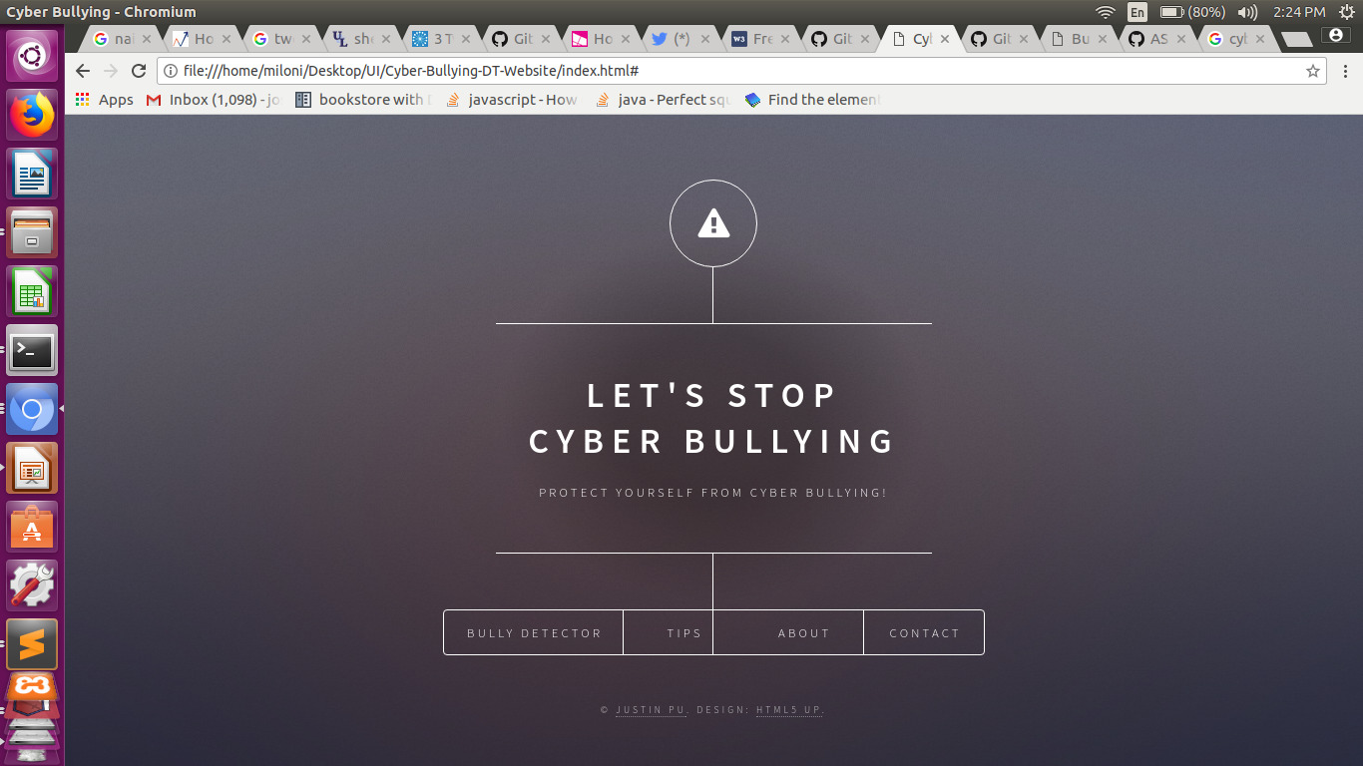
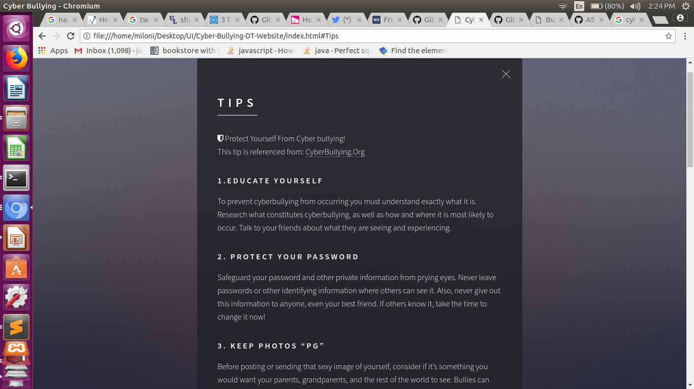
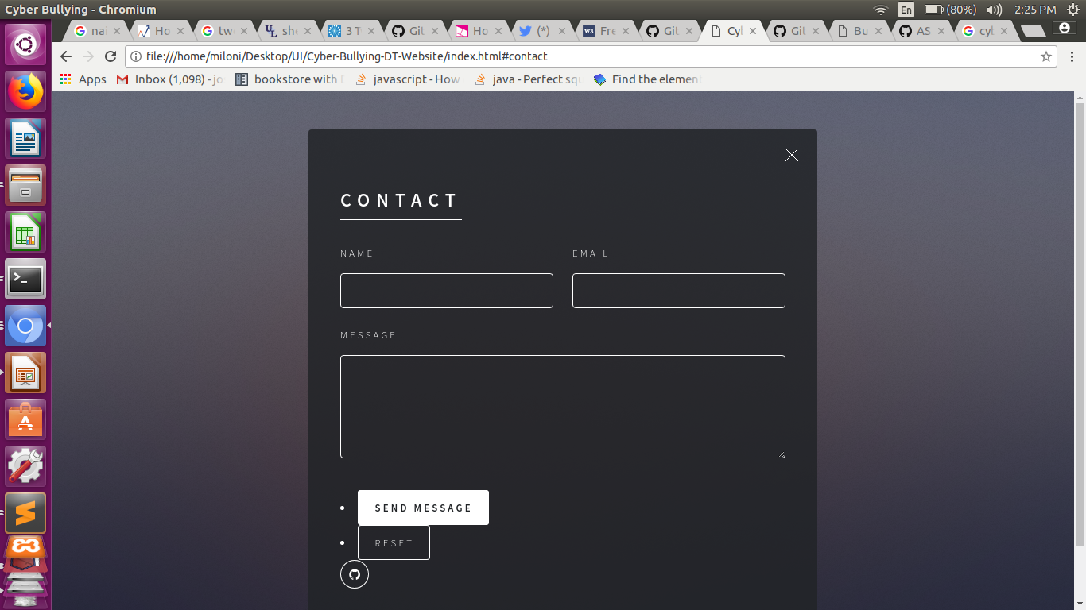
WEB USER INTERFACE

