Slide 1
GDP Prediction Using Socioeconomic Indicators
Leveraging Machine Learning to Forecast Economic Strength Across Nations
Joshin Mathews joseph
Final Project – Masai Construct Week ,Cds05_092

Slide 2
Project Introduction
- Built during Masai Construct Week
- Objective: Predict GDP using key indicators
- Tools: Python, Scikit-learn, Streamlit
- Solo Project (7 Days)

Slide 3
Introduction
Understanding and Predicting GDP Growth Using Key Socioeconomic Indicators
Predict the economic output (GDP) of nations based on social, demographic, and environmental indicators from 2010–2019.
Approach: Regression-based machine learning

Slide 4
Data Overview Dataset Details:
Dataset: - Source: Kaggle (World Bank Simulated)
- 20 Countries | 10 Years (2010–2019
Dataset Dimensions: ~322 records × 21 features
Granularity: Country-level socioeconomic and environmental indicators
Target Variable:GDP (USD) — Gross Domestic Product in USD
Selected Features for Prediction:
Demographic: Population, Life Expectancy
Economic: Unemployment Rate (%)
Environmental: CO2 Emissions (metric tons per capita)
Infrastructure: Access to Electricity (%)

Slide 5
Data Preprocessing Steps Taken:
Icon | Step Name | Description (Short & Clear)
🧼 | Missing Value Treatment | Filled numerical with mean, categorical with mode
📈 | Outlier Handling | Removed or capped extreme values
⚖️ | Feature Scaling | Used Min-Max Scaling for continuous features
🛠️ | Feature Engineering | Created or dropped columns if needed
📊 | Correlation Analysis | Identified highly correlated features
🧹 | General Data Cleaning | Removed duplicates, fixed data types
🧪 | Train-Test Split | 80/20 split for model training and testing

Slide 6
Key Performance Indicators
GDP per Capita
GDP Growth Rate
Inverse Unemployment Rate
Access to Electricity
CO₂ Emissions

Slide 7
Feature Engineering Enhancing Predictive Power Through Derived Features
GDP per Capita -> GDP per Capita = GDP / Population
Normalizes GDP based on population size, helping compare economies more meaningfully.
GDP Growth Rate (%) -> Growth Rate = % Change in GDP (Year over Year)
Captures a country’s economic momentum or slowdown across years.
Inverse Unemployment Rate -> 1 / (Unemployment Rate + ε)
Helps better differentiate between low and very low unemployment rates — avoids zero-division errors with a small epsilon.

Slide 8
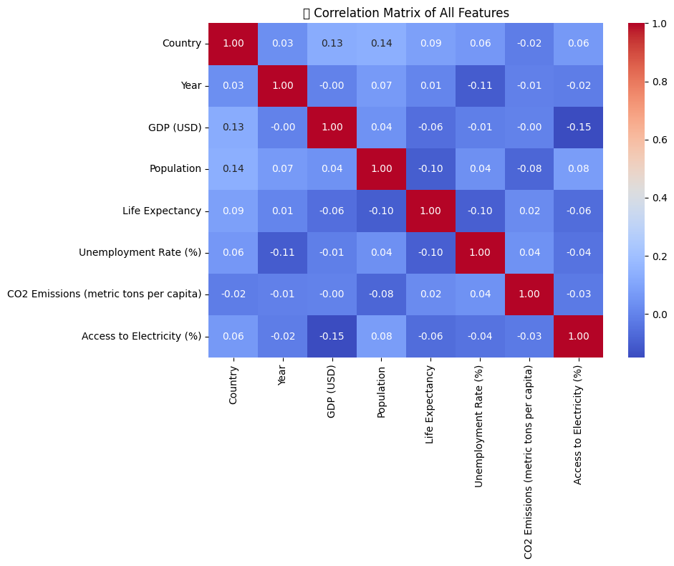
Exploratory Data Analysis (EDA) Insights from Data Analysis:
Correlation Heatmap
Shows correlation between GDP and features like Population, Life Expectancy, etc. Useful for feature selection

Slide 9
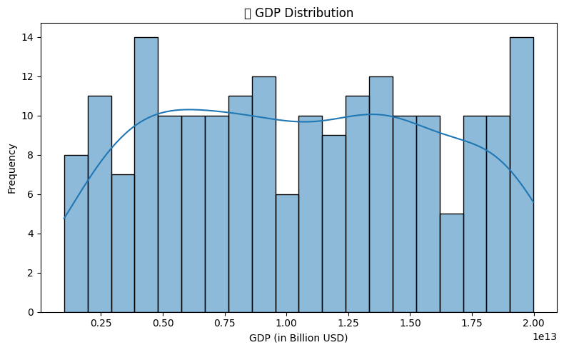
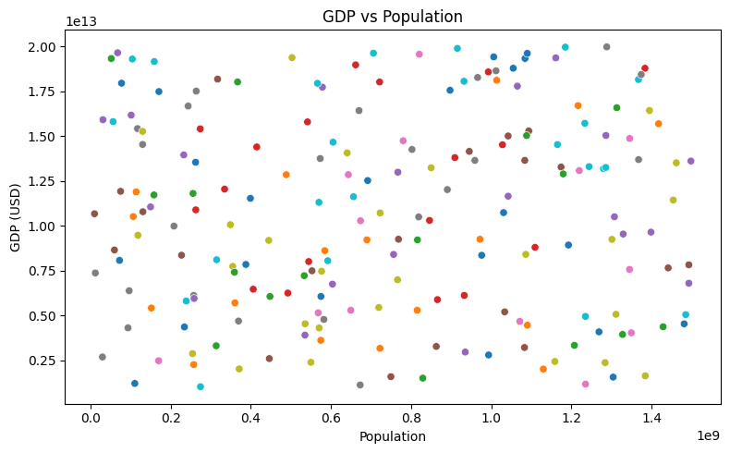
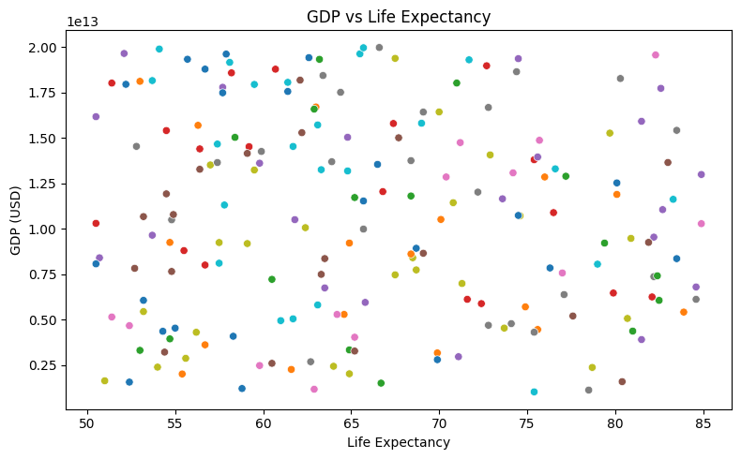
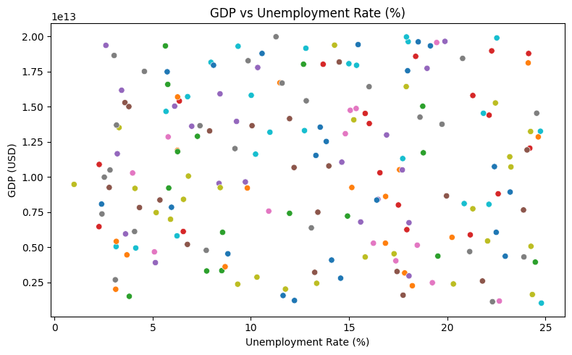
2. GDP Distribution

Slide 10
Model Selection Chosen Model:
Model Used: - Linear Regression
- Random Forest
- XGBoost
- Gradient Boosting
Final Choice: Gradient Boosting
Performance (R²: 0.91)

Slide 11
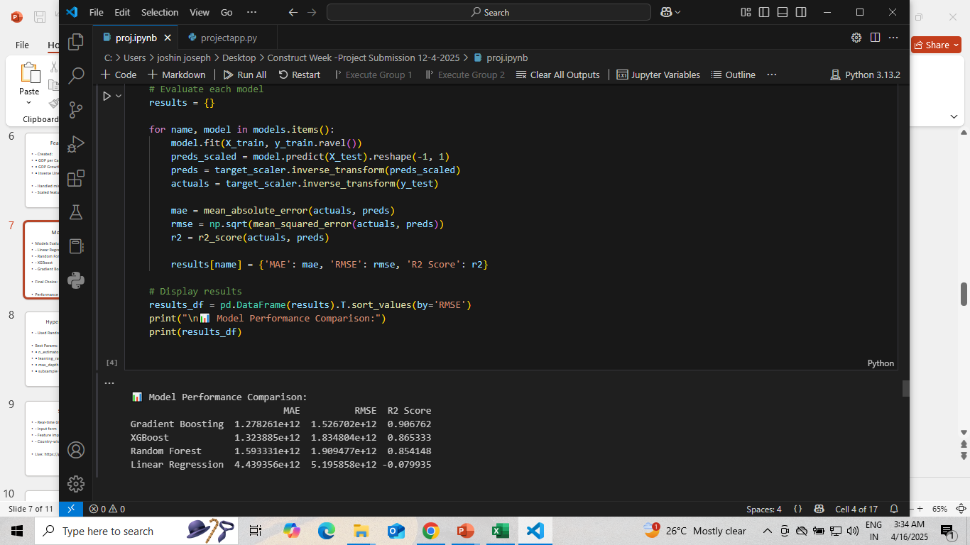
Model Training & Evaluation
Train-Test Split: 80% training, 20% testing
Scaling and preprocessing was consistently applied across all models.
Linear Regression underperformed due to the non-linearity in features.
Tree-based models (Random Forest, XGBoost, Gradient Boosting) handled feature interactions better.
Gradient Boosting showed consistent results across different runs.

Slide 12
Optimizing the Gradient Boosting Model
Purpose:
Improve model performance
Prevent overfitting
Method:
RandomizedSearchCV
5-Fold Cross-Validation
Tuned Parameters:
n_estimators: 200 max_depth: 7 subsample: 0.8
learning_rate: 0.05 min_samples_split: 10 min_samples_leaf: 1

Slide 13
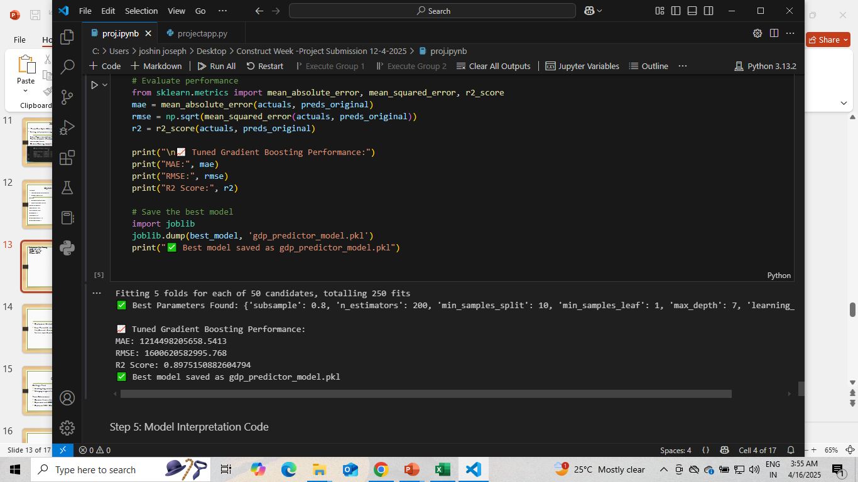
Performance After Tuning
MAE: 1.21 × 10¹²
RMSE: 1.60 × 10¹²
R² Score: 0.8975

Slide 14
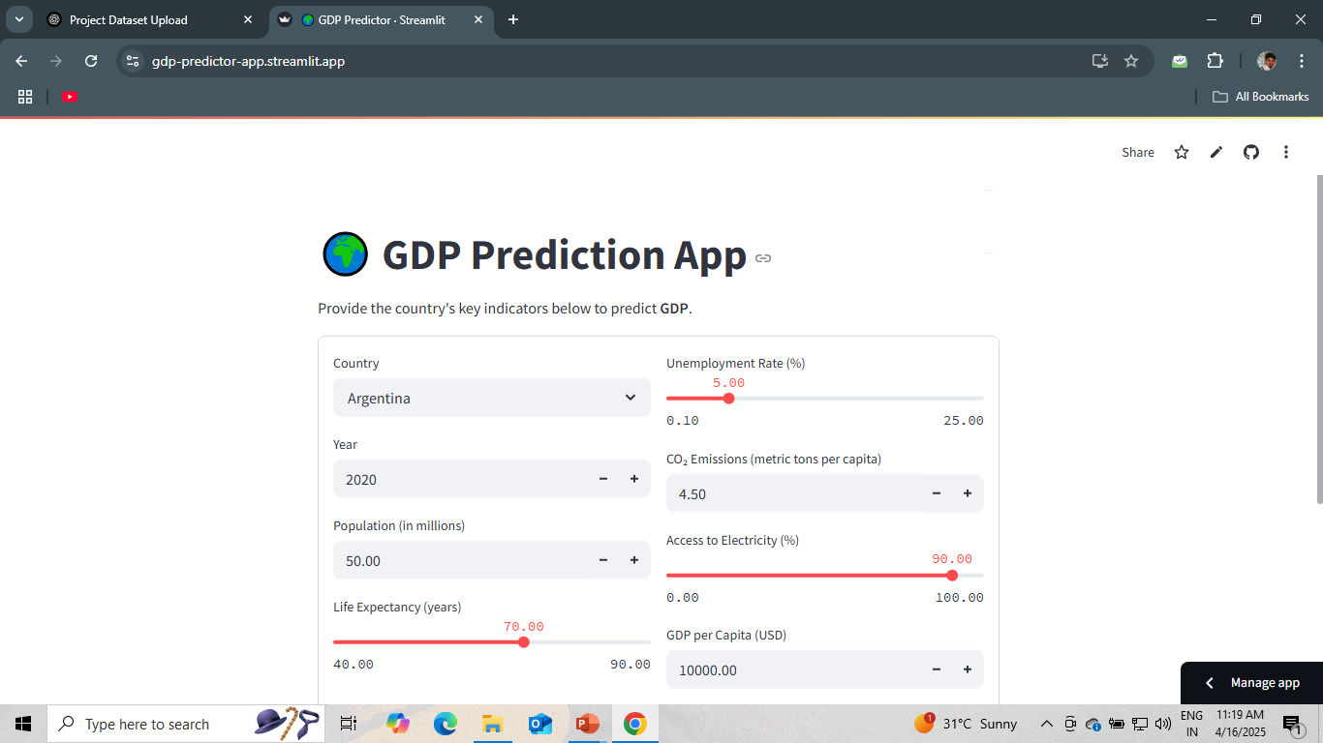
Streamlit Web App
Features
Sidebar for user inputs:
Year, Population, Life Expectancy, CO₂ Emissions, Unemployment Rate, etc.
Real-time GDP Prediction with one click
Includes derived features like:
GDP per Capita
GDP Growth Rate
Inverse Unemployment Rate
Deployment
Deployed on Streamlit Cloud
Source code hosted on GitHub
Live: https://gdp-predictor-app.streamlit.app

Slide 15
Optimizing the Gradient Boosting Model
Purpose:To deploy the trained model and allow users to predict GDP based on socioeconomic inputs interactively.
Features:
Sidebar for user inputs:Year, Population, Life Expectancy, CO₂ Emissions, Unemployment Rate, etc.
Real-time GDP Prediction with one clickIncludes derived features like:
GDP perCapita,GDP Growth Rate,Inverse Unemployment Rate
Deployment:
Deployed on Streamlit Cloud
Source code hosted on GitHub🔗
Live Demo Link👉 https://gdp-predictor-app.streamlit.app

Slide 16
Insights & Observations Key Insights from the Model
GDP per Capita, Life Expectancy, and Access to Electricity were most impactful
Countries with higher life expectancy tend to have higher GDPInverse
Unemployment had a strong positive correlation with GDP
CO₂ Emissions reflect industrial strength — moderately associated with GDP

Slide 17
Challenges Faced & Solutions
Challenge | Solution
Dataset had missing values | Handled with mean/mode imputation
Negative predictions in deployment | Fixed by scaling & inverse transform
Model inconsistencies | Solved using RandomizedSearchCV
Deployment errors (file paths) | Used relative paths for Streamlit

Slide 18
Conclusion
End-to-End ML Project
Successfully built a complete pipeline: Data Preprocessing → EDA → Feature Engineering → Modeling → Deployment
Best Performing Model
Gradient Boosting Regressor
Achieved R² Score: 0.8975
Outperformed all other regression models in accuracy
Real-World Application
Predicts GDP based on real-world indicators
Can assist in economic analysis and policy-making scenarios
Deployment
Success Built and deployed a Streamlit web app
Made the solution interactive and accessible

Slide 19
Thank You!

