Slide 1

Secure Distributed Backend System for Web Vulnerability Detection
SAI KIRAN ABBURI | 2520030125
JOSHI RUSHITHA KASTURI | 2520030204
ALAHARI VENKATA SAI THAPASWI | 2520030223
Under the Guidance
of
Dr.Y Subbarayudu
Assitant Professor
Department of Computer Science and Engineering
KONERU LAKSHMAIAH EDUCATION FOUNDATION

Slide 2
GROUP NUMBER:1
Name of Candidate | Role
SAI KIRAN ABBURI | Safety & Location Features: GPS/location tracking, map integration, SOS workflow, emergency notifications, safety zones, check-in/timer functionality, testing
JOSHI RUSHITHA KASTURI | Frontend & UI:Login/registration screens, dashboard, SOS interface, emergency contacts UI, safety tools UI, responsive design, navigation
ALAHARI VENKATA SAI THAPASWI | REST APIs, user authentication, emergency contacts APIs, SOS data, safety zones, check-ins, database tables, API–database connection

Slide 3
ABSTRACT
WomenSafety is a personal safety system designed to help users during emergency situations.
The system provides Normal SOS and Secret SOS, live GPS location sharing, emergency contacts, safety timers, safe zones, check-ins, and a fake call feature.
The application brings important safety functions into one platform so that emergency actions can be triggered quickly and information can be shared with trusted contacts. The main goal is to provide a simple, accessible, and reliable safety solution.

Slide 4
INTRDOUCTION
Women frequently need quick access to emergency support while travelling or moving through unfamiliar places.
Using separate applications for calls, location sharing, and emergency contacts can take additional time.
WomenSafety combines these functions in a single safety platform.
The system uses GPS to support location-based emergency assistance and provides quick-access safety tools.
The main aim is to make emergency response simpler, faster, and more organized

Slide 5
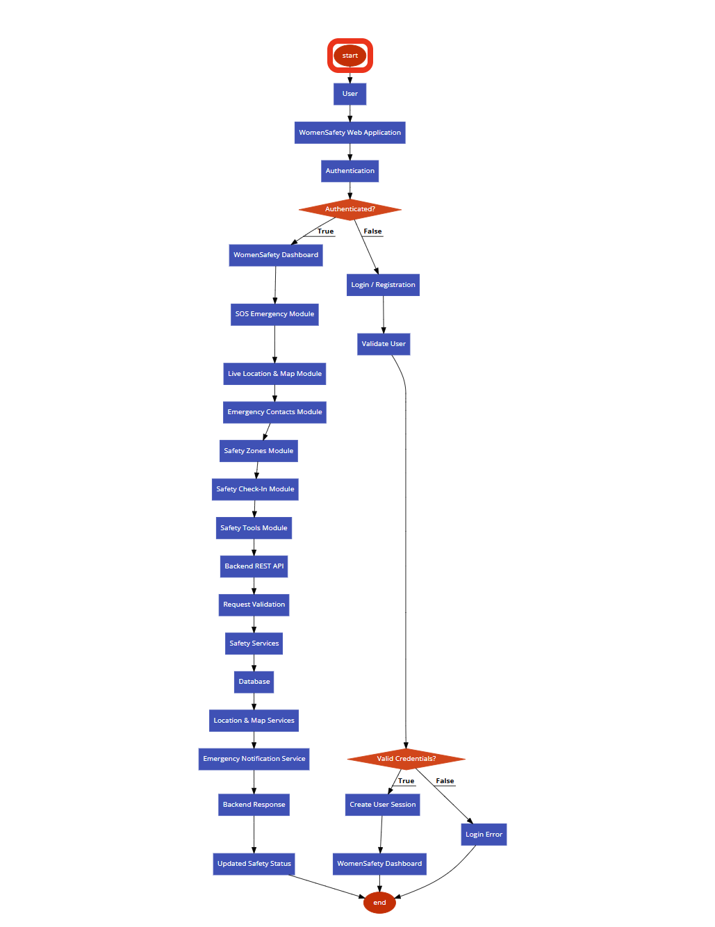
SYSTEM ARCHITECTURE

Slide 6
Problem Statement:
Develop a simple and integrated safety system that can help users respond quickly during emergency situations.
Major Problems:
Emergency actions may require multiple apps or steps.
Live location sharing is not always integrated with emergency alerts.
Managing emergency contacts manually can delay communication.
Users may not have safety timers, safe zones, or check-ins in one place.
Emergency tools should be easy to access when the user is under stress.

Slide 7
SOLUTION(Contribution)
Proposed Solution:
Proposed Solution:
Develop WomenSafety as a single personal safety platform.
Allow users to register and maintain trusted emergency contacts.
Provide Normal SOS and Secret SOS for emergency situations.
Use GPS/Google Maps for location-based support.
Provide safety timer, check-ins, safe zones, and fake call features.
Store and manage user and emergency information securely.
Contribution:
One-platform safety solution
Quick emergency response
Location-aware assistance
Trusted-contact alerts
Multiple preventive and emergency safety tools.

Slide 8
Objectives
To develop an integrated personal safety application.
• To provide quick Normal SOS and Secret SOS functionality.
• To share the user's live GPS location during emergencies.
• To manage priority-based emergency contacts and alerts.
• To provide safety timers, safe zones, and safety check-ins.
• To include a fake call feature for personal safety situations.
• To make emergency features simple and easy to access.

Slide 9
Modules
1. User Authentication Module
User registration and login with secure access.
2. Emergency SOS Module
Normal SOS and Secret SOS for quick emergency response.
3. Location & Map Module
GPS-based location and map support.
4. Emergency Contacts Module
Priority-based trusted contacts and emergency alerts.
5. Safety Monitoring Module
Safety Timer, Safe Zones, and “I’m Safe” check-ins.
6. Safety Tools Module
Fake Call and other quick-access safety features.

Slide 10
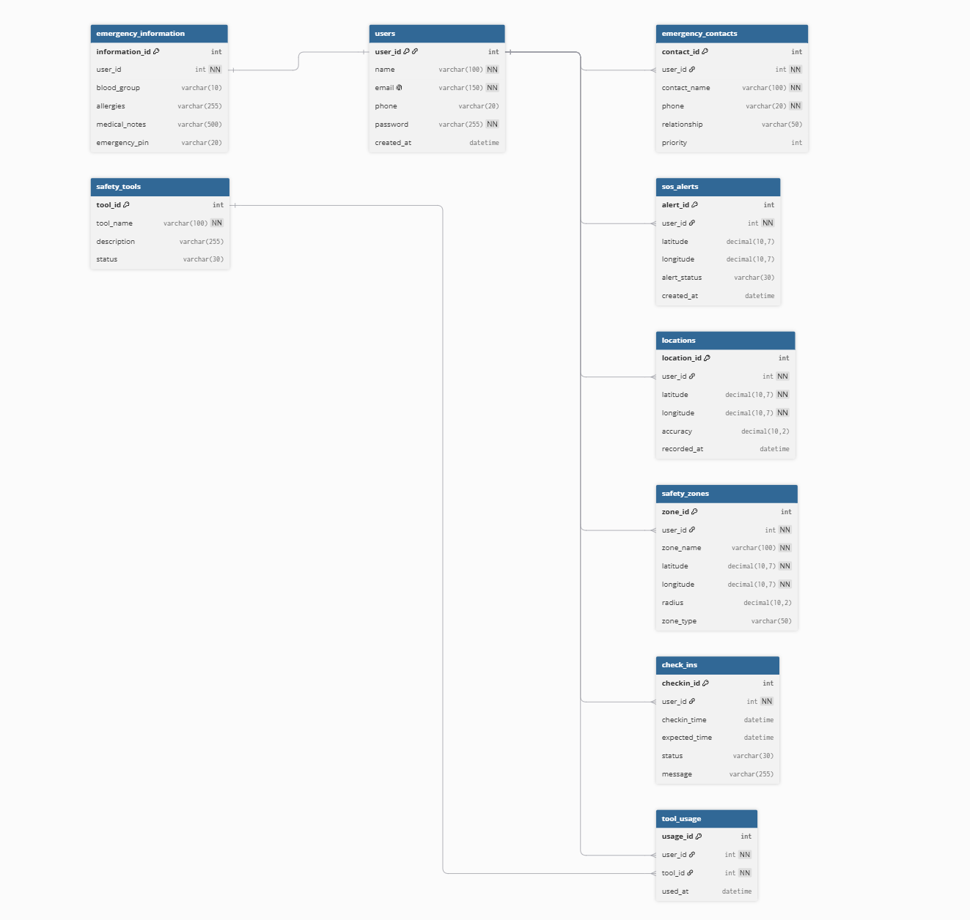
IR DIAGRAM

Slide 11
SOFTWARE REQUIREMENTS
Programming Language
JavaScript
Mobile Framework
React Native + Expo
Backend
Node.js + Express.js
Database
MySQL
Location Services
GPS + Google Maps
Authentication & Security
JWT Authentication
Development Tools
VS Code
Git & GitHub

Slide 12
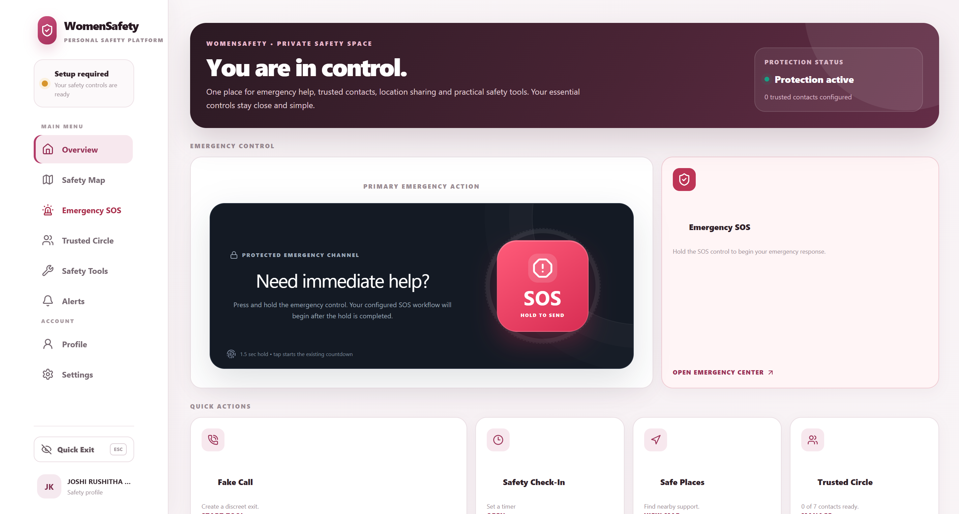
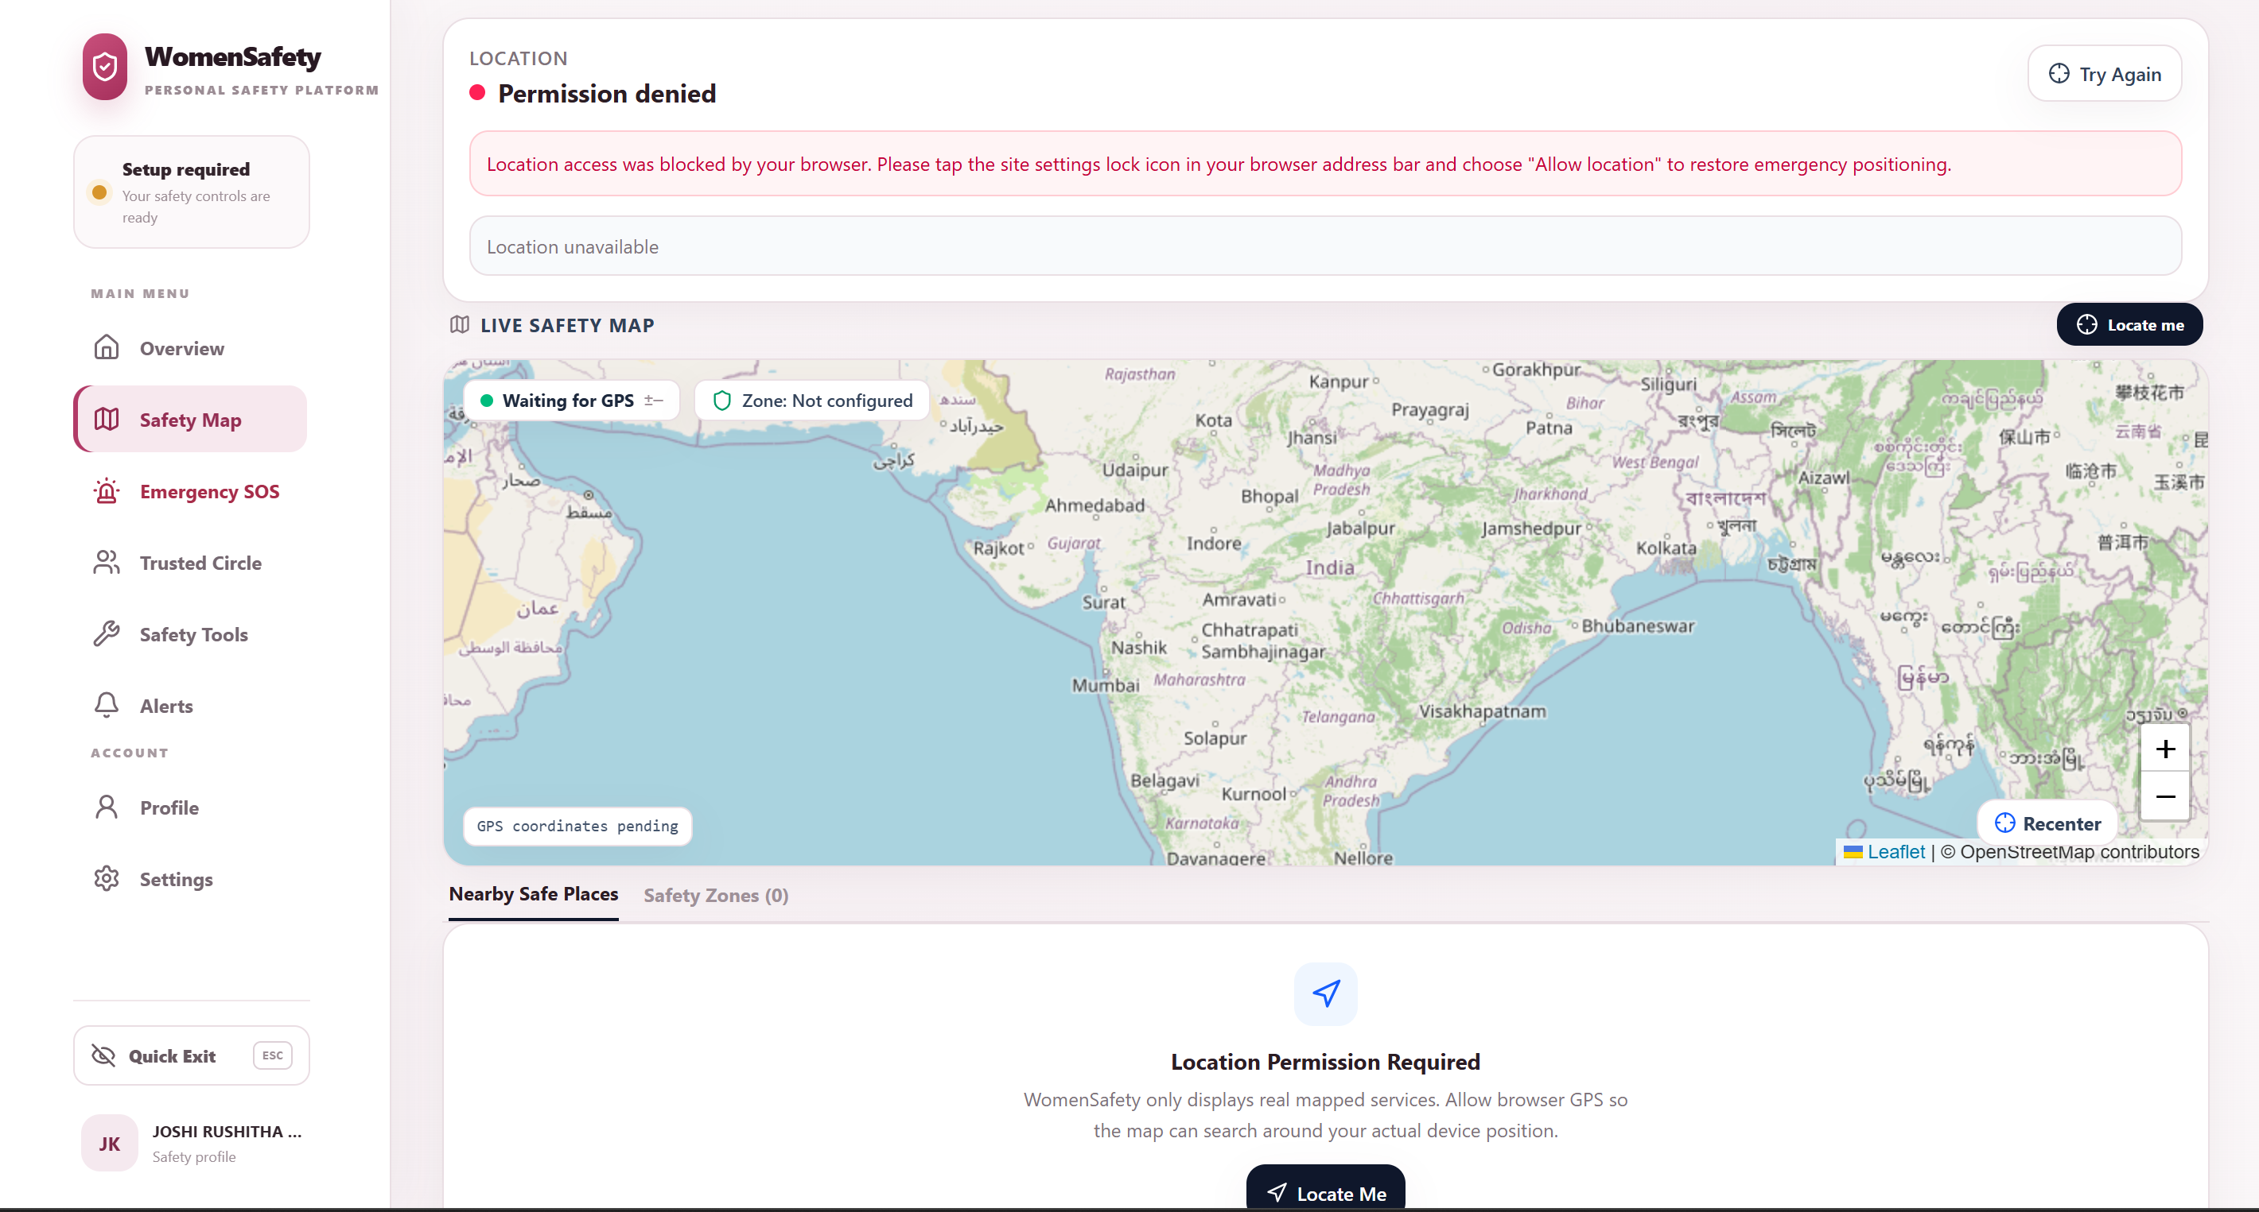
Screenshots of the app

Slide 13
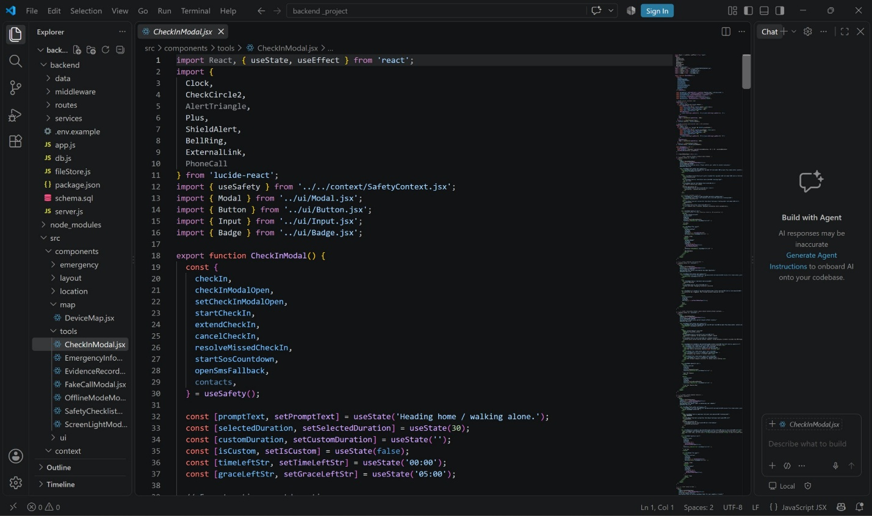
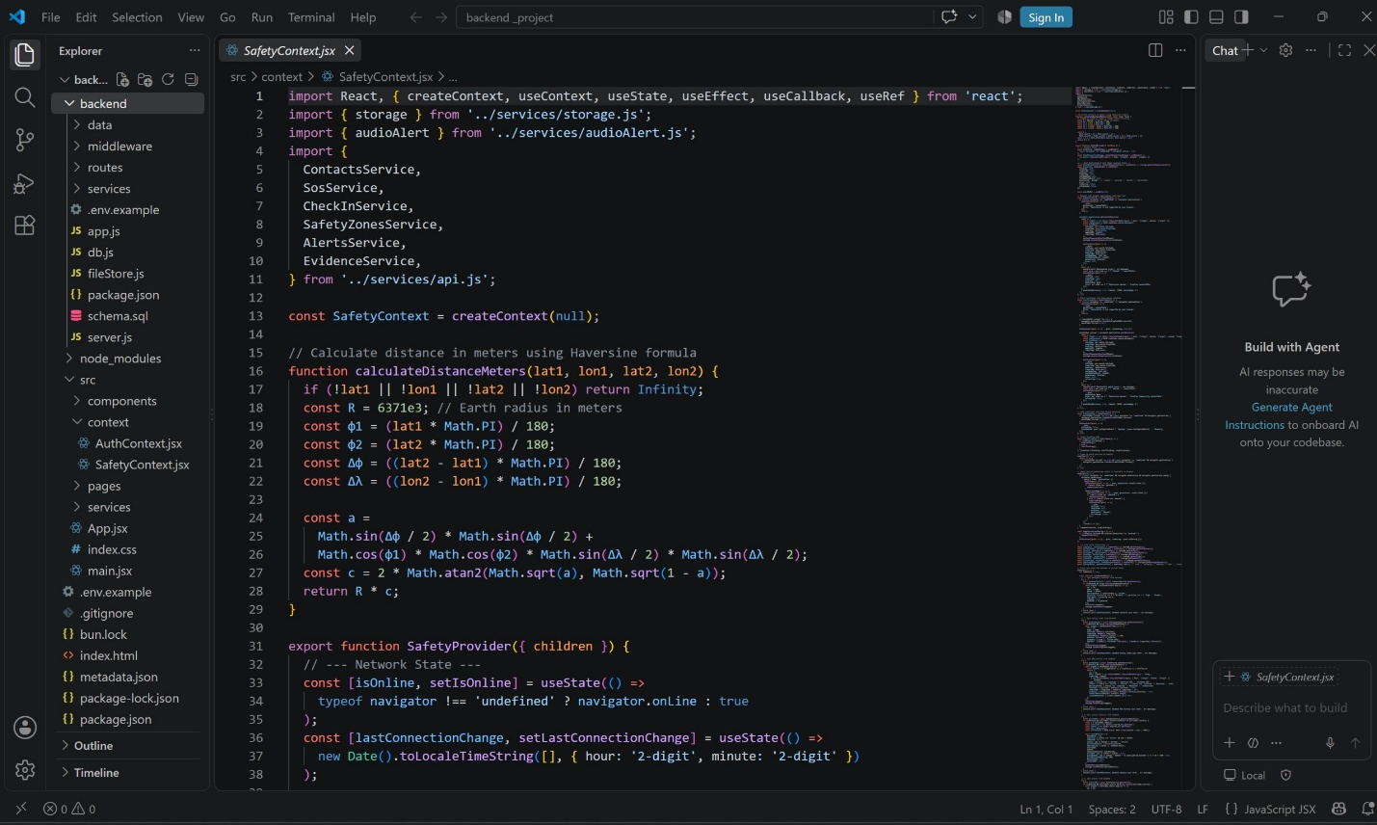
Sample code snippets

Slide 14
CONCLUSION AND FUTURE SCOPE
Conclusion:
WomenSafety combines important personal safety features into one application.
The system provides quick SOS actions, GPS-based location support, emergency contacts, and safety monitoring tools.
It is designed to reduce the time and effort required to access emergency assistance.
Future Scope:
• Add voice-activated emergency actions.
• Add real-time location tracking for trusted contacts.
• Add AI-based danger detection and risk alerts.
• Improve emergency notification and evidence support.
• Deploy the system as a scalable cloud-based service.

Slide 15
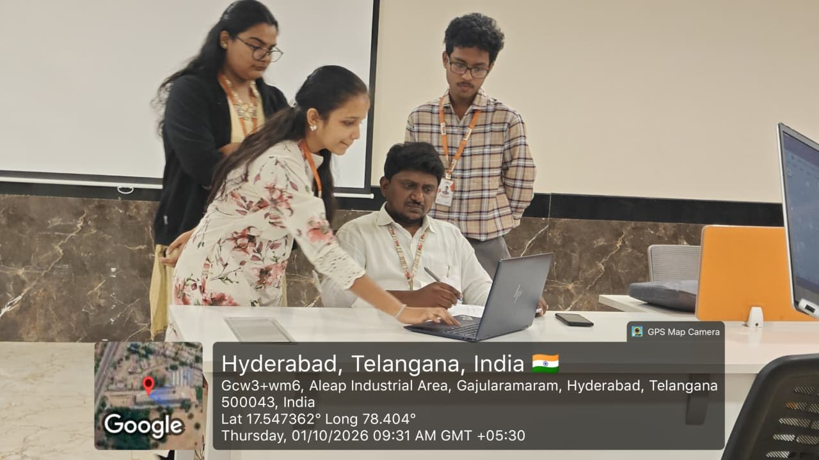
Geo Tag photos with guide

Slide 16
THANK YOU

