Slide 1
Data Structures and Algorithms -3 (25CS2103E)
PrimeGuard: Web-Based Large Prime Number Validation Using the Miller–Rabin Algorithm
Team Members
2520030204 – Joshi Rusitha
2520030415 – V Ashish Reddy
2520030419 – Shettini Teja
Under the Esteemed Guidance of
Mrs. J. Yamini Devi, Assistant Professor

Slide 2
Contents
Abstract
Introduction
Literature survey
Problem Statement and Objectives
Hardware and Software requirements
Results
Conclusion
Future Scope

Slide 3
Abstract
PrimeGuard is a web-based service that validates very large prime numbers using the Miller–Rabin probabilistic primality test.
Unlike trial division or deterministic methods, it efficiently handles integers with hundreds of digits that traditional approaches cannot process in reasonable time.
Users submit a number through a simple web interface and instantly receive a Prime / Composite verdict.
Each result is returned with its execution time and confidence level, showcasing how randomized algorithms trade a controllable error margin for massive speed gains.
The project demonstrates the practical application of probabilistic algorithm design in a real-time, accessible system.

Slide 4
Introduction
Prime numbers underpin modern cryptography, including RSA key generation, Diffie–Hellman exchange, and hashing schemes.
As key sizes grow to hundreds or thousands of bits, testing primality by trial division or exhaustive search becomes computationally infeasible.
Probabilistic tests such as Miller–Rabin verify primality with an error probability that shrinks exponentially with the number of test rounds.
PrimeGuard wraps this algorithm in a lightweight web application, letting anyone test arbitrarily large integers without installing specialized software.
The system highlights the trade-off between speed and certainty that defines randomized algorithm design.

Slide 5
Literature Survey
Trial Division: checks divisibility up to √n; simple but exponential in time for large numbers, making it impractical beyond small integers.
Fermat Primality Test: fast but unreliable, since Carmichael numbers can pass the test while being composite.
AKS Primality Test: the first deterministic, polynomial-time algorithm, but its constants make it too slow for practical large-scale use.
Miller–Rabin Test: a widely used probabilistic method whose error probability falls to at most 4⁻ᵏ after k independent rounds, giving strong practical guarantees.
Existing libraries such as OpenSSL and GMP implement Miller–Rabin internally but rarely expose an accessible, user-facing web interface for direct experimentation.

Slide 6
Problem Statement and Objectives
Problem Statement:
Develop a web-based service to validate very large prime numbers using randomized algorithms such as the Miller–Rabin Primality Test. The application should efficiently determine whether a given integer is prime or composite with high probability, supporting numbers too large for traditional methods, while displaying execution time and confidence level.
Objectives:
Implement the Miller–Rabin algorithm to test primality for arbitrarily large integers using big-integer arithmetic.
Build a simple, responsive web interface for entering numbers and viewing results.
Report execution time and statistical confidence level for every test performed.
Allow the number of test rounds (k) to be configured to balance speed against accuracy.
Demonstrate the design and analysis of a probabilistic (randomized) algorithm in a practical system.

Slide 7
Flow Chart
Start: User enters an integer N via the web interface or upload a dataset
Validate input & handle edge cases (N < 2, N = 2 or 3, even N)
Run Miller–Rabin test for k independent random rounds (witness selection)
Any round returns 'composite'? Yes → Composite | No → Continue
Compute confidence level: probability of error ≤ 4⁻ᵏ
Display result: Prime / Composite, execution time & confidence level

Slide 8
Results
PrimeGuard correctly classified numbers ranging from small integers to 300+ digit values as prime or composite.
Execution time remained in the millisecond range even for very large inputs, confirming the efficiency of the Miller–Rabin approach over trial division.
The observed error rate stayed within the theoretical bound of at most 4⁻ᵏ for k rounds, validating the algorithm's probabilistic guarantee.
The web interface clearly displayed the Prime/Composite verdict alongside execution time and confidence level for each query.
Increasing the number of rounds (k) showed a direct, measurable improvement in confidence with only a modest increase in runtime.

Slide 9
Hardware and Software requirements
Hardware Requirements:
Standard PC or laptop with a dual-core processor or better
Minimum 4 GB RAM
Stable internet connection for accessing the web service
Software Requirements:
Operating System: Windows / Linux / macOS
Runtime: Node.js for server-side big-integer computation
Web Browser: Chrome, Firefox, or Edge
Development Tools: VS Code and a version control system such as Git
Big-integer arithmetic library (e.g., native BigInt)

Slide 10
Conclusion
PrimeGuard shows that randomized algorithms can efficiently validate very large primes where deterministic methods become impractical.
Delivering the Miller–Rabin test as a web-based service makes advanced number-theory tools accessible without requiring specialized local software.
The system successfully balances speed and accuracy by allowing the number of test rounds to be tuned.
Overall, the project demonstrates strong practical understanding of probabilistic algorithm design, big-integer computation, and web application development.

Slide 11
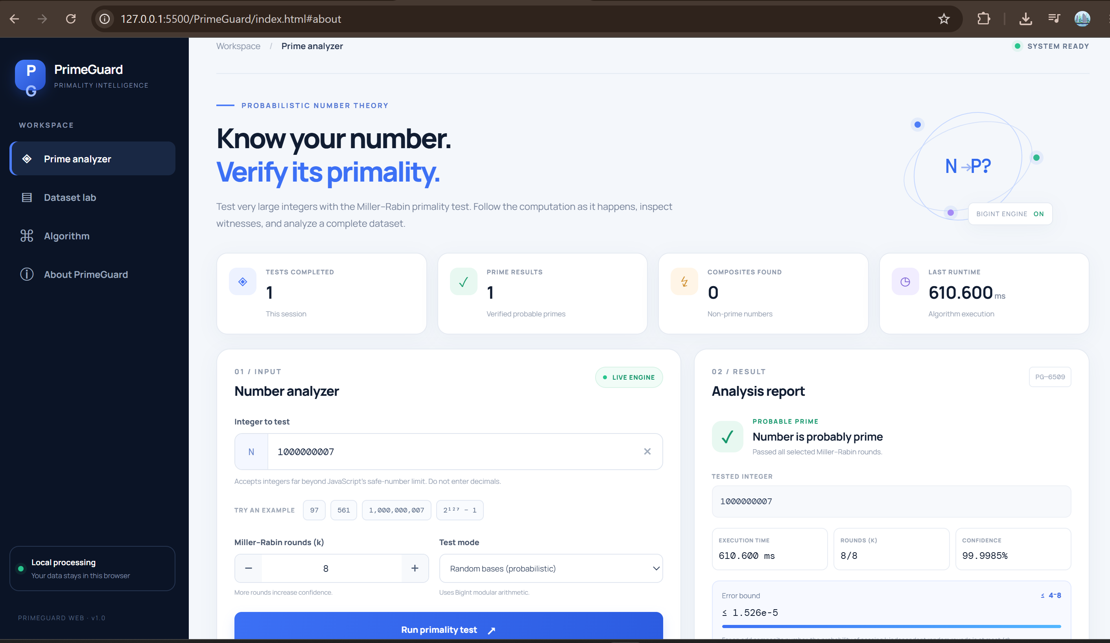

Slide 12


Slide 13
Future Scope
Add an optional deterministic verification stage (e.g., AKS) for cases requiring absolute certainty.
Extend the service to generate large primes for cryptographic key-pair creation.
Optimize performance for very large bit-lengths using parallel or GPU-accelerated arithmetic.
Expose PrimeGuard as a public REST API for integration into third-party applications.
Add support for batch validation of multiple numbers in a single request.

Slide 14
Thank you

