Slide 1
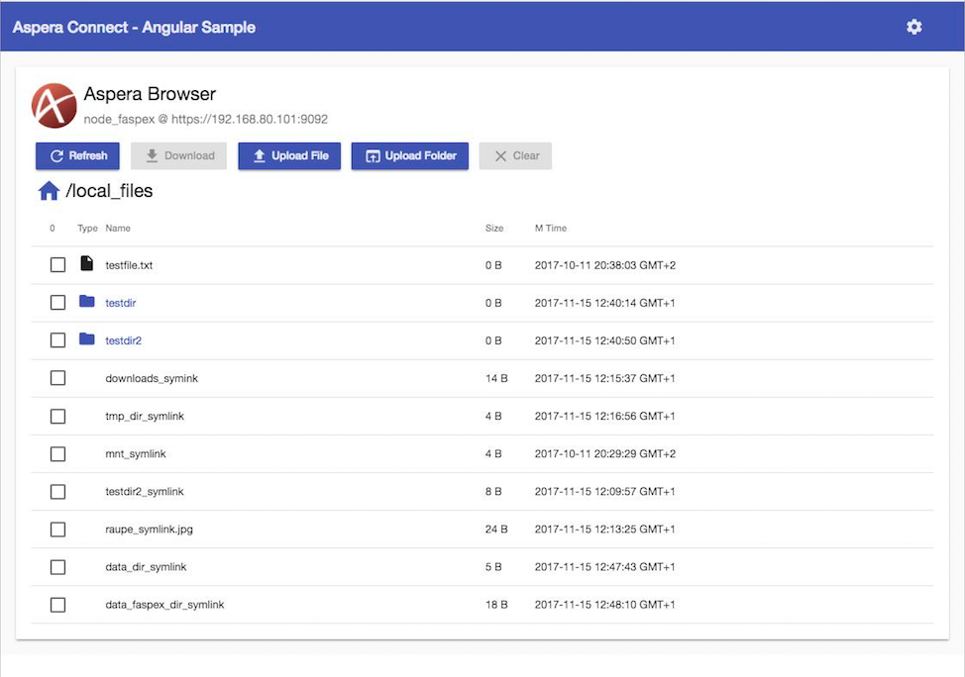

AsperaBrowser - components
Browser / Angular SPA
node.js server
Web-Client
( e.g. IBM Bluemix)
Static Angular App (SPA content)
Angular Web App
node.js api proxy
dynamic REST API forward
Angular HttpClient
nodeAPI.service.ts
Aspera node API REST
https://…:9092
info, browse, delete
get upload / download transfer spec + token
API redirect to avoid CORS Browser issue
Aspera connect API javascript
https://local.connectme.us
DNS resolves to 127.0.0.1
„direct“
clientconfig
apiConnectProxy
Aspera Transfer Server
NodeAPI
asperanoded
Aspera Connect
ascp
Connect ssh key (for tokenauth)
Aspera FASP tcp & udp
ascp
ssh key + token auth
( user/password if no token)

