Slide 1

THEN?

Slide 2

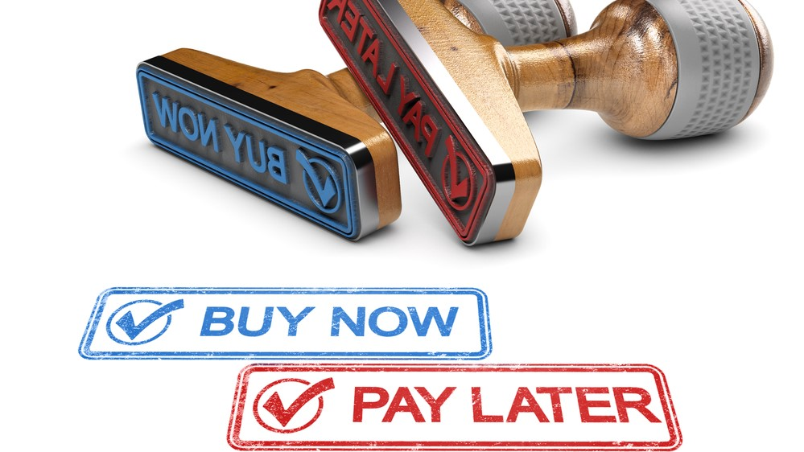
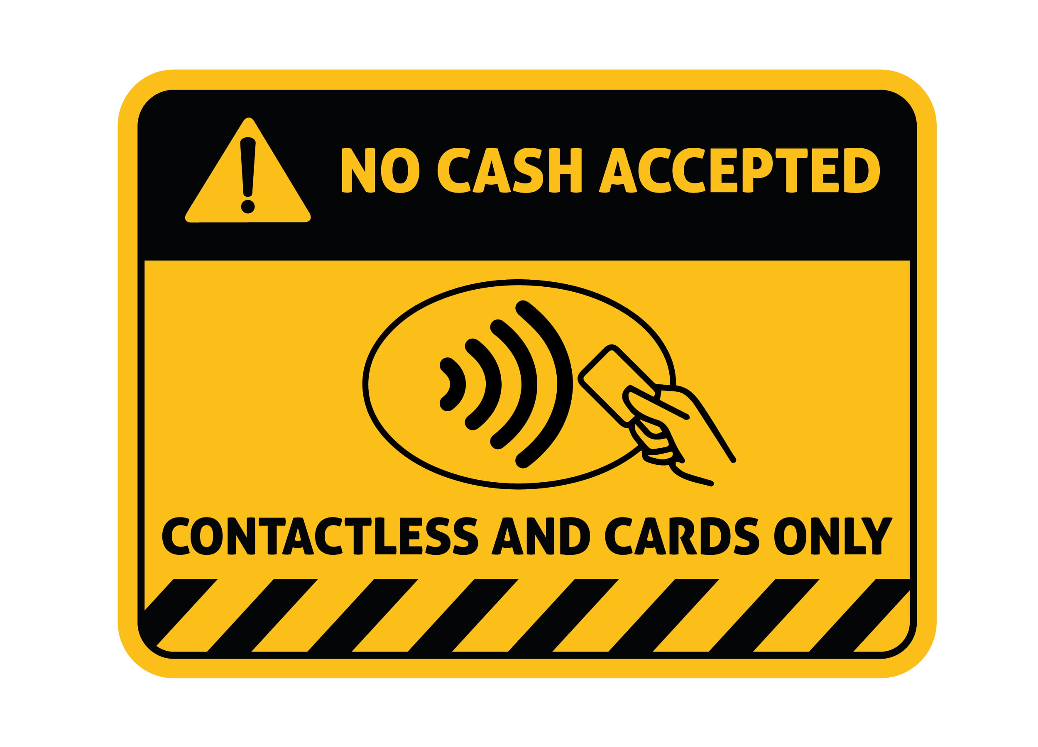

CREDIT CARD

Slide 3
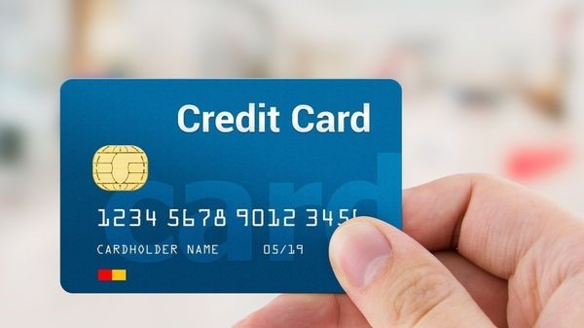
CREDIT CARD PAYMENT APPLICATION

Slide 4
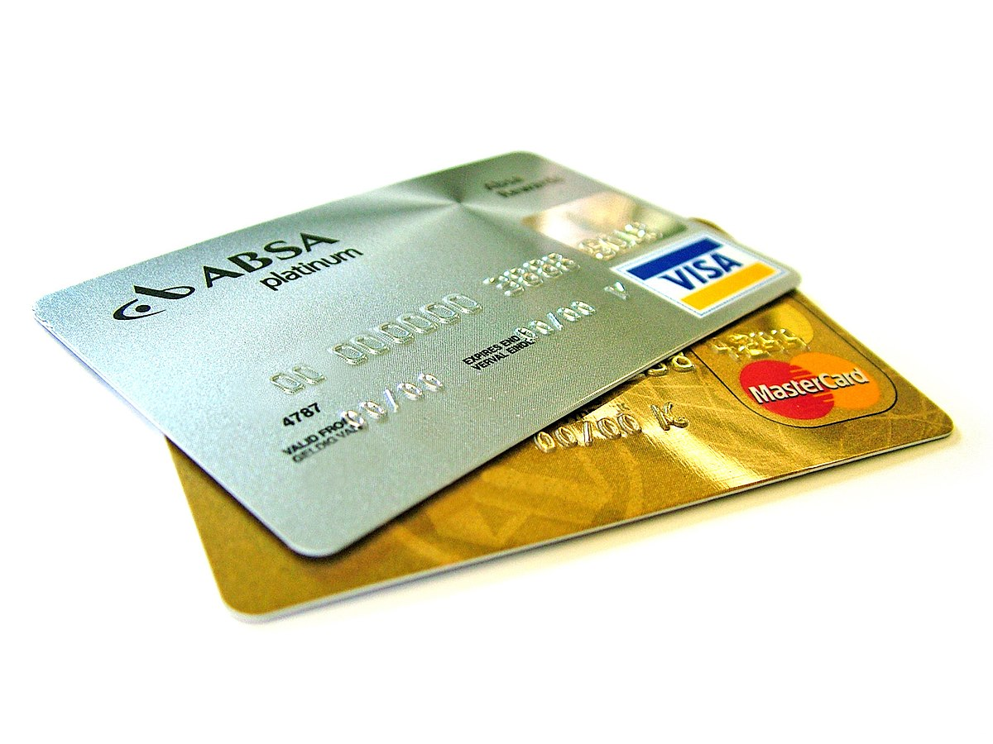
OBJECTIVE
Customer should be able to view credit card payment due date and amount.
Customer can able to pay the bill due amount or he can pay different amounts.
Customer can able to view statement history.
Customer can able to view payment history.

Slide 5
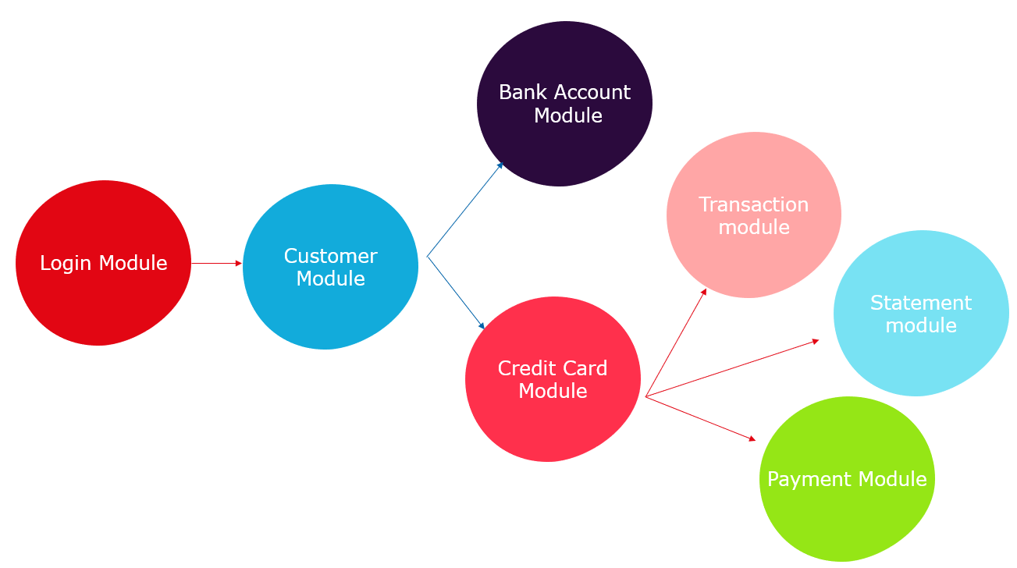
Flow
Overview

Slide 6
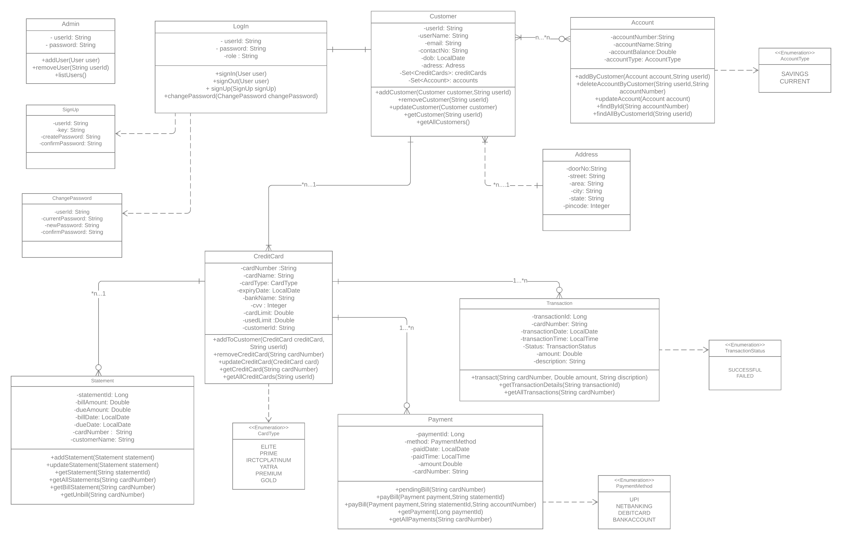
Class Diagram

Slide 8
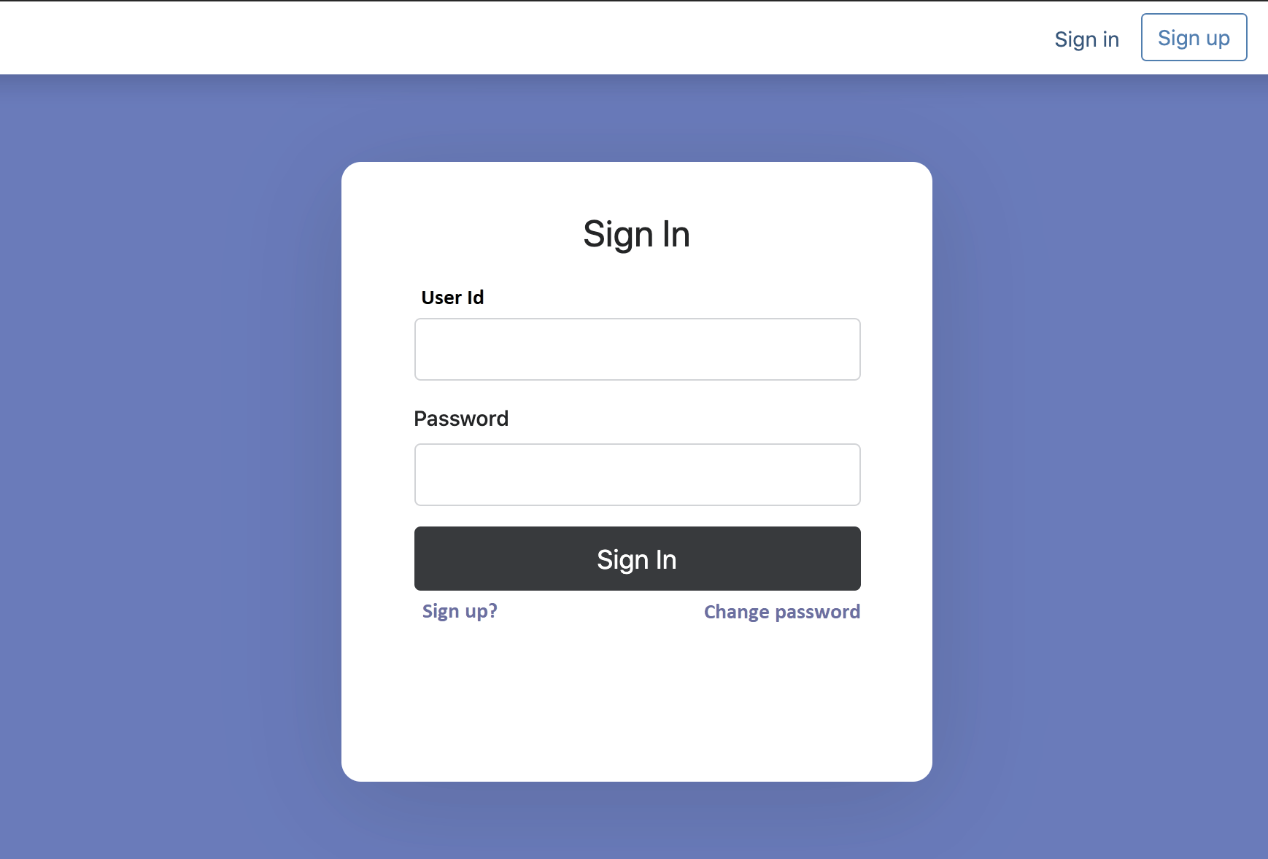
LOGIN MODULE
Sign In
Sign Out
Sign Up
Change Password

Slide 9

CUSTOMER MODULE
Add Customers.
View and Edit Customer Details.
Find customer by customer Id.

Slide 10

ACCOUNT MODULE
Add Bank Accounts
Update Bank Account Details
Delete Bank Account Details
List All Accounts

Slide 11

CREDIT CARD MODULE
Add Creditcards
Delete Credit cards
Find Credit Cards using customer Id
List all credit cards Which belongs to particular customer

Slide 12

TRANSACTION MODULE
Make a new transaction
Find transaction by its id
List of all Transaction

Slide 13

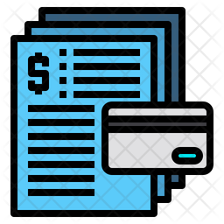
STATEMENT MODULE
Add new statements
Update statements
Get all Billed Statements
Get all Unbilled Statements
Statement history

Slide 14

PAYMENT MODULE
Add Payment
Find payment by its Id.
List all the payments.
Pay the Bill.
List Pending bills.
Payment History.

Slide 15


THANK YOU

