Slide 1
Review 2 Report On Finance +
Designed And Presented By:
Shalini Joshi (13EMBIT042)
Vaishali Jain (13EMBIT052)
Vandana Khatwani (13EMBIT054)
Saloni Pareek (13EMBIT040)
Simran Sharma (13EMBIT045)

Slide 2
Abstract:-
Financial accounting is a combination of Finance and accounting, finance generally refers to financial activities and financial relations, is refers to the enterprise in the production process of the movement of capital, it is the enterprise and all aspects of the relationship.
Accounting is based on the currency as the main units of measurement .Accounting processes are typically far from web technologies. With this project we aim to provide a web application to perform calculation of the profit margins obtained with each product. A better interface between accounting users and offices will be achieved using this application.

Slide 3
Finance+ identify customer’s personal assets and liabilities, determine which of these are included within a balance sheet, develop an accounting system to track changes to their assets and liabilities and recognize revenue and expenses, prepare financial statements, and develop significant accounting policies.

Slide 4
Contents:-
Introduction
1.Introduction To Problem
2.Study of Existing System
3.Scope of Project
Overall Description
1. Product functional Requirement
2. Product Non-functional Requirement
3. H/W interface requirement
4. S/W interface requirement

Slide 5
Planning of Project
1.Gantt chart for schedule estimation
2.Resource graph for Time-Effort estimation
Designing
1. Database Schema Designing
2. Use Case Diagram
3. Class Diagram
4. Activity Diagram
Development Model
1. Details of each phase of Development
Details of Modules
Conclusion
References

Slide 6
Introduction

Slide 7
Introduction to Problem:-
Tally is a trade name of accounting software maintaining accounts and for performing additional accounting and other analytical operations helpful in management of an organization.

Slide 8
Problem With Existing System:-
The existing system follows the manual process. It doesn’t have any technical support.
The existing system is offline and can’t be
Access from anywhere and at anytime
The existing system needs to be understand first and require proper guide to operate it for e.g. Tally.
The existing system Has Overhead of managing paper documents for every sell and purchase Cannot have alerts if credit limit exceeds for any customer No pop ups or message by the software

Slide 9
Proposed System:-
The Proposed system is online and can be access from anywhere and at any time.
The Proposed system is easy to operate.
The Proposed system is user friendly because it has a clean and concise layout so everyone can understand it properly.
The Proposed system has Reporting capabilities.
The Proposed system Has Time-saving features

Slide 10
Scope:-
An Financial Accounting System is the system used to manage the income, expenses, and other financial activities of a business .
An accounting system allows a business to keep track of all types of financial transactions, including purchases (expenses), sales (invoices and income), liabilities (funding, accounts payable), etc.

Slide 11
Overall Description

Slide 12
PRODUCT FUNCTIONAL REQUIREMENT:-
Customer:-Create and manage information of customer.
Supplier:-Create and manage information of supplier.
Product:-List of available products.
Purchase:-It will Manage the list of all purchase items.
Sales Invoice:-Entry of sales invoice to generate and print the bill.

Slide 13
PRODUCT NON-FUNCTIONAL REQUIREMENT:-
Credit / Debit
If there is a payment than there is a credit then it will save to sundry creditors.
Using the Journal voucher table the transition will be balanced.
If payment is not done then system shows the status as due status.
If payment is done after sometime then its status will change from due to paid and the remaining amount will be 0.
View all account groups related to profit and loss account with their respective amounts.
Check the opening and closing balance of each account through ledgers.

Slide 14
H/W interface requirement:-
Processor:-Intel(R) Core (TM) i3-5005U CPU@ 2.00Ghz
Installed Memory(RAM):-4.00GB
System Type:-64 bit Operating System,X64 – based processor
Pen and Touch:-no pen and touch input is available for this Display

Slide 15
SOFTWARE REQUIREMENT
TOOLS:- Oracle JDeveloper (12c)
FRAMEWORK:- Application Development Framework (ADF)
DATABASE:- MYSQL Workbench(6.0)

Slide 16
Planning of Project

Slide 17
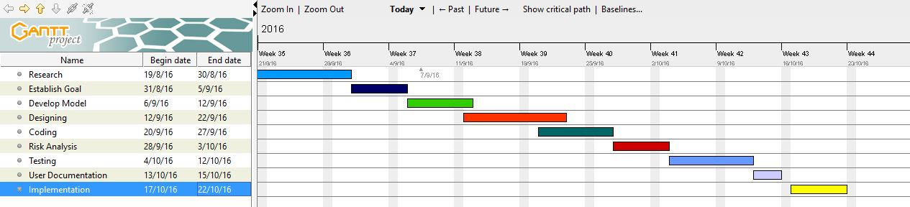
Gantt chart for schedule estimation:-

Slide 18
Gantt chart
A Gantt chart, commonly used in project management, is one of the most popular
and useful ways of showing activities (tasks or events) displayed against time.
On the left of the chart is a list of the activities and along the top is a suitable time scale.
Each activity is represented by a bar the position and length of the bar the start date, duration and end date of the activity. This allows you to see at a glance:
1] What the various activities are.
2] When each activity begins and ends.
3] How long each activity is scheduled to last.
4] Where activities overlap with other activities, and by how much.
5] The start and end date of the whole project.

Slide 19
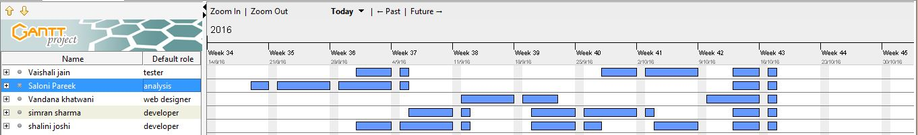
Resource graph for Time-Effort estimation:-

Slide 20
Designing

Slide 21
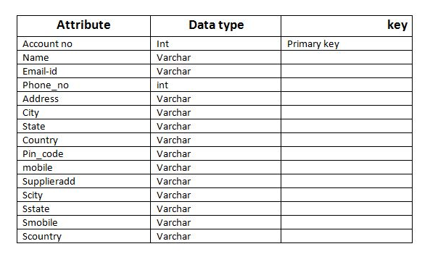
CUSTOMER SCHEMA:-

Slide 22
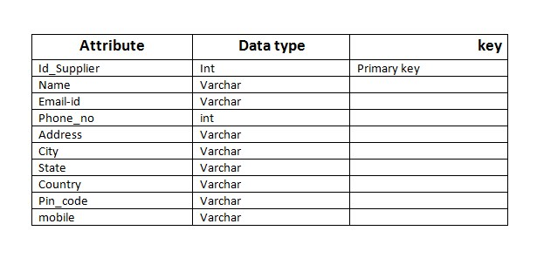
SUPPLIER SCHEMA:-

Slide 23
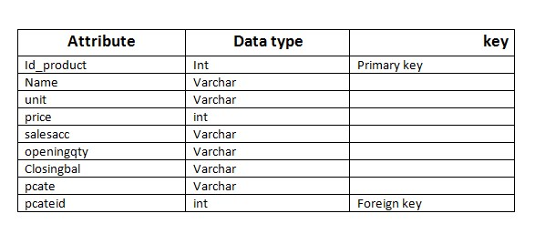
PRODUCT SCHEMA:-

Slide 24
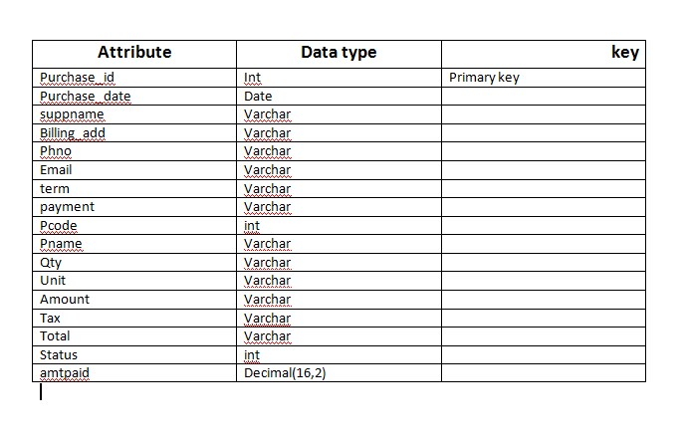
PURCHASE SCHEMA:-

Slide 25
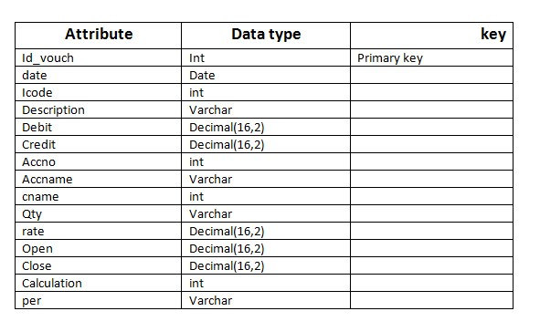
JOUNRAL VOUCHER:-

Slide 26
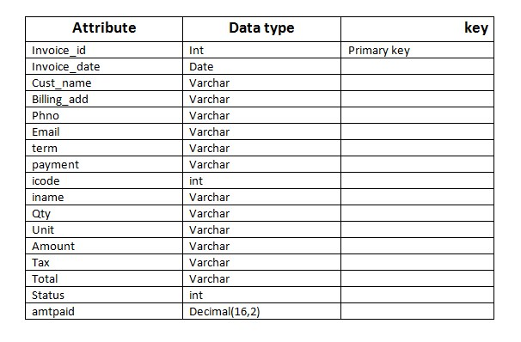
INVOICE SCHEMA:-

Slide 27
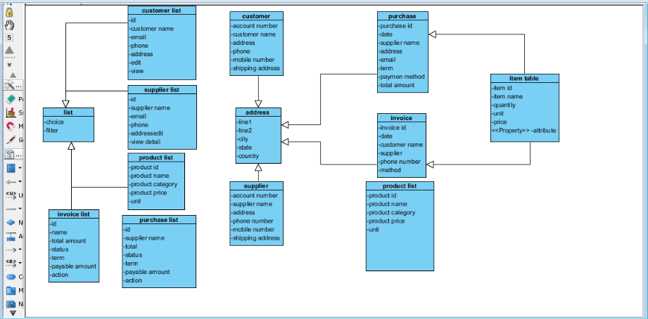
Class Diagram:-

Slide 28
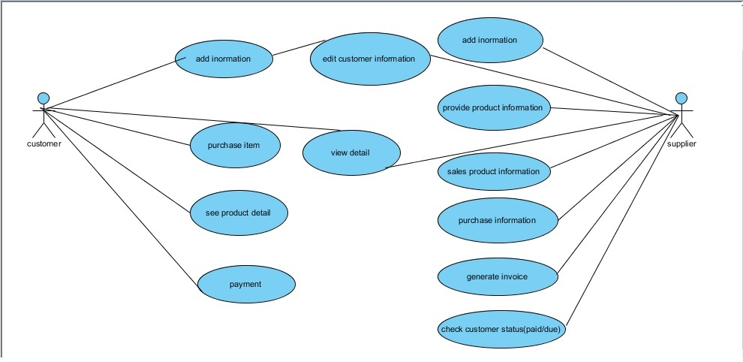
USE CASE DIAGRAM:-

Slide 29
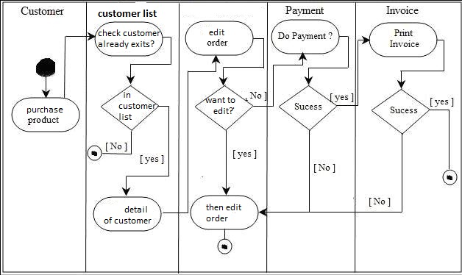
Activity Diagram:-

Slide 30
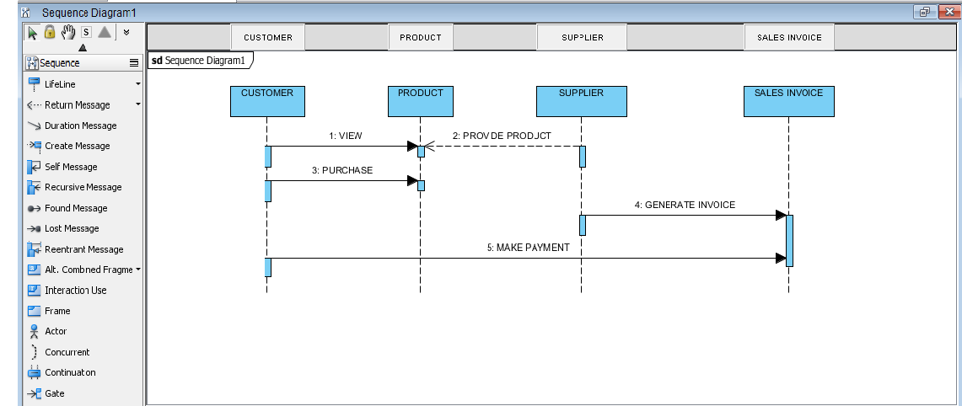
Sequence diagram:-

Slide 31
Development Model:-We have used Incremental development model
In incremental model the whole requirement is divided into various builds. Multiple development cycles take place here, making the life cycle a “multi-waterfall” cycle. Cycles are divided up into smaller, more easily managed modules.
Each module passes through the requirements, design, implementation and testing phases. A working version of software is produced during the first module, so you have working software early on during the software life cycle. Each subsequent release of the module adds function to the previous release. The process continues till the complete system is achieved.

Slide 32
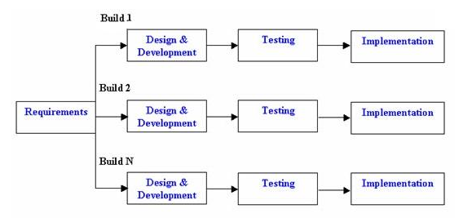
Incremental Model:-

Slide 33
Advantage:-
Generates working software quickly and early during the software life cycle.
This model is more flexible – less costly to change scope and requirements.
It is easier to test and debug during a smaller iteration.
In this model customer can respond to each built.
Lowers initial delivery cost.
Easier to manage risk because risky pieces are identified and handled during it’d iteration.

Slide 34
Disadvantages:-
Needs good planning and design.
Needs a clear and complete definition of the whole system before it can be broken down and built incrementally.
Total cost is higher than waterfall.

Slide 35
Details of each phase of Development :-
Stage 1:-Requirement analysis is the most important and fundamental stage in software development life cycle . It is performed by the senior members of the team. In the aspect of the project financial accounting we have following requirement as :-

Slide 36
[1]Customer List :-
It is very important requirement of the project . In this we require a list of all current customer. All customer information will be saved with their respective detail like name, address, phone number, email address. At last we require two actions as :-
1. For editing
2. For view detail

Slide 37
[2]Supplier List :- :-
It is very important requirement of the project . In this we require a list of all current supplier. All supplier information will be saved with their respective detail like name, address, phone number, email address. At last we require two actions as :-
1. For editing
2. For view detail

Slide 38
[3]Product Detail :-
It is very important requirement of the project .Product is playing key role in every business . In this we require a list of all current products. All product information will be saved with their respective detail like name, address, phone number, email address. At last we require actions as :- For editing.
This information is then used to plan the basic project approach and to conduct product feasibility study in the economical, operational, and technical areas.

Slide 39
Designing the product architecture
SRS is the reference for product architects to come out with the best architecture for the product to be developed. Based on the requirements specified in SRS, usually more than one design approach for the product architecture is proposed and documented.
In our project we have designed four modules as :-
[1] Customer List
[2] Supplier List
[3] Product List
[4] Product Category List

Slide 40
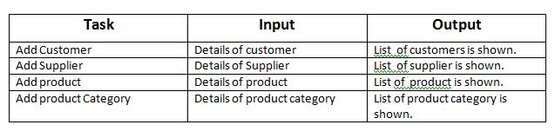
Testing

Slide 41
Details of Modules:-
1.Customer:-
Requirement Analysis:-To improve usability and efficiency the user must be able to import all existing customers from an existing business.
The customer is the party who is willing to purchase the project’s output, whether the output be a product or a service. Customer required to fill details for the billing and contact purpose.
Project had maintained a list of customers and provide functionality to filter, select, update and view the detail of particular customer detail transactions.

Slide 42
Design & Development:-
As per our requirement we have added a form for customer. In this form we will fill all the information of the customer, payment method then all this information will be saved to our database.
The customer must specify the following:
1. Customer’s legal name
2. Customer's billing address
3. Customer's shipping address
4. Customer’s phone numbers
5. Customer’s email addresses
At last this information will be reflect to our customer list page.

Slide 43
The system is able to produce a list of customers, orderable by:
1.Account number
2.Customer name
3.Customer email
4.Phone number
5.Address
System is able to filter customers from the database who match a given criteria, including:
1.Account no.
2.Customer name
3.Phone number
The system allowing new customers to be added.
The system allowing customer details to be edited.

Slide 44
Supplier:-
Requirement Analysis:-
To improve usability and efficiency the user must be able to import all existing supplier from an existing business.
The supplier is the party who is willing to supply the project’s input, whether the input be a product or a service. Supplier required to fill details for the contact purpose.
Project had maintained a list of suppliers and provide functionality to filter, select, update and view the detail of particular supplier detail transactions.

Slide 45
Design & Development:-
As per our requirement we have added a form for supplier. In this form we will fill all the information of the supplier, then all this information will be saved to our database.
The Supplier must specify the following:
1. supplier’s legal name
2. supplier’s billing address
3. supplier’s phone numbers
4.supplier’s email address
At last this information will be reflect to our supplier list page.
System is able to filter suppliers from the database who match a given criteria, including:
6. Account no.
7. Supplier name
8. Phone number

Slide 46
The system is able to produce a list of Suppliers, orderable by:
1. Account number
2. Supplier name
3. Supplier email
4. Phone number
5. Address
The system allowing new suppliers to be added.
The system allowing supplier details to be edited.

Slide 47
Product:-
Requirement analysis:-
To improve usability and efficiency the company must be able to import all existing product from an existing business.
Company required to fill details about existing products or newly added product. Project had maintained a list of products and provide functionality to filter, select, update and view the detail of particular product

Slide 48
Design and Development:-
As per our requirement we have added a form for product .In this form company will fill all the information about the product, then all this information will be saved to our database.
The company must specify the following:
1. Product id
2. Product name
3. Product price
4. Product unit
5. Sales account
6. Opening quantity
7. Opening balance
8. product category
At last this information will be reflect to our product list page.

Slide 49
At last this information will be reflect to our product list page.
System is able to filter product from the database who match a given criteria, including:
1. Product id
2. Product name
3. Product price
The system is able to produce a list of Products, orderable by:
1. Product id
2. Product name
3. Price
4. Unit
5. Category
The system allowing new product to be added.
The system allowing product details to be edited.

Slide 50
Product Category:-
Requirement Analysis:-
Company can provide various product category like in electronics shop categories will be laptops, led's, air conditioners, refrigerators etc.
Design and development:-
As per our requirement we have added a form for product category .In this form company will add all the category for the products, then all this information will be saved to our database.
The company must specify the following:
1. Product category id
2. Product category
At last this information will be reflect to our product category list page.

Slide 51
System is able to filter product category from the database who match a given criteria, including:
1. Product category id
2. Product category
3. by all
The system allowing new product category to be added.
The system allowing product category details to be edited.

Slide 52
Snap Shots

Slide 53
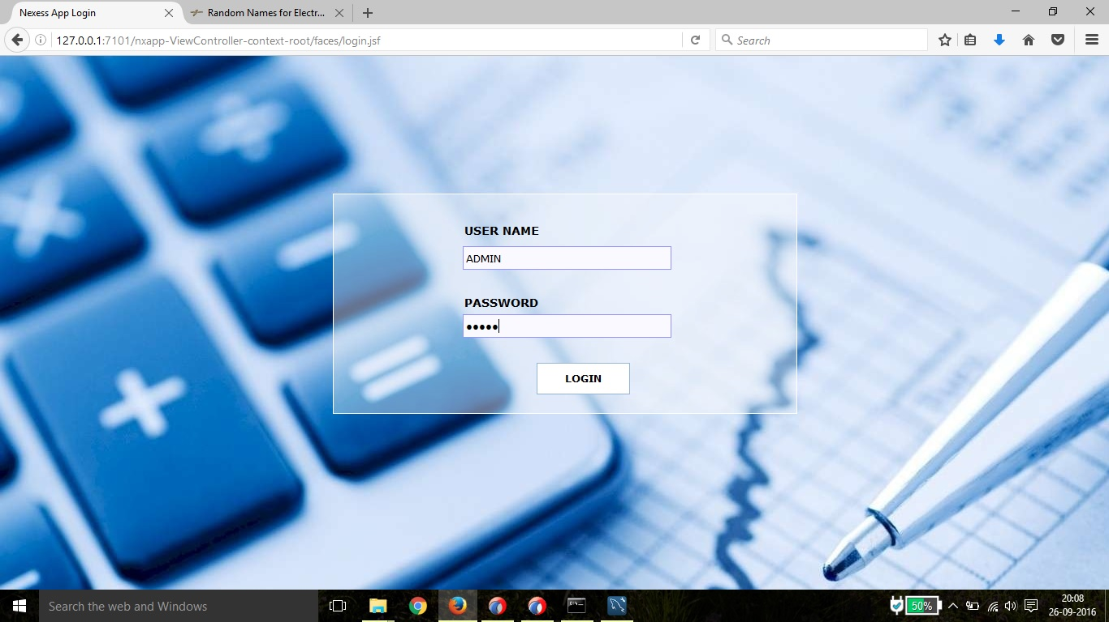
Login page:-

Slide 54
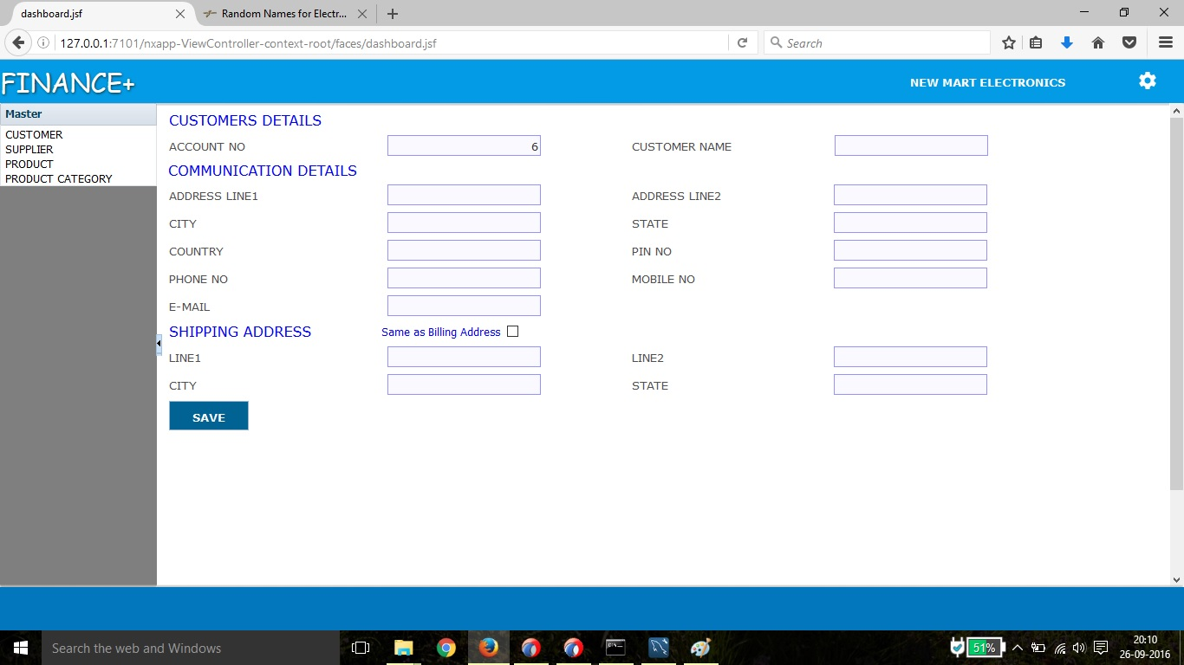
Customer:-here we will enter all the details of customer and by clicking on save button all the details will save in the database and this information will be reflect to our customer list page.

Slide 55
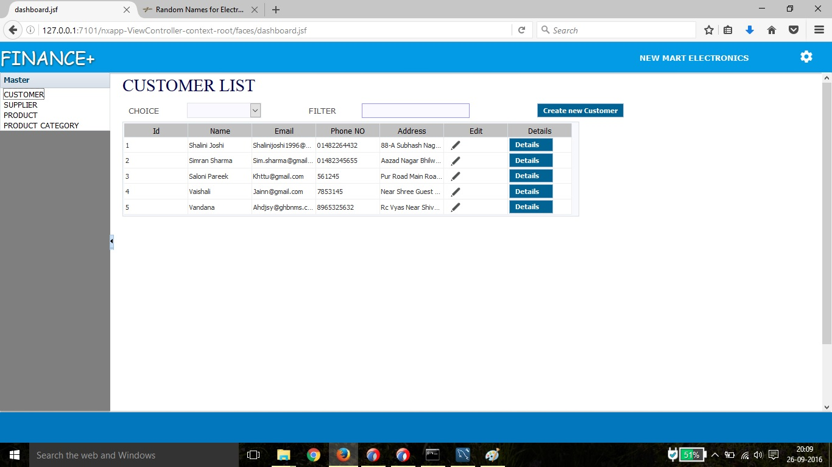
Customer list:-here the customer list will appear. we can filter them acc. To requirement and by clicking on create new customer we can add new customer details

Slide 56
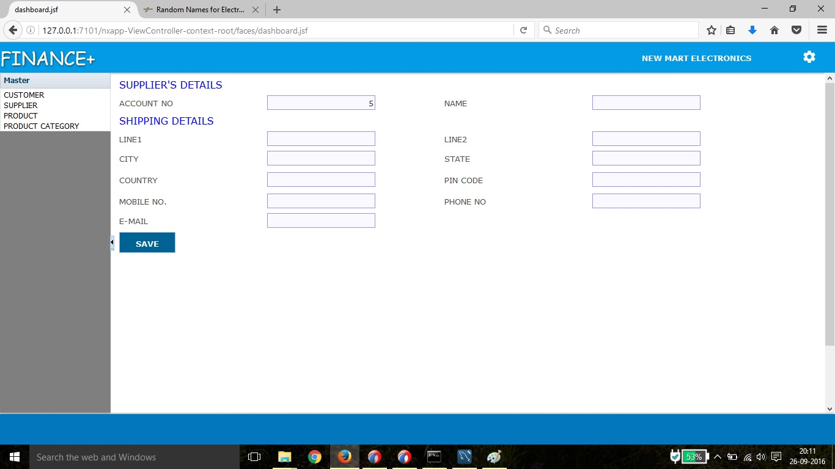
Supplier:- we will fill all the information of the supplier, then all this information will save to our database and last this information will be reflect to our supplier list page.

Slide 57
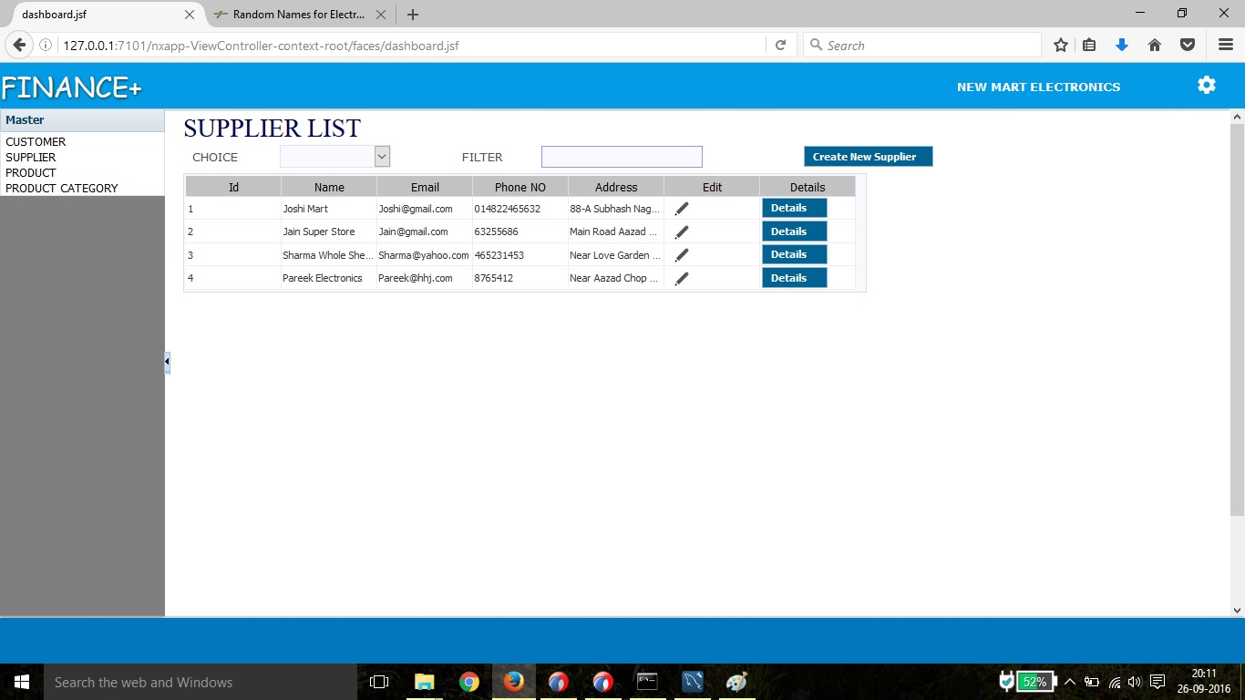
Supplier List:- here the supplier list will appear. we can filter them acc. To requirement and by clicking on create new supplier we can add new supplier details.

Slide 58
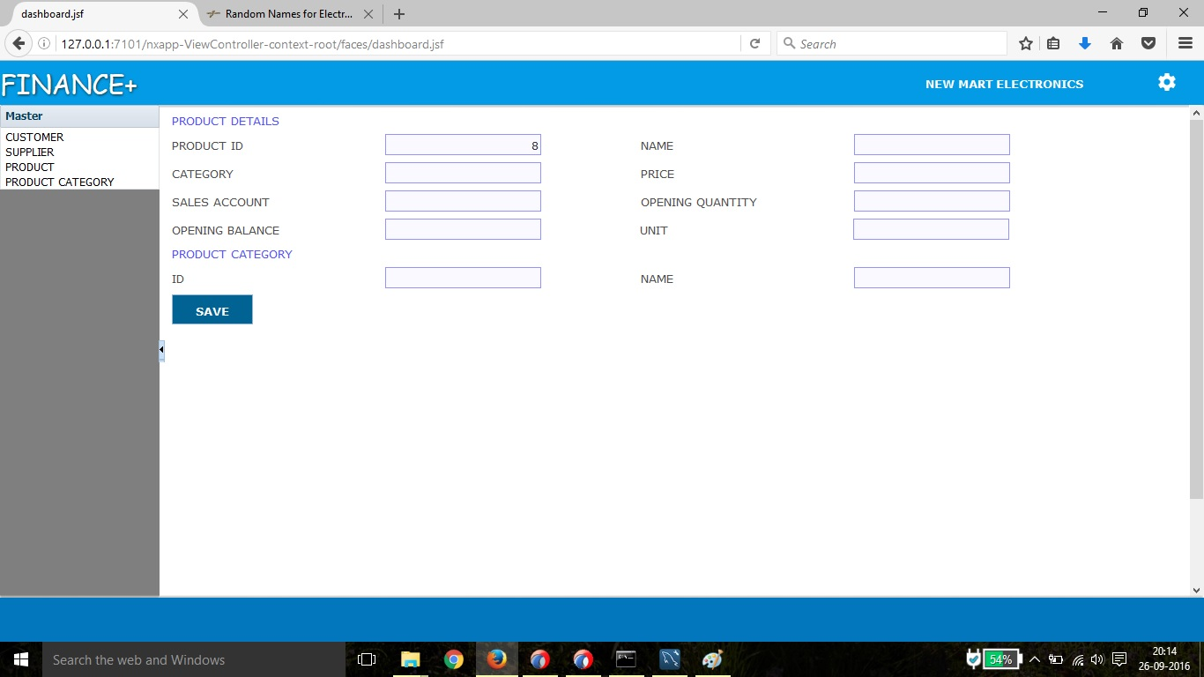
Product:- In this form company will fill all the information about the product, then all this information will be saved to our database and this information will be reflect to our product list page.

Slide 59
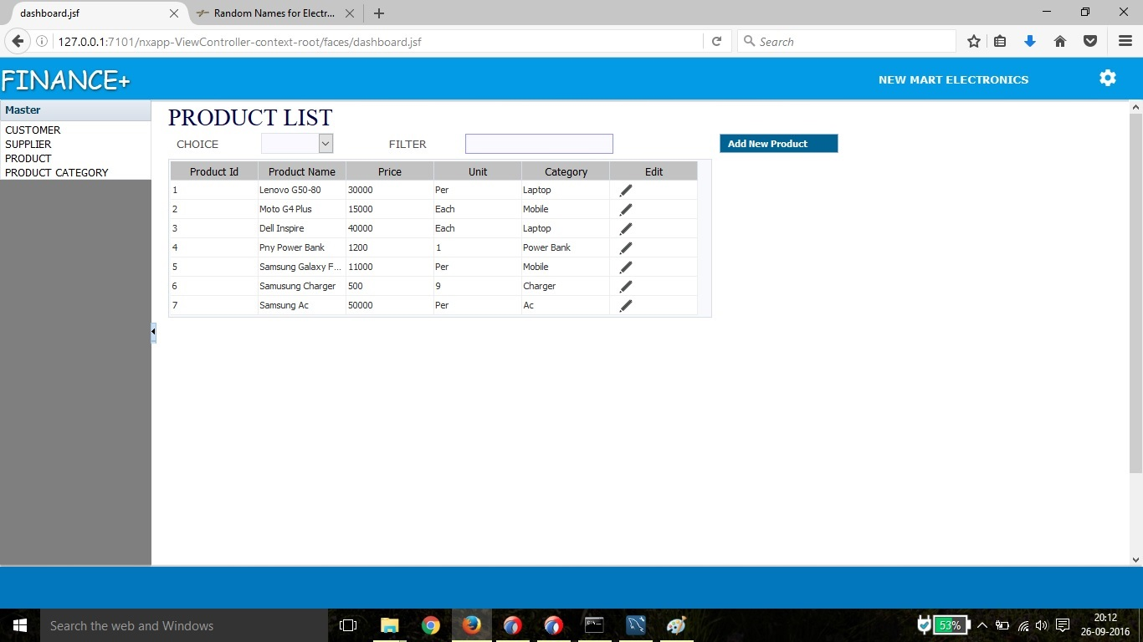
Product List:- here the product list will appear. we can filter them acc. To requirement and by clicking on add new product we can add new product details.

Slide 60
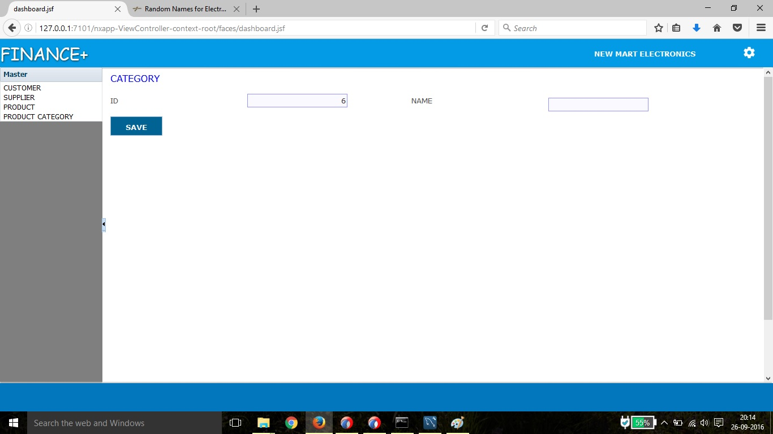
Product Category:- In this form company will add all the category for the products, then all this information will be saved to our database and this information will be reflect to our product category list page

Slide 61
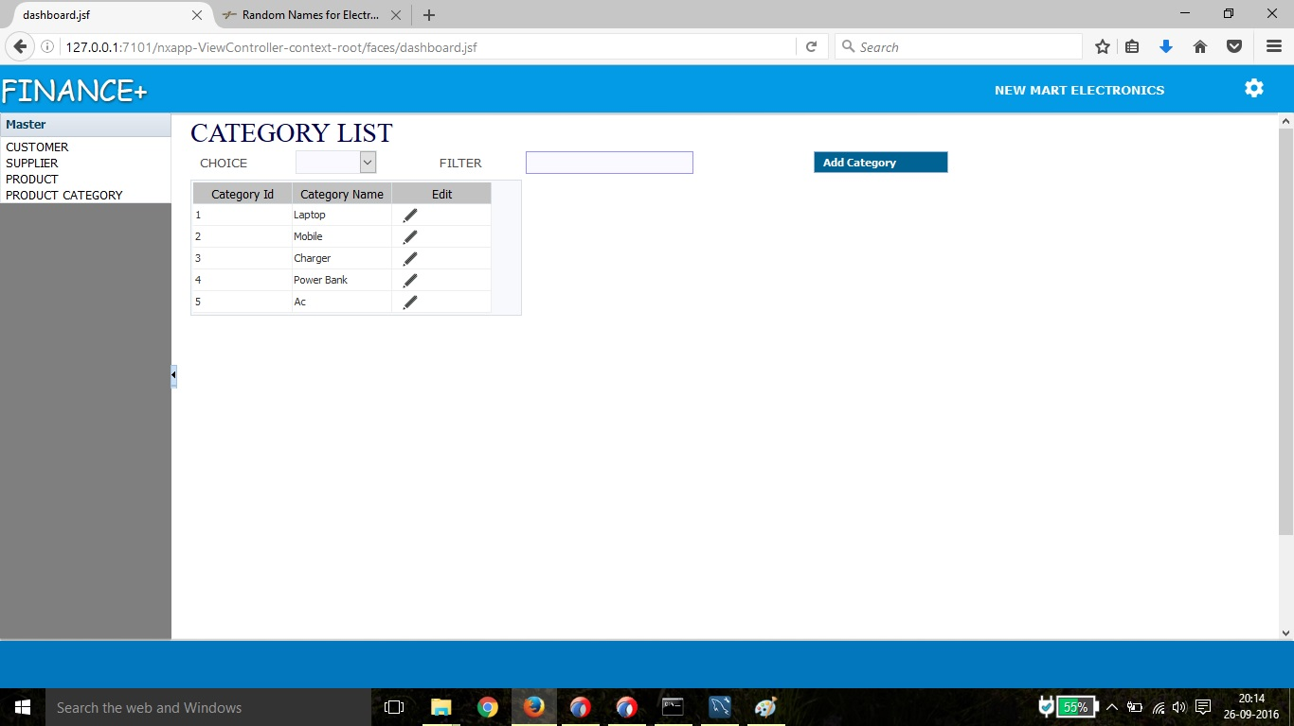
Category list:- :- here the category list will appear. we can filter them acc. To requirement and by clicking on add category we can add new product category details.

Slide 62
References:-
IEEE Std. 830-1998 “IEEE Recommended Practice for Software Requirements Specifications”
IEEE Std. 730.1-1995 “IEEE Standard for Software Quality Assurance Planning”
Team Chilli, “433-440 Software Quality Assurance Plan (SQAP) 2006”
Team Chilli, “433-440 Software Process Management Plan (SPMP) 2006”

Slide 63
Thank You!!!

