Slide 1
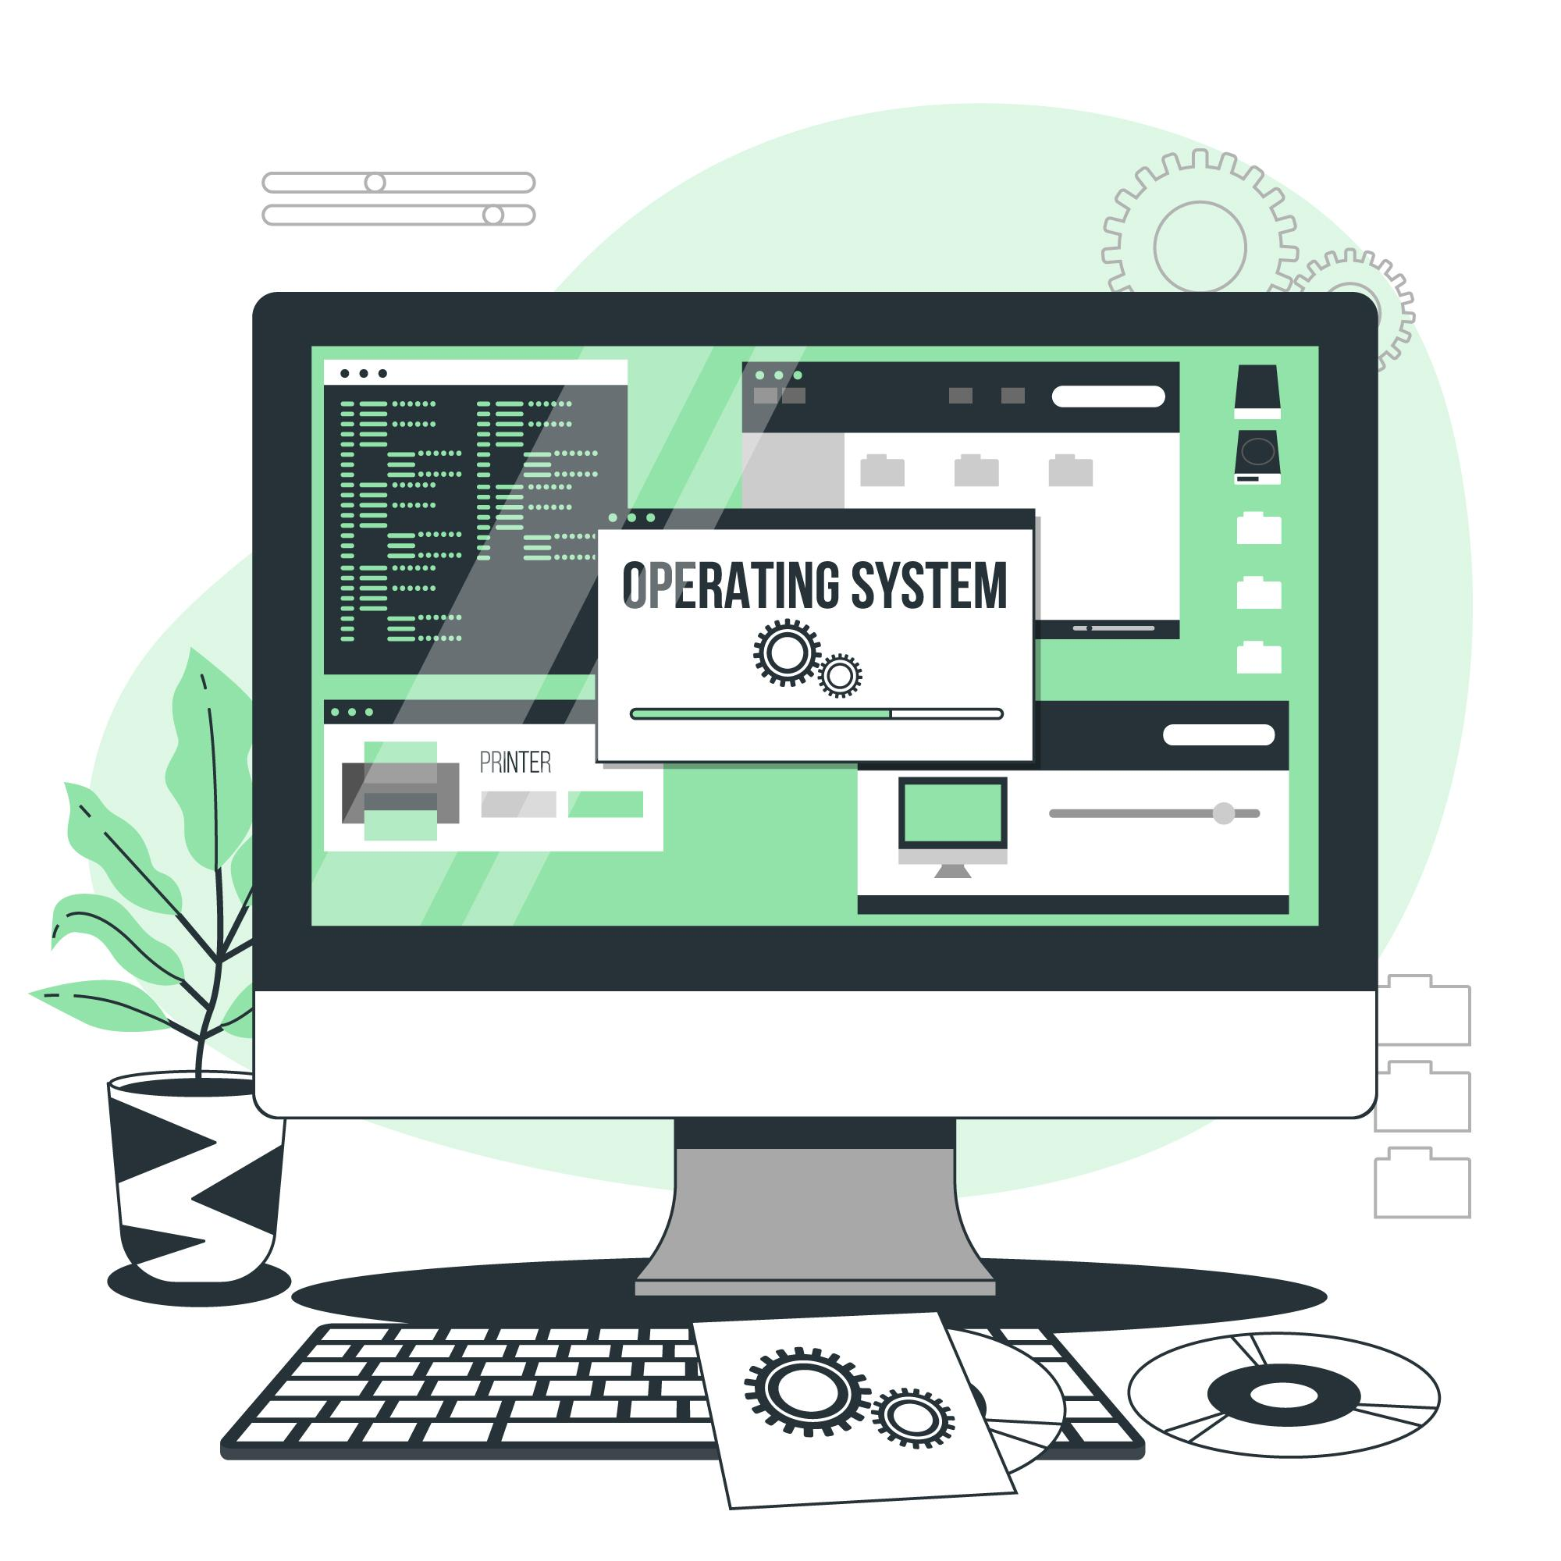
Comparison between
Operating Systems

Slide 2
An Operating system (OS) is a software which acts as an interface between the end user and computer hardware.
Introduction
It also allows you to communicate with the computer without knowing how to speak the computer's language.

Slide 3
Single-Tasking and Multi-Tasking
Single-User and Multi-User
Distributed
Types of Operating Systems
Templated
Embedded
Real-Time
Library

Slide 4

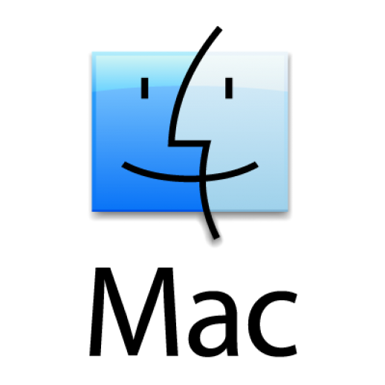
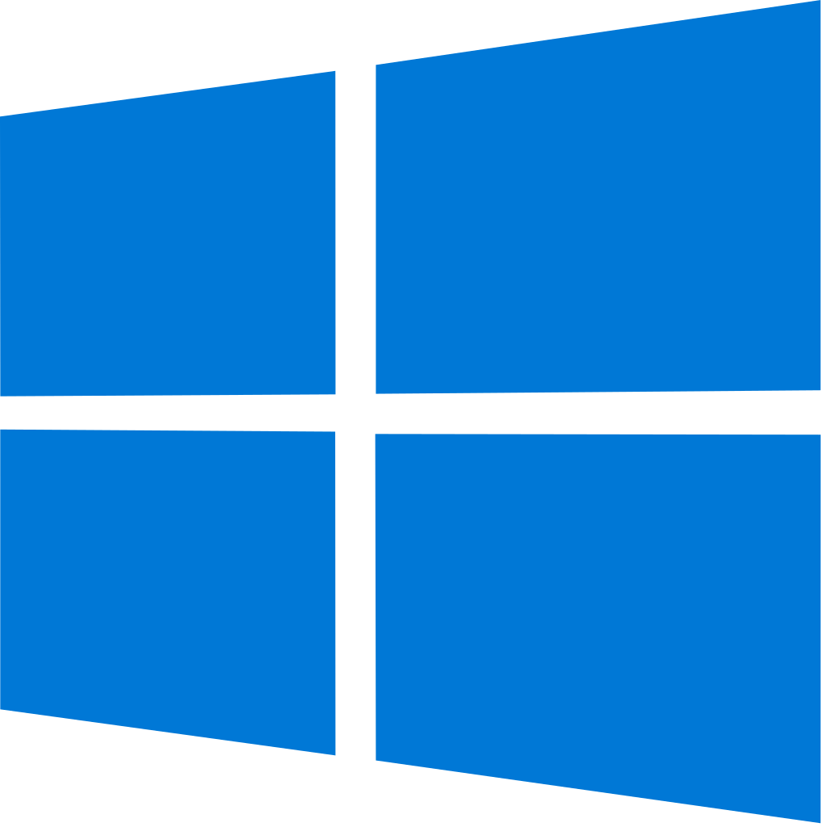

Popular OS

Slide 5
Microsoft Windows, computer operating system developed by Microsoft Corp. first graphical user interface(GUI) for IBM-compatible PCs.
Linux is an open source Unix-like operating system based on the Linux kernel; an open source operating system. Linux is typically packaged in a Linux distribution.
Mac OS, operating system developed by American computer company Apple Inc. The OS was released to run company’s Macintosh line of PCs. The Mac heralded the area of GUI.

Slide 6
Comparison
between

Slide 7
Emphasis on graphical user interface (GUI) rather than command-line interface (CLI).
Either a command-line interface (CLI), a graphical user interface (GUI), or controls attached to associated hardware, common on embedded system.
User Interface
Both command-line interface (CLI) and graphical user interface (GUI).

Slide 8
Less secure among all OS as lots and lots of malware and virus exists. Collects user data too.
Security is modular, separates users and limits their application and access.
Security
Most secure OS, as its source is open. Anyone can review it and make sure there are no bugs or back doors.
Secure to use minus the fact that they collect user data.

Slide 9
Older versions of windows were stable. Newer version (Windows 10) is not 100% stable.
Most stable OS among all. Gained popularity of being stable and mostly used in server for it’s stability.
Stability
As stable as Linux but only have OS for personal computers.

Slide 10
Allows to have laptop/tablet hybrids.
Helps to achieve whatever user want in the most efficient way.
Flexibility
Advantage of uniformity, the UI never changes dramatically.

Slide 11
Almost every hardware are compatible.
General hardware are fully compatible. Few proprietary hardware are not supported (some of graphics card).
Hardware
Compatibility
Only the hardware that are listed by company are compatible.

Slide 12
Relatively cheaper than Mac OS. But can be installed on any computers.
Open source OS, freely available. Only some distribution are paid.
Price
Most expensive OS among all as it only runs on devices manufactured by Apple Inc.

