Slide 1
Analyzing the Impact of Lifestyle Factors on Sleep Quality and Health
-Joshitha Dandlamudi

Slide 2
Table of Contents:
Data Description
Scatter Plot Analysis
Feature Selection
Exploratory Data Analysis
Predictive Models Logistic Regression | Linear Regression | K-Nearest Neighbors (KNN) Naive Bayes | Support Vector Machines (SVM) | Random Forest
Conclusion
References
Contribution

Slide 3
Data Description:
This project utilizes the Sleep Health and Lifestyle Dataset from Kaggle, which contains information about individuals' sleep patterns, lifestyle choices, and health indicators.
Source: Kaggle (https://www.kaggle.com/datasets/uom190346a/sleep-health-and-lifestyle-dataset)
The dataset comprises records of individuals' sleep health and lifestyle factors. It includes various sleep-related metrics, daily habits, and health indicators that can potentially influence sleep quality and overall well-being.

Slide 4
Data Attributes:
BMI:
Categorizes individuals' Body Mass index into Normal, Overweight, and Obese.
Gender:
Indicates the gender of individuals (e.g., Male/Female).
Quality of Sleep:
Subjective rating of sleep quality on a scale of 1 to 10, where 1 is poor and 10 is excellent.
Heart Rate:
Represents the number of heartbeats per minute (BPM).
Physical Activity Level:
A subjective rating of physical activity on a scale of 1 to 100, where 100 is highly active.
Sleep Disorder:
Indicates the type of sleep disorder (e.g., Insomnia, Sleep Apnea, or None).

Slide 5
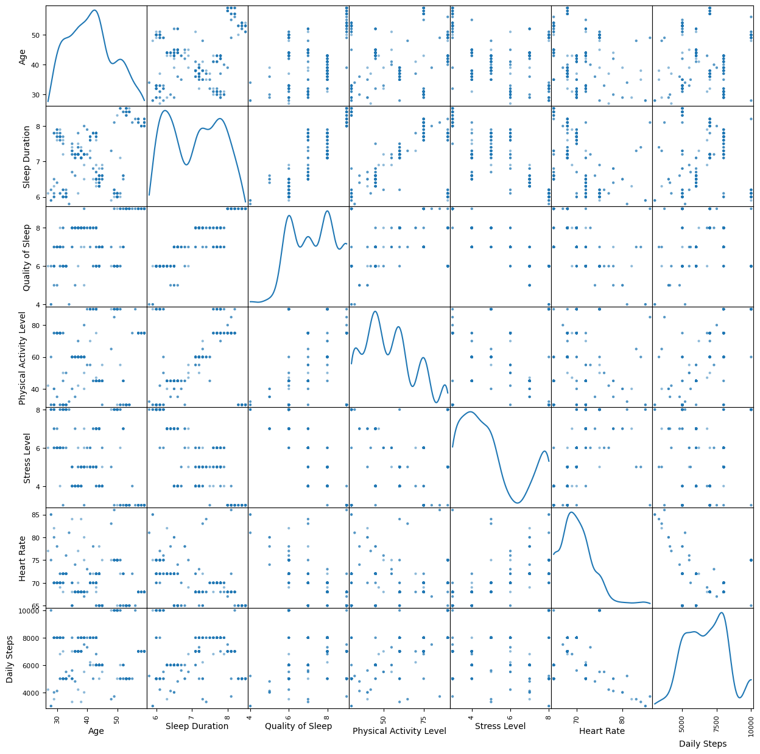
Scatter Plot Analysis
Objective:
To identify relationships between
key variables in the dataset.

Slide 6
Findings:
Positive Correlations:
Sleep Duration & Sleep Quality: Longer sleep durations are associated with better sleep quality.
Physical Activity Level & Daily Steps: Higher activity levels correlate with more daily steps.
Negative Correlations:
Stress Level & Sleep Quality: Higher stress reduces sleep quality.
Stress Level & Sleep Duration: Stress is inversely related to sleep duration.
Key Observations:
Promoting physical activity may improve sleep quality and overall health.
Stress management could be crucial in enhancing sleep metrics.

Slide 7
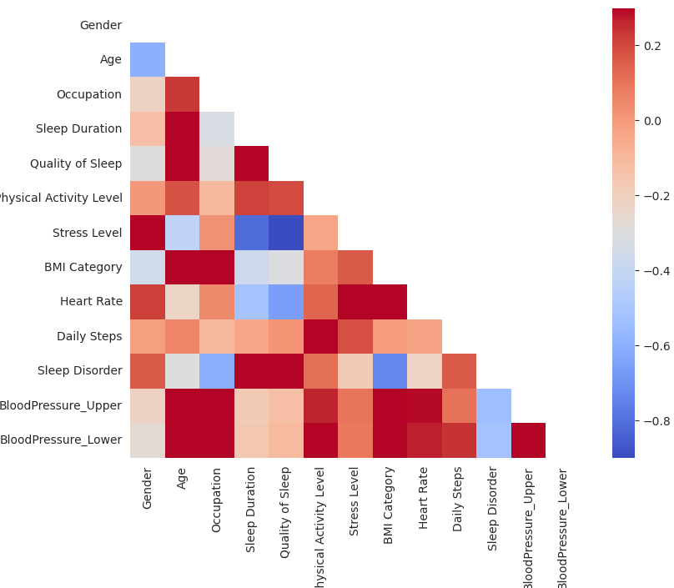
Feature Selection
Objective:
To select relevant features
for modeling and analysis.

Slide 8
Features Selected:
Positive Correlations:
Sleep Duration (linked to better quality).
Daily Steps & Physical Activity Level (mutually reinforcing).
Negative Correlations:
Stress Level (affects both Sleep Quality and Duration).
Strategy:
Focused on variables with meaningful relationships to sleep quality and health.
Demographic features (e.g., Gender, BMI) were also included for richer analysis.

Slide 9
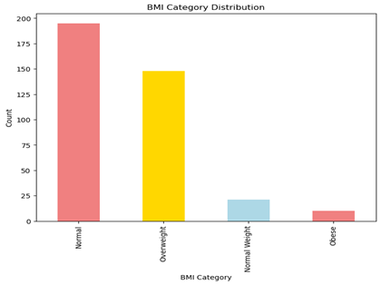
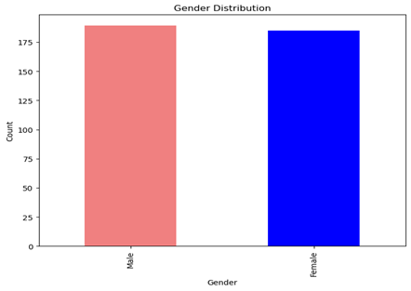
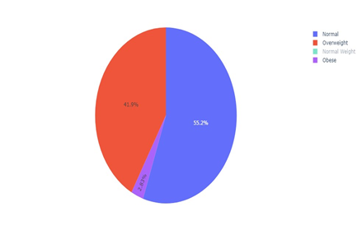
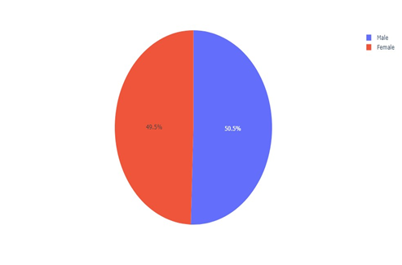

Slide 10
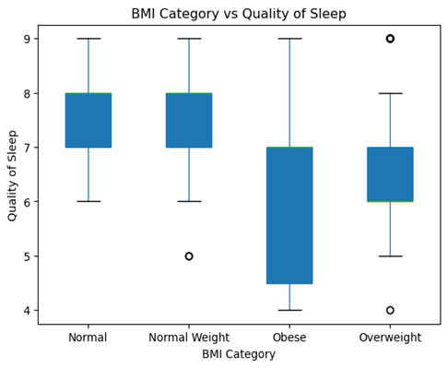
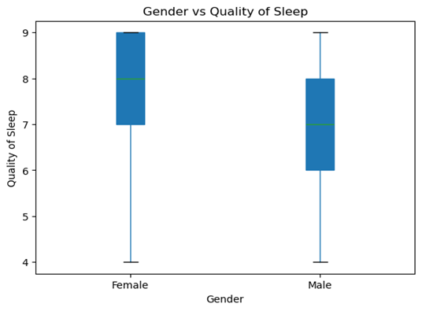
Box Plots

Slide 11
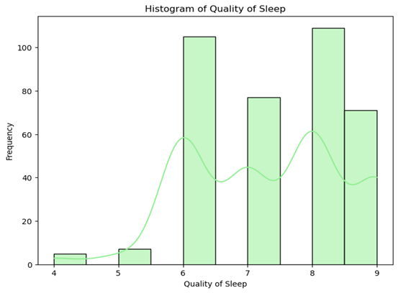
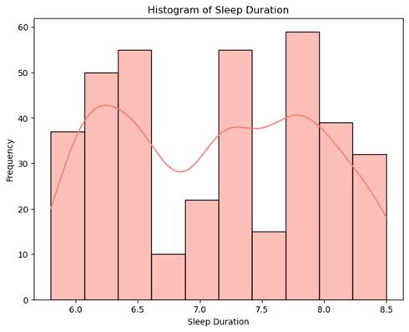
Histograms

Slide 12
Exploratory Data Analysis
Objective:
Prepare a clean, structured dataset for visualization and machine learning.
Key Steps:
Handling Missing Values:
Addressed missing entries in the 'Sleep Disorder' column.
Feature Engineering:
Split 'Blood Pressure' into Systolic and Diastolic columns.
Encoding Categorical Variables:
Converted Gender to numeric values using Label Encoding.
Outcome:
Dataset ready for analysis, ensuring improved model accuracy and consistency.

Slide 13
Confusion matrix
Class 0 (None): Low accuracy with 8 TPs and 7 FNs.
Class 1 (Sleep Apnea): High accuracy with 36 TPs, but 14 FPs.
Class 2 (Insomnia): Moderate accuracy, 9 TPs and 2 FPs.
Precision Issues: Class 0 and Class 2 struggle with false positives.
Best Performance: Class 1 shows the strongest detection capability.

Slide 14
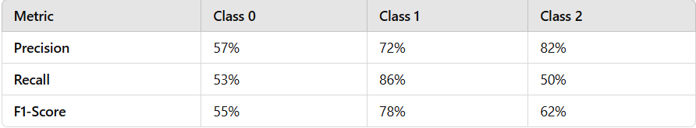
Logistic Regression
Objective:
Classify Sleep Disorders using selected independent variables(Sleep Duration, Stress Level, Physical Activity Level) for better accuracy.
Logistic Regression Results:
Overall Accuracy: 71%
Strengths: Good at identifying Sleep Apnea cases.
Weaknesses: Struggled with correctly predicting "None" and distinguishing "Insomnia."

Slide 15
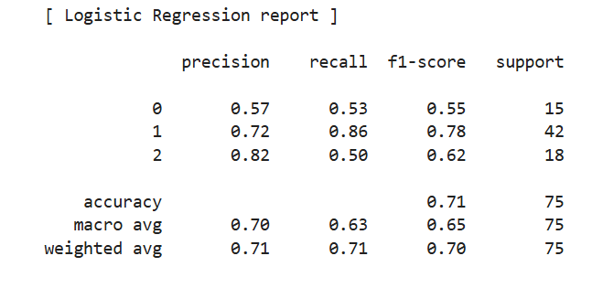

Slide 16
Linear Regression
Objective: To explore the relationship between Sleep Duration (independent variable) and Heart Rate (dependent variable) using a Linear Regression model.
Results:
MSE (Mean Squared Error): 14.28
Indicates significant prediction errors.
R² (Coefficient of Determination): 27.8%
Suggests the model captures only a small portion of variability in sleep outcomes.

Slide 17
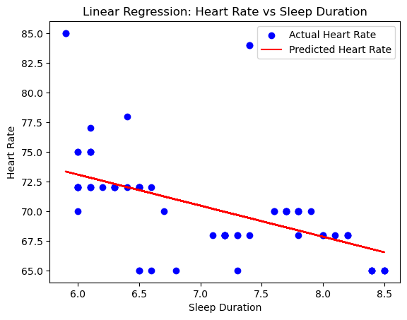
Trend: Longer sleep duration correlates with lower heart rate.
Variance: Heart rate is influenced by factors beyond sleep duration.
Model Fit: Linear model shows the trend but isn't a strong predictor.

Slide 18
KNN
Objective:
Classify sleep disorders based on heart rate and physical activity level using the K-Nearest Neighbors (KNN) algorithm.
K-Nearest Neighbors (KNN):
Optimal K Value: 5 (determined using the Elbow Method).
Accuracy:
Training: 92.31%
Testing: 86.67%
Insights: Captures data complexity well but has slight overfitting.

Slide 19
Model Type: K-Nearest Neighbors (KNN), recognized for its ability to capture complex patterns in data.
Performance Metrics:
Training Accuracy: 92.31% - Indicates effective learning and adaptability to the training dataset.
Test Accuracy: 86.67% - Reflects good generalization performance on unseen data.
Insight: The slight drop in test accuracy suggests minor overfitting, where the model may be overly tailored to specific training data patterns.
Overall: Despite minor overfitting, the KNN model demonstrates strong performance and reliability on new data.

Slide 20
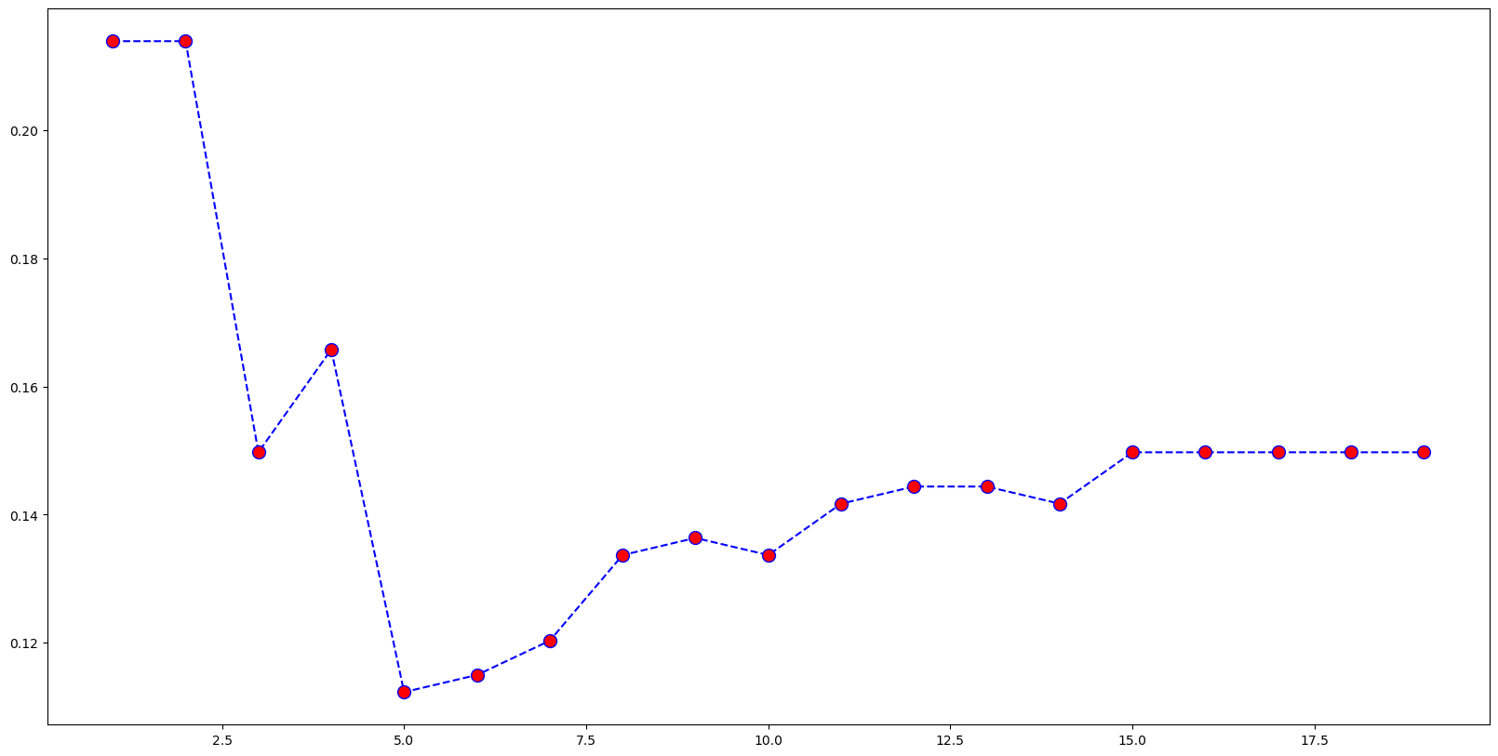
The graph shows a sharp drop from k = 1 to k = 5, and after k = 5, the slope starts to flatten out. After k = 5, the improvements in error reduction become less significant, which is why it is typically considered the "elbow" point where you stop gaining much benefit by increasing k. Thus, based on the shape of this curve, k = 5 seems to be the optimal value.

Slide 21
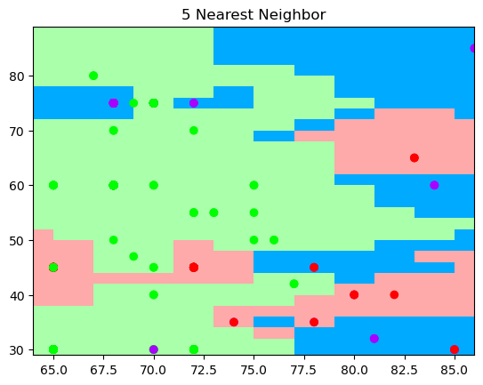

Slide 22
Naive Bayes
Naive Bayes (NB):
Accuracy: Moderate (60-70%).
Strengths: Balances precision and recall across classes.
Weaknesses: Less accurate compared to KNN for this dataset.

Slide 23
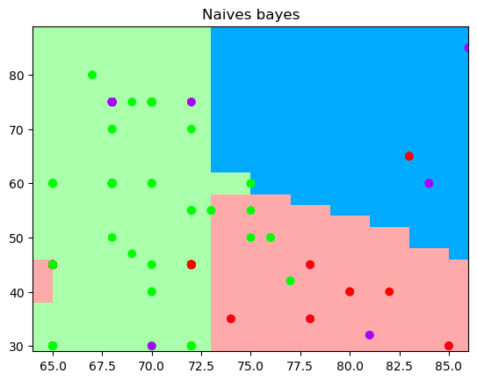

Slide 24
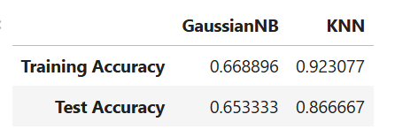
Gaussian NB
Type: Gaussian Naive Bayes
General Performance: Moderate Accuracy
Training Accuracy: 66.89%
Testing Accuracy: 65.33%
Observation:Narrow difference indicates good generalization
The model shows consistent performance across both training and testing datasets.
The modest degree of accuracy (60-70%) suggests balanced fitting, with no significant overfitting.

Slide 25
SVM
Objective:
Develop a Support Vector Machine (SVM) model to classify Sleep Disorders using Heart Rate and Physical Activity Level as predictors, aiming to identify underlying patterns and achieve accurate categorization of sleep disorder types.
Support Vector Machine (SVM):
Tested with multiple kernels:
Linear Kernel: Limited accuracy (66.31%).
RBF Kernel: Best accuracy (91.71%), captures complex patterns.
Polynomial Kernel: Moderate performance (72.73%).
Conclusion: RBF Kernel is the most effective for this dataset.

Slide 26
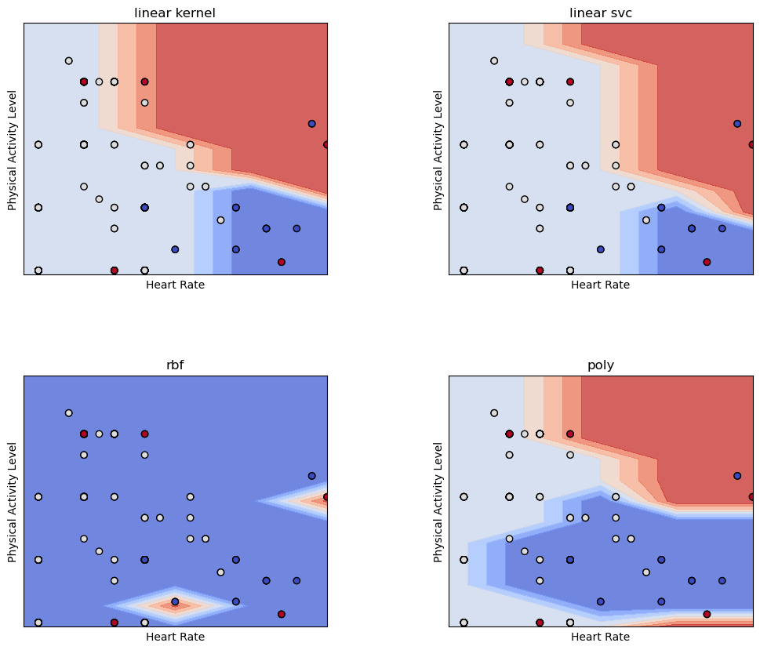

Slide 27
Linear & Linear SVM Kernels:
Simple straight boundaries.
Clear separation but prone to misclassifications.
RBF Kernel:
Highly flexible boundary.
Effectively minimizes misclassification.
Best captures complex data patterns.
Polynomial Kernel:
More nuanced than linear, less flexible than RBF.
Exhibits a jagged, step-like boundary.
Overall Insight:
Choice of kernel significantly impacts model performance.
Essential to match kernel complexity with data characteristics.

Slide 28
Random Forest:
Objective:
Build a Random Forest classification model to predict Sleep Disorders using Sleep Duration, Stress Level, and Physical Activity Level as independent variables, aiming to leverage the ensemble approach for improved accuracy and robust performance.
Overall Accuracy: 90.27%
Class-Specific Results:
Sleep Apnea: High precision (94%) and recall (97%).
Insomnia: Room for improvement (recall: 76%).
Insights:
Effective in handling class imbalance and feature importance.
Suggests potential for feature tuning to improve performance.

Slide 29
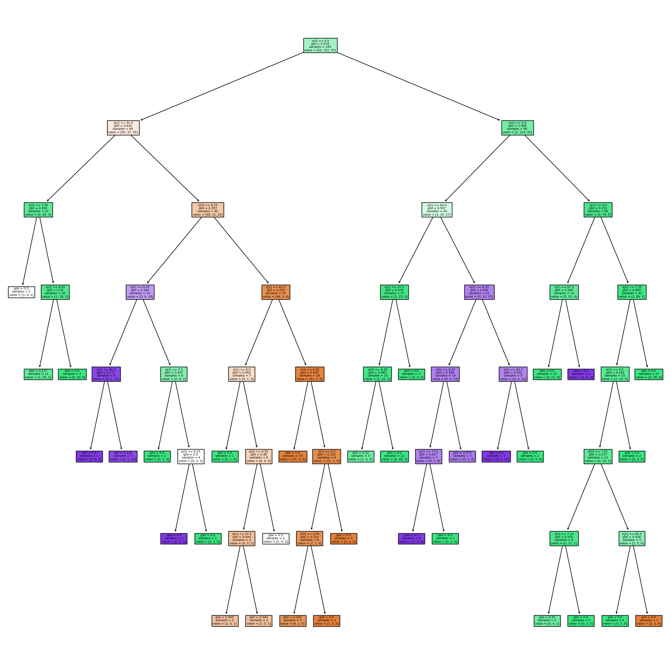

Slide 30
Conclusion
My analysis highlights the significant impact of lifestyle factors on sleep quality and overall health. Key insights include:
Physical Activity & Sleep Quality:
Higher physical activity levels are positively associated with better sleep quality and longer sleep duration.
Promoting active lifestyles can lead to improved health outcomes.
Stress as a Critical Factor:
Stress negatively influences both sleep quality and duration.
Stress management strategies can be pivotal for better sleep health.

Slide 31
3. Modeling Insights:
Advanced machine learning models like SVM (RBF Kernel) and Random Forest demonstrated high accuracy in predicting sleep disorders and classifying sleep health patterns.
While Random Forest excels at precision and recall, SVM effectively captures non-linear relationships in complex datasets.
4. Applications:
These findings can guide interventions aimed at improving sleep health through lifestyle changes and targeted support for individuals with high stress levels or poor sleep habits.
Overall, the project demonstrates how data-driven insights can inform strategies for better health and well-being.

Slide 32
References
University of Moratuwa. Sleep Health and Lifestyle Dataset. Kaggle. Published 2021.Available from: https://www.kaggle.com/datasets/uom190346a/sleep-health-and-lifestyle-dataset

