Slide 1
ELECTRICAL-SIGNATURE DIAGNOSTICS FOR ELEVATOR DRIVES
AURA-LIFT
A working hardware prototype that acquires motor current and voltage in real time, and six research-backed fault models that show how a drive fault appears in those same two signals.
6
7
3
2 of 6
fault models built and validated against published engineering data
journeys logged live on our own hardware, segmented by trip phase
manufacturer worked examples reproduced exactly
faults we can trace to a cause — and we show where the rest stop
Team Immortal
The question the project answers
What can voltage and current alone prove about the health of an elevator drive?
KIT — Kalaignar Karunanidhi Institute of Technology, Coimbatore
Houshik R · Joshitha G · Charunethra S

Slide 2
THE PROBLEM
Drive faults are confirmed too late
The components that fail in an elevator drive degrade slowly. The information that would reveal it is already being measured.
HOW A DRIVE FAULT IS FOUND TODAY
Degradation begins
Months pass
The drive trips
Diagnosis on site
capacitor dries out, a switch weakens, drag rises
nothing in the maintenance schedule looks at it
or a passenger is stranded and a callback is raised
a fault code with several possible causes, found by substitution
THE SIGNALS ARE ALREADY THERE
THE QUESTION NOBODY HAD ANSWERED
Every drive measures motor current and DC-bus voltage continuously, because it needs them to run the motor. Nothing has to be installed to read them. A diagnostic built only on those two signals deploys as software, across old and new equipment alike.
Signature analysis is an established field. What we could not find was a measured answer to the practical question: across the faults that actually occur in a drive, how many can current and voltage identify, and where exactly does the evidence run out?
So we set out to measure the answer, not assert it.
Build hardware that acquires the two signals for real, then build fault models where the fault is injected into a circuit and the physics produces the waveform — and see, fault by fault, what those signals support.
AURA-LIFT · Team Immortal
2

Slide 3
THE SOLUTION
AURA-LIFT
One constraint, two layers, and a single way of reading both.
The rule we held to throughout: voltage and current, nothing else.
BUILT
BUILT
BUILT
Layer 1 · Acquisition
Layer 2 · Fault models
A physical bench rig that measures, segments and logs
A simulated 400 V drive with injectable faults
ESP32 with current and voltage sensing on a driven DC load
Journeys split into phases and averaged per phase
UP and DOWN runs paired to separate load from loss
Six faults spanning the whole power path
The fault edits the circuit; the solver produces the waveform
Features and thresholds drawn from published drive literature
BOTH LAYERS ARE READ THE SAME WAY
Only the plant differs. The two layers are validated separately today; linking them is the next step.
current + voltage
derived feature
physical explanation
fault indication
AURA-LIFT · Team Immortal
3

Slide 4
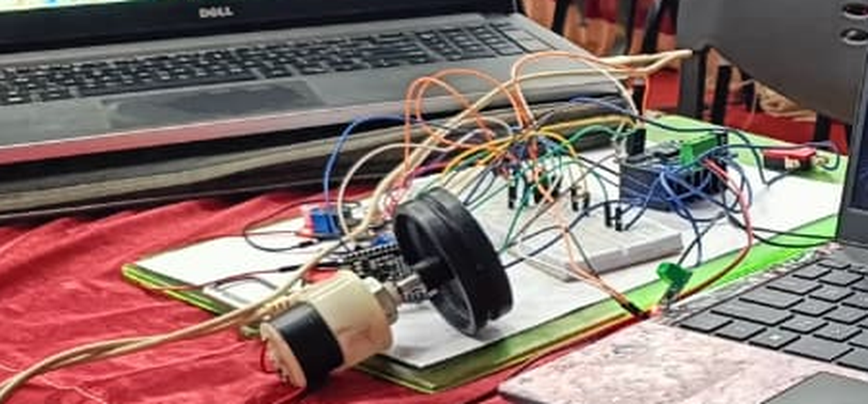
WHAT WE BUILT
The hardware prototype
BUILT
POWER AND SIGNAL PATH
12 V adapter
ACS712
BTS7960
DC motor
LM2596 5 V
V sensor
ESP32
ADC G34 / G35 · PWM G25 / G26 · enable G32 / G33 · limits G18 / G19
DC motor, driver, current and voltage sensing and an ESP32 on a single 12 V supply
Red: the 12 V motor current path. Teal: 3.3 V sense and control lines.
WHAT THE PROTOTYPE DOES
Measures
Drives
Segments
Reports
Bus current and voltage sampled continuously while the motor runs under load
Four-quadrant control of the load through an H-bridge, with limit-switch travel ends
Each journey split automatically into Idle, Start, Accel, Cruise, Decel and Level
Its own Wi-Fi dashboard, a per-trip record and a CSV export, with no PC software
Built as a 12 V DC proxy so the measurement problem could be studied safely on a student bench.
AURA-LIFT · Team Immortal
4

Slide 5
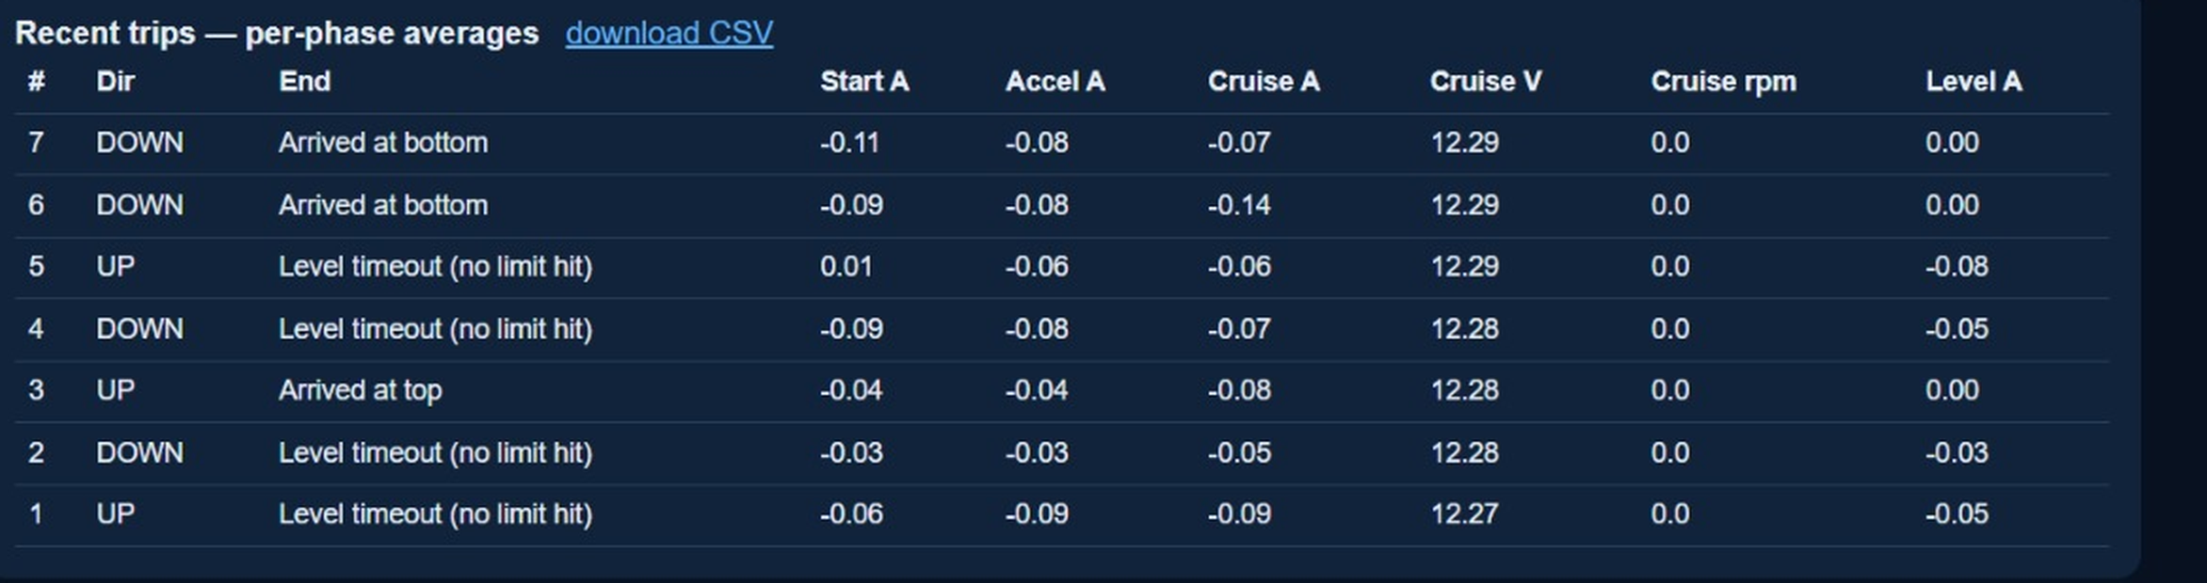
WHAT WE DEMONSTRATED
Live acquisition on our own hardware
BUILT
Every number on this slide came off the rig. The ESP32 serves this itself, over its own Wi-Fi access point.
RUNNING ON THE DEVICE
Continuous current and voltage sampling
Automatic phase segmentation per journey
Per-trip storage and UP / DOWN pairing
Limit detection, trip counting, CSV export
Seven journeys, each segmented and averaged per phase, exportable as CSV
THE RESULT WE SET OUT TO GET: LOAD SEPARATED FROM LOSS
A counterweighted car is its own differential experiment. Going up, the drive supplies imbalance plus losses. Going down, gravity returns the imbalance and the drive supplies only losses minus imbalance. So the half-difference of a matched pair isolates the load term, and the half-sum isolates the loss term — with no load-weighing device anywhere in the system.
READ IT HONESTLY
The separation runs end to end on real measurements. At 12 V the cruise currents are only tens of milliamps and readings quantise near 0.01 A, so treat this as proof that the method works, not as a calibrated load figure.
last UP
last DOWN
load term
loss term
−0.064 A
−0.070 A
0.003 A
−0.067 A
AURA-LIFT · Team Immortal
5

Slide 6
HOW IT WORKS
Fault injection, not waveform drawing
SIMULATED
We do not draw an abnormal waveform. We change the circuit condition and let the physics generate the signature.
01
Phase loss
02
Switch fault
03
Bus overvoltage
an edit to the conduction set
an edit to the conduction table
one clamp on the bridge current
Remove one supply phase from the set the rectifier may select. The six-pulse ripple becomes two-pulse on its own; nothing draws that shape.
A device that has lost controlled conduction drops out of the table. Positive current then freewheels through the diode and decays, while negative current is untouched.
Nothing switches the rectifier off. The machine regenerates, the capacitor charges, the bus climbs past the rectified peak and the diodes reverse-bias themselves.
WHAT THE MODEL SOLVES
WHERE THE NUMBERS COME FROM
The DC bus is a state variable, not a fixed number
A salient PM machine solved in the rotor frame under current control
Fixed-step integration with PWM edges resolved below one time step
Machine parameters from a published open drive-simulator dataset
Trip and protection levels quoted from manufacturer drive manuals
Any threshold without a published source is labelled as ours, in the app
AURA-LIFT · Team Immortal
6

Slide 7
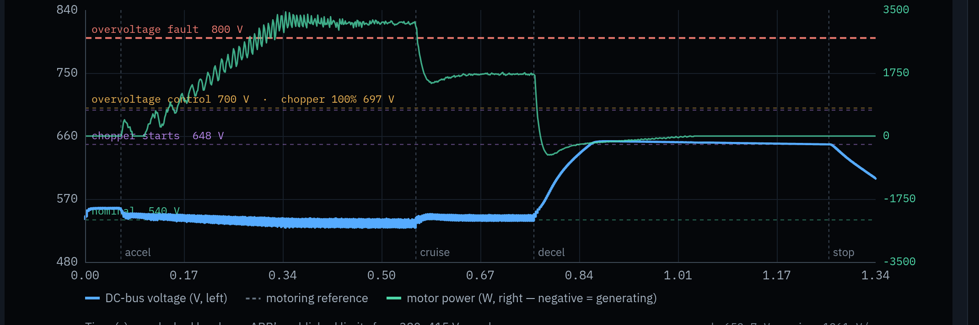
WHAT WE DEMONSTRATED
Six faults on one drive
SIMULATED
Six faults spanning the whole power path, all on the same plant with nothing retuned between them.
supply sag
phase loss
capacitor
overvoltage
switch fault
overcurrent
06
03
01
05
02
04
400 V mains
Rectifier
DC choke
DC link
Inverter
PM machine
Car + c/wt
3-phase
six-pulse
4 mH
500 µF
6 IGBT
2.2 kW
45% bal.
regenerated energy — a diode bridge cannot return it to the mains
ONE MODEL, RUNNING
The overvoltage model solved over a single journey. Bus voltage in blue against the manufacturer’s published trip and chopper levels; motor power in green, going negative where the car regenerates and drives the bus up.
Every model reports its features in engineering units, a verdict with the reasoning shown, and the evidence grade behind each number.
AURA-LIFT · Team Immortal
7

Slide 8
WHAT WE DISCOVERED
An evidence map, not a detection claim
All six faults are detectable from current and voltage. Which of them can be traced to a cause turned out to be the more useful question.
FAULT MODEL | CAUSE IDENTIFIED | WHAT THE EVIDENCE SHOWS
01 Capacitor ageing | YES | capacitance and ESR act on different parts of the spectrum, so they separate
05 DC-bus overvoltage | YES | supply-side and regeneration-side indicators reverse together
03 Rectifier phase loss | PARTLY | a supply unbalance within its own standard overlaps the indicator
06 Supply sag | PARTLY | below a critical residual, a deep sag and an interruption become identical
02 Inverter switch fault | NO | a failed device and a dead gate driver produce the same signature
04 Overcurrent | NO | manufacturer manuals list eight causes behind the one fault code
WE CHECKED OUR MODELS
AND FOUND SOMETHING ELSE
Why the map is the result
Three published manufacturer worked examples reproduced exactly
Protection levels cross-checked across four manufacturers
Four arithmetic errors found in the published sources
Protection thresholds are not uniformly published. Bus overvoltage and undervoltage limits appear in four manuals out of five, but an overcurrent trip level in only one, and a ripple threshold for phase loss in none at all.
A monitor claiming six of six invites one counter-example and loses the room. Showing exactly where each fault’s evidence stops is what makes the other two trustworthy.
AURA-LIFT · Team Immortal
8

Slide 9
WHY IT MATTERS
Where this leads
The value of a diagnostic built only on current and voltage is that it needs nothing added to the machine.
For the technician
For maintenance planning
For the equipment owner
Arrives with a named subsystem and the evidence behind it, instead of a fault code with several possible causes and a process of substitution.
Degradation reported in engineering units against a published limit turns an emergency call-out into a task inside a visit already scheduled.
It reads signals the drive already produces, so it can reach old and modernised equipment as software rather than as a retrofit.
Stated as mechanisms. We claim no percentage saving — measuring one needs field data we do not have.
NEXT
THEN
LATER
GOAL
Close the loop
Attribution layer
Real-drive validation
Explainable diagnosis
Inject a real fault on the bench — a degraded capacitor, a disconnected phase — and check whether the measured signature moves the way the model predicts.
Add persistence testing and evidence fusion above the segmentation and UP/DOWN pairing already running, to move from detection to a ranked cause.
Logged data from a working drive, the capacitance estimate calibrated against instrument measurement, and a false-alarm rate over a long healthy run.
A component-level verdict with the evidence for and against it, delivered from signals the drive already measures.
AURA-LIFT · Team Immortal
9

Slide 10
SCOPE
What is proven, and what is not
Kept on one slide so that nothing elsewhere in this deck needs a footnote.
BUILT AND MEASURED
SIMULATED, NOT MEASURED
NOT CLAIMED
The bench rig, its sensing, segmentation, dashboard and CSV log
The UP / DOWN load and loss separation, on real measurements
Six fault models, validated against published worked examples
Every fault waveform in this deck comes from a physics model
No fault has yet been injected into physical hardware
The models have never been compared against a real elevator drive
No accuracy, detection rate or false-alarm figure — none is measured
Nothing is tuned to any manufacturer’s equipment
The rig is a 12 V testbed for the method, not a scaled elevator drive
What the project set out to do, and did
We built hardware that acquires real-time current and voltage and separates load from loss on its own, then built six research-backed fault models that show how each fault reaches those same two signals — and measured, fault by fault, how far the evidence goes. Two of the six can be traced to a cause. For the other four we can say precisely why not, which is the part that makes the first two worth trusting.
AURA-LIFT · Team Immortal
10

