Slide 1
Book Bodega
Simple way to get your text books

Slide 2
Purpose
The purpose of Book Bodega is to allow students to buy, sell, and trade their used textbooks to other students within the campus.
This provides an affordable alternative to the bookstore or purchasing though online sources.
Create a sense of community between students within the university

Slide 3
Features
Mobile friendly
Buy, Sell, Trade
Users will be able to search for books by title, author, or ISBN
Users will be able to browse for books by department and/or class
Users will use email to communicate with seller

Slide 4
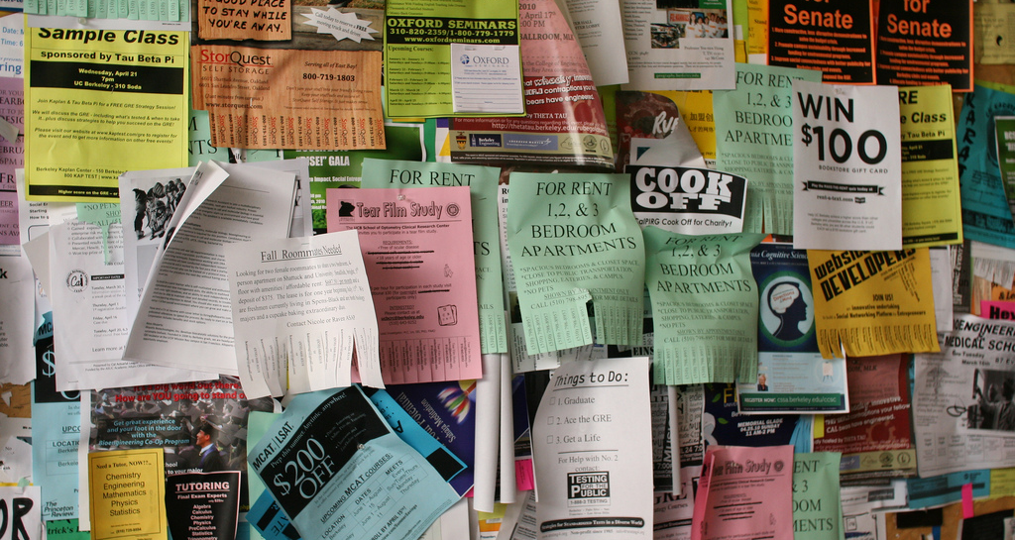
IDEA

Slide 5

IDEA

Slide 6

WHAT we used

Slide 7
Node.js
JavaScript
Asynchronous
Uses npm package

Slide 8
Express
Lightweight frame work used to build web applications in Node.
Allows for building single and multi page web applications
Creates routes
Inspired by Ruby framework, Sinatra

Slide 9
MongoDB
NoSQL database system
Saves in binary JSON format
Makes it easier to pass data between client and server

Slide 10
Angularjs
JavaScript framework developed by Google
Provides two-way data binding
Provides rapid front end development

Slide 11

Hosting

Slide 12
Limitations
Does not provide infrastructure for online transactions
Does not provide any sort of shipping
Information about users limited
Site does not facilitate any direct communication

Slide 13
FUTURE Considerations
Improving user contact process
User Profiles
User Direct Messaging
Expanding to multiple school

