Slide 1

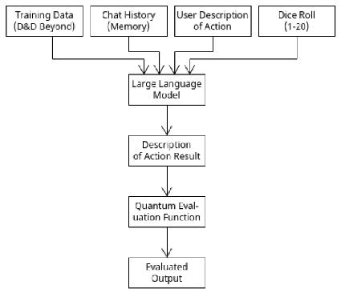
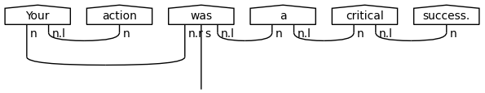
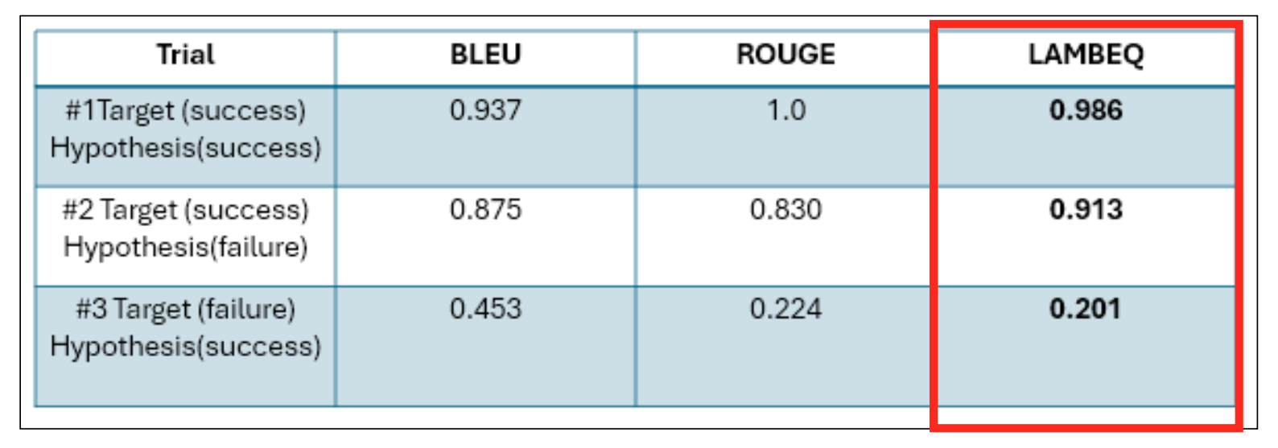
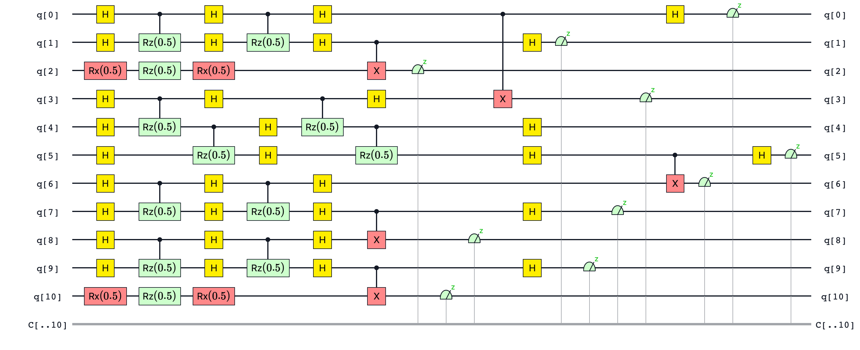

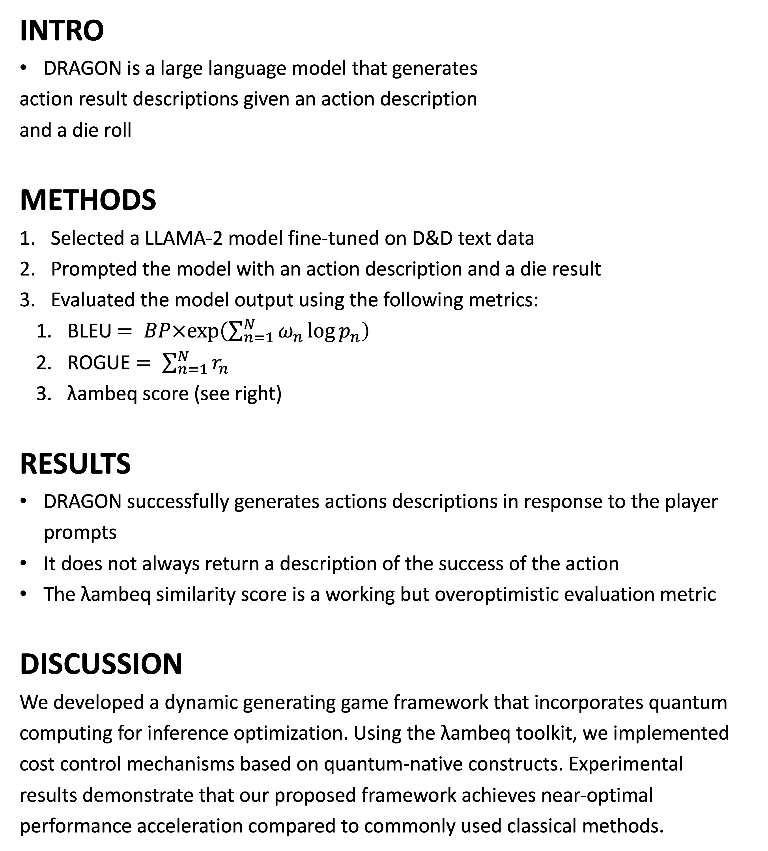
Die Roll Action Generating
Operational Network (DRAGON)
Shawn Bray, Josh Li, Reece Robertson
CMSC 491/691: Interactive Fiction and Text Generation
Fall 2024
DRAGON generates action effect descriptions in response to player input. Model output is evaluated using a quantum cost function.
INTRO
DRAGON is a large language model that generates
action result descriptions given an action description
and a die roll
METHODS
Selected a LLAMA-2 model fine-tuned on D&D text data
Prompted the model with an action description and a die result
Evaluated the model output using the following metrics:
BLEU $= BP×exp\left(\sum_{n=1}^{N}{ω_{n}\log{p_{n}}}\right)$
ROGUE $= \sum_{n=1}^{N}{r_{n}}$
λambeq score (see right)
RESULTS
DRAGON successfully generates actions descriptions in response to the player prompts
It does not always return a description of the success of the action
The λambeq similarity score is a working but overoptimistic evaluation metric
DISCUSSION
We developed a dynamic generating game framework that incorporates quantum
computing for inference optimization. Using the λambeq toolkit, we implemented
cost control mechanisms based on quantum-native constructs. Experimental
results demonstrate that our proposed framework achieves near-optimal
performance acceleration compared to commonly used classical methods.
ΛAMBEQ SCORE
λambeq is a python package for quantum natural language processing
We use λambeq to encode a natural language circuit into a DisCoCat representation
We then use λambeq to generate a quantum program from the DisCoCat diagram
The quantum program encodes the sentence in a latent representation space
We encode the model output and an expected output into a representation space and compute the distance between the two points in the space
This successfully creates an evaluation metric; however, it tends to give much greater scores then BLEU and ROGUE in most cases
DRAGON Model Diagram
DisCoCat String Diagram Example
Score results during inference.
Circuit Representation of Above DisCoCat Diagram
https://github.com/joshl1-umbc/cmsc691_term_project

