Slide 1

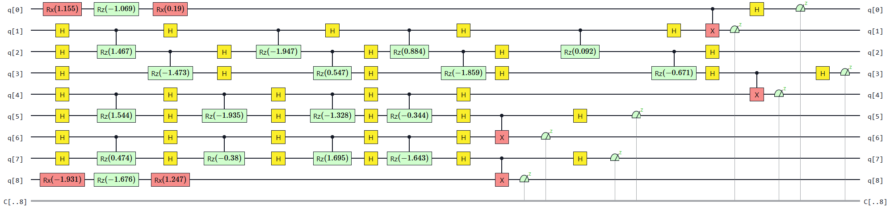
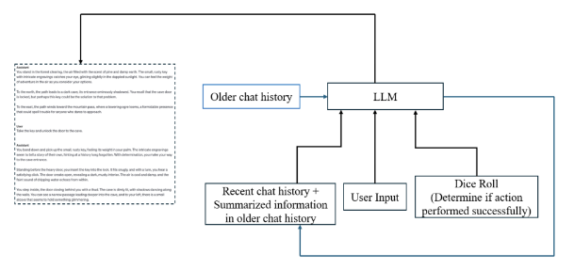
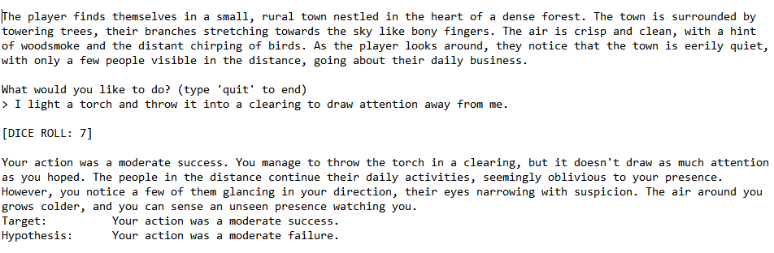
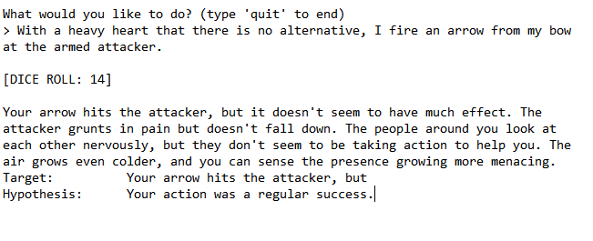
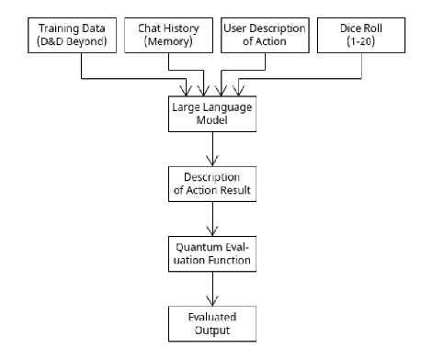
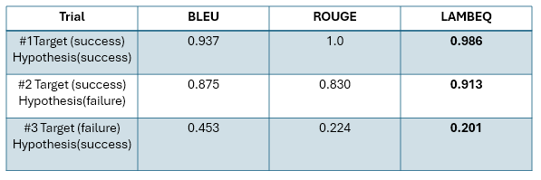
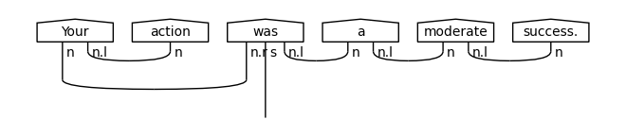

Title
CMSC 491/691: Interactive Fiction and Text Generation Fall 2024
Dice Roll Action Generative Operational Network (DRAGON)
Shawn Bray¹, Reece Robertson¹, Josh li¹,
University of Maryland, Baltimore County¹
DRAGON generates action effect descriptions in response to player
input. Model output is evaluated using a quantum cost function.
INTRODUCTION
DRAGON Architecture System
Traditional approach: bag-of-words models, and grammar rules, pattern matching.
Our approach: leverage quantum computing to handle large scale datasets. Optimize massive parameter spaces, using exponential parallelism.
This Work
Aims to target the computational efficiency of LLM IF inference on GPU’s.
An improved exponentially faster factorization and decomposition.
An enhanced semantic representation.
Accuracy Analysis
Circuit representation quantum neural network with parameterized gates.
Qubit Hadamard gates, rotation gates and controlled opertation highly entangled.
Figure 5: Circuit representation DisCoCat:
EVALUATION/RESULTS
METHODOLOGY
Figure 1: Dragon Architecture D
The design adopts the LLM model.
Selected a LLAMA-2 model fine-tuned on D&D text data
Prompted the model with an action description and a die result
Evaluated the model output using the following metrics:
BLEU score
ROGUE score
λambeq score*
Figure 6: game simulation inference results.
Figure 7: game simulation inference results.
The results illustrate a dynamic, interactive narrative system uses dice rolls to evaluate player actions, generating adaptive feedback based on probabilistic success. The system evaluates actions, providing descriptive feedback that aligns with the player's decision and the computed success level..
ALGORITHM
The λambeq
Encoded NLP circuit into DisCoCat.
Figure 2: Flow Diagram
Table 1: Score results during inference.
sentence
parsing
Syntax
tree
encoding
String diagram
rewriting
Rewritten
string
parameterisation
Quantum circuit
optimization
Task-specific
output
SUMMARY
We developed a dynamic generating game framework that incorporates quantum computing for inference optimization. Using the λambeq toolkit, we implemented cost control mechanisms based on quantum-native constructs. Experimental results demonstrate that our proposed framework achieves near-optimal performance acceleration compared to commonly used classical methods, showcasing its potential for efficient and effective NLP and LLM applications.
Figure 3: Target
Figure 4: Hypothesis
[1] Kartsaklis, D., Fan, I., Yeung, R., Pearson, A., Lorenz, R., Toumi, A., de Felice, G., Meichanetzidis, K., Clark, S., & Coecke, B. (2021). lambeq: A High-Level Python Library for Quantum NLP. CQCL/lambeq.
[2] Meichanetzidis, K., Gogioso, S., de Felice, G., Chiappori, N., Toumi, A., & Coecke, B. (2020). Quantum Natural Language Processing on Near-Term Quantum Computers..
[3] Zhang, L., Lyu, Q., & Callison-Burch, C. (2020). Reasoning about Goals, Steps, and Temporal Ordering with WikiHow. EMNLP, pp. 4630–4639. Association for Computational Linguistics..
CONTACT
Shawn Bray: shawnb2@umbc.edu
Reece Robertson: rrobert2@umbc.edu
Code Link

