Slide 1
Intro to Programming w/ Arduino
University of Maryland, College Park
A. James Clark School of Engineering
ENME351
Version 0.1

Slide 2
Purpose
Explain how to use code to control an Arduino
Explore Arduino syntax and underlying semantics
Draw comparisons with other programming languages
Provide insight into common programming paradigms to make code more efficient

Slide 3
Table of Contents
Arduino Basics
Audience: first time you have interacted with Arduino
Topics: IDE, ...
Coding Fundamentals
Audience 1: first time you have interacted with code
Audience 2: desire to improve your understanding of code
Topics: Variables, Functions, Scope, Data Types, Statements, Loops
Advanced
Audience: looking to optimize code
Topics: Bit shifting, …
Coding Examples
Audience: looking to reference well written code related to this course

Slide 4
What is Arduino?
Encompassing term that refers to
Hardware
Software
Language

Slide 5
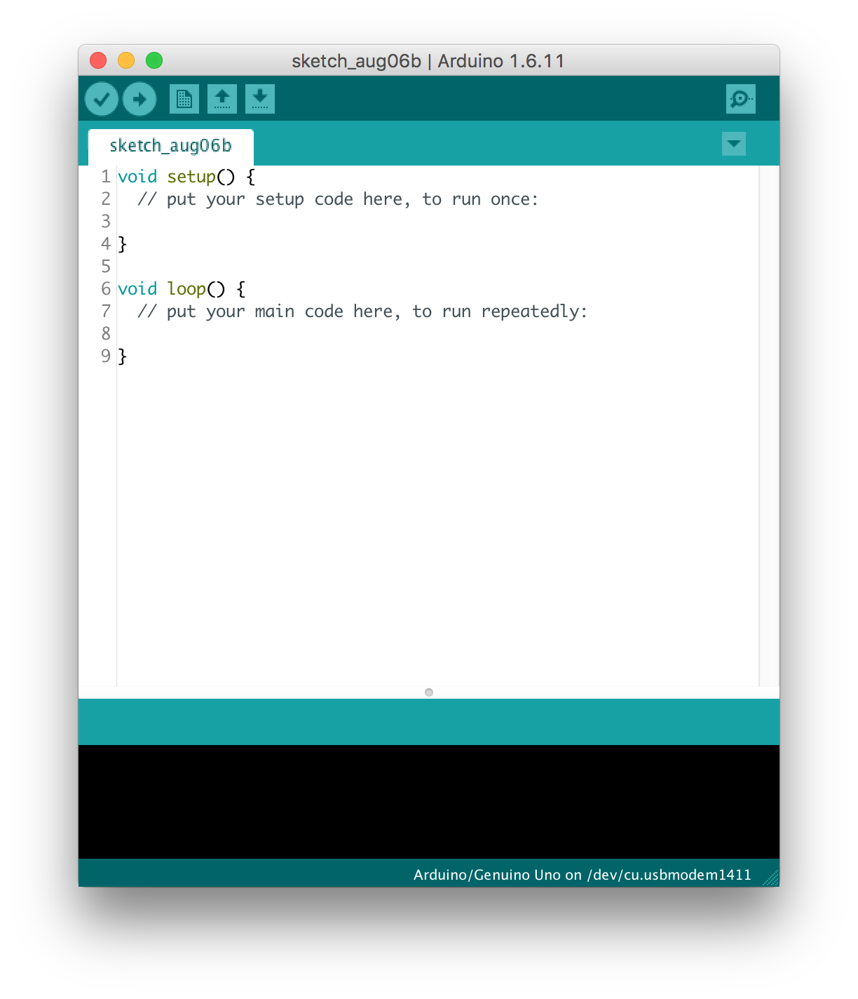
Arduino Software
Integrated Development Environment (IDE)
The window you see when you run the Arduino software on your PC

Slide 6
IDE
Editor: Where you write your code
Console: Where output from code is displayed

Slide 7
Arduino Language
Language
based on C/C++ programming languages
Reference
https://www.arduino.cc/en/Reference/HomePage

Slide 8
Data Types
Computers store data as binary numbers
0100100100111110100101101010101100111100010101
All data is the same
Programming languages allow us to define different types of data in ways that humans understand
Numbers
Words

Slide 9
Basic Types
Type | Size | Range | Precision
boolean | 1 bit | 0 or 1 | N/A
char | 1 byte | 0 to 255 (ASCII) | N/A
int | 4* bytes | -2,147,483,648 to 2,147,483,647 | N/A
float | 4 bytes | 1.2E-38 to 3.4E+38 | 6 decimal places
double | 8 bytes | 2.3E-308 to 1.7E+308 | 15 decimal places
* - depends on particular environment
https://www.tutorialspoint.com/cprogramming/c_data_types.htm

Slide 10
Advanced Types
String
Arrays
Pointers

Slide 11
Variables
A name for a value of a particular data type
A reference to a location in memory that stores data
Consider the following math equation: x^2 + 4 = 29
x is the variable name!

Slide 12
Variables (Examples)
int x = 5;
int answerToLife = 42;
String name = “Professor Mitchell”;
String traitor = “Kyrie”;
boolean nickelback_is_good = false;
boolean larger = 8 > 4;
double pi = 3.14159;
double trouble = 69;

Slide 13
Variables (Anti-Examples)
int age = “twenty”;
int favorite_number = ‘1’;
String best friend = “Alicia”;
String side_kick = Michelle Williams
boolean true = 4 == 4;
boolean nickelback_is_good = true;
double 1st_index = 0;
double double = 22.22;
String assigned to int
char assigned to int
variable names cannot have spaces
Strings must be designated with quotes
variable names cannot be constants
don’t lie to yourself
variable name cannot start with number
variable names cannot be type names

Slide 14
Operators

Slide 15
Methods
Analogy to black box
Return type
Signature
Parameters

Slide 16
Scope

Slide 17
if/else statements

Slide 18
while statements

Slide 19
switch statements

Slide 20
Arrays

