Slide 1
World Happiness
Presented by: Joshua Njoku
Last Updated: December 27, 2023

Slide 2
SQL queries
Tableau profile
Original dataset
GDP
Gross domestic product

Slide 3
objective
Identify if there are health, generosity, family, good government, freedom, and/or economic factors that contribute to happier lives in the world.

Slide 4
The world happiest years
World was the happiest in 2016
This year also 2nd place for both highest average GDP and good health

Slide 5
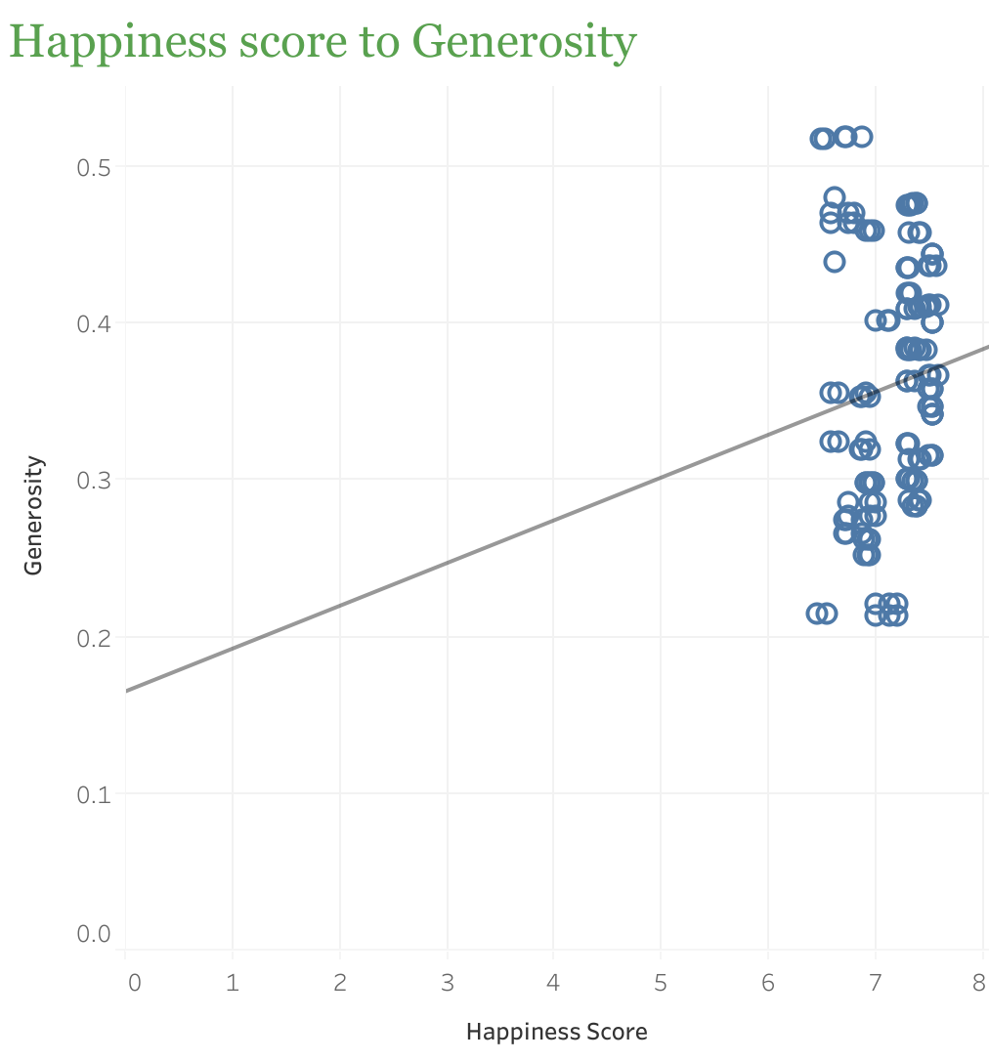
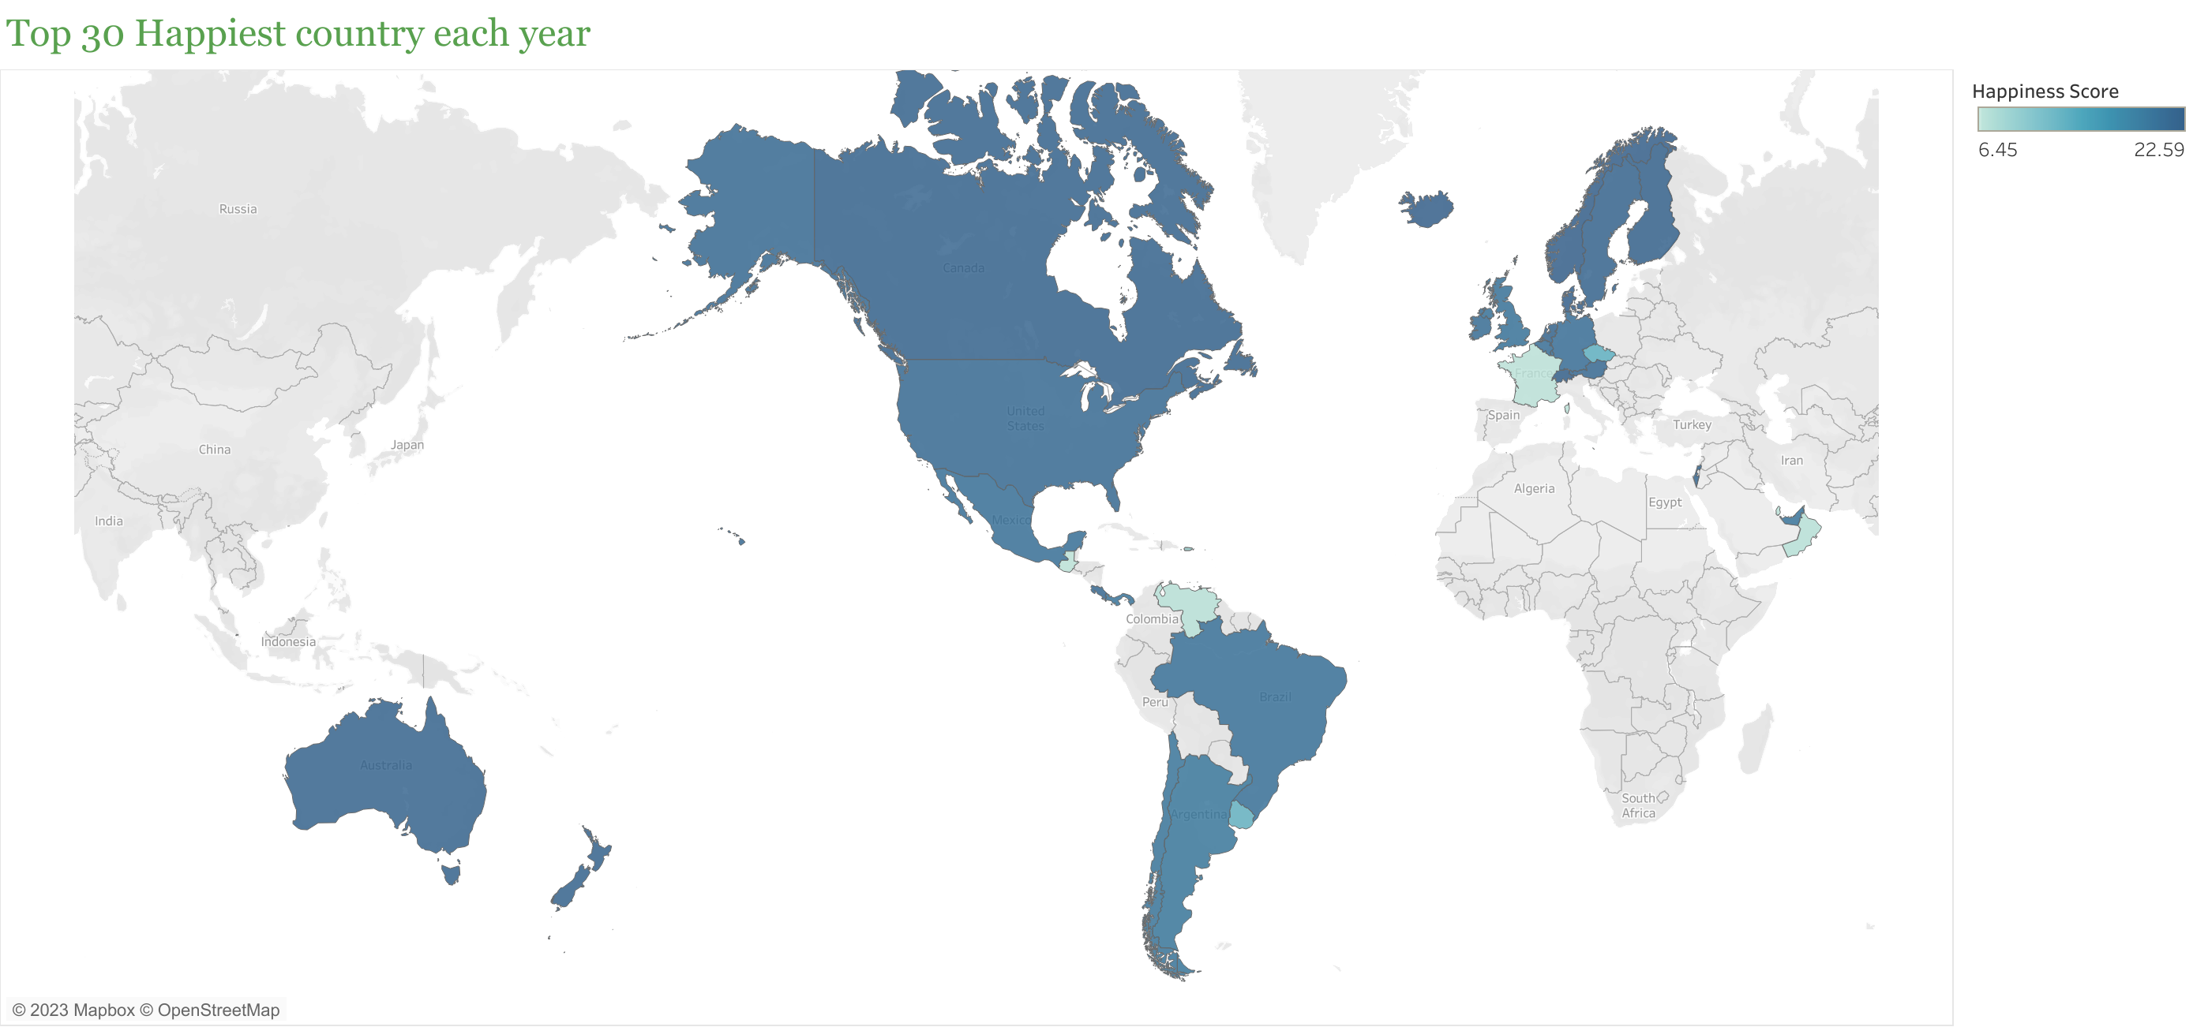
What causes happiness
Using the top 30 happiest country
. Generosity has little relationship to happiness

Slide 6
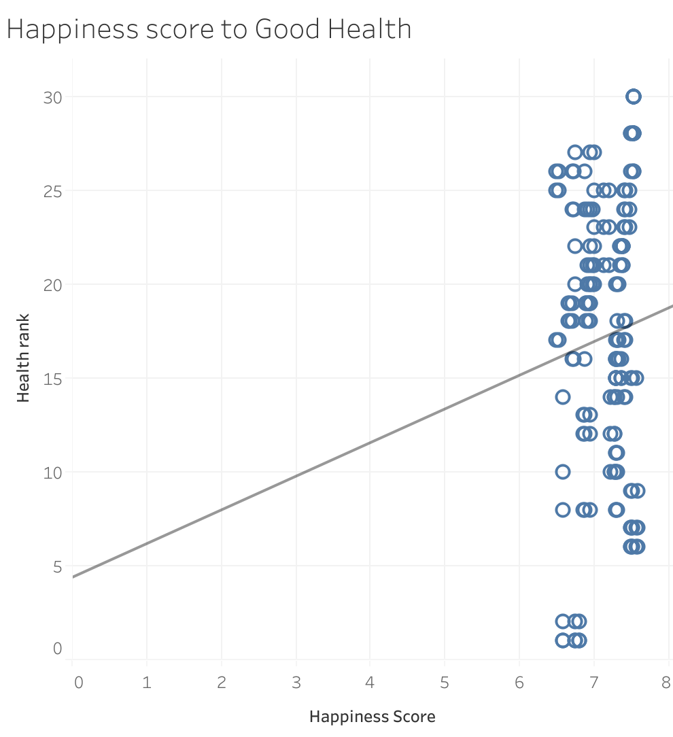
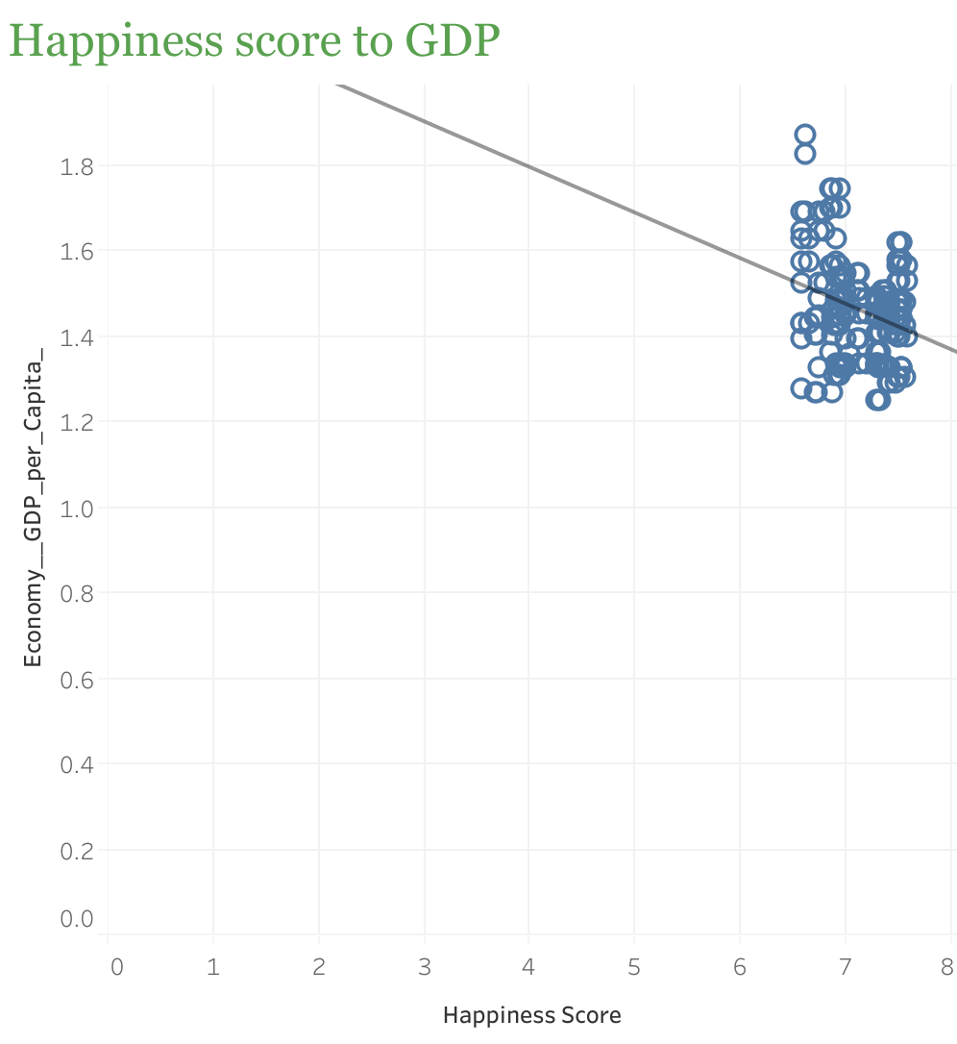
Top 2 strongest correlation
Good GDP suggests a strong correlation to Higher Happiness score
Good health also suggest a strong correlation to Higher Happiness score

Slide 7
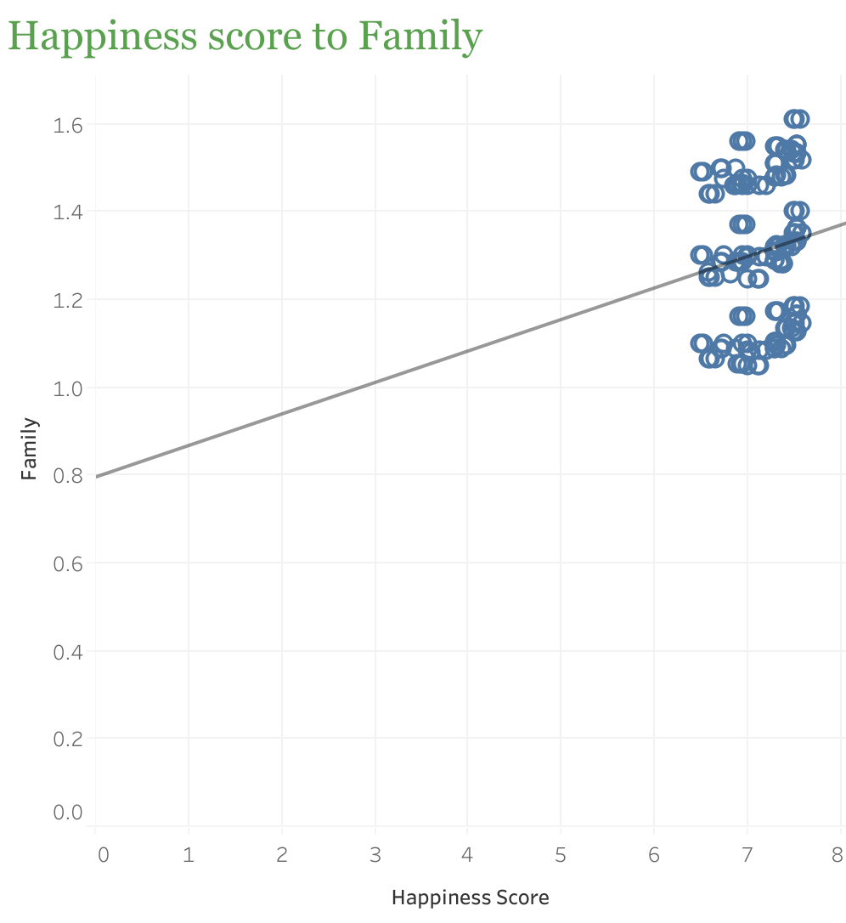
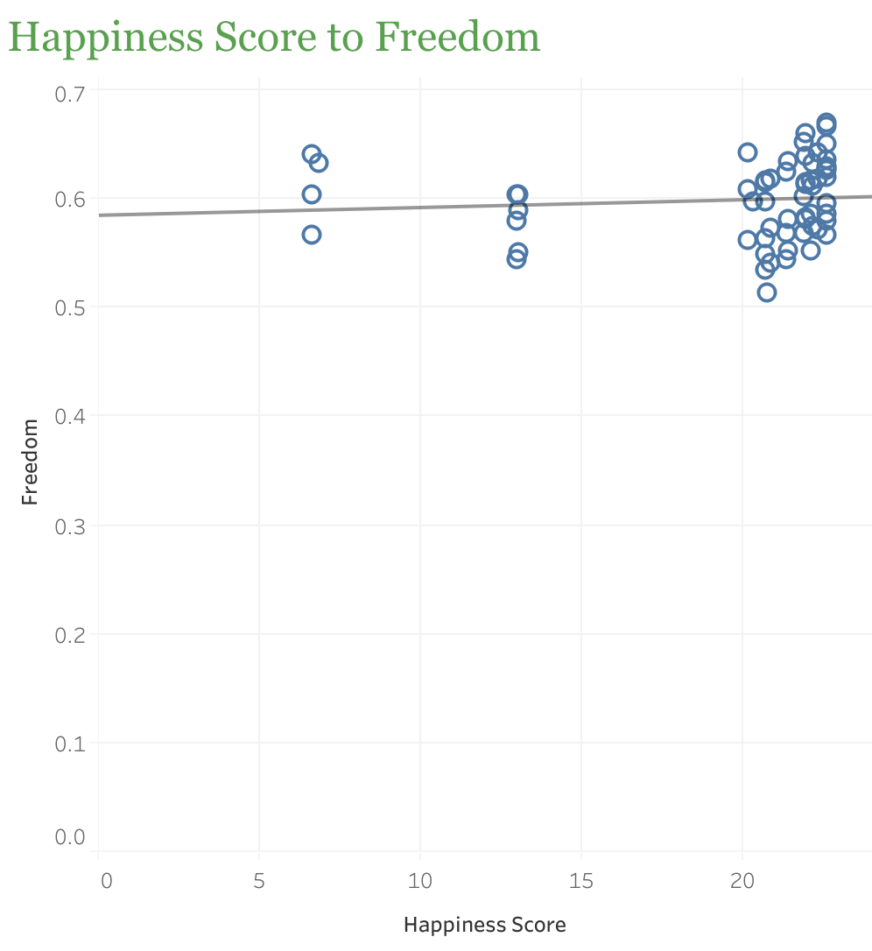
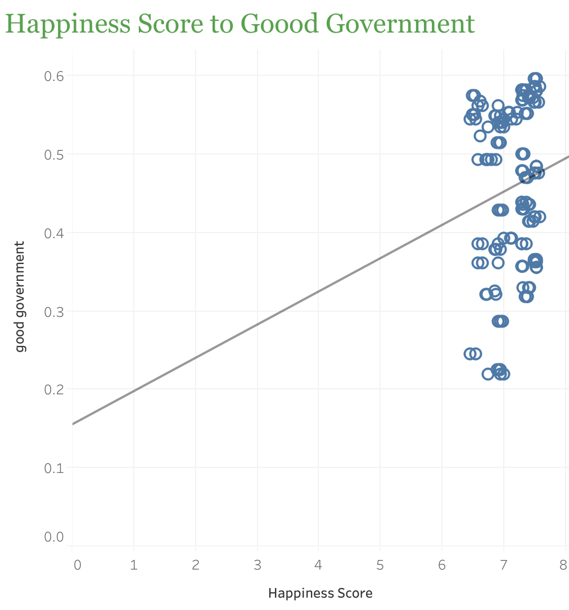
What else
Good government suggest little relationship with happiness
Freedom suggest no correlation to happiness
Family also has little to no correlation to happiness

Slide 8
conclusion
Health and wealth are the top 2 indicator of happiness
The richer and healthier a country is the happier the country seem to be

Slide 9

recommendations
For a happier country Governments should focus on:
Increasing their GDP
Providing and promoting healthy habits so citizens can have a higher life expectancy
also establish trust between citizens and the government.

