Slide 1
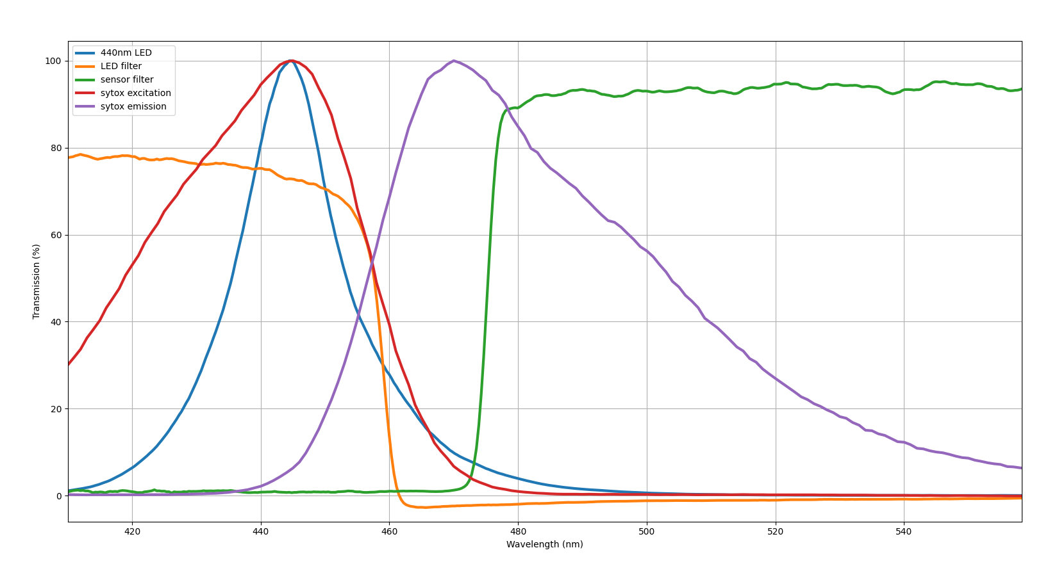
Sample Fluorimeter

Slide 2
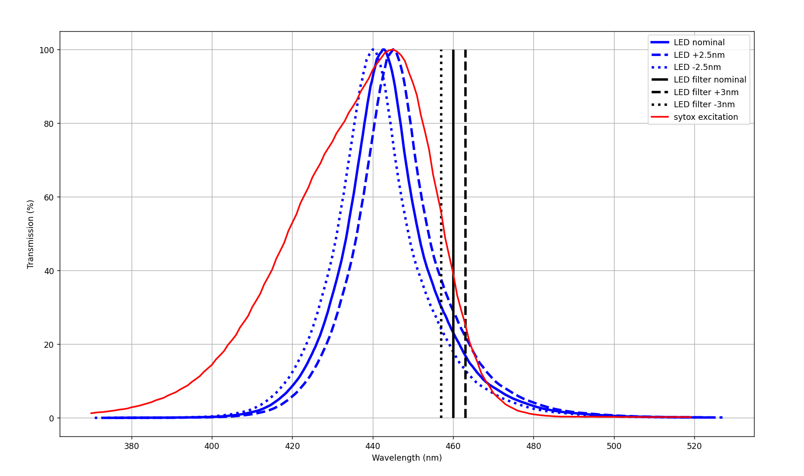
LED

Slide 3
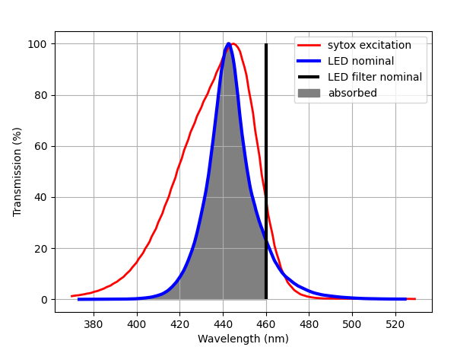
LED Nominal
Area = 1926

Slide 4
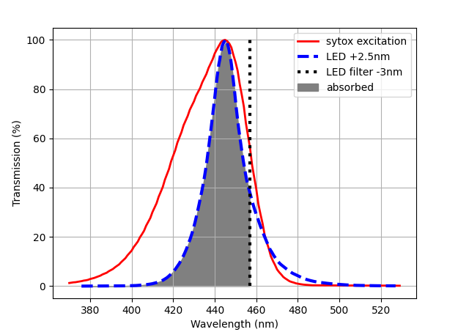
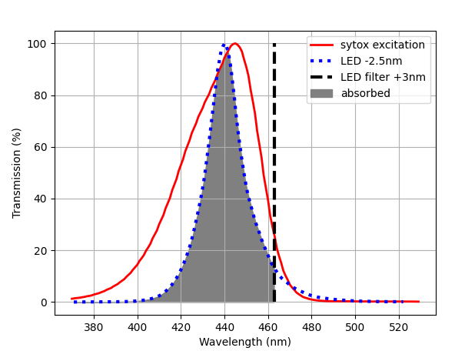
LED Shift
LED + 2.5nm
Filter – 3nm
LED – 2.5nm
Filter + 3nm
Area = 1821
Area = 2000

Slide 5
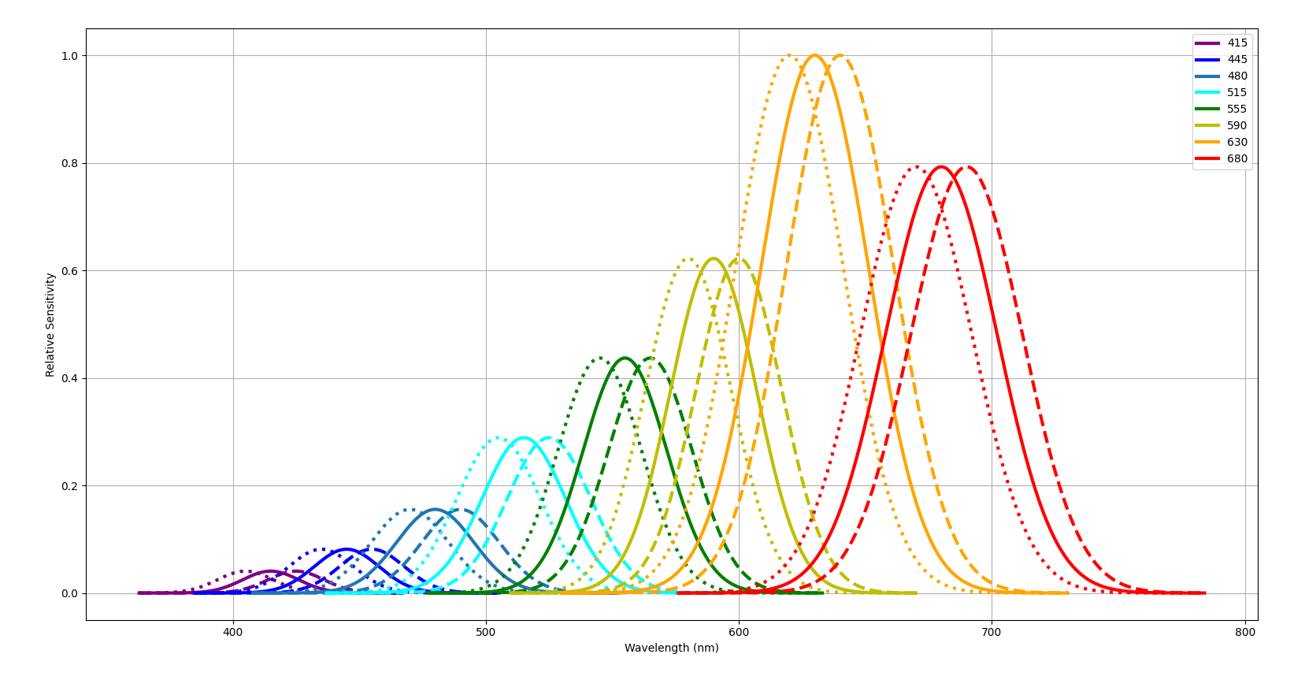
Detector

Slide 6
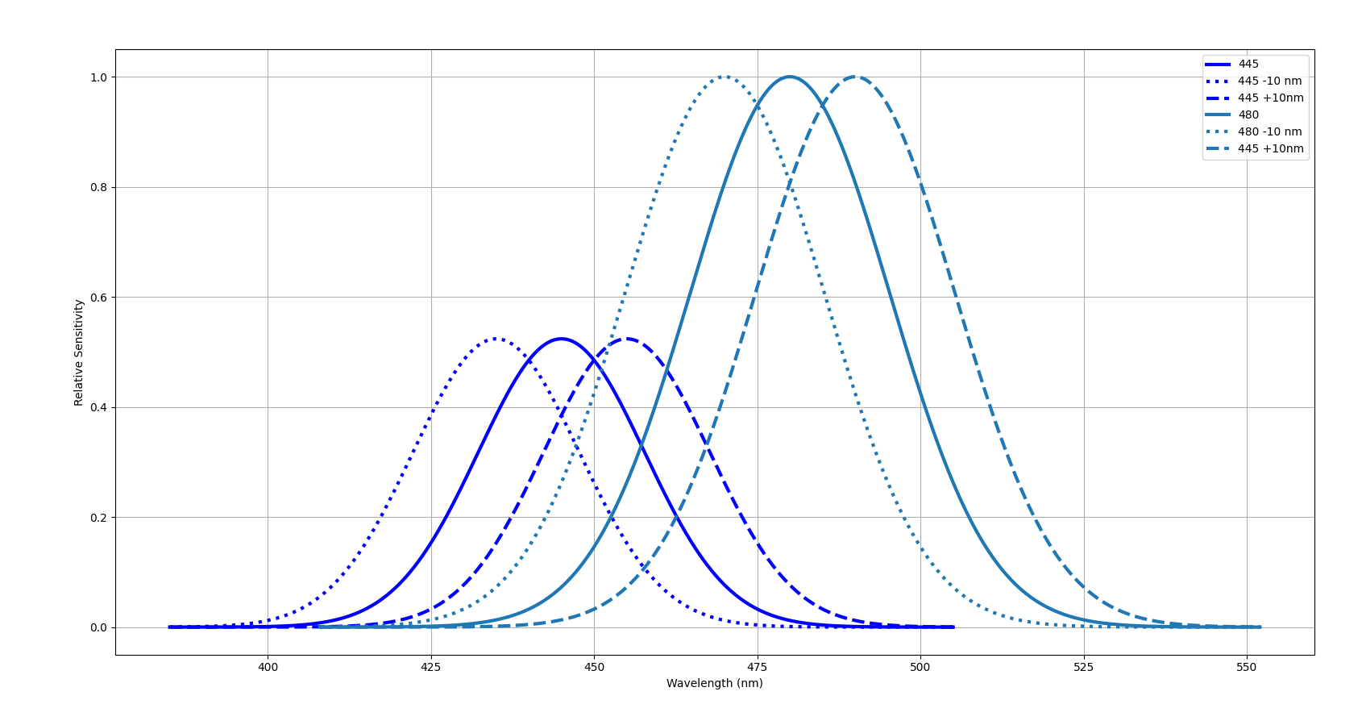
445 + 480

Slide 7
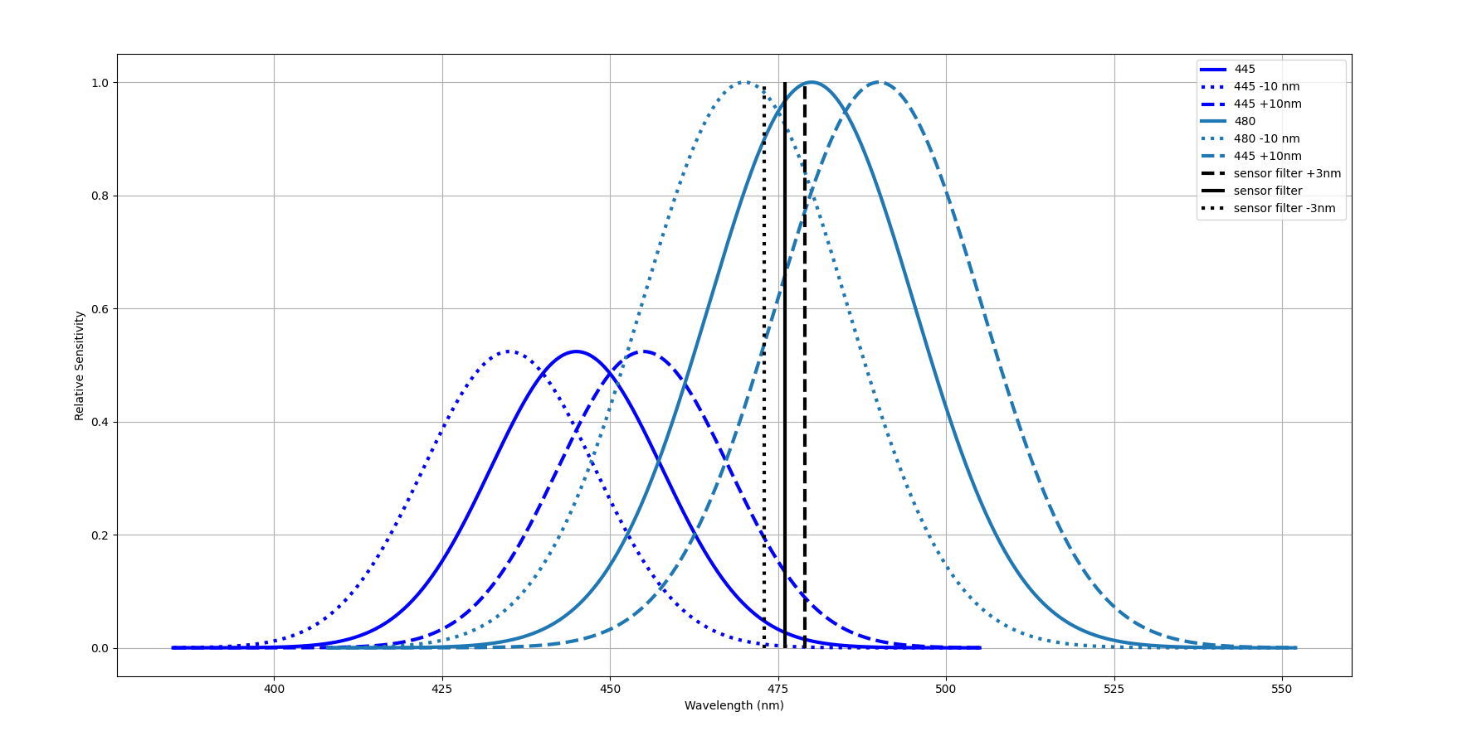
445 + 480

Slide 8
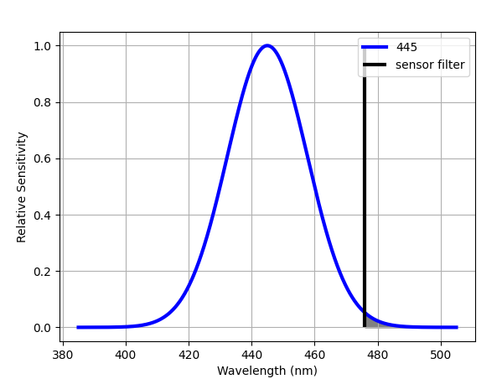
445 Nominal
Area = 0.238

Slide 9
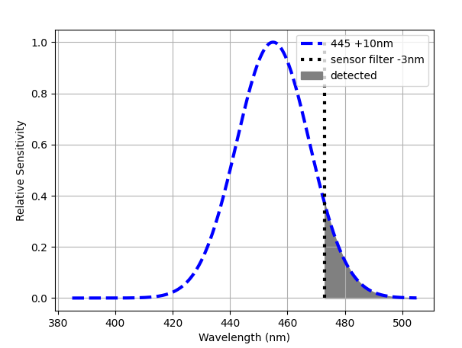
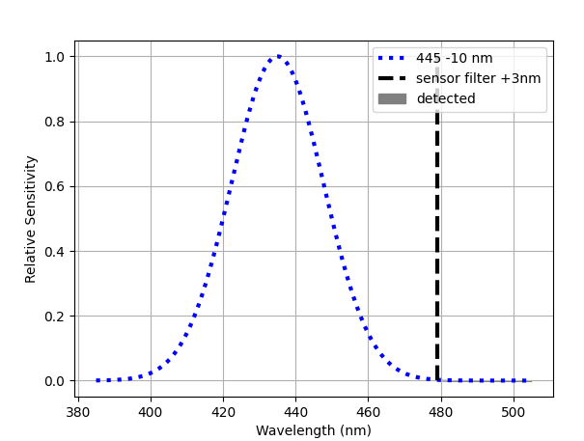
445 Shift
445 + 10nm
Filter – 3nm
445 – 10nm
Filter + 3nm
Area = 2.51
Area = 0.009

