Slide 1
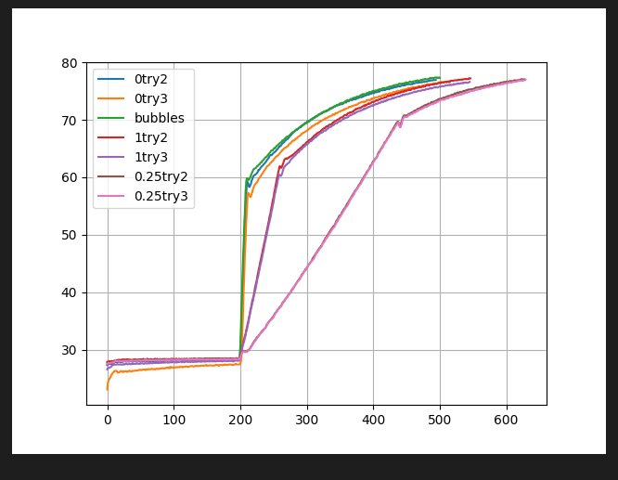
0 ramp rate has steepest slope

Slide 2
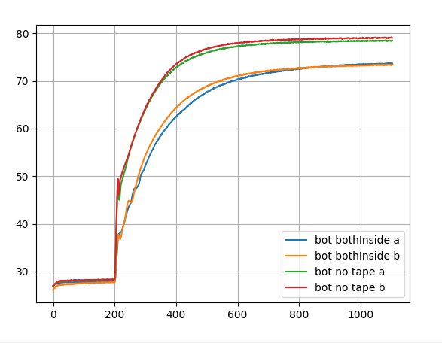
Red/green: no tape on bottom
Blue/orange: tape on bottom
Tape/thermocouple on outside changes energy transfer

