Slide 1
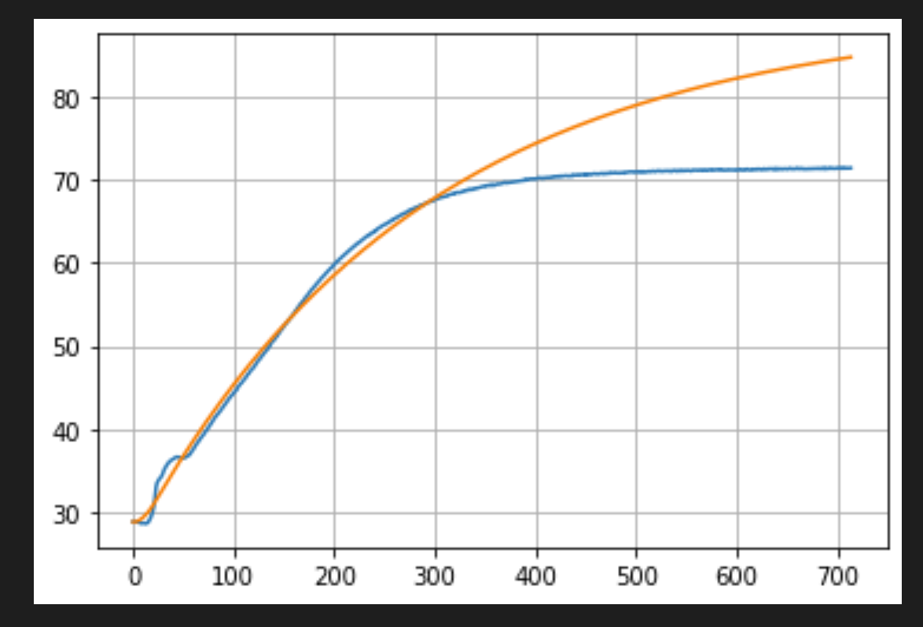
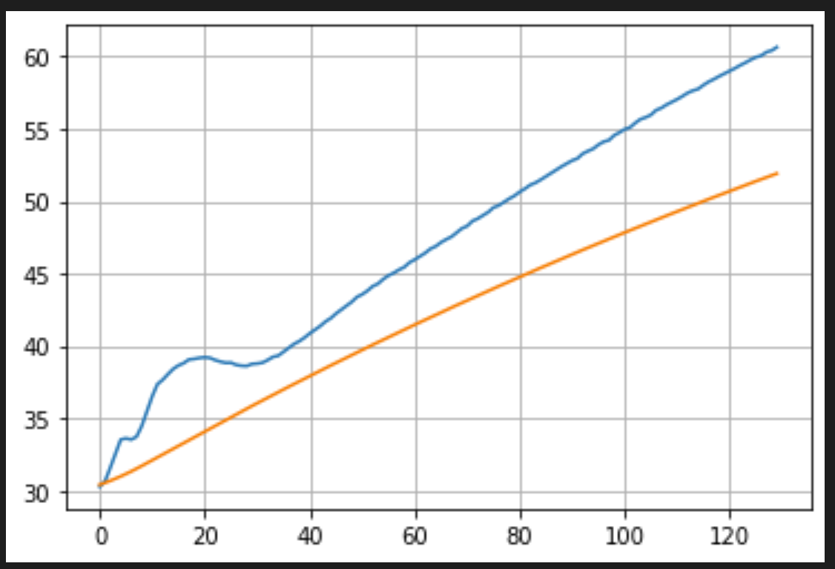
Klauman filter method, found optimal coeff for test data but doesn’t match for full run
Filter overshoots data at ~300s but works for piecewise function

Slide 2
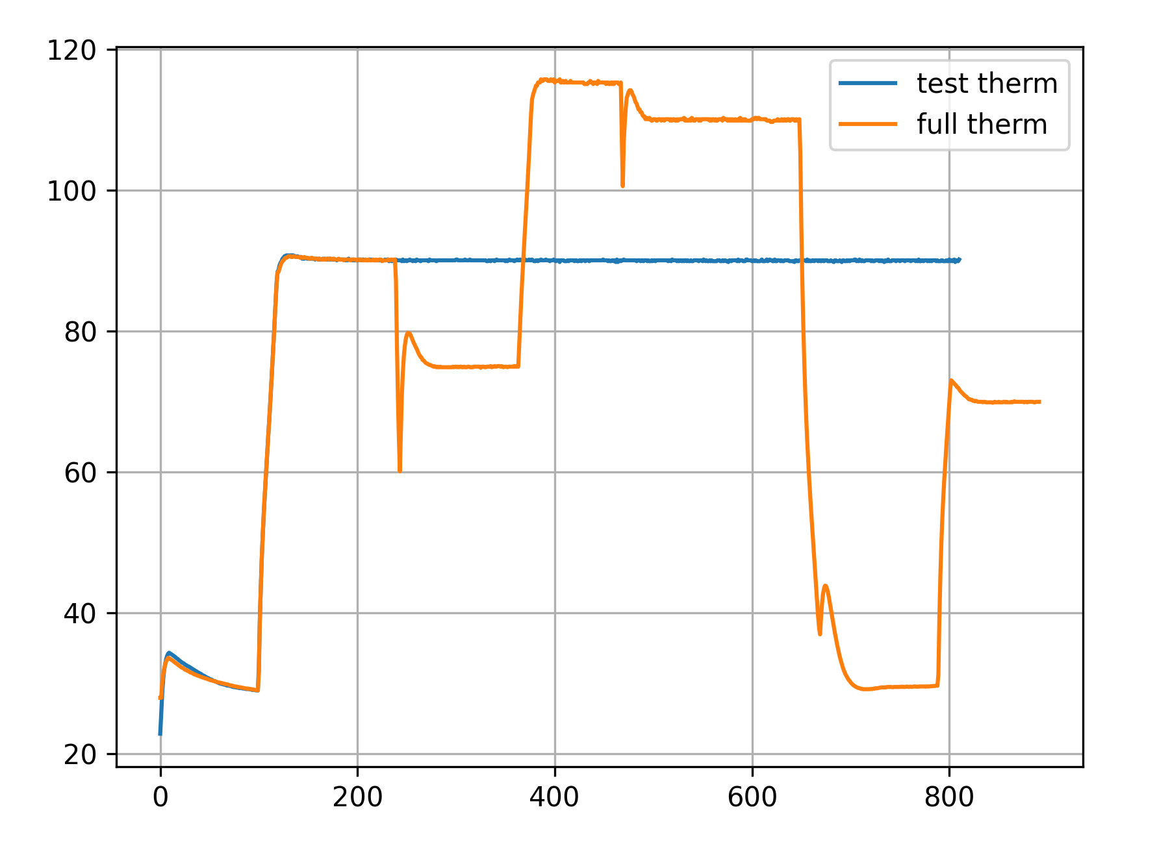
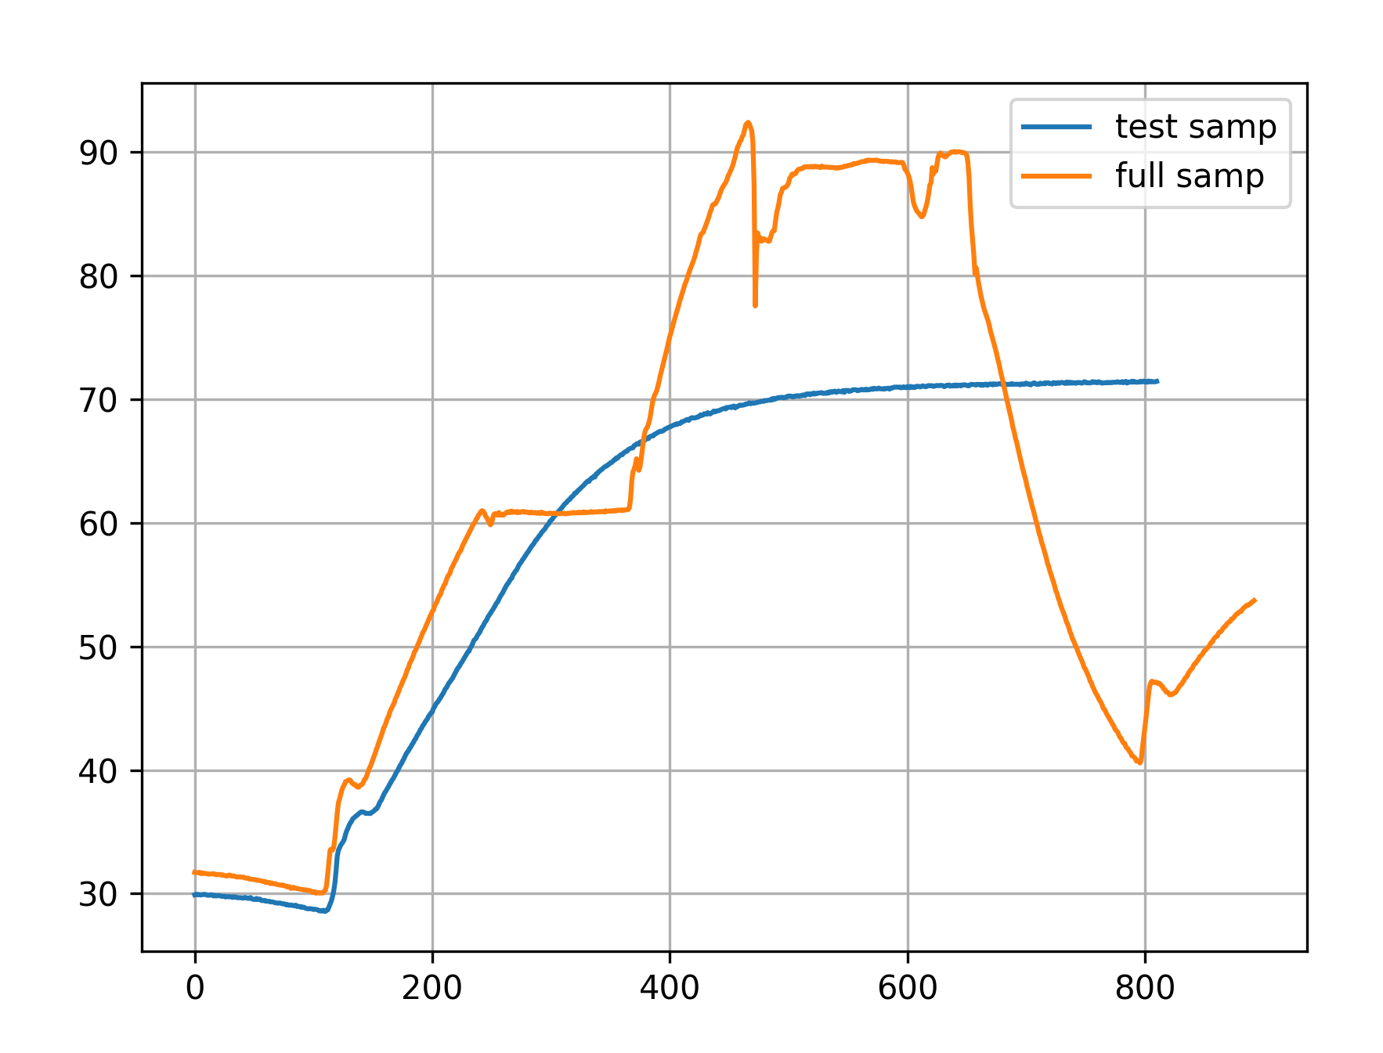
Thermister readings have little variability from run to run but thermocouple data is ~10C off

Slide 3
Problem:
Inconsistent placement of thermocouple
Instruments may ramp at different speeds

Slide 4
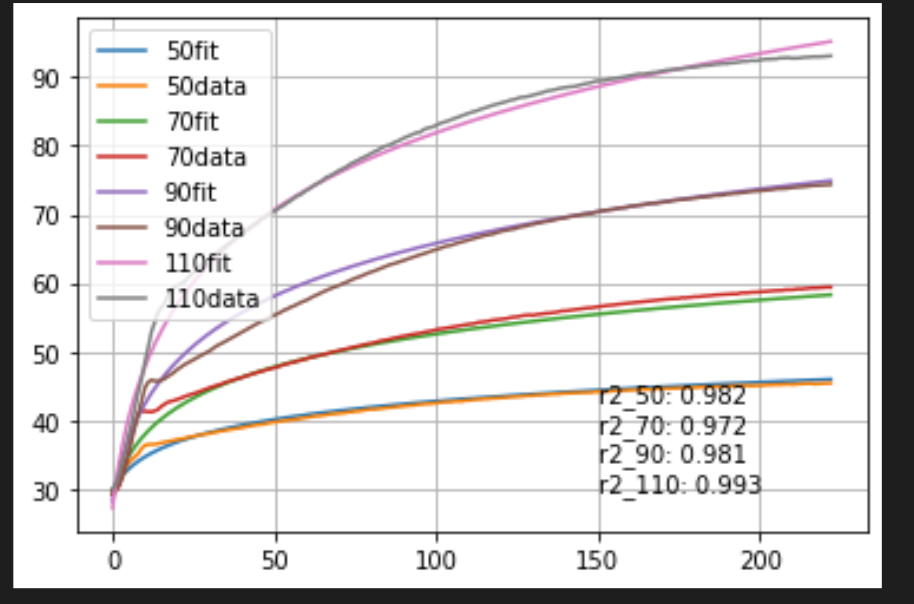
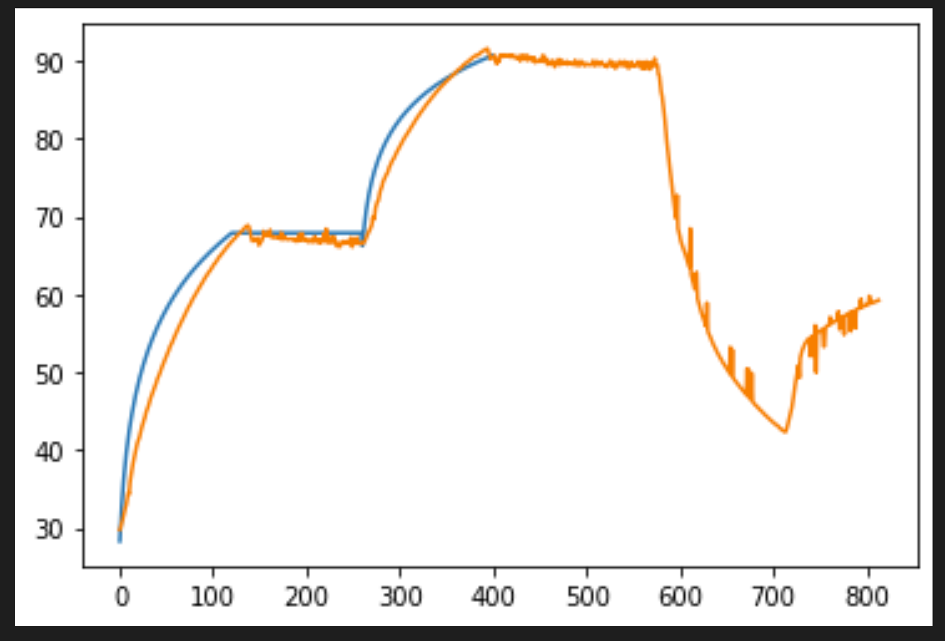

Slide 5
