Slide 1
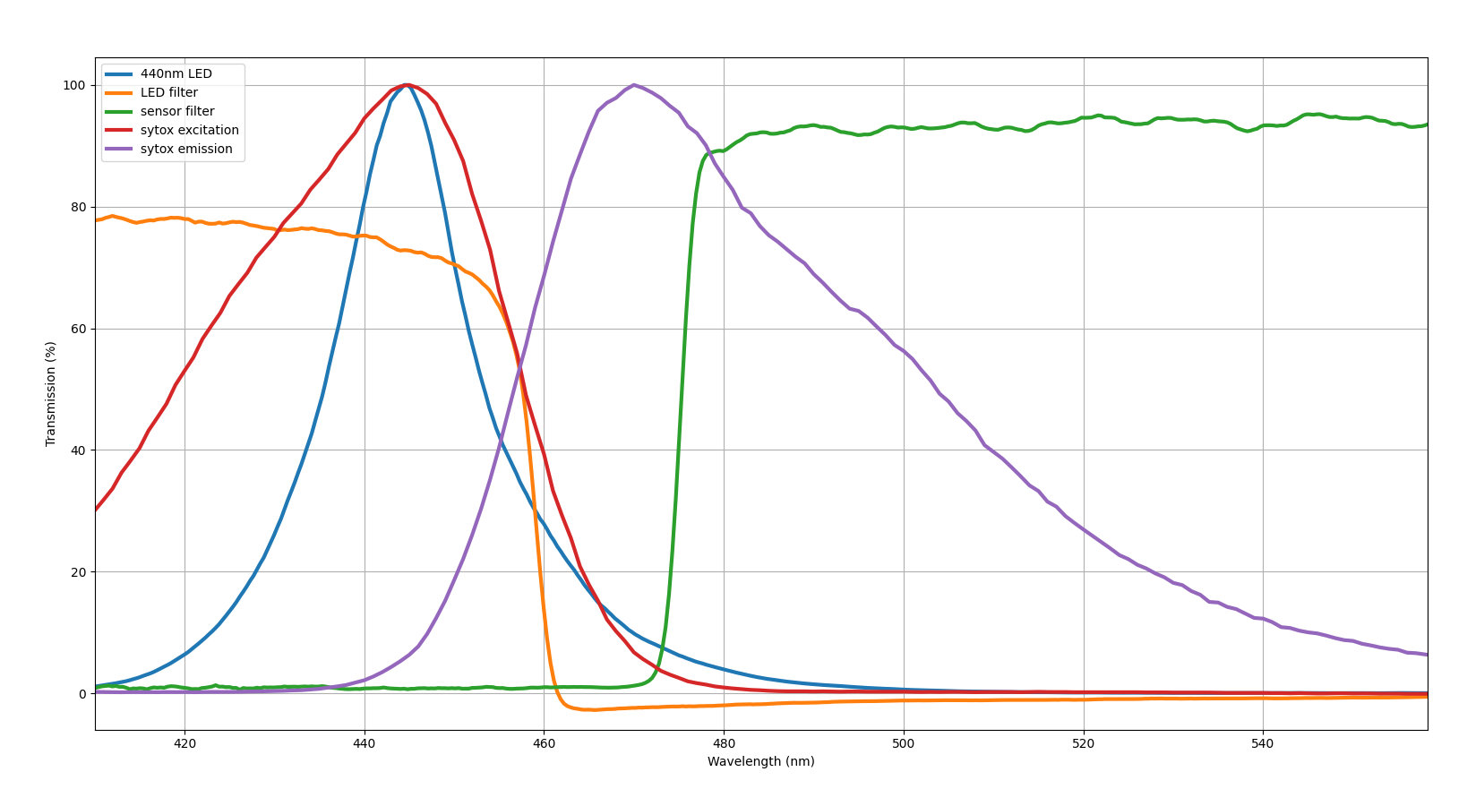
Sample Fluorimeter

Slide 2
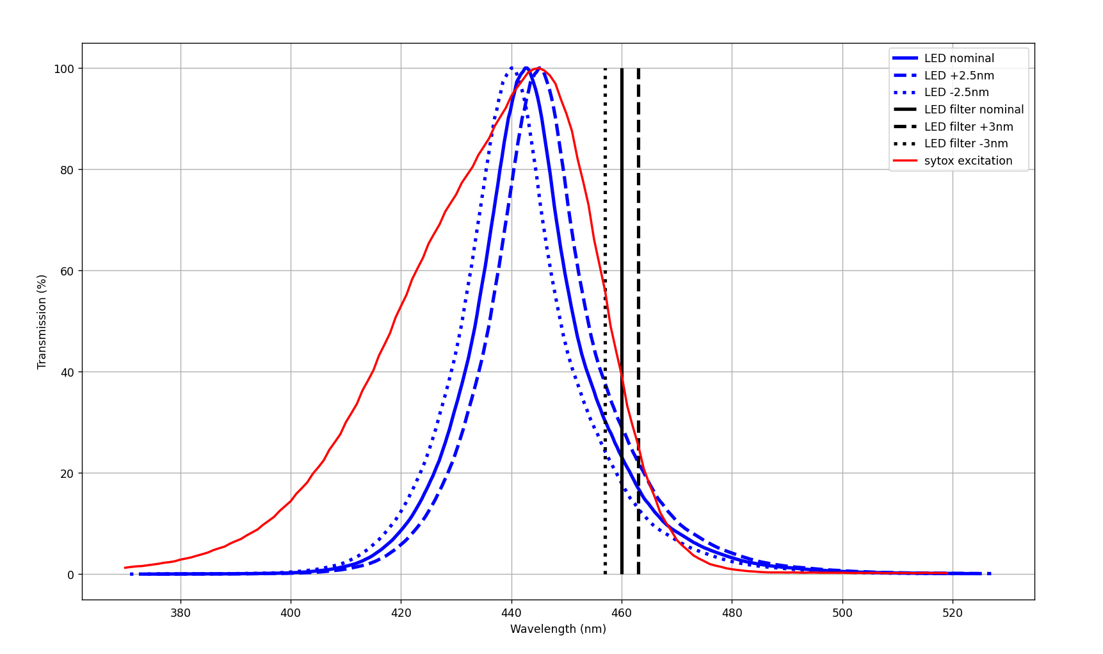
LED

Slide 3
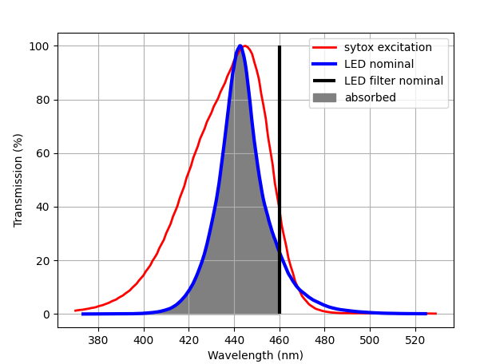
LED Nominal
Area = 1926

Slide 4
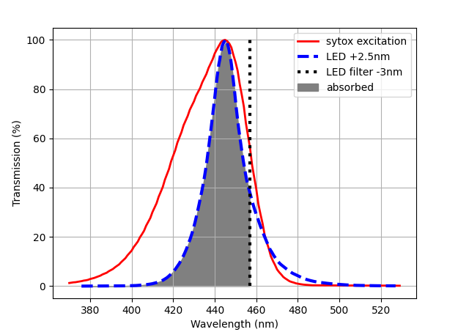
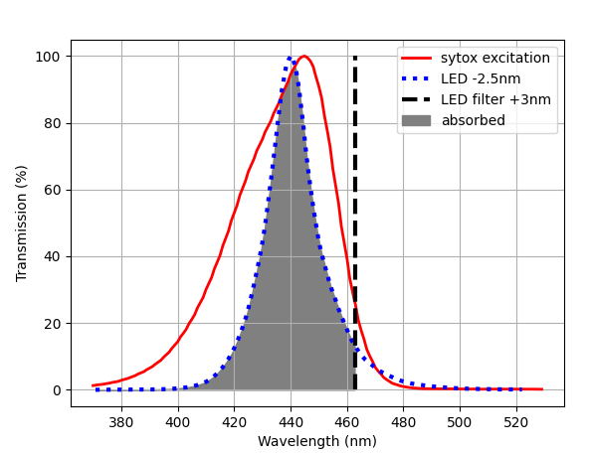
LED Shift
LED + 2.5nm
Filter – 3nm
LED – 2.5nm
Filter + 3nm
Area = 1821
Area = 2000

Slide 5
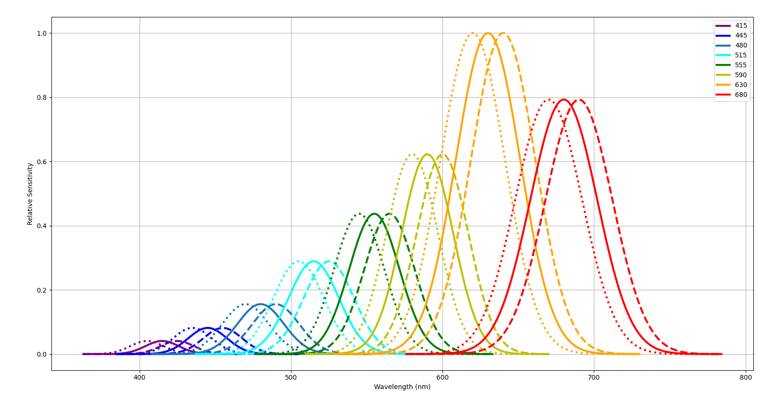
Detector

Slide 6
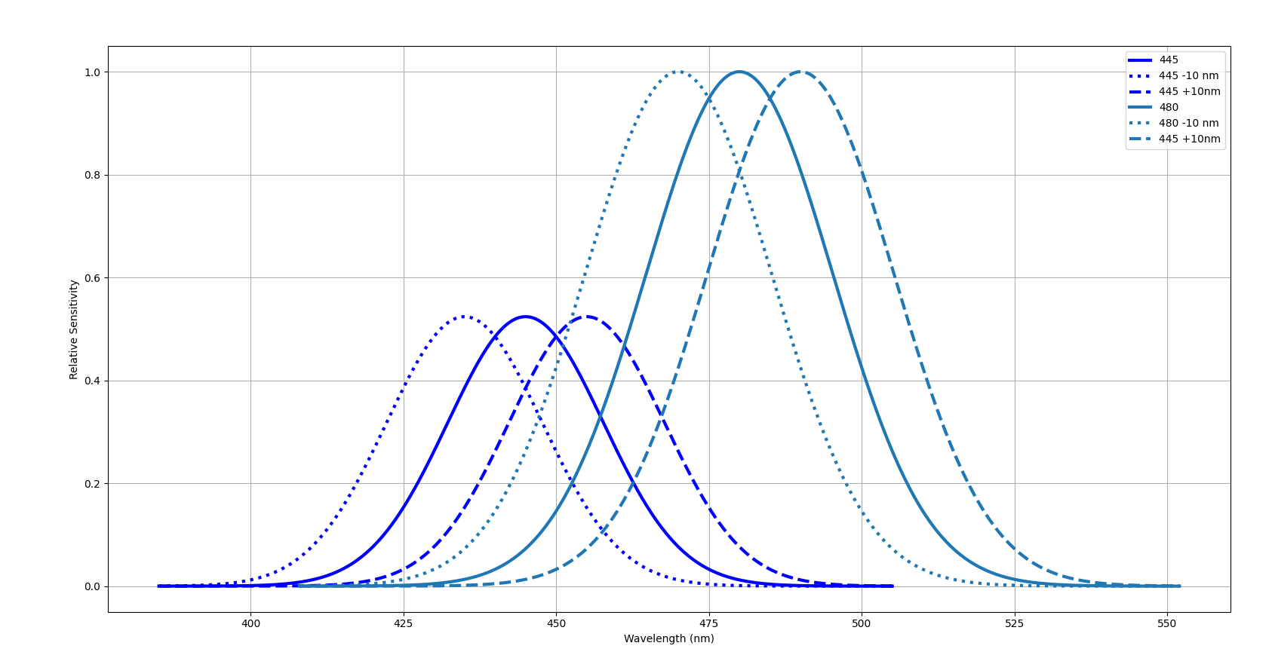
445 + 480

Slide 7
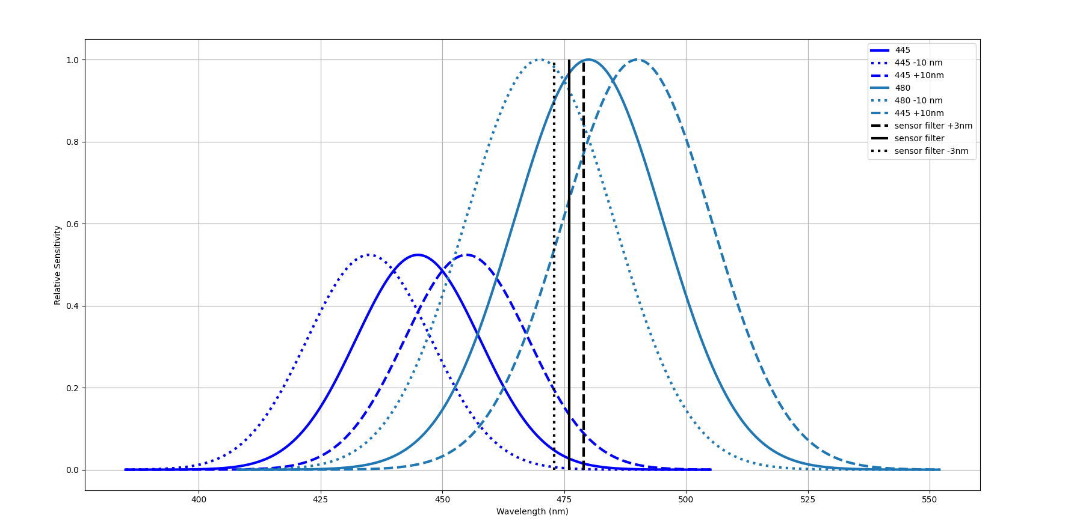
445 + 480

Slide 8
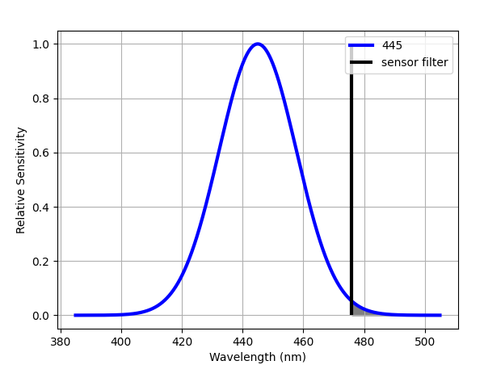
445 Nominal
Area = 0.007

Slide 9
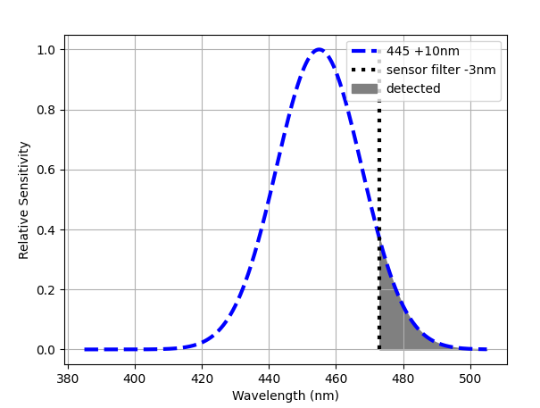
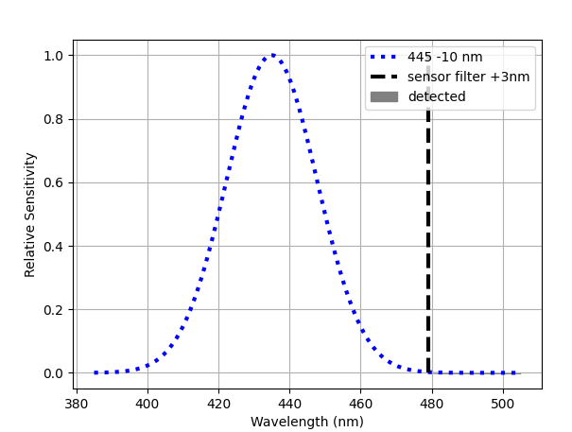
445 Shift
445 + 10nm
Filter – 3nm
445 – 10nm
Filter + 3nm
Area = 0.079
Area = 0.0003

Slide 10
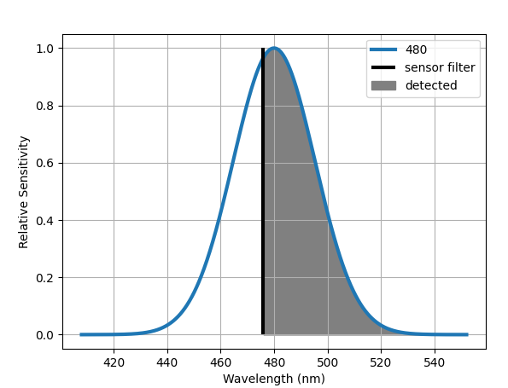
480 Nominal
Area = 0.60

Slide 11
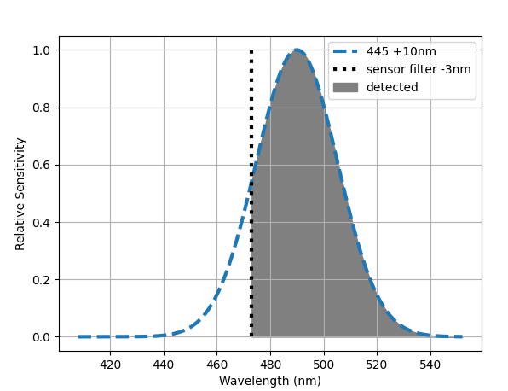
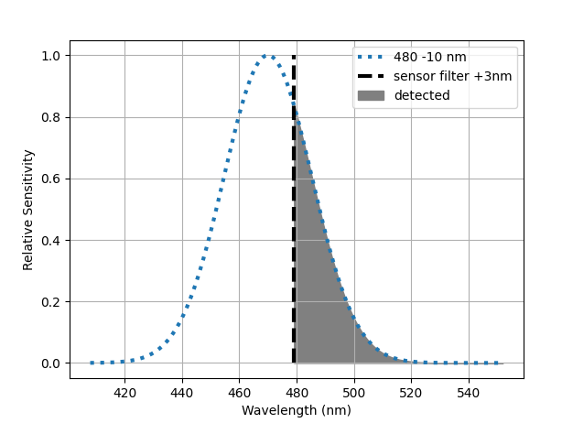
480 Shift
480 + 10nm
Filter – 3nm
480 – 10nm
Filter + 3nm
Area = 0.87
Area = 0.28

Slide 12
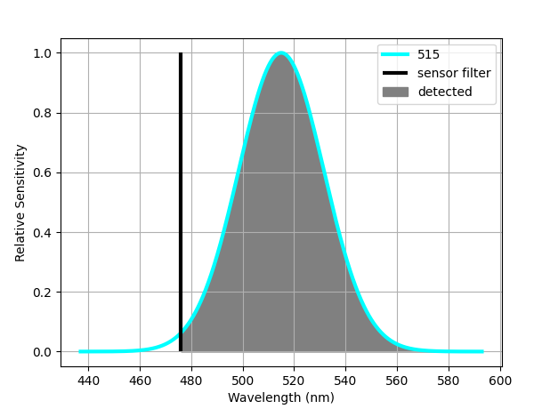
515 Nominal
Area = 0.991

Slide 13
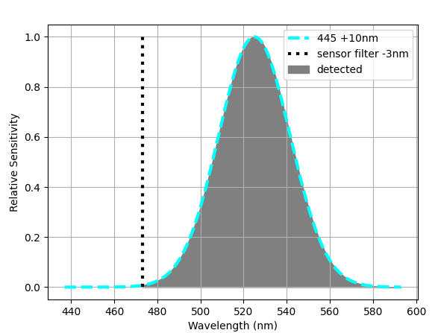
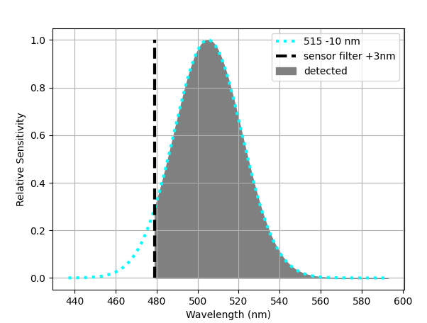
515 Shift
515 + 10nm
Filter – 3nm
515 – 10nm
Filter + 3nm
Area = 0.999
Area = 0.942

