Slide 2
PCR Thermals
hgDNA has not been amplifying on Beta instruments
Why?

Slide 3
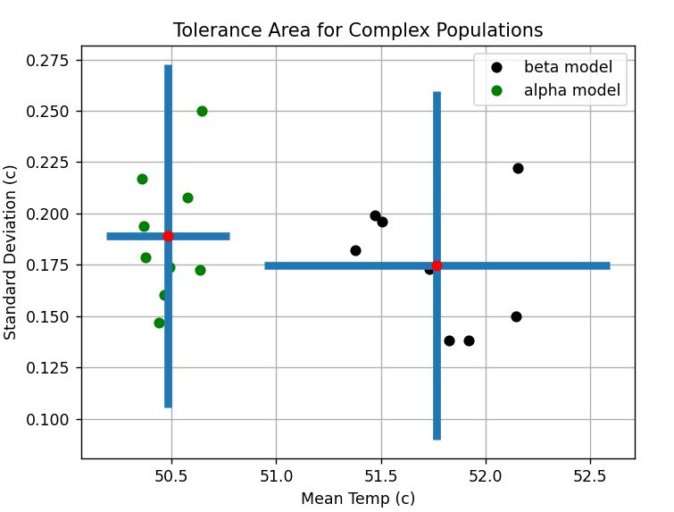
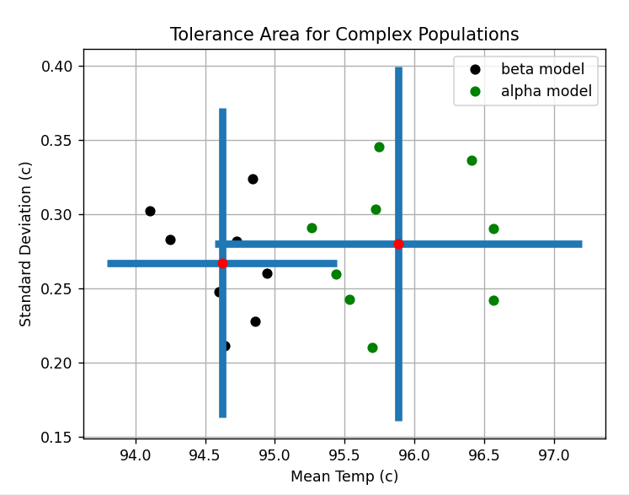
Alpha vs Beta Thermal Model
ANNEAL
DENATURE
https://research-internal.co-dx.io/#/plots/c%5B%5D%3Df731a958-3806-40e4-a0a1-8f35981e3b79%26c%5B%5D%3D3b00ce66-57c5-479a-8fbb-532b1ea2ee50%26c%5B%5D%3Df98cb520-589e-4de6-a31a-63938c89a463%26c%5B%5D%3De21e2621-b56d-4a98-83ff-dfae56de5182%26c%5B%5D%3Dd5626ba4-1311-40ce-9441-064f4f9ee133%26c%5B%5D%3D16a81a1e-2635-41e3-a131-e1e05ccc67fc%26c%5B%5D%3Dbd321178-9262-4111-bfa9-c9b7d0942b00
Notes:
Obvious difference between thermal models

Slide 4
Adjust Protocol with Beta Thermal Model
Nominal temps
Lower anneal 3c
Raise denature 1c
Lower anneal 3c + raise denature 1c
https://research-internal.co-dx.io/#/plots/c%5B%5D%3D918ac8c9-ae1c-4537-ad65-05f68383b6cd%26c%5B%5D%3Db634336d-9e0f-4dc8-878d-6517237378a7%26c%5B%5D%3D8be8e661-646d-4921-990b-76ff8fa89bdf%26c%5B%5D%3D422fffe5-9831-4fb5-9a6d-fbf9f55120a1%26c%5B%5D%3D5641c8d7-26ac-4c3f-97ba-f2f737dd767a%26c%5B%5D%3D34bcfb4d-d960-4f1c-9c7e-6166b6d7c204%26c%5B%5D%3Df4ed2ccd-0f23-41d7-9321-00c59c01c592%26c%5B%5D%3Dd2ca78e5-ee53-44f1-a50b-36c44ca362ab%26c%5B%5D%3D998d0de7-a23c-493b-83c5-88046a795b88
Notes:
Are not denaturing fully on each cycle

Slide 5
To Recap:
Tape cup detects 1-2c difference between thermal models
hgDNA peak observed when using alpha thermal model but not with beta thermal model
hgDNA peak observed on beta thermal model by raising the denature temp
BOTTOM LINE:
We likely are not reaching the denature temp which suggests the model is inaccurate
Notes:
Model is 100% dependent on 1 thermocouple cup that may or may not be representative of a typical chemistry run

