Slide 1
ENSC 427: Communication Networks Spring 2024
Final Project Presentation
Investigating the Effects of DDoS Attacks on End Users Over Different Ethernet Mediums
https://joshma25.github.io/
Joshua Ma | Josh Wong | Andrew Speers
jma154 | jcw49 | aspeers
jma154@sfu.ca | jcw49@sfu.ca | aspeers@sfu.ca
Group 2

Slide 2
Introduction
DDoS (Distributed Denial of Service) attacks are malicious attacks on a legitimate user to a service to prevent them of accessing that service
DDoS Attacks can happen to anybody at anytime and we want to find away to help defend ourselves on top of the defenses handled by ISP’s (Internet Service Provider)
We’ve been the victims of attacks in competitive online games and want a way to protect ourselves
The most common way we access the internet is using an ethernet connection
The purpose of this project was to test the effectiveness of better more expensive ethernet cables at mitigating the effects of an incoming DDoS attacks

Slide 3
Literature Review
Simulation of DDOS Attacks on P2P Networks ^{[1]}
Attacks server node via link (router) node to bottleneck server
User must send more packets to maintain connection further reducing available bandwidth
Large amounts of packet loss due to unavailability of destinations
Study found that DDoS attacks affect both the target node and the entire P2P network since it slows down the network performance and restricts flexibility

Slide 4
Background to DDoS Attacks
DDoS attacks are used to deny access to a service by flooding a network/server with bogus traffic
Performed by a hacker hijacking multiple machines known as attack daemon/zombies
These daemons then send a large volume of requests to the target’s IP address to overwhelm the network ^{[2,3]}
Smurf: Send an ICMP (Internet Control Message Protocol) flood with source address of the victim ^{[4]}
SYN Flood: TCP (Transmission Control Protocol) flood by continuously starting a 3 way handshake and never finishing them ^{[5]}
UDP flood: Sends a massive volume of UDP (User Datagram Protocol) to take up all of server bandwidth ^{[6]}

Slide 5
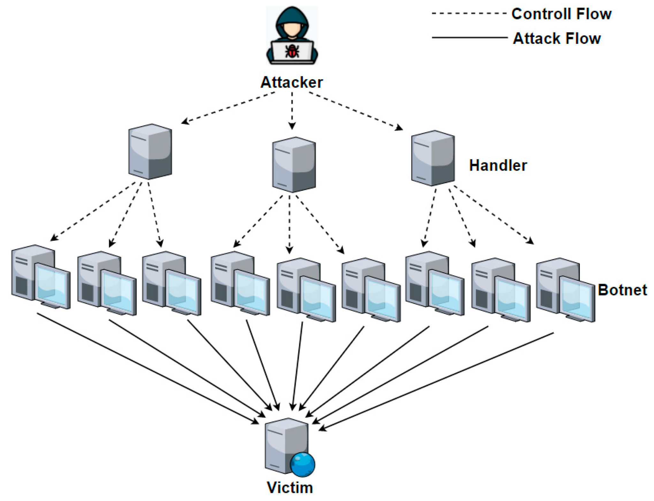
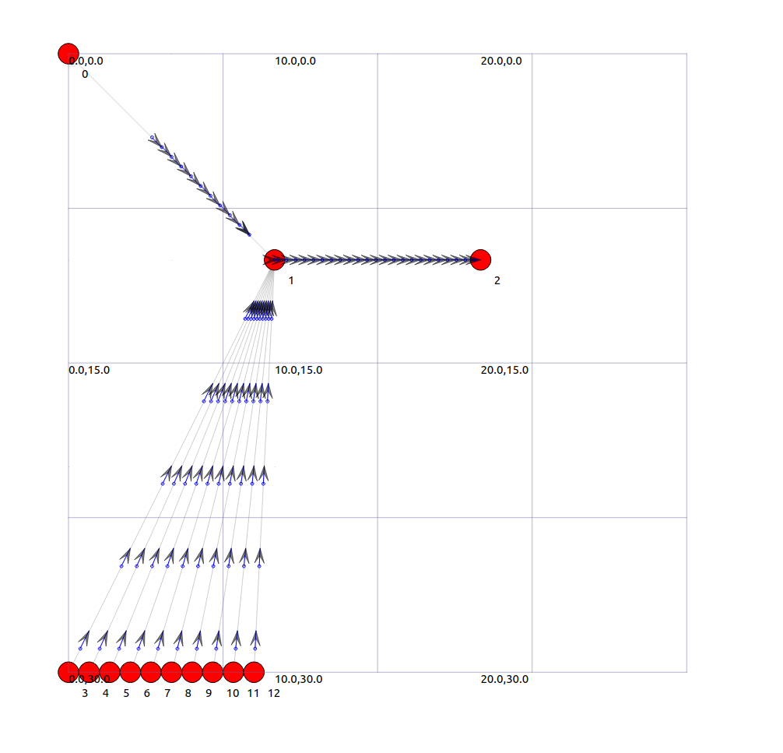
Background to DDoS Attacks
DDoS Attack Setup
Our DDoS simulation
Reference: [7]

Slide 6
Background: Ethernet Cables - Construction and Operation
Ethernet Cables provide a reliable and high-speed form of wired network connections
Ethernet cables consist of four twisted copper wire pairs
Twisting pairs of wires together helps to reduce crosstalk and noise induced between the wires
Shielding techniques between wires can also reduce noise and increase data transfer speeds
Shielding techniques include encasing the wires and/or cable with foil, braiding or a combination of both ^{[8]}
A plastic spline is also included in later generations of ethernet cables to further reduce noise by physically separating the twisted pairs ^{[9]}

Slide 7
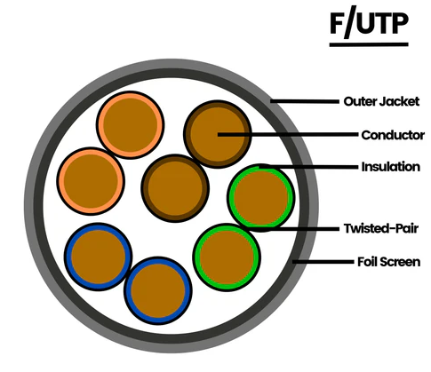
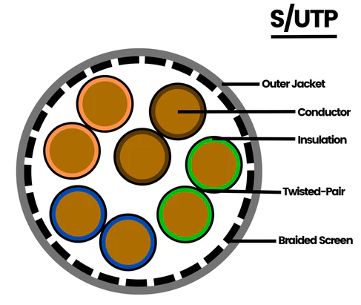
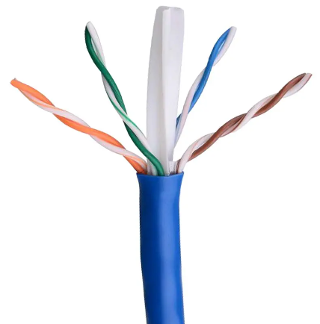
Background: Ethernet Cables - Shielding and Noise Reduction
Foil Shielding
Braided Shielding
Dielectric Spline
References: [10,11]

Slide 8
Background: Ethernet Cables - Types
Category | Max Speed | Max Bandwidth | Application
Cat 4 | 16 Mbps | 20 MHz | Found in old buildings that are unable to upgrade, mostly for IBM Token Ring networks
Cat 5 | 100 Mbps | 100 MHz | Old hardware but not for home networks
Cat 5e | 1 Gbps | 100 MHz | Home networks
Cat 6 | 1-10 Gbps | 250 MHz | Home and office networks
Cat 6a | 10 Gbps | 500 MHz | Office networks and data centers
Cat 7 | 40 Gbps | 600 MHz | Data centers and server rooms
References: [12,13]

Slide 9
Background: Ethernet Cables - Differences
The most important difference between the different ethernet cables is the maximum speed
In order to achieve fast speeds, the maximum bandwidth supported by the cable must also increase
Increasing bandwidth introduces more high frequency noise from the signal
Better shielding and noise suppression techniques needed to support higher bandwidths to increase transmission speeds
For example: jump from 100 MHz to 250 Mhz for cat5e and cat6 cables is the result of the addition of a plastic spline ^{[9]}

Slide 10
Investigating the Problem of DDoS Attacks
DDoS attacks have become more powerful overtime
Typical number of attacker bots ranges from 400-2000 depending on the scale and severity of the attack ^{[14]}
Typical attack rate of DDoS attacks range from 5-10 Gbps, also dependent on the scale and severity of the attack ^{[15]}
Attacks of up to over 2 Tbps have been recorded
For a majority of DDoS attacks, the links between nodes are not completely saturated and usually peak around 95% usage for less than 10 minutes ^{[15]}
Improving the data rate between nodes may improve the performance under a DDoS attack
This is the scope of our experimentation to see if the performance improves with higher speed ethernet cables

Slide 11
NS-3 Implementation
Create 1 legitimate user node, 1 server node, 1 node that connects the user and server, and a varied number of bots ranging from 10 to 100
Set the DDoS rate to 20480 Kb/s
When the code is ran, the bots will flood the server node with packets to produce network congestion while the user attempts to communicate with the server
The amount of congestion is proportional to the amount of bots
The data rate of the connection from the user node to the connection node is also varied, this connection simulates an ethernet cable
To measure the delay experienced by the user, we measure the time it takes for the first packet entering the congested network to return to the user

Slide 12
NS-3 Implementation - Pseudo code ^{[16]}
Create 3 nodes, a node for the legitimate user, the destination server, and the interface between the two
Create N number of attacker bot nodes
Create point-to-point connections between user and server
Create point-to-point connections between attacker bots and server
Loop N times to create all attacker bot connections
Assign IP address to user and server
Assign IP addresses to attacker bots
Loop N times to assign all attacker bot addresses
Setup UDPSink on receiver side
Setup TCPSink on server side
Configure NetAnim

Slide 13
Results
Increase in the number of bots increases the delay experienced
When using an ethernet cable with a higher transmission rate, the cable is more resistant to an increase in delays due to an increase in the number of bots
The Cat5 cable is significantly delayed when the server is attacked by 100 bots compared to 10 bots
In contrast, the Cat6 cable is barely affected by the congestion
When we used 10 bots for an attack and varied the transmission rate from 16 Mbps (Cat 4) to 1 Gbps (Cat 5e), we found that the delay decreases as transmission rate increases at a rate of 1/t
Notes:
We found that an increase in the number of bots increased the delay and that when we used an ethernet cable with a higher transmission rate, it was more resistant these delays. The cat5 cable is significantly delayed when the server is attacked by 100 bots compared to 10 bots in contrast, the cat6 cable is barely affected by the congestion. When we used 10 bots for an attack and varied the transmission rate from 16 Mbps to 1 Gbps, we found that the delay decreases as transmission rate increases at a rate of 1/t.

Slide 14
Results
Time between packet sent and return packet received (seconds)
Number of Bots DDoS Rate: 20480 kb/s | Data Rate (Cable Type)
 | # of Bots | Cat5 (100 Mbps) | Cat5e (1 Gbps) | Cat6 (10 Gbps)
 | 10 | 0.008698 | 0.003998 | 0.00395662
 | 20 | 0.008438 | 0.0040106 | 0.00400249
 | 30 | 0.00841 | 0.004013 | 0.004004
 | 40 | 0.008404 | 0.004021 | 0.004000003
 | 50 | 0.00842776 | 0.00436642 | 0.0040013
 | 75 | 0.01208 | 0.00443995 | 0.00400186
 | 100 | 0.01416 | 0.0044132 | 0.0040137
0 bot control = 0.0039861
Notes:
This is the data that we compiled for Cat5, Cat5e, and Cat6

Slide 15
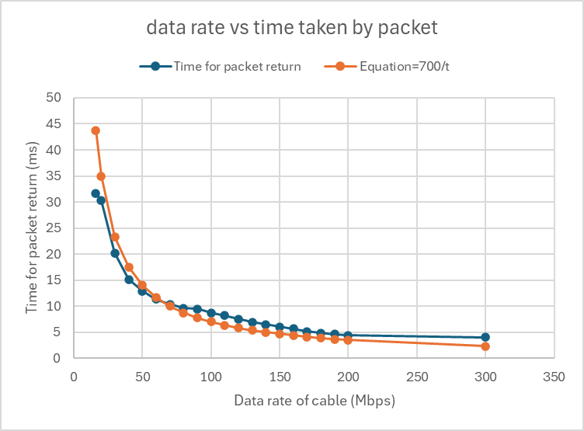
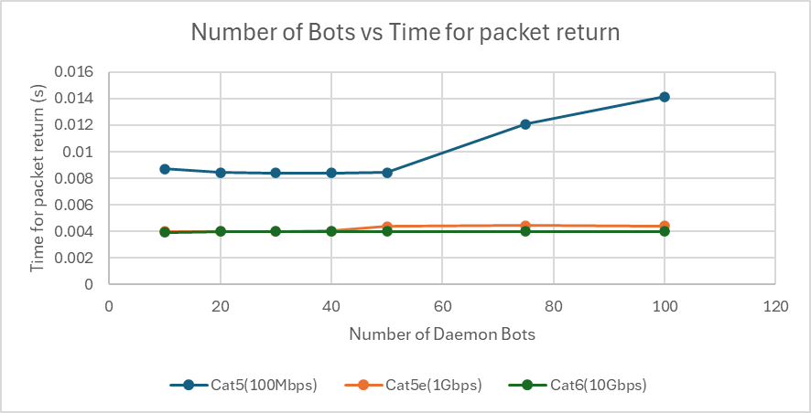
Results
Performance graph of different ethernet cables vs an increasing number of daemon bots
Graph of the relationship of data rate compared to packet transmission time

Slide 16
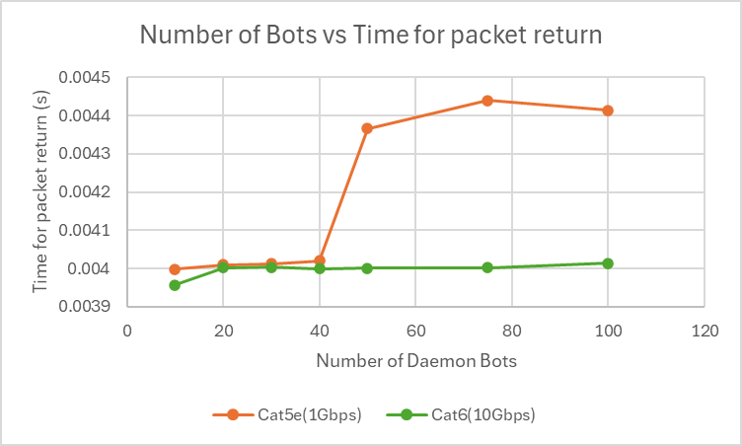
Results - Comparison between Cat5e and Cat6
Performance graph of different ethernet cables vs an increasing number of daemon bots
Performance graph zoomed in to better see the difference in Cat5e and Cat6

Slide 17
Discussion - Results
A higher transmission rate relative to the attack rate of the bots leads to higher resistance to network congestion
Cat5 has dramatically worse performance compared to Cat5e and Cat6
Cat6 cable was highly resistant to the rates that we attacked it with
At lower DDoS attack rates, the difference between Cat5e and Cat6 was not significant
Congestion could possibly be seen at much higher attack rates and number of bots that we were incapable of producing
Require a more efficient algorithm / a better computer to attack with even more bots .
Even though we were not able to simulate attacks with higher number of bots, we expect that the 1/t relationship between number of bots and transmission speeds would hold for faster ethernet cables
Notes:
We noticed that Cat5 performed dramatically worse compared to Cat5e and Cat6 and that Cat6 was highly resistant to the rates that we attacked it with. At lower attack rates, the difference between Cat5e and Cat6 is not as significant. Congestion for Cat6 cables could be possibly be seen in much higher attack rates and/or much higher number of bots that we were incapable of producing. We would need a more efficient algorithm or a better computer for this. We would expect that the 1/t relationship will still hold for faster ethernet cables

Slide 18
Discussion - Future Work
Refine algorithm so that we can run more bots/increase the attack rate
Try running the code on a better computer
Finalize the code for wireless connections so that we can compare wireless connections such as Wi-Fi to wired connections during DDoS attacks
Refine code so that it can more accurately represent modern DDoS attacks
Try using alternate simulators that could possibly simulate attacks more accurately (Riverbed)
Notes:
For future work, we would want to refine the algorithm so we can run more bots and increase the attack rate. We would also want to finalize the code for wireless connections so that we can also compare wireless conections such as WiFi. We would also want to refine code so that it can more accurately represent modern DDoS attacks and maybe try using alternate simulators that could possibly simulate attacks more accurately.

Slide 19
Conclusions
Analysed the effect of 10 - 100 bots attacking a server at a rate of 20480 Kb/s on ethernet cables of different types
Determined that there is an inverse relationship (1/t) between number of attacker bots and delay
Gained knowledge of how DDoS attacks work
Gained experience in NS-3
Notes:
Analysed the effect of 10-100 bots attacking a server at a rate of 20480 Kb/s on ethernet cables of different types and determined that there is an inverse relationship between the number of attacker bots and delay

Slide 20
References
[1] N. Qwasmi, F. Ahmed, and R. Liscano, “Simulation of DDOS Attacks on P2P Networks” in 2011 IEEE International Conference on High Performance Computing and Communications, Banff, AB, Canada, 02-04 Sept. 2011. DOI: 10.1109/HPCC.2011.86
[2] imperva, “DDoS Attacks.” imperva.com. https://www.imperva.com/learn/ddos/ddos-attacks/ (accessed Apr. 6, 2024).
[3] cloudflare, “What is a DDoS attack?” cloudflare.com. https://www.cloudflare.com/learning/ddos/what-is-a-ddos-attack/ (accessed Apr. 6, 2024).
[4] cloudflare, “Smurf DDoS attack.” cloudflare.com. https://www.cloudflare.com/learning/ddos/smurf-ddos-attack/ (accessed Apr. 6, 2024).
[5] cloudflare, “SYN flood attack.” cloudflare.com. https://www.cloudflare.com/learning/ddos/syn-flood-ddos-attack/ (accessed Apr. 6, 2024).
[6] cloudflare, “UDP flood attack.” cloudflare.com https://www.cloudflare.com/learning/ddos/udp-flood-ddos-attack/ (accessed Apr. 6, 2024).
[7] C. Shieh et al., “Detection of Unknown DDoS Attacks with Deep Learning and Gaussian Mixture Model,” MDPI Applied Science, vol. 11, no. 11, pp. 5213, Jun. 2021, doi: 10.3390/app11115213
[8] vcelink, “Ethernet Cables 101: The Basics of Network Cabling.” vcelink.com. https://www.vcelink.com/blogs/focus/ethernet-cable-101#:~:text=Ethernet%20cables%20come%20in%20different,to%20electromagnetic%20interference%20(EMI). (accessed Apr. 6 2024).

Slide 21
References Cont.
[9] blackbox, “What’s the difference between CAT5e and CAT6?” blackbox.co.uk. https://www.blackbox.co.uk/gb-gb/page/43869/Resources/Technical-Resources/Black-Box-Explains/Copper-Cable/Category-5e-And-6#:~:text=Not%20only%20does%20CAT6%20provide,and%20higher%20data%20transmission%20rates. (accessed Apr. 6, 2024).
[10] D. Harris. “Ethernet Cable Shielding Types.” truecable.com. https://www.truecable.com/blogs/cable-academy/ethernet-cable-shielding-types (accessed Apr. 6, 2024).
[11] lightguru, “CATEGORY 6 (CAT6) Cable UTP Data Blue PVC with Spline (Per meter).” lightguru.sg. https://lightguru.sg/product/category-6-cat6-cable-utp-data-blue-pvc-with-spline/ (accessed Apr. 6, 2024).
[12] vcelink, “Choosing the Best Ethernet Cable for Gaming in 4 Steps.” vcelink.com. https://www.vcelink.com/blogs/focus/best-ethernet-cable-for-gaming (accessed Apr. 6, 2024).
[13] TRIPP LITE, “Ethernet Cables Explained.” tripplite.eaton.com. https://tripplite.eaton.com/products/ethernet-cable-types (accessed Apr. 6, 2024).
[14] redwolfsecurity, “Simulating DDoS Attacks - how many attackers is enough?” redwolfsecurity.com. https://www.redwolfsecurity.com/simulating-ddos-attacks-many-attackers-enough/ (accessed Apr. 6 2024).
[15] S. Cook, “20+ DDoS attack trends and statistics in 2024: The rising threat.” comparitech.com. https://www.comparitech.com/blog/information-security/ddos-statistics-facts/ (accessed Apr. 6, 2024).
[16] DDoSim.cc. (2020), S. Upadhyay. Accessed: Mar. 8, 2024, [C++, online], Available: https://gist.github.com/Saket-Upadhyay/c4c702716233cab91eb31b6d547aaeab

Slide 22
Contributions
Joshua Ma: Charts, website, discussion - 33%
Josh Wong: Ethernet background research, NS-3 pseudo code and comments, reference list - 33%
Andrew Speers: Graphs and DDoS attack background and discussion - 33%
Evenly Shared: Simulations and results

Slide 23
Questions?

