Slide 1

Education VCE Passing Score- ATAR (or equivalent) of success
GROUP 6
Josh Martin
Peregrin Ryan
Udeshi Pereira

Slide 2


Motivation:
Our group was interested in investigating relationship between Geolocation access to education as well as the effect of Private and Public education has on academic success.

Slide 3

If students within Major Cities such as Melbourne or Geelong, that also receive Private, Non-Gov education then we expect them to have best chance of academic success within Victoria
Hypothesis:
This Photo by Unknown Author is licensed under CC BY-NC

Slide 4

Our measurement of academic success
The way we measure academic success was measuring ATAR Score

Slide 5


Slide 6


Slide 7
Is there a relationship with Geolocation academic success?
YES, Schools closer to Major Cities have better academic performance.
Is there a relationship with Geolocation and the choices of schools?
YES, There are more schools closer to Major Cities than regional Victoria
Which school sector has their best academic success?
Non-Gov school sector had their best academic success.

Slide 8

Data clean up process
Josh Martin

Slide 9
JOSH

Slide 10
JOSH

Slide 11
DATA Analysis
PEREGRIN RYAN

Slide 12
Defining Geolocation
Major city (Melbourne and Geelong)
Provincial city (e.g., Ballarat and Bendigo)
Provincial centre (e.g., Mildura, Swan Hill)
Large town (e.g., Leongatha, Lorne)
Small town (e.g., Terang, Skipton)
Rural (e.g., Bright, Donald)
Remote (e.g., Orbost).

Slide 13
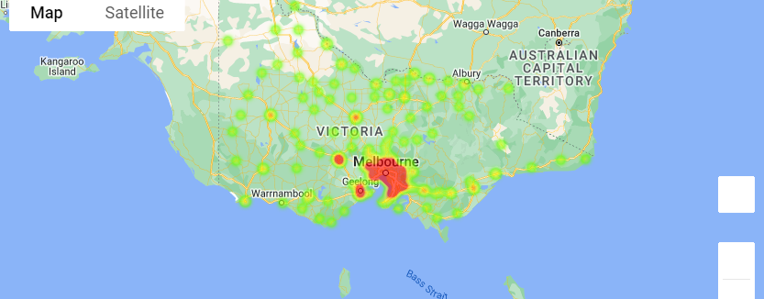
School Geolocation heatmap

Slide 14
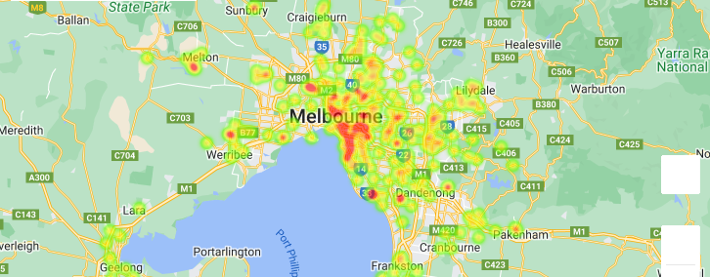
School Geolocation heatmap Major Cities

Slide 15
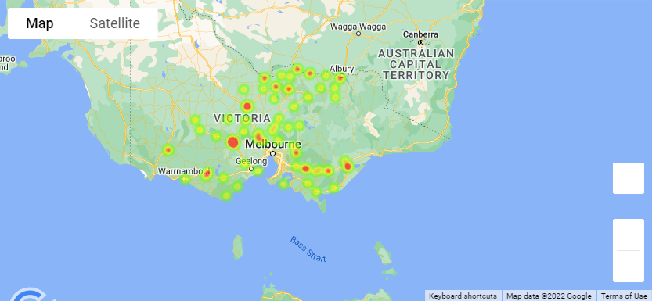
School Geolocation heatmap Inner Regional

Slide 16
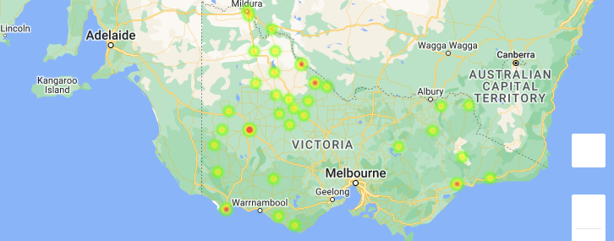
School Geolocation heatmap Outer Regional

Slide 17
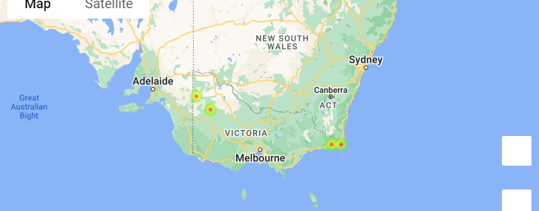
School Geolocation heatmap Remote

Slide 18
Access to education from Geolocation

Slide 19
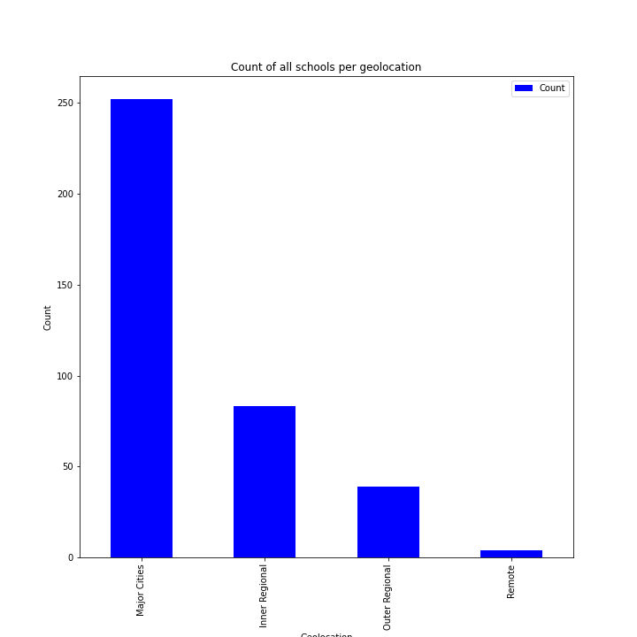
Count of all schools per Geolocation

Slide 20
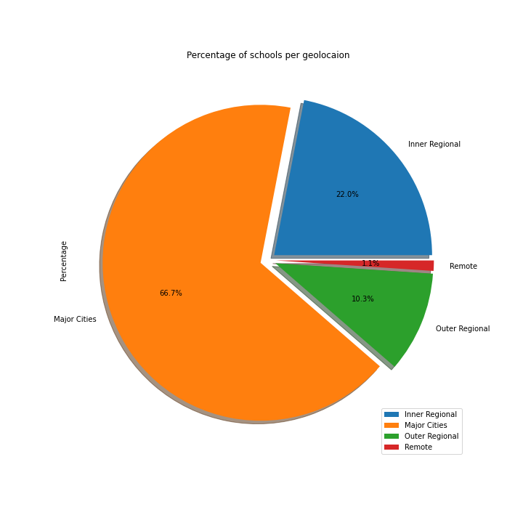
Percentage of schools per Geolocation

Slide 21
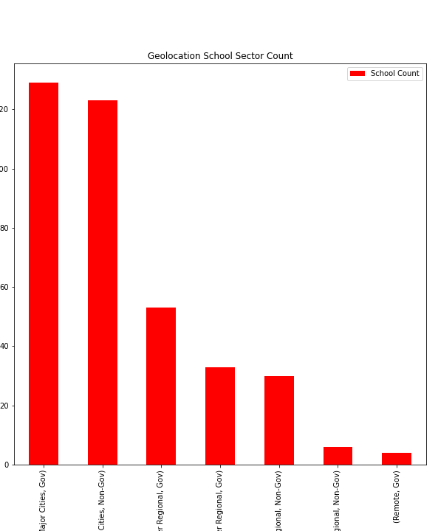
Geolocation School sector count
Which students has more choices of schools between gov or non gov?
Number of school
Number of Gov and Non-gov

Slide 22
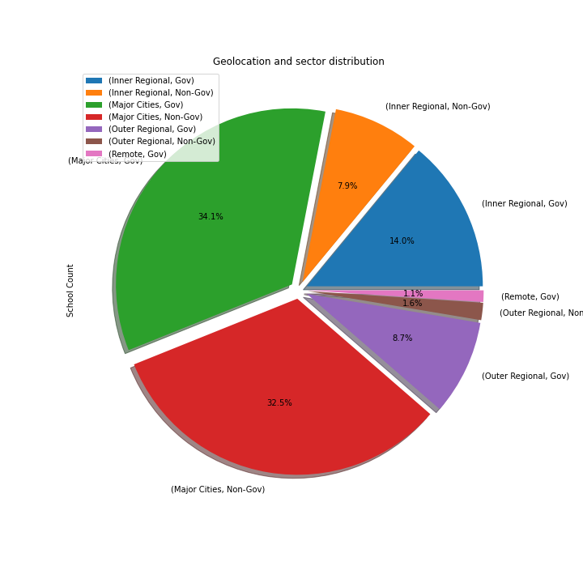
Geolocation and sector distribution

Slide 23
Geolocation and academic success

Slide 24
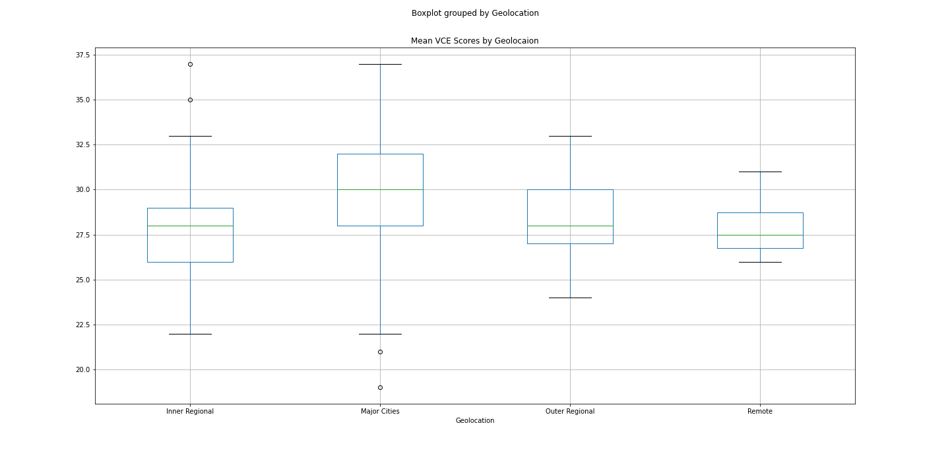
Mean VCE Box Plotting

Slide 25
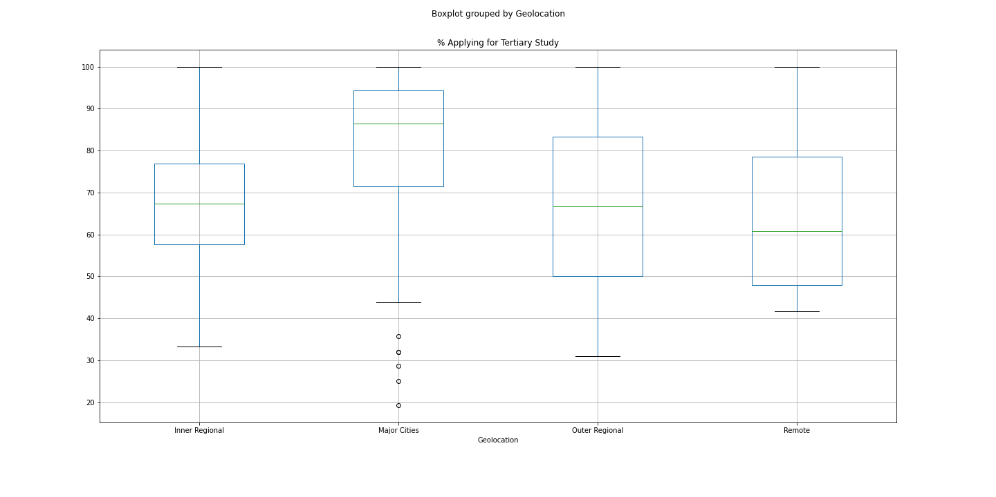
Boxplot grouped by Geolocation

Slide 26
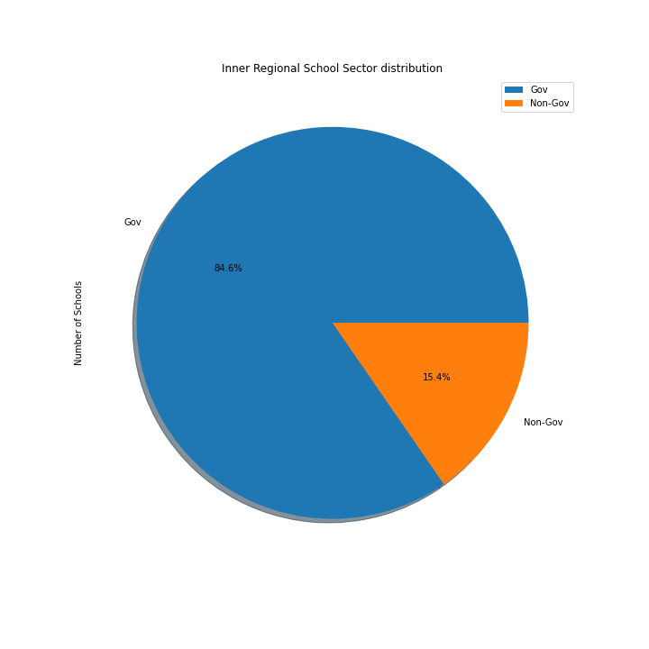

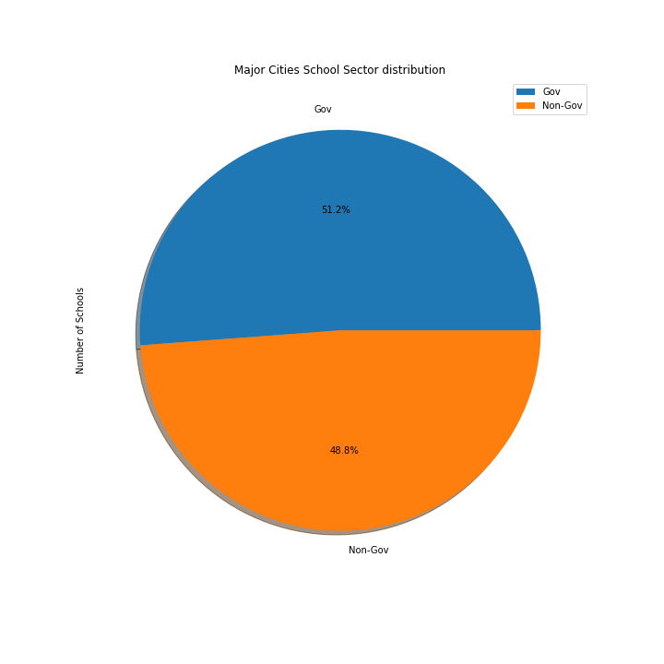
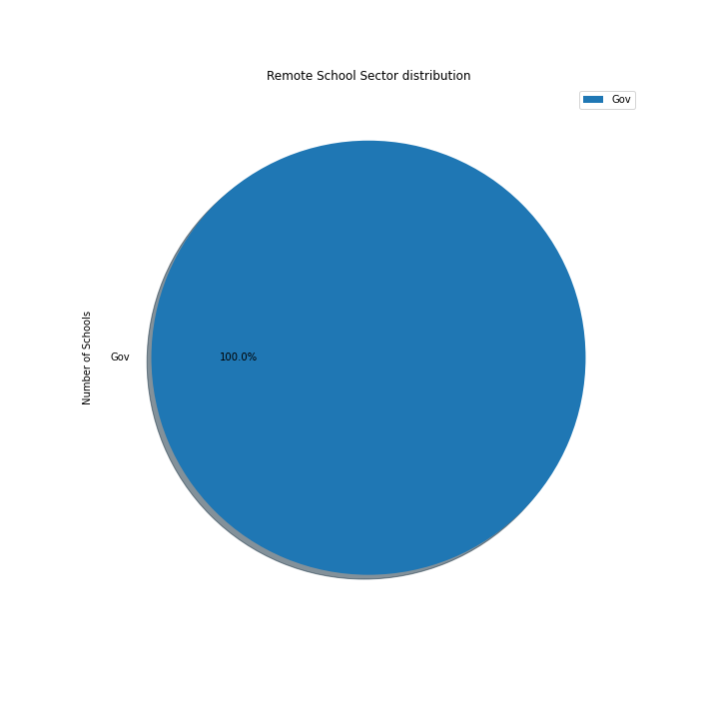
Pie Charts

Slide 27

Conclusion

Slide 28

Conclusion
After collecting processing and analysing the data we can confirm our hypothesis that in fact students within the Major Cities also receive Non-Gov education do have higher average academic performance.

Slide 29
Data Sources: https://asl.acara.edu.au/about-asl - https://bettereducation.com.au/results/VCE_ATAR.aspx -

Slide 30

Group 6
Josh Martin
Peregrin Ryan
Udeshi Pereira

