Slide 1
Safira
Protecting children and restoring hope since 2022.
BYU IS 413 · 414 · 455 — Winter 2026

Slide 2
The Problem
51%
85%
5th
of rape victims in Brazil
are children under 13
surge in child sexual violence reports in March 2020 alone
Brazil ranked 5th globally for online child sexual abuse content reports in 2024, up from 27th in just two years
Safira

Slide 3
Meet Safira
Inspired by Lighthouse Sanctuary
Who We're Building For
The Survivors
Safira is a nonprofit modeled after a real organization operating safe homes for girl survivors of sex trafficking and abuse in the Philippines. Safira replicates this mission in Brazil.
Safira — Portuguese for "sapphire" — reflects our belief that every survivor is precious. Safira exists to walk alongside girls through their hardest moments and help them emerge with dignity, hope, and a future.
Survivors of trafficking and abuse who deserve safety, dignity, and a clear path toward healing and a future.
Project Leaders and Donors
The staff and supporters who make it possible need one trusted system to manage residents and make decisions on live data.
Safira

Slide 4
Our Solution
Donor Portal
Case Management
Donation history, impact dashboards, and ML-powered churn prediction to retain and grow the donor base.
Centralized resident records, counseling notes, home visitations, and intervention tracking across all safe houses.
AI & ML Intelligence Built In
Security & Privacy
From predicting donor churn the moment a gift is recorded, to a Claude-powered chat assistant for staff, Safira turns raw data into actionable insight automatically.
RBAC, ASP.NET Identity, HTTPS, CSP headers, GDPR cookie consent, and encrypted credentials for sensitive survivor data.
Safira

Slide 5
Tech Stack
Deployed via Railway and Vercel
Frontend
Backend
Data & ML
React + Vite + TypeScript
ASP.NET and .NET 10 / C#
PostgreSQL
Safira

Slide 6
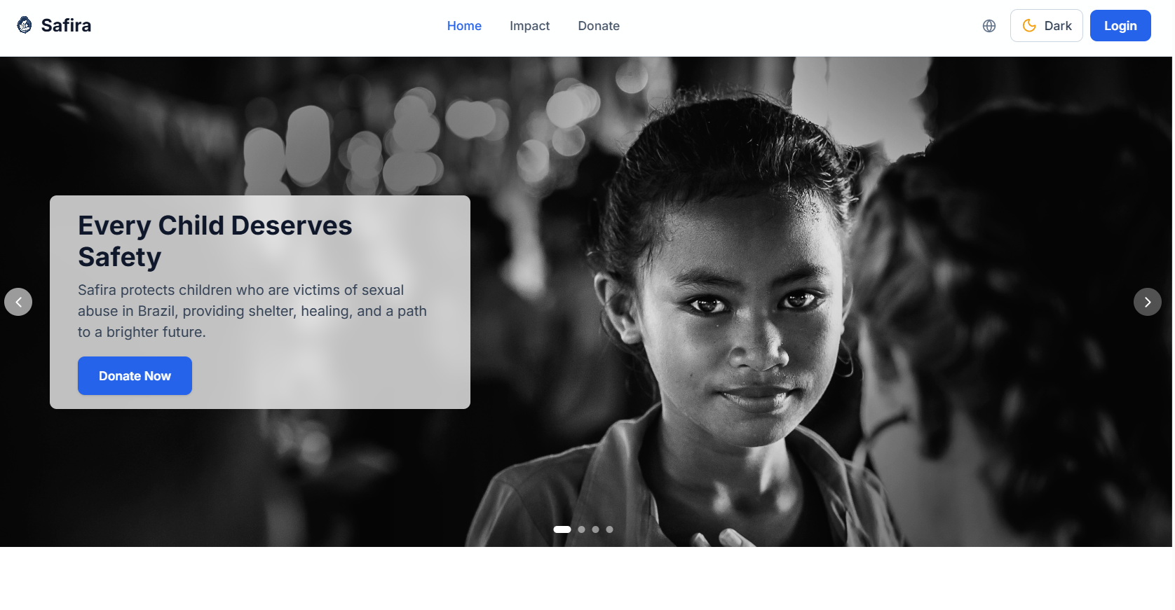
Link to page here: www.safira.world
BYU IS 413 · 414 · 455 — Winter 2026

