Slide 1
Automated Test Design:
Single Use vs Resuable Tests
Josh Grant
Test Developer
simplythetest.tumblr.com
April 30, 2014

Slide 2
Acknowledgements
Lorinda Brandon, Kendal Peiguss at SmartBear
Ron Perrault
Adam Goucher?
Others?

Slide 3
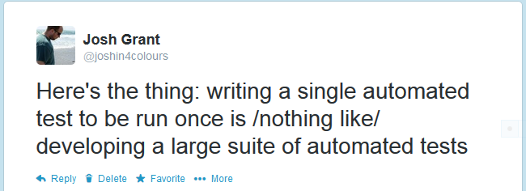
How So?

Slide 4
Single-Use Tests

Slide 5
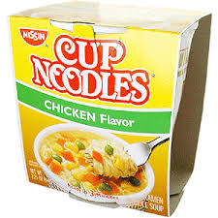

Slide 6
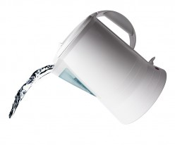
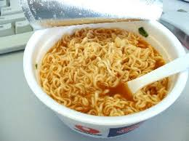
And That's It!

Slide 7
    Straightforward
    Well-Defined
    One-Time Use

Slide 8
Reusable Tests

Slide 9
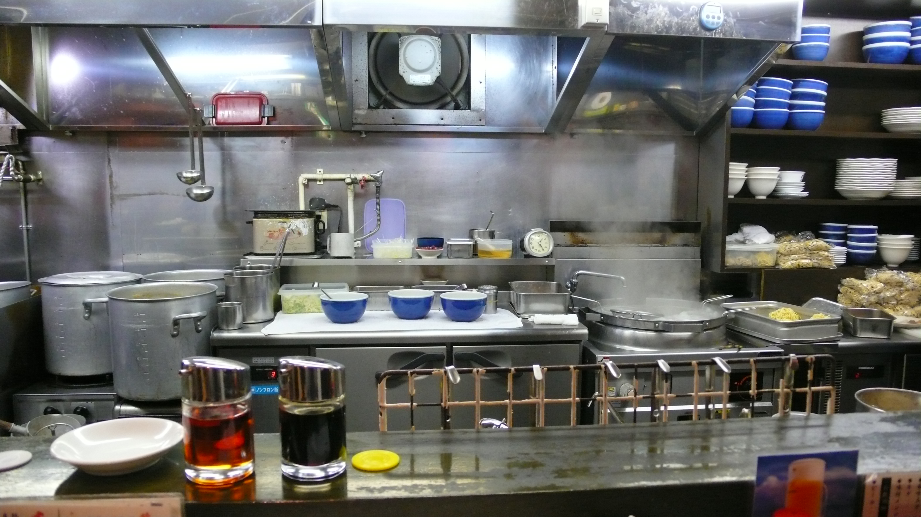

Slide 10
      Budgets
      Patrons
      Menus
      Maintenance
      Staffing
      Decor

Slide 11
In other words, not at all like...
Several aspects don't even apply

Slide 12
Complexity

Slide 13
In the case of
complexity is clear (and not too high)

Slide 14
    Tests designed for one-time use
    ...by a single person
    ...with set resources
    ...with a clear, objective goal

Slide 15
In the case of
complexity is much higher

Slide 16
    Reusable tests may mean tests
    ...have multiple people working with them
    ...in varying environments
    ...with different resources
    ...and possibly changing goals

Slide 17
Reusable tests need to address subjectivity
“Prediction is hard, particularly about the future.” ~ Yogi Berra

Slide 18
What are your goals?

Slide 19
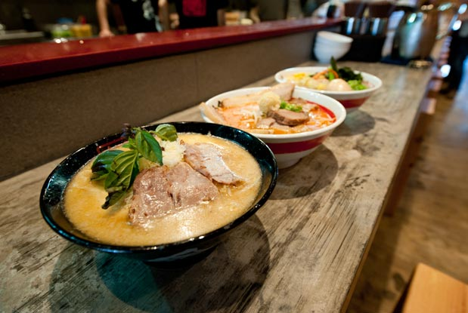

Slide 21
Value

Slide 22
Here,

Slide 23
Here,
Value is pretty clear

Slide 24
What about here?
Depends on who you are

Slide 25
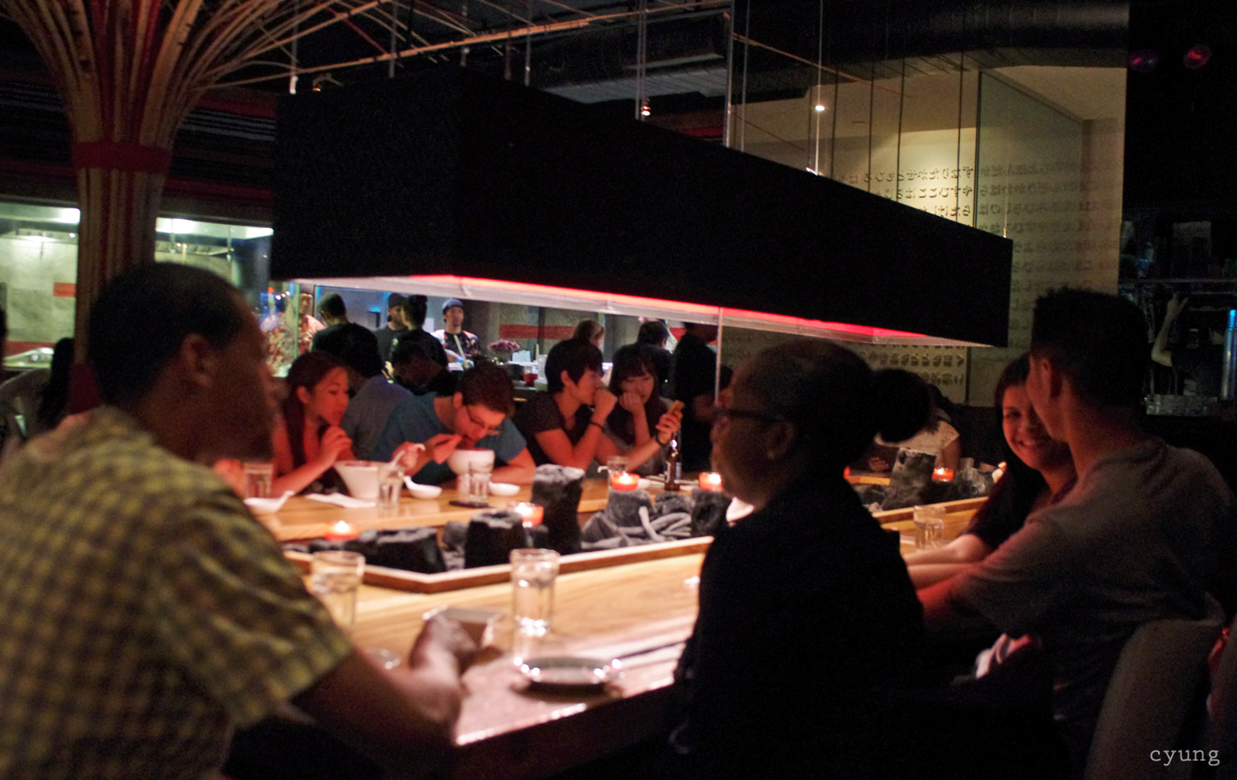
Depends on who you are

Slide 26

Depends on who you are

Slide 27
Different kinds of value
Business value (yes, this means $$$)
Technical value
Opportunity costs
(Is this even a good idea?)

Slide 28
Maintenance

Slide 29
In this case
This doesn't even apply

Slide 30
Maintenance doesn't apply to single use tests
by definition
This is a key feature of single use tests

Slide 31
Meanwhile, here
It's almost all maintenance

Slide 32
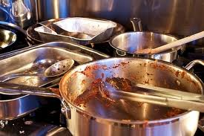

Slide 33
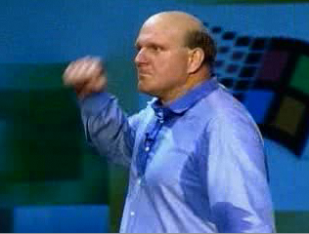

Slide 34
Reusable Tests mean Usable Tests
Code Rot
Technical Debt
Fragile Tests
...and the app is changing as well

Slide 35
Tooling

Slide 36
Tooling is easy here

Slide 37
...which is kind of the point.

Slide 38
Many more tooling choices here

Slide 39
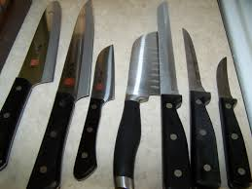
Some are familiar...

Slide 40
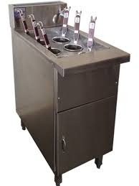
...and some are less so

Slide 41
Tools help solve problems, not be a problem
Source Control
Languages/Editors
Third-party or roll your own?
Most important tool is your brain

Slide 42
Teamwork

