Slide 1
Automated Test Design:
Single Use vs Resuable Tests
Josh Grant
Test Developer, CaseWare
April 30, 2014

Slide 2
Acknowledgements
Lorinda Brandon, Kendal Peiguss at SmartBear
Ron Perrault
Adam Goucher?
Others?

Slide 3
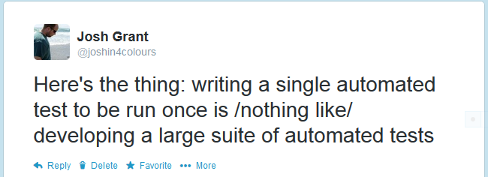

Slide 4
How So?

Slide 5
Single-Use Tests

Slide 6
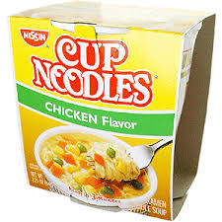

Slide 8
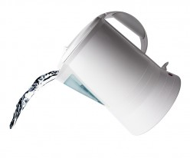

Slide 9
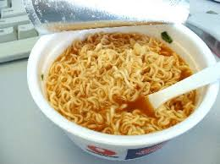

Slide 10
And That's It!

Slide 11
    Straightforward
    Easy
    One-time Use

Slide 12
Reusable Tests

Slide 13
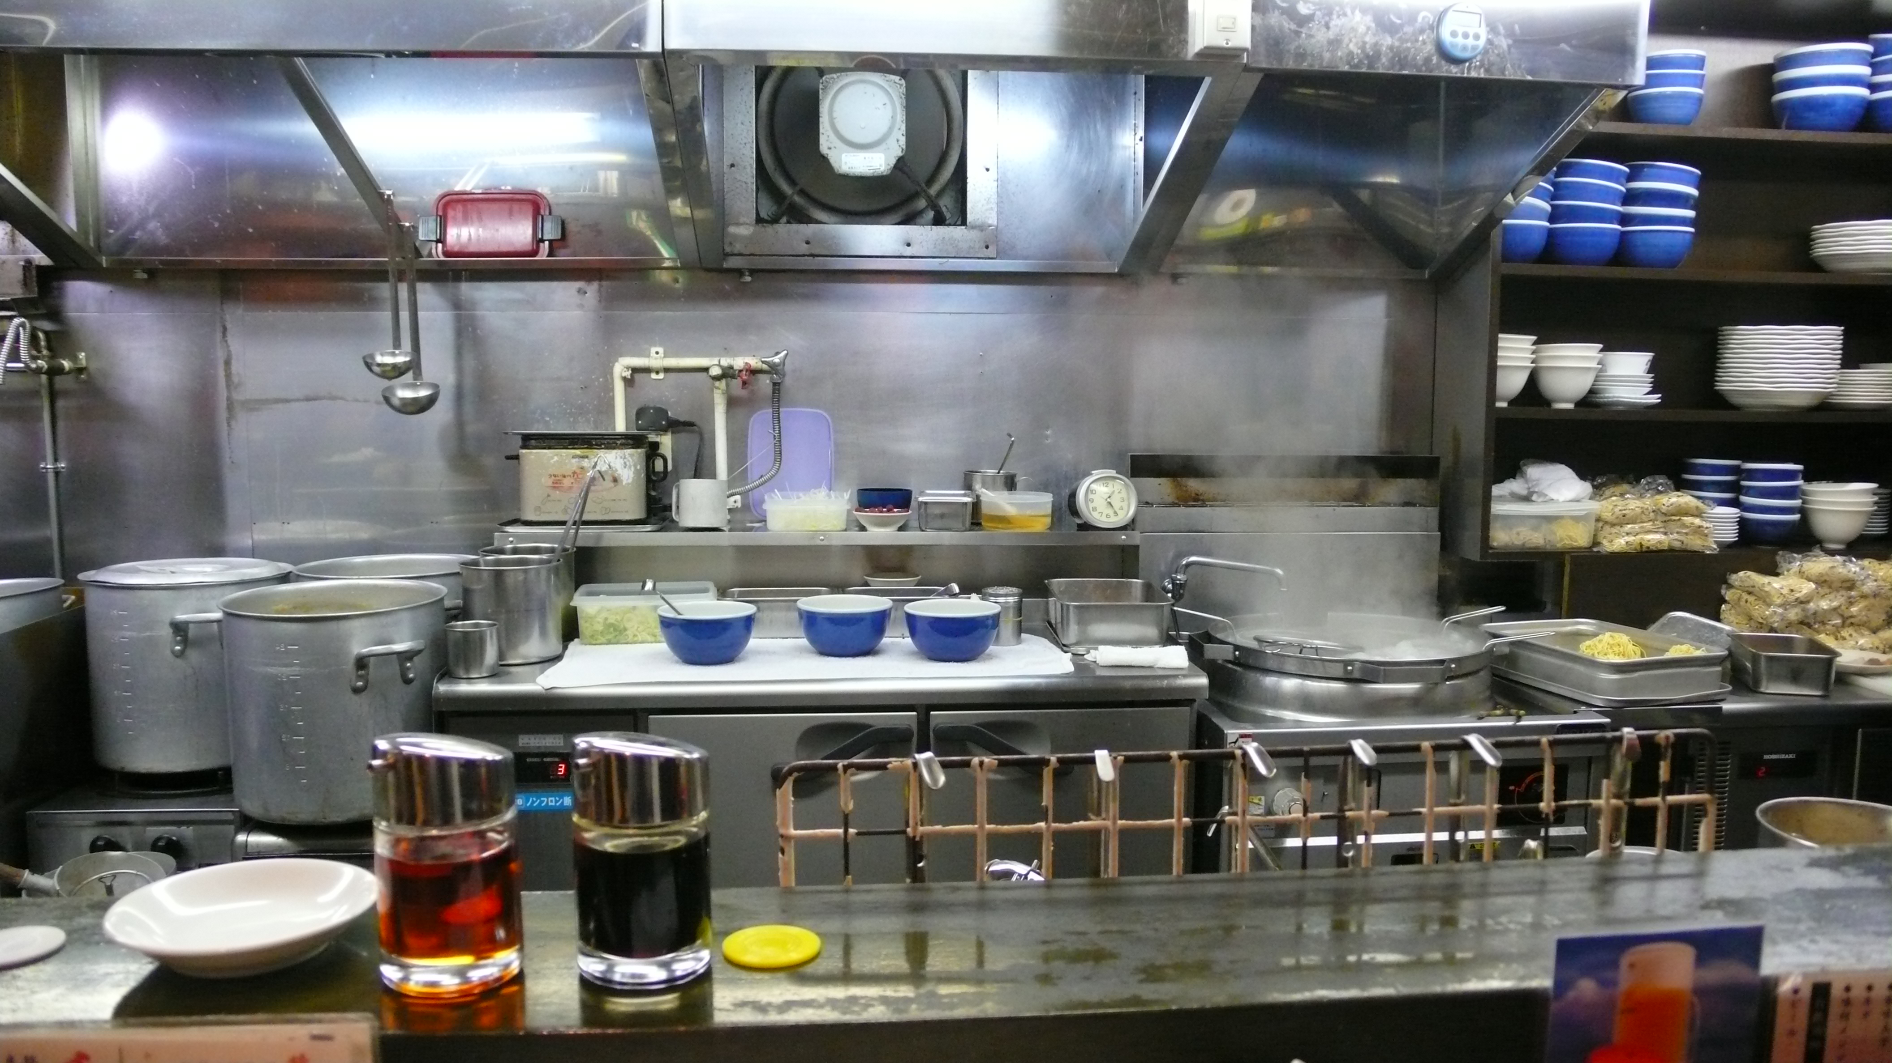

Slide 14
      Budgets
      Patrons
      Menus
      Maintenance
      Staffing
      Decor

Slide 15
In other words, not at all like...

Slide 16
In other words, not at all like...

Slide 17
In other words, not at all like...
Several aspects don't even apply

Slide 18
Complexity

Slide 19
Value

Slide 20
Maintenance

Slide 21
Tooling

Slide 22
Teamwork

