Slide 1

Case study 02
Josh Mitchell

Slide 2
Project Breakdown
Exploratory Data Analysis
Naïve Bayes
Clustering
Multiple Linear Regression
Regression

Slide 3
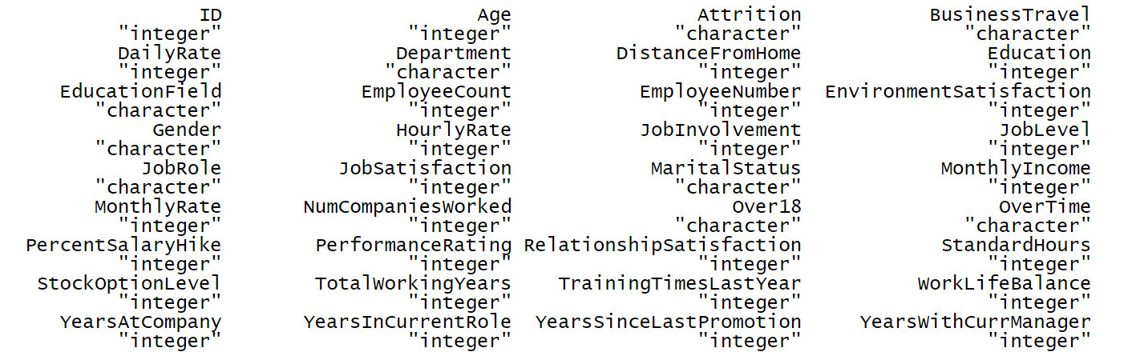
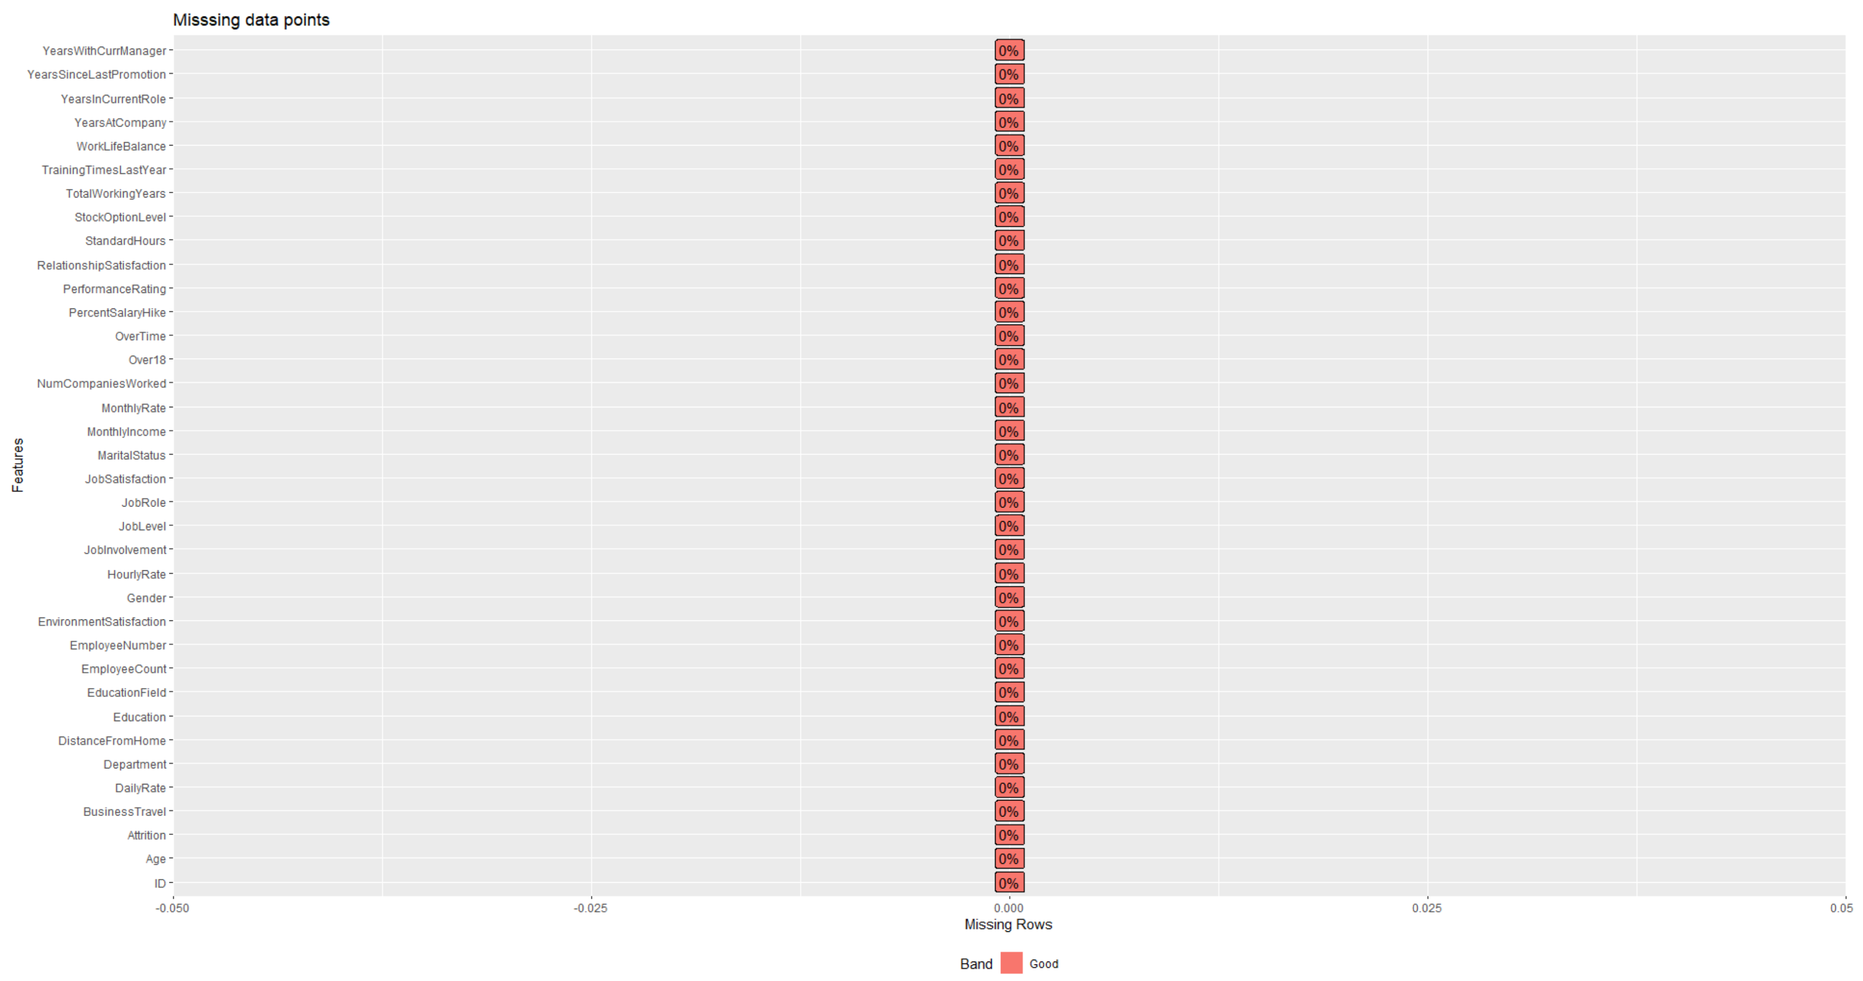
Exploratory Data Analysis
Dimensions:
Rows: 870
Columns: 36
Noninformative:
EmployeeCount
Over18
StandardHours
Important Variables:
Attrition
MonthlyIncome

Slide 4
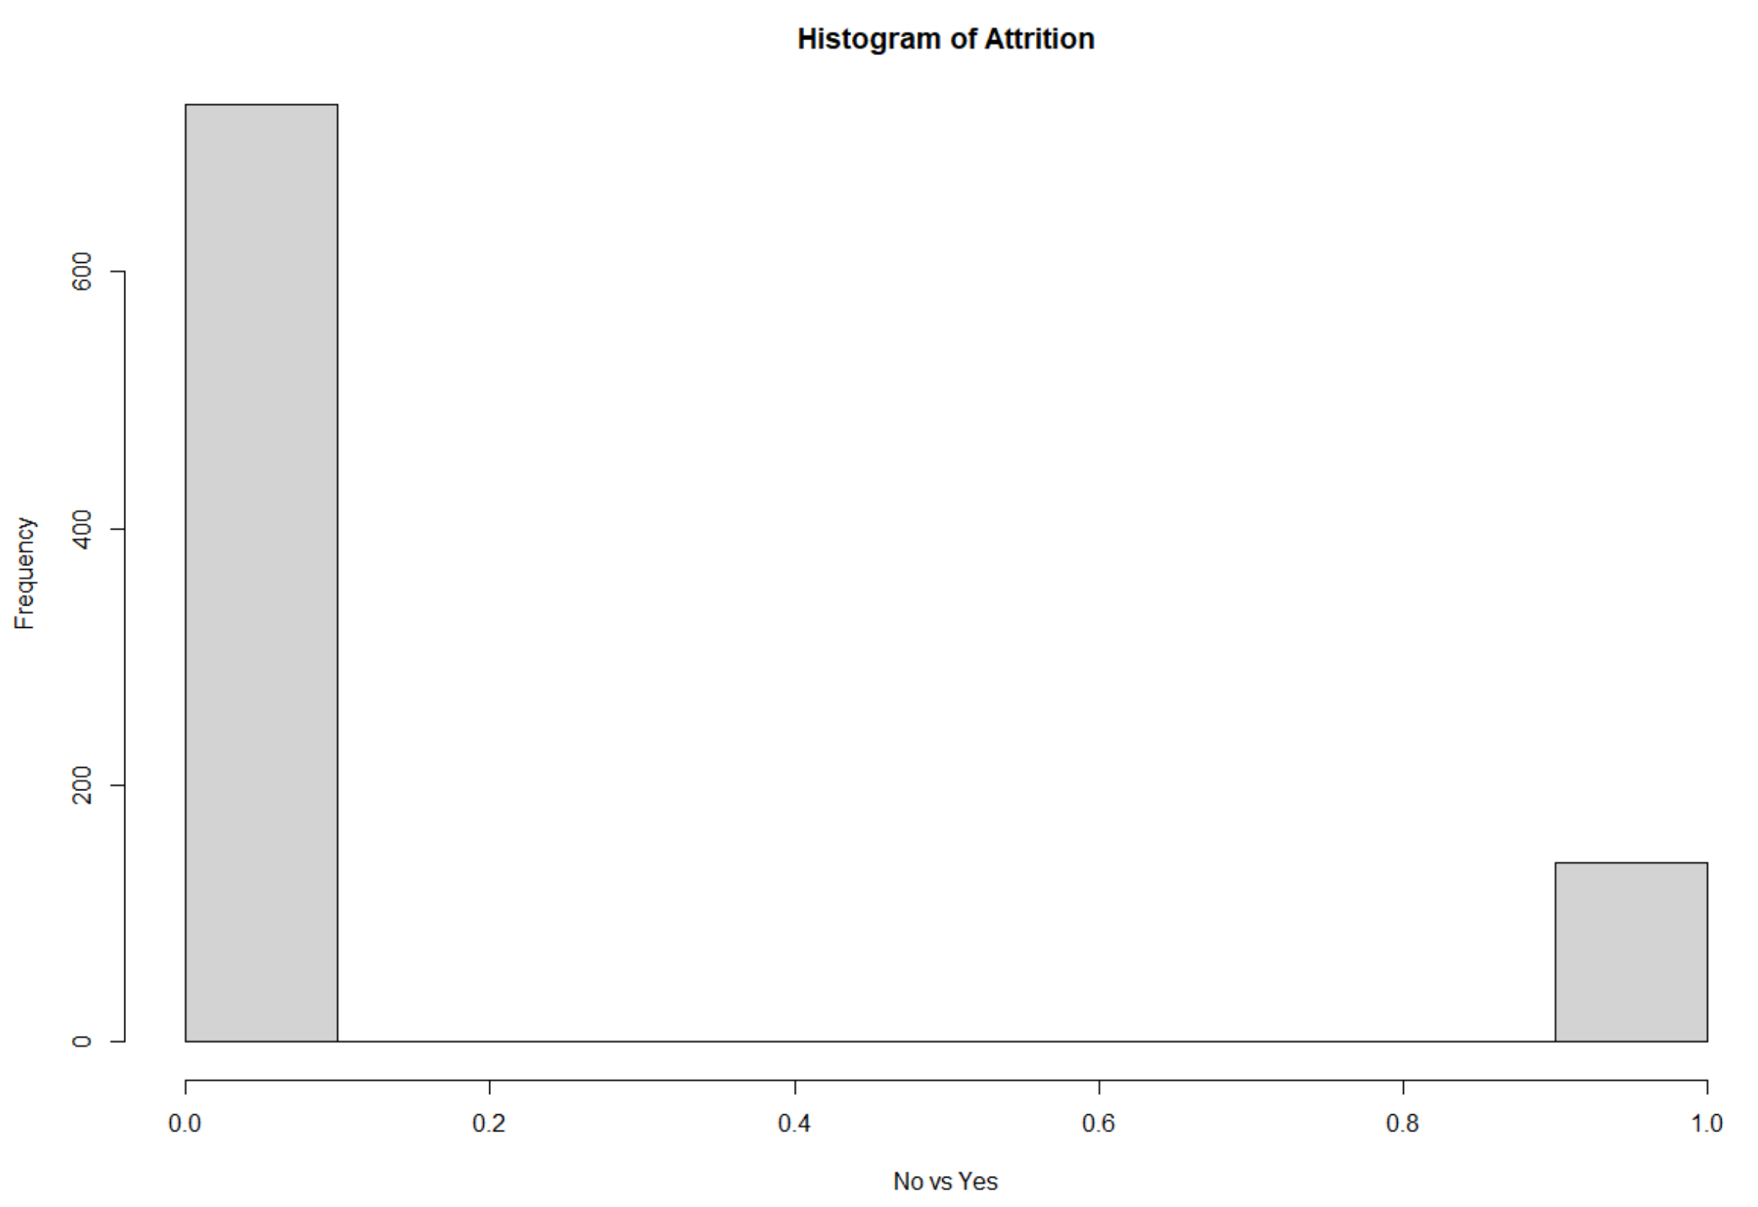
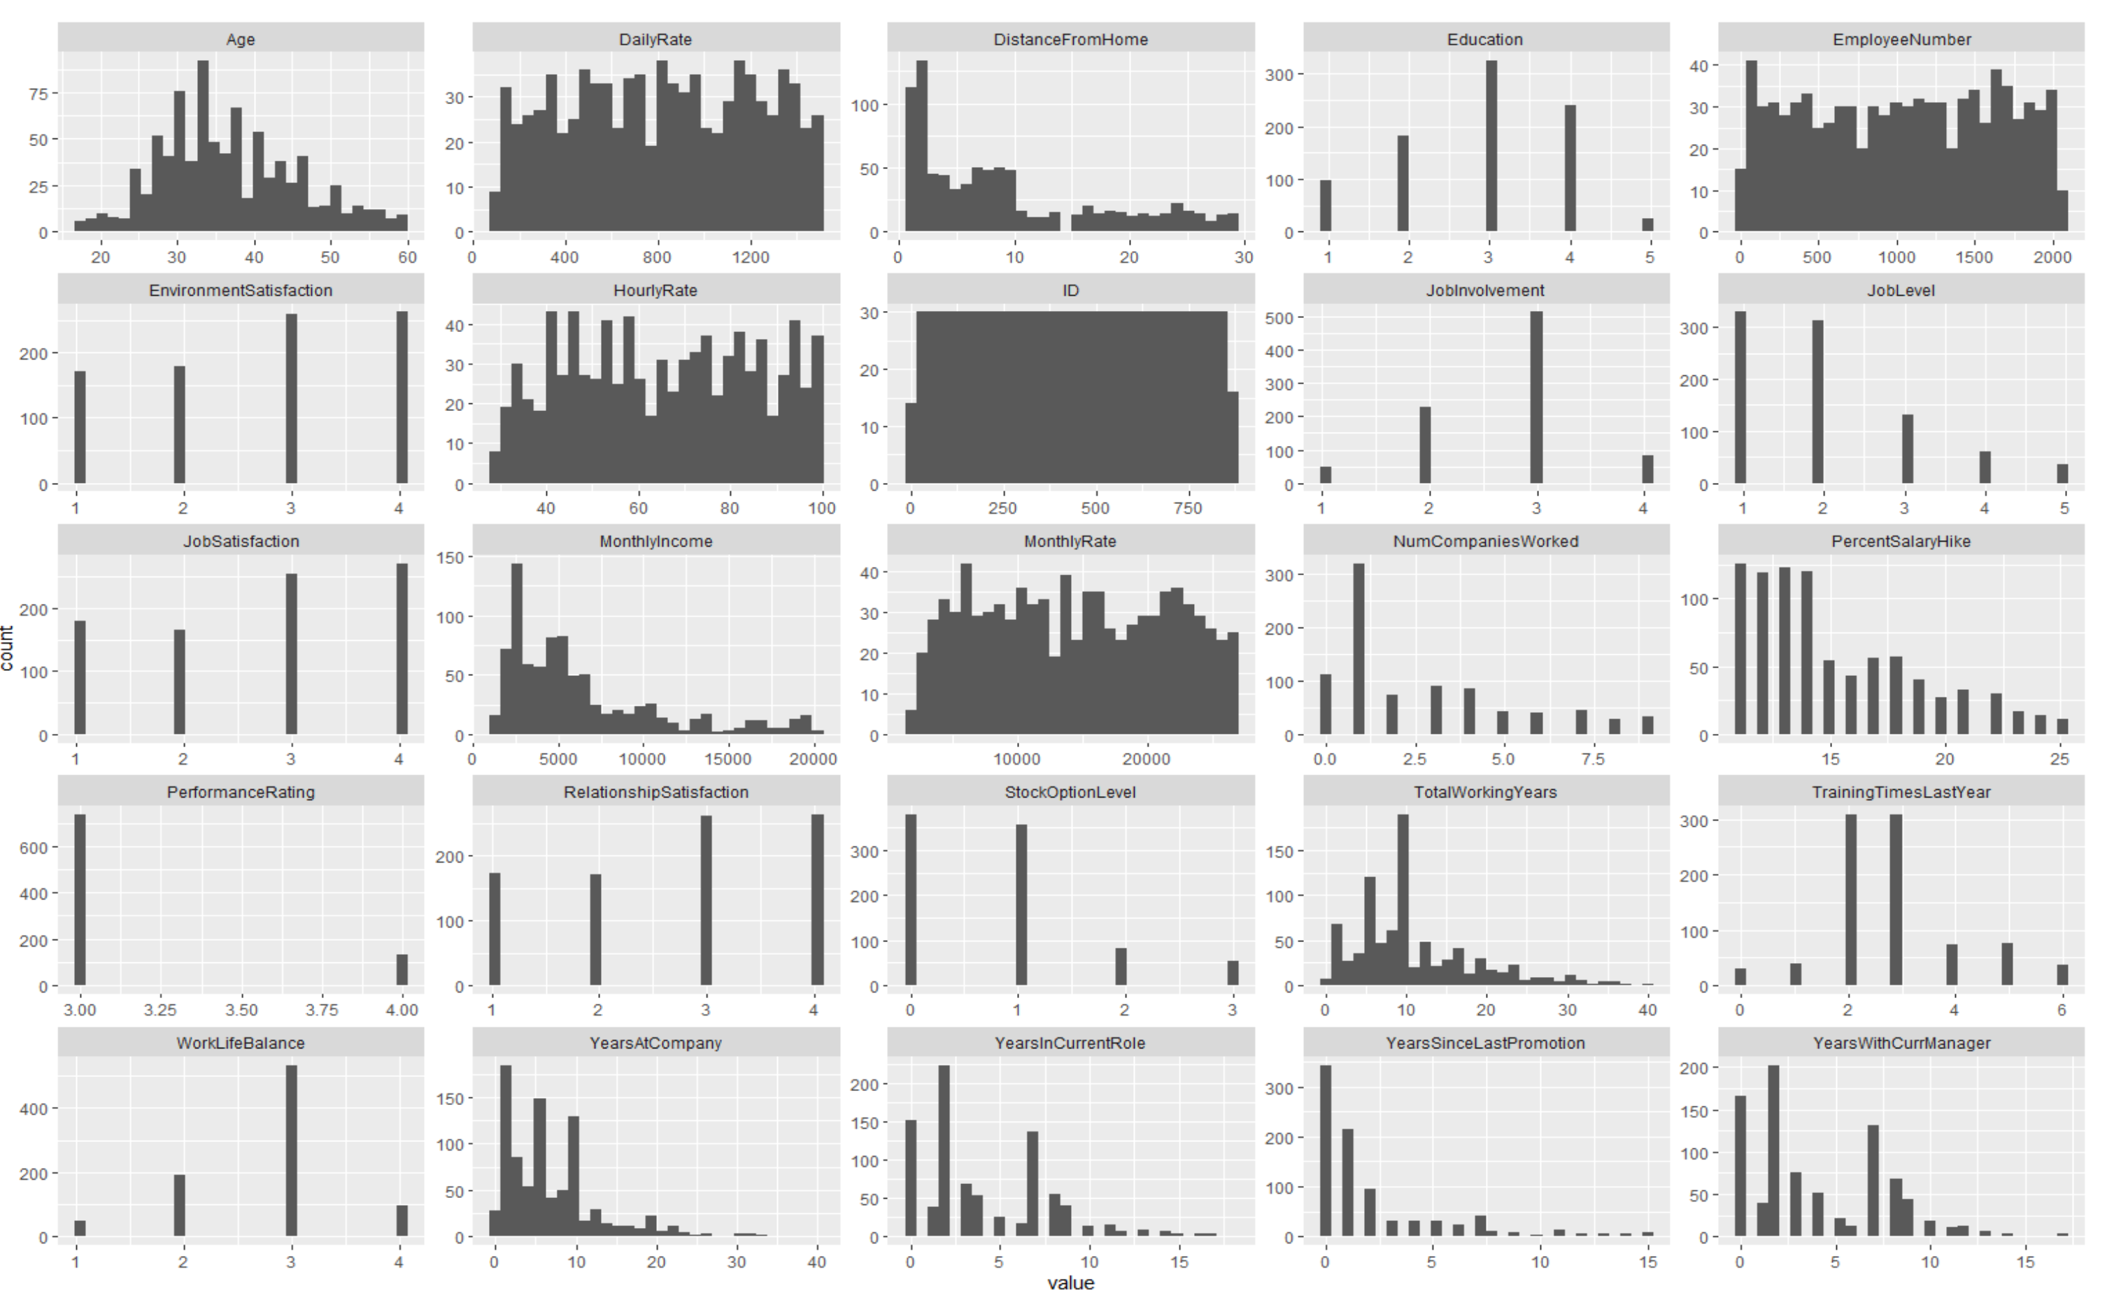
Exploratory Data Analysis

Slide 5
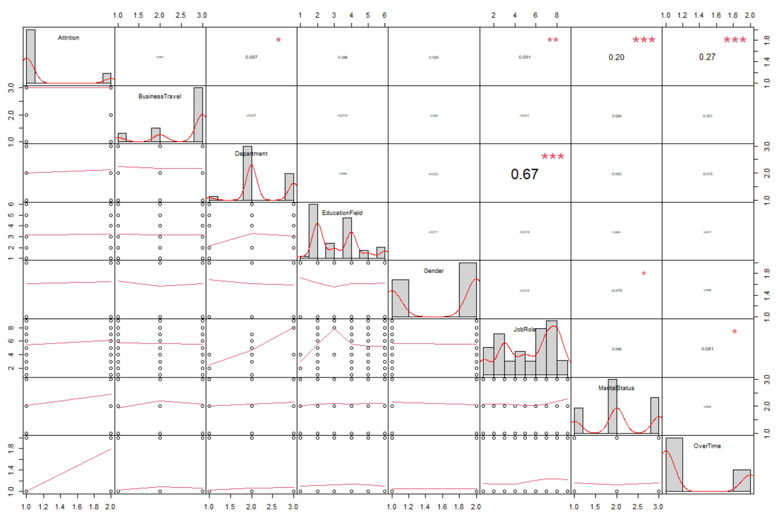
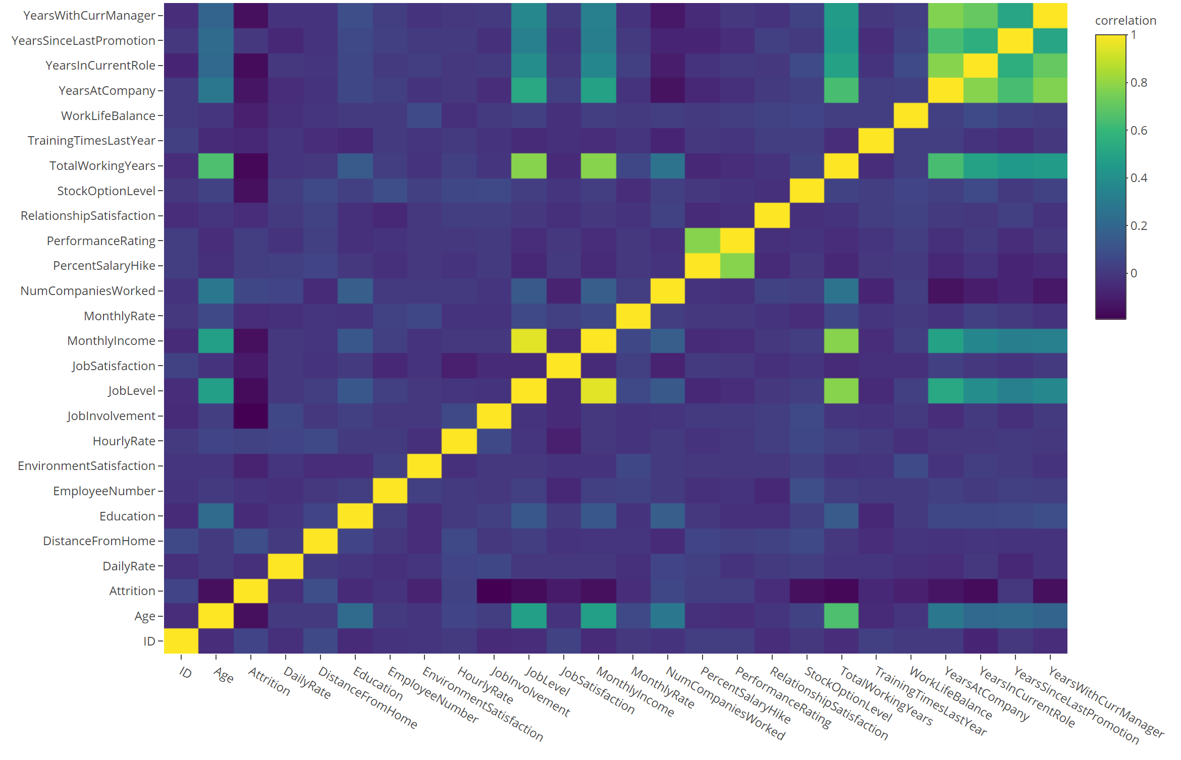
Exploratory Data Analysis

Slide 6
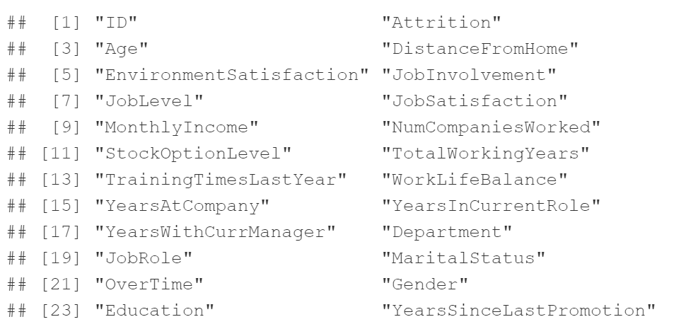
Clustering - Attrition
NB Model
24 Features
Downsampled
Averaged
Accuracy: 72.20175
Sensitivity: 69.8
Specificity: 72.38302

Slide 7
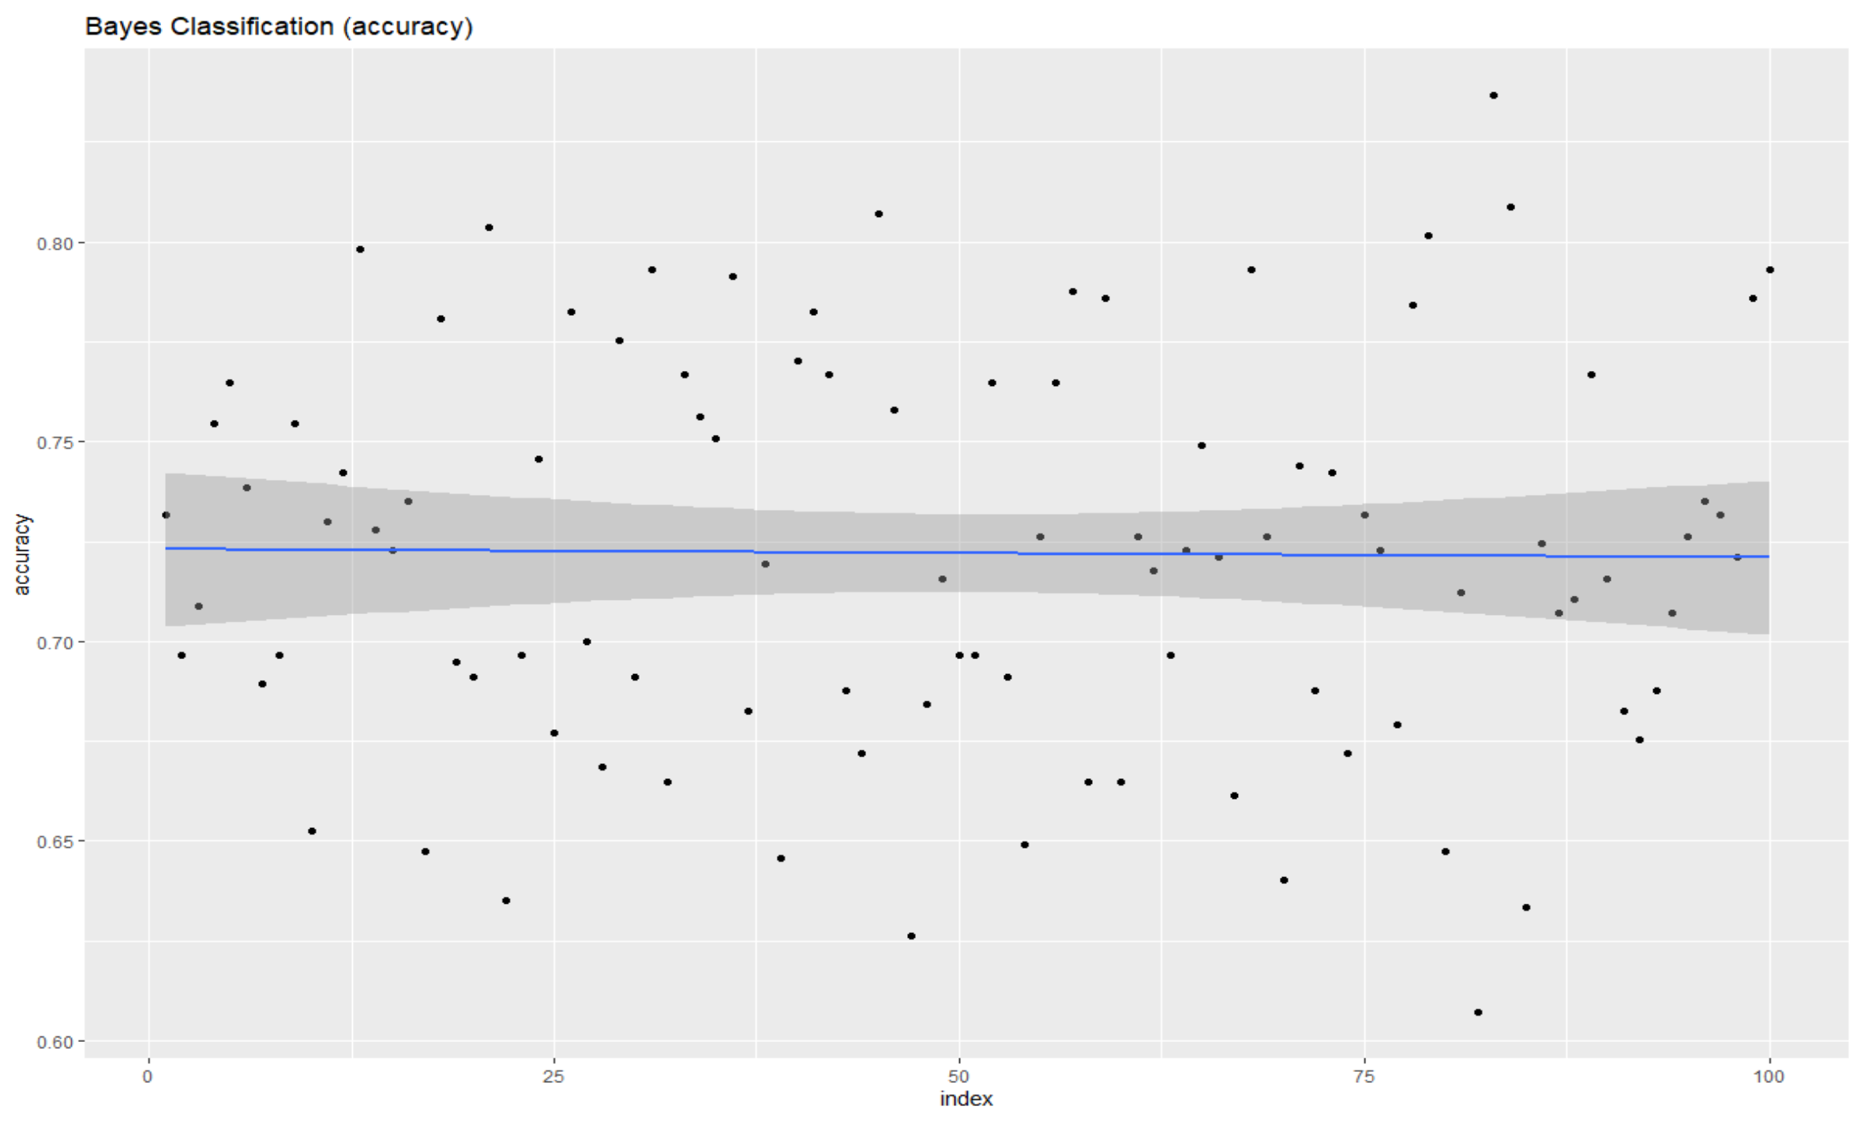
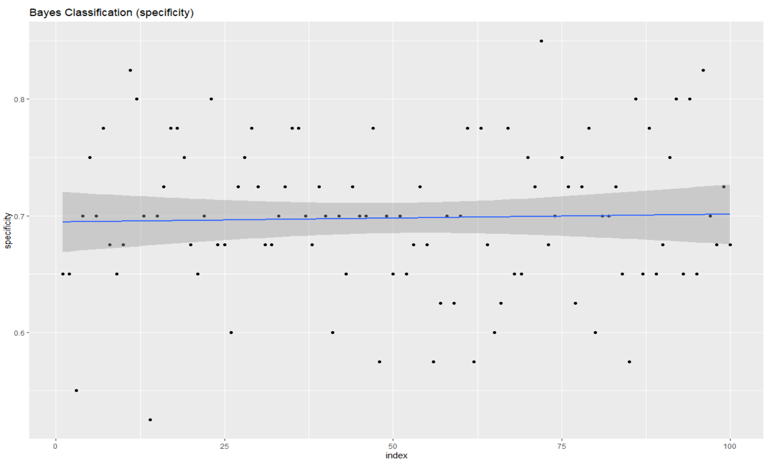
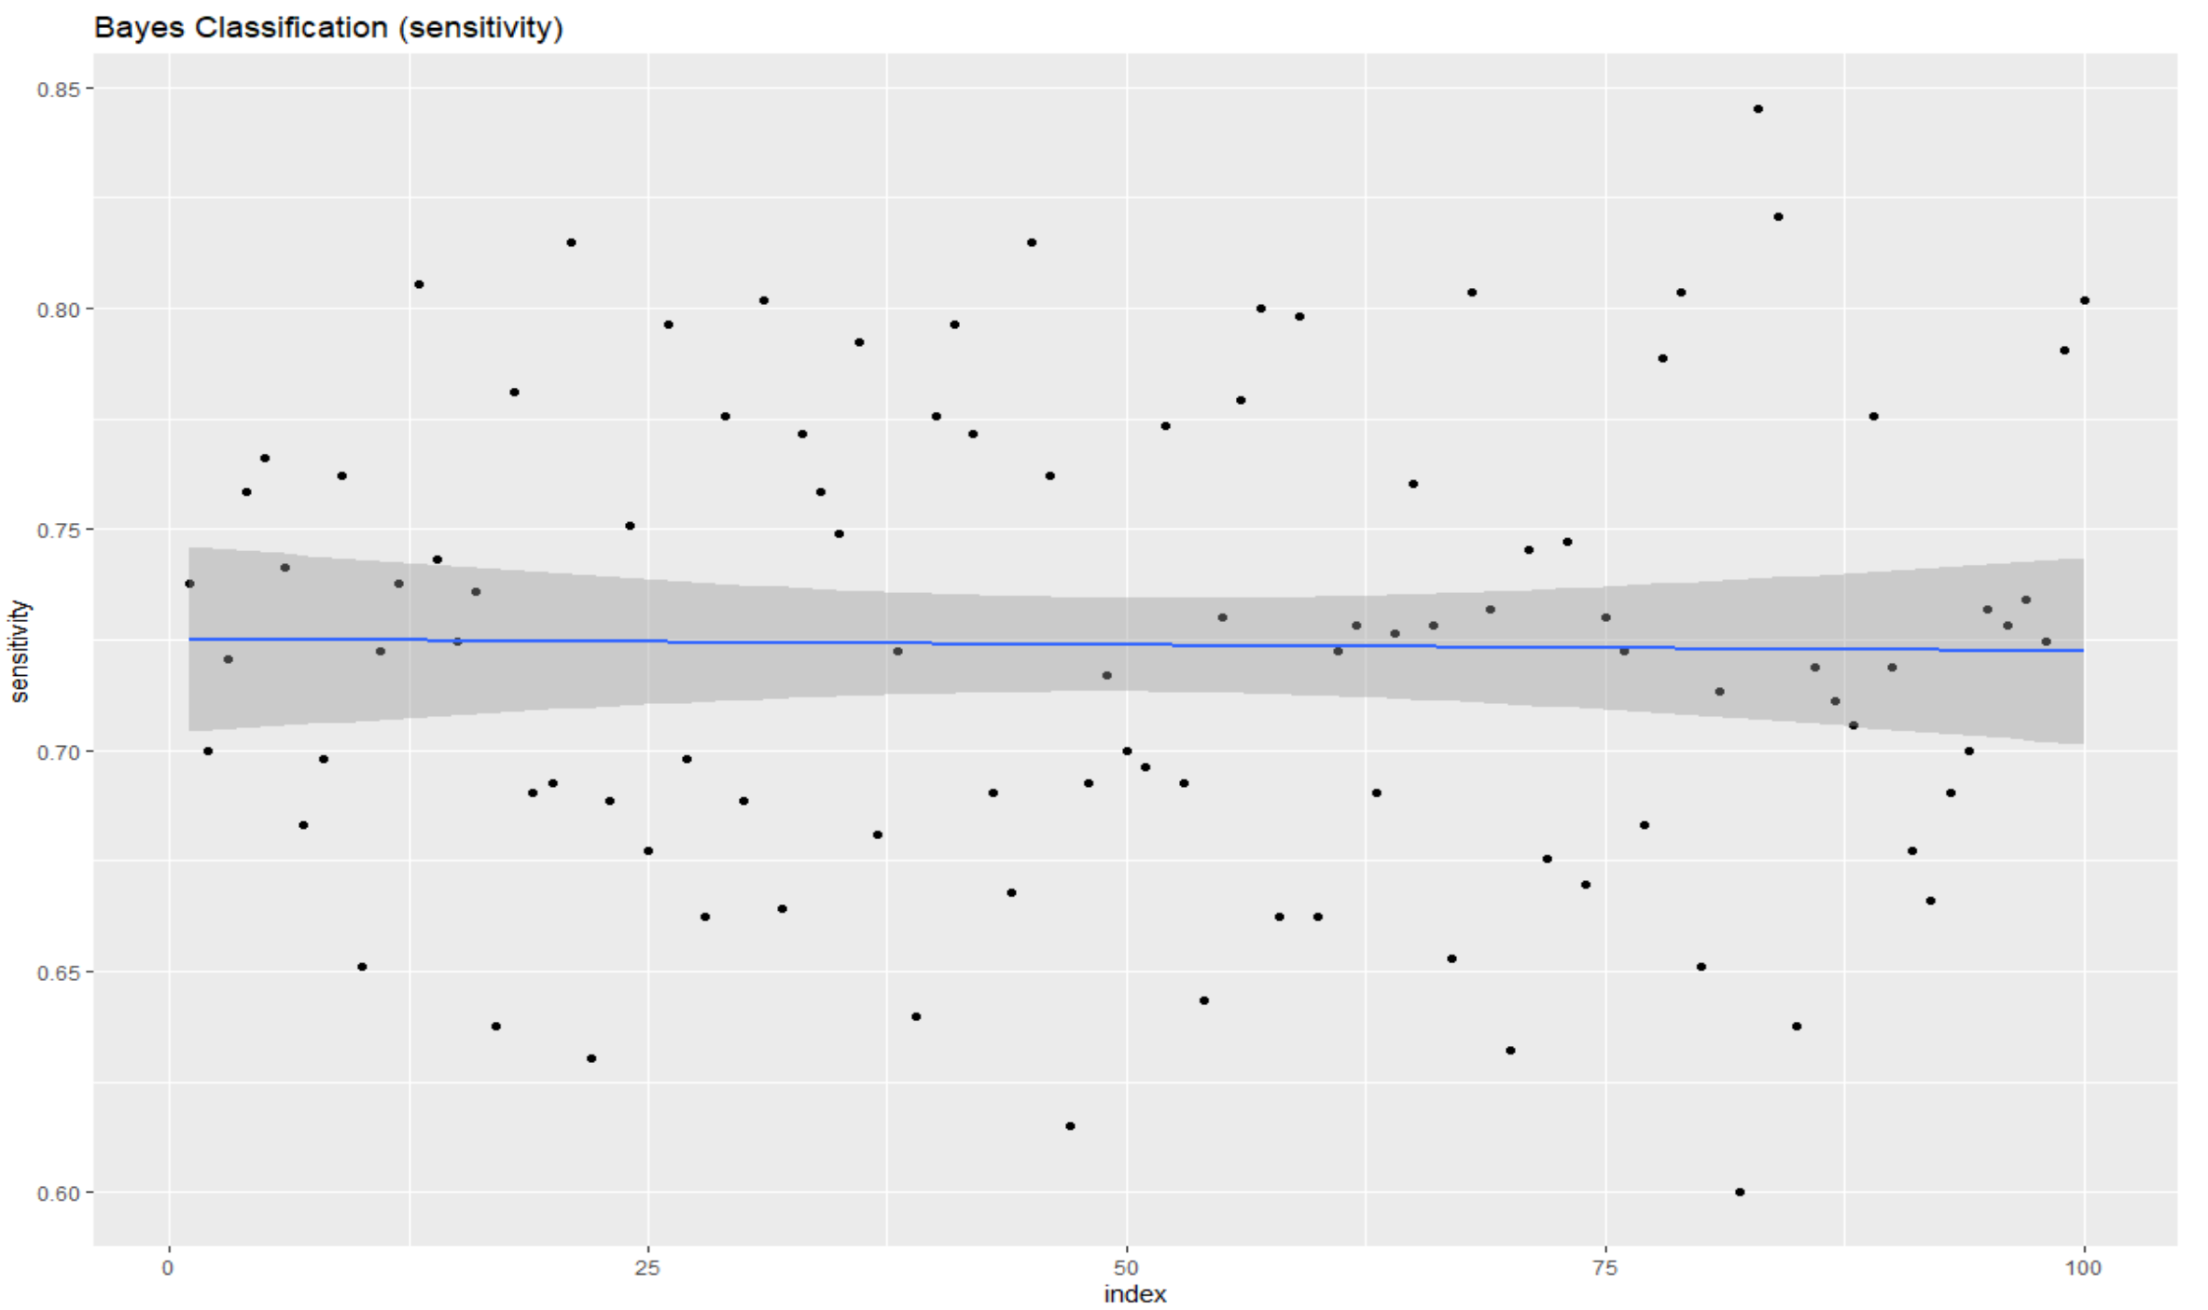
Clustering - Attrition

Slide 8
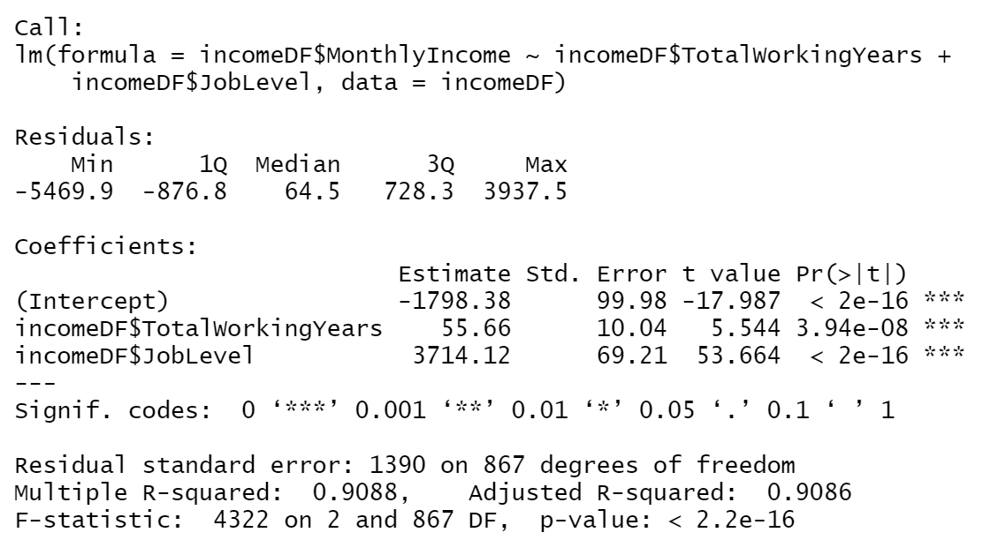
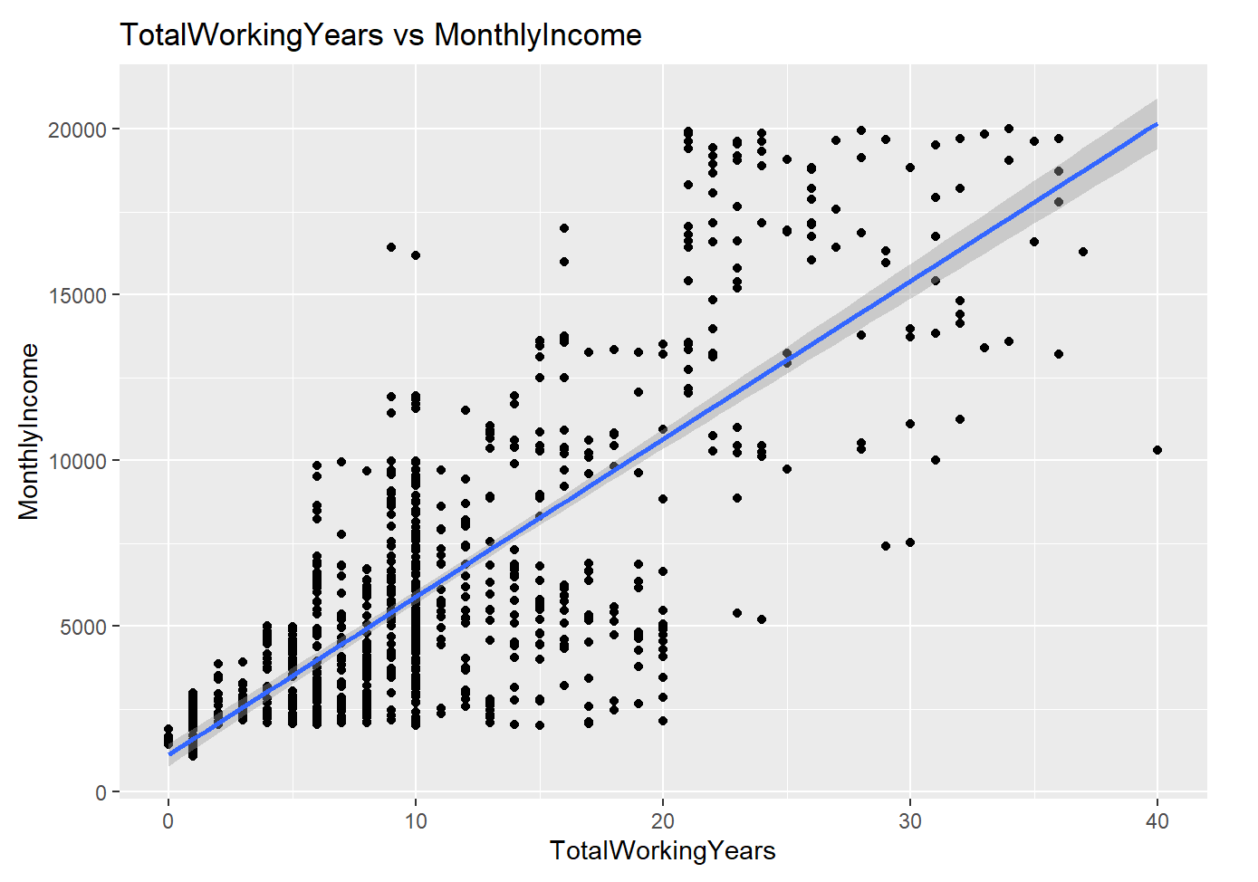
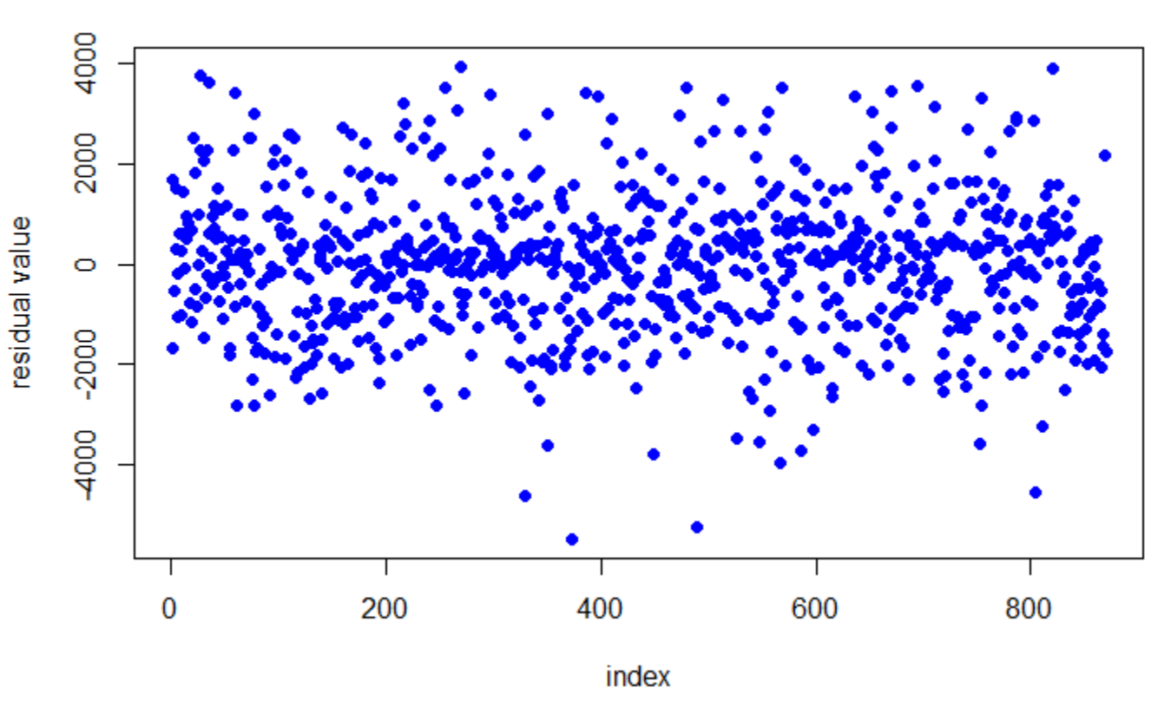
Regression - MontlyIncome
MLR Model
TotalWorkingYears
MonthlyIncome
JobLevel
RMSE: 1387.298

Slide 9
Conclusion
EDA
Identified good feature candidates
Two Models
Clustering: NB
Regression: MLR

