Slide 1
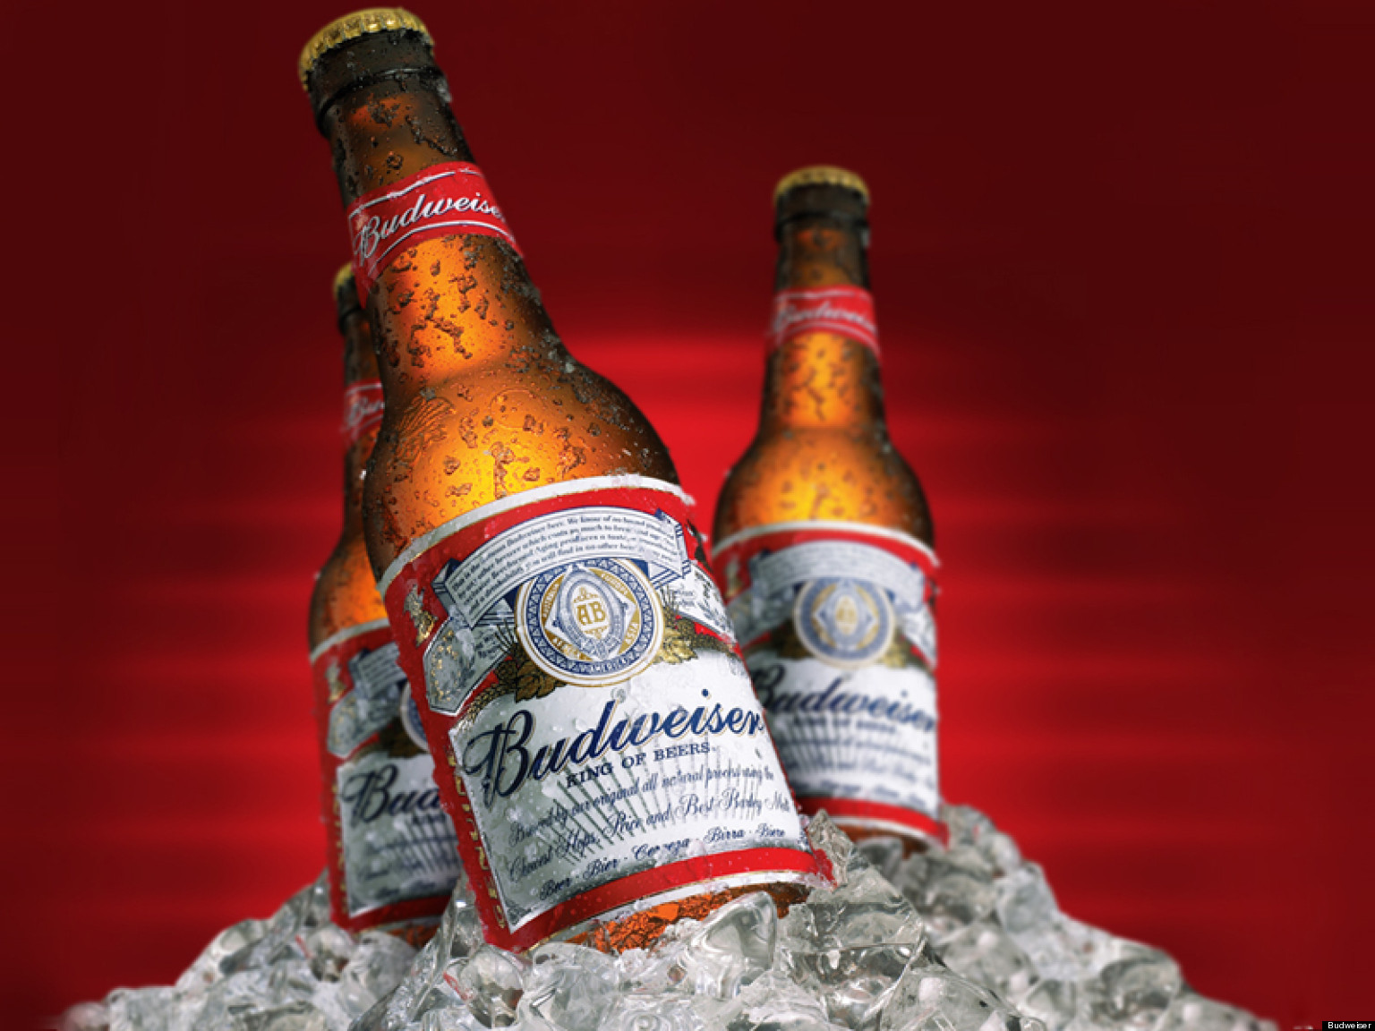
Unit 8 Presentation
Josh Mitchell
&
Erin McClure-Price

Slide 2
General Overview
Colorado has more breweries than any other state (47)
A simply scatterplot of IBU vs ABV showed positive correlation, inferring that alcohol increases as bitterness increases (or vice versa)
IPA style beers were higher in both IBU and ABV (THIS IS A GUESS)
Median IBU content were significantly lower in a handful of states
ABV content did not vary greatly, with exceptions occurring for significantly lower ABV content in both Arkansas and Utah

Slide 3
Breweries per State
Need to make a map or table for this
Notes:
1. How many breweries are present in each state?

Slide 4
Notes:
3. Address the missing values in each column.

Slide 5
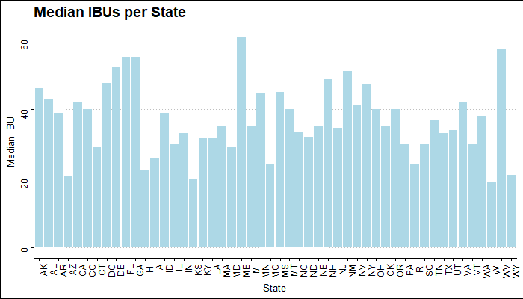
Analysis of IBU per State
IBU varies
Notes:
4. Compute the median alcohol content and international bitterness unit for each state. Plot a bar chart to compare.

Slide 6
Notes:
5. Which state has the maximum alcoholic (ABV) beer? Which state has the most bitter (IBU) beer?

Slide 7
Notes:
Questions 1,3,4,5,6 and 7 should be fully addressed
6. Comment on the summary statistics and distribution of the ABV variable.

Slide 8
Notes:
7. Is there an apparent relationship between the bitterness of the beer and its alcoholic content? Draw a scatter plot. Make your best judgment of a relationship and EXPLAIN your answer.

