Slide 1
Case Study 01
Erin McClure-Price
Josh Mitchell

Slide 2
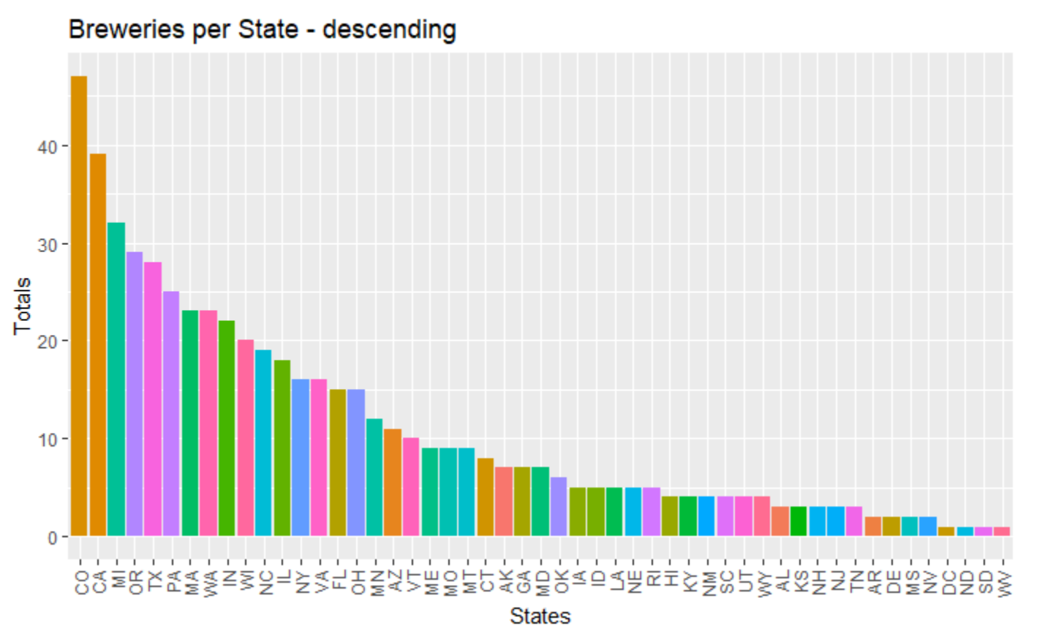
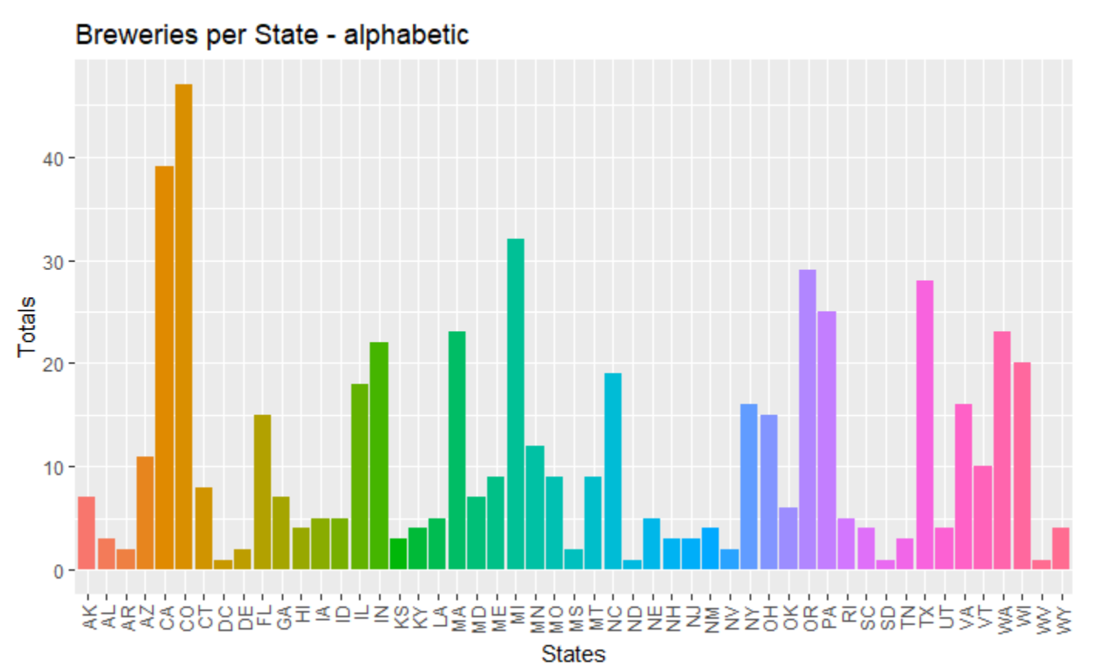
Breweries by State
Something something something
Min. : 1.00
Mean :10.94
SD : 10.61
Notes:
1. How many breweries are present in each state?

Slide 3
Addressing Missing Data
Total: 2410
Missing IBU: 959
Missing ABU: 1
Minimize impact on ABU calculations
~40% of data has some form of missing elements
….
Notes:
3. Address the missing values in each column.

Slide 4
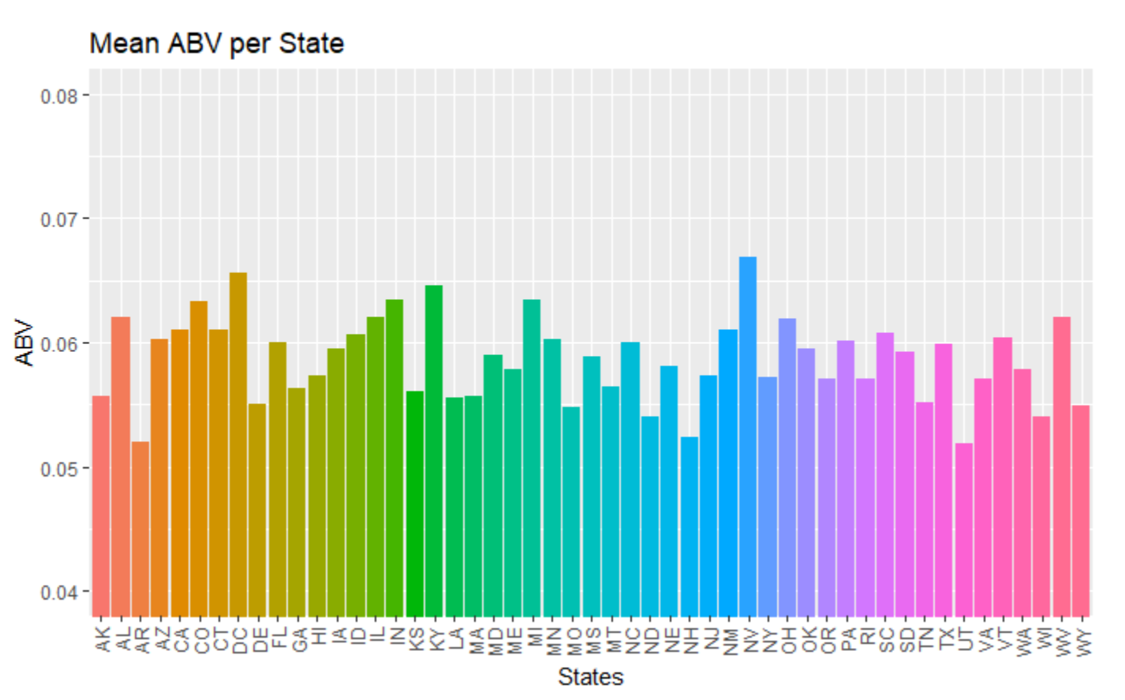
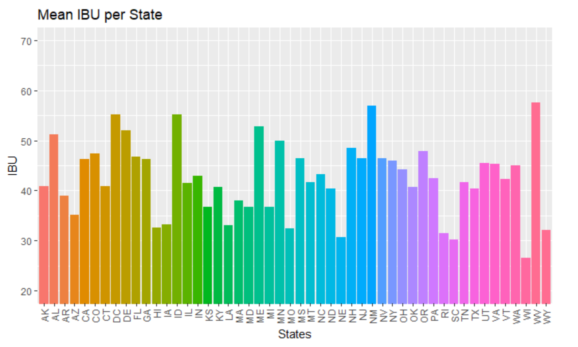
Median ABU and IBU
Something something missing south Dakoda
b/c IBU data is missing
Highest IBU
Oregon
Highest ABV
Colorado
Notes:
4. Compute the median alcohol content
5. Which state has the maximum alcoholic (ABV) beer? Which state has the most bitter (IBU) beer? and international bitterness unit for each state.

Slide 5
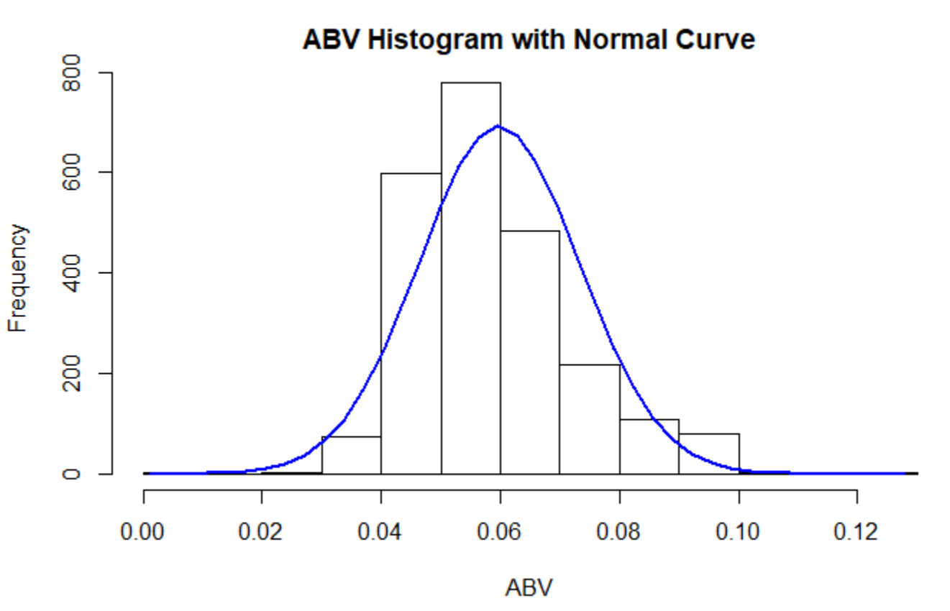
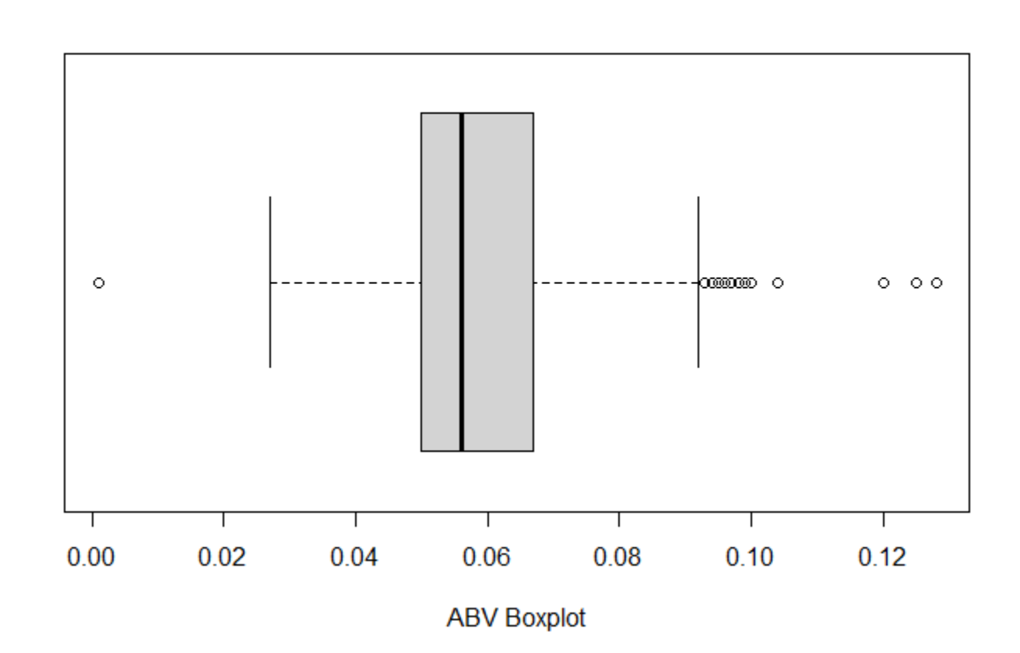
ABV Summary
Min. : 0.00100
Mean : 0.05977
Max : 0.12800
Standard Dev. : 0.01354173
Variance : 0.0001833786
Notes:
Comment on the summary statistics and distribution of the ABV variable.

Slide 6
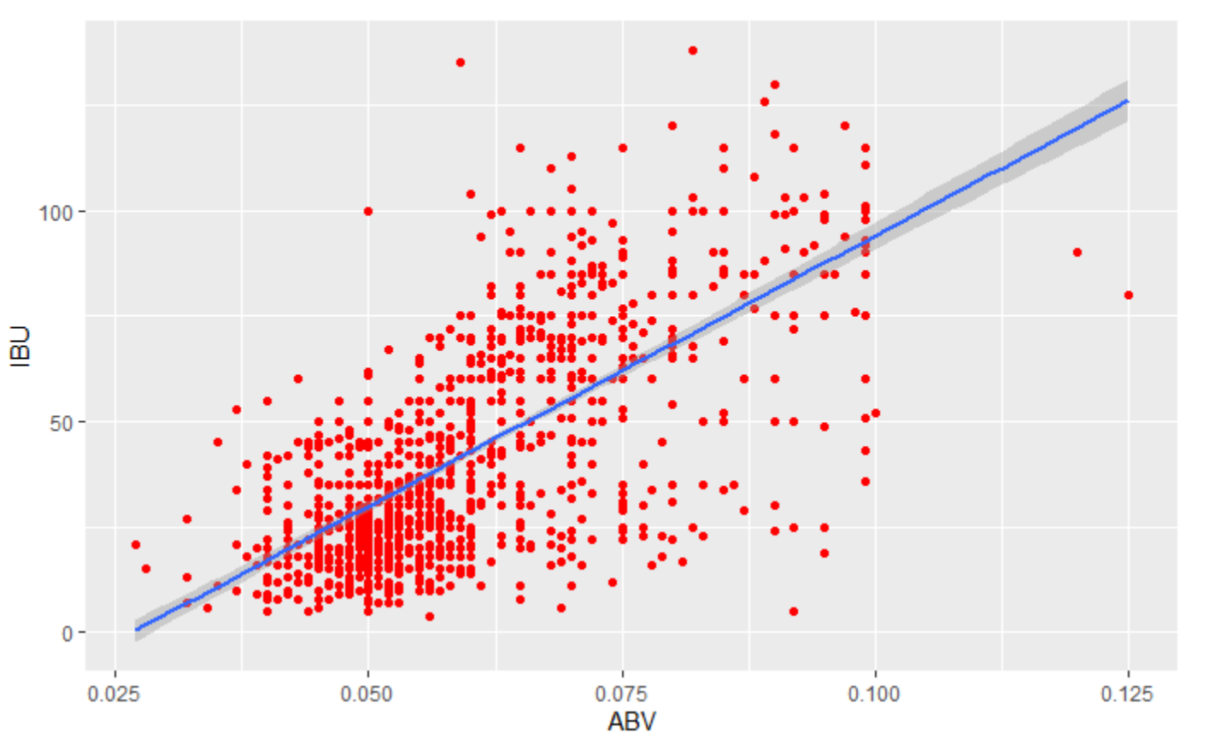
ABV & IBU Relationship
Min. : 0.00100
Mean : 0.05977
Max : 0.12800
Standard Dev. : 0.01354173
Variance : 0.0001833786
Notes:
7. Is there an apparent relationship between the bitterness of the beer and its alcoholic content?

