Slide 1
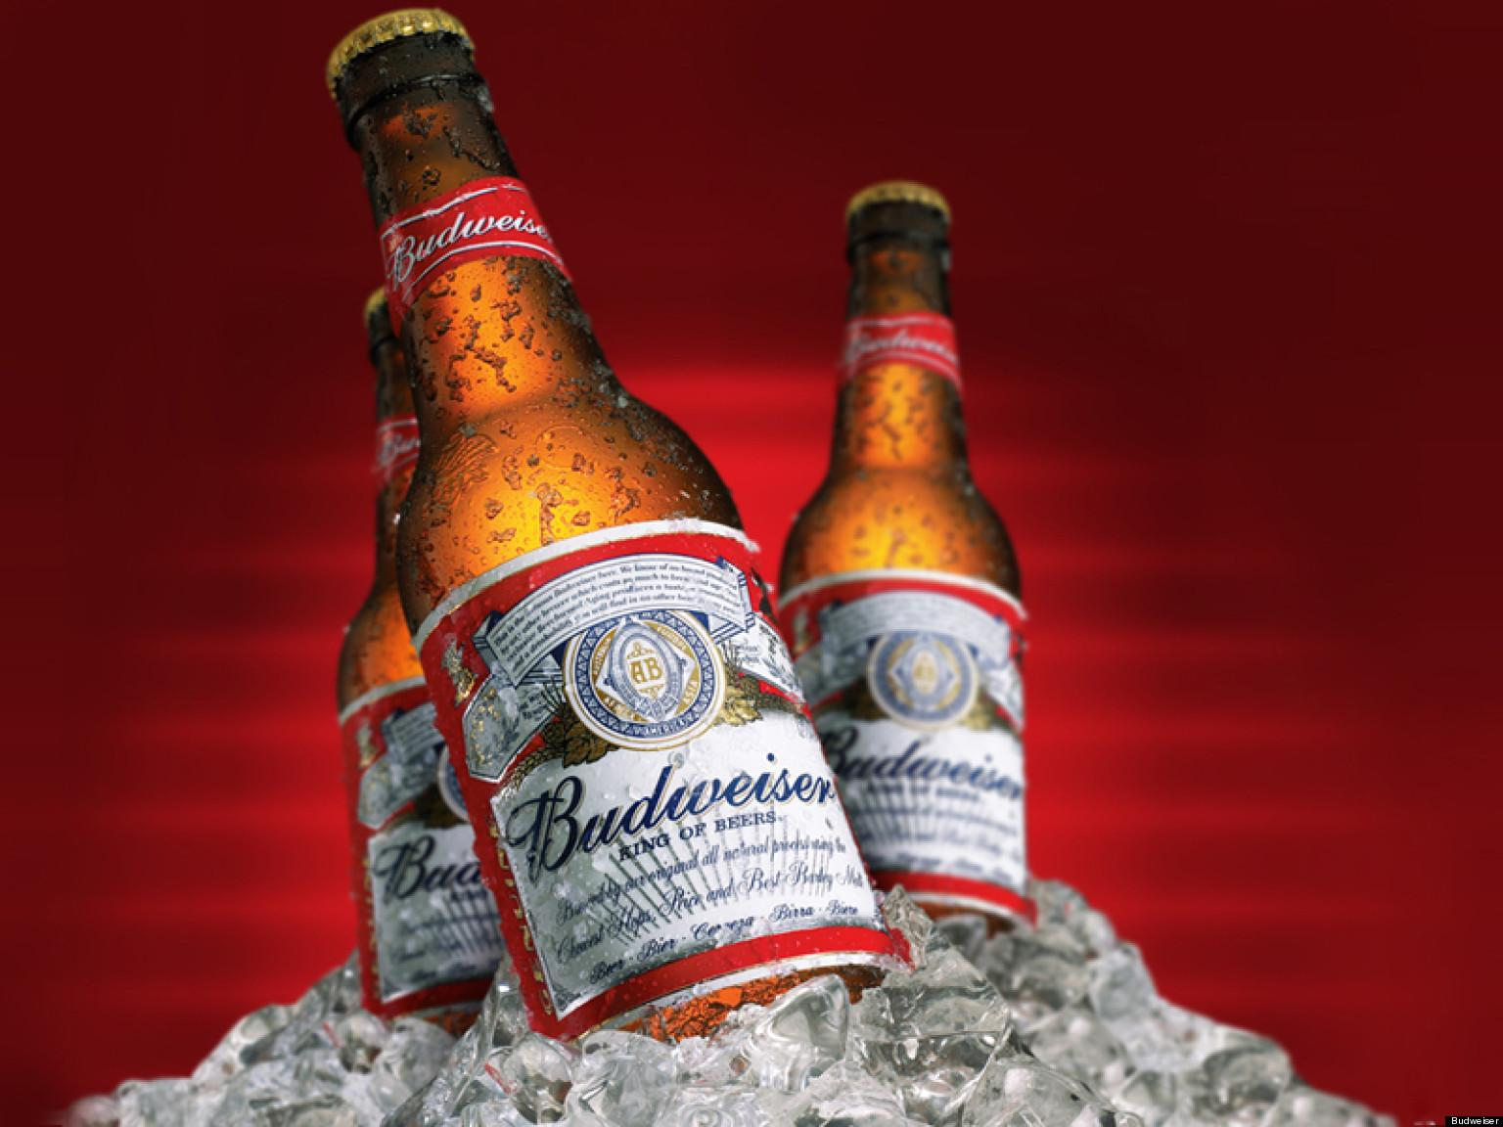
Case Study 01
Josh Mitchell
&
Erin McClure-Price

Slide 2
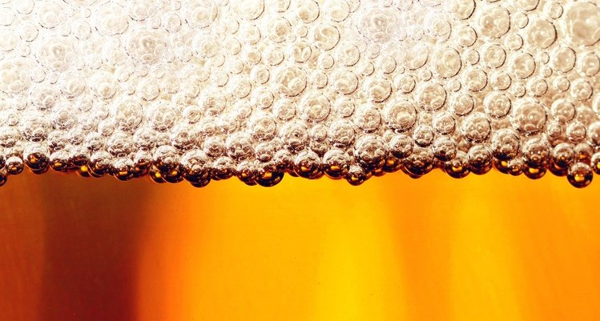
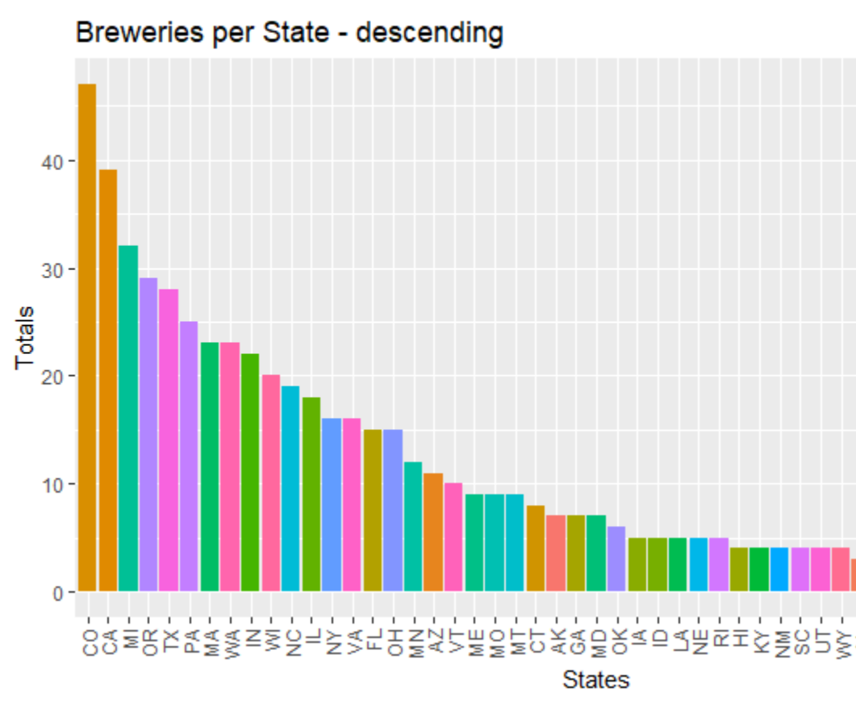
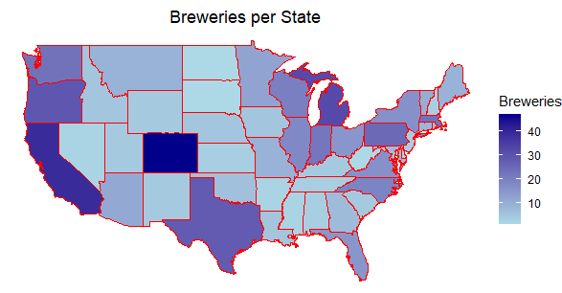
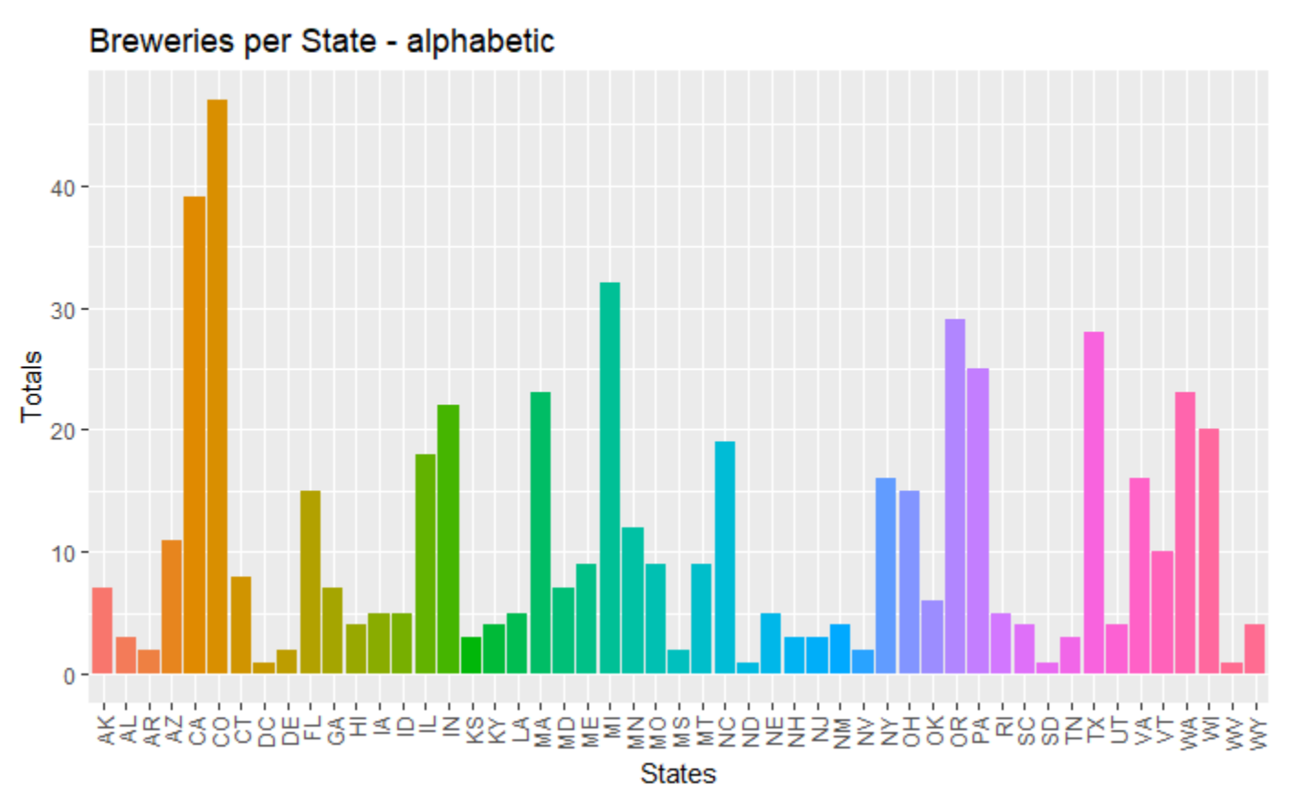
Breweries per State
Underrepresented markets
Increase facilities in states with few breweries
Target customer base with few existing options
Notes:
Colorado and California have the most breweries which indicates that there would be a lot of competition in these areas. Takeaways – avoid the west coast and focus on SE US.

Slide 3
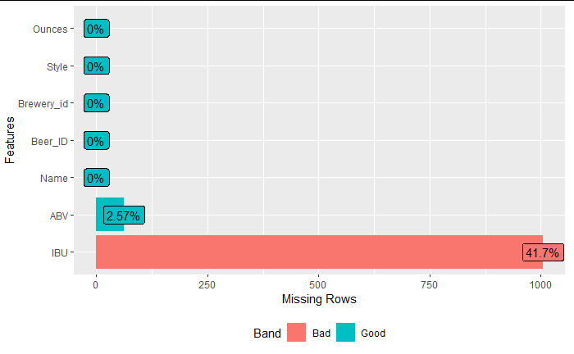
Addressing Missing Data
Total Data Points: 2,410
Total of Missing Data for IBU: 959
Total of Missing Data for ABV: 1
Approximately 40% of data has some form of missing entries
Minimize impact on calculations
Replace missing values with ‘0’
No missing entries from Breweries data
Notes:
While the Brewery dataset had no missing entries, we found that the Beers dataset had a total of 2410 missing entries, mostly for IBU content. We did not want to lose these entries entirely since they contained other important information, so we replaced the IBU values with 0.

Slide 4

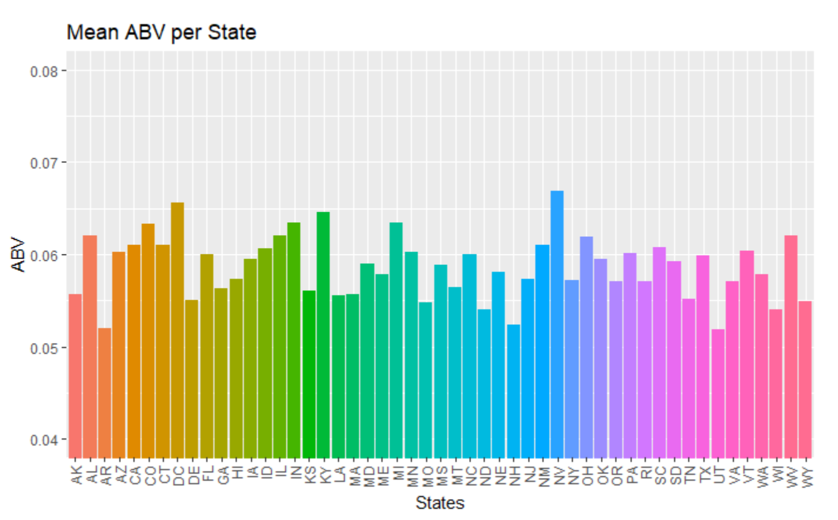
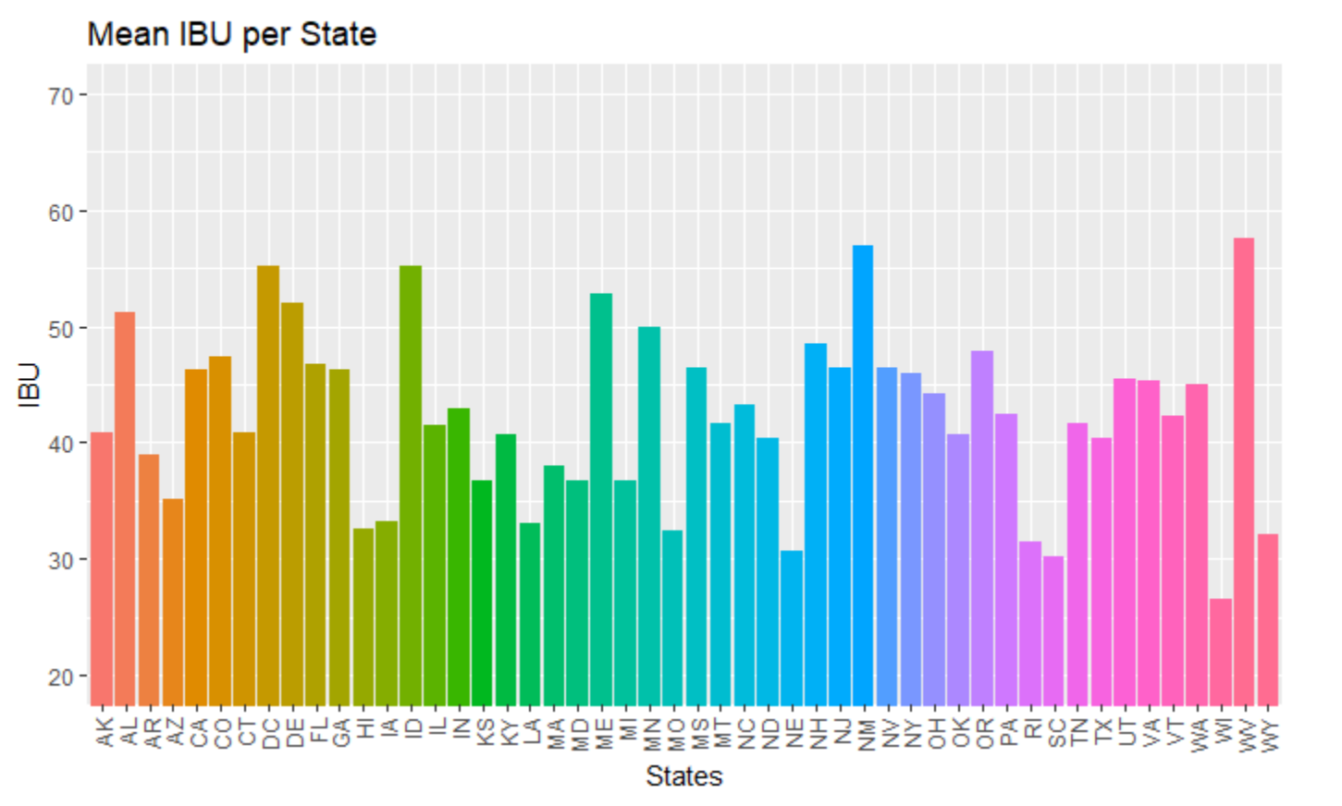
Median ABU & IBU
Insufficient data available for South Dakota
Highest IBU: Oregon (138)
Highest ABV: Colorado (12.8%)
Repurpose existing facilities
Increase product availability for SE markets
Notes:
Colorado had the highest ABV value at 12.8% while Oregon had the highest IBU content at 138. The average ABV is 6%, which indicates that this ABV is the most popular. The median IBU was 37, which is slightly higher than the average lager which is between 20-25 IBUs. Overall, the values indicate that a beer with 6% alcohol and between 30-40 IBUs would appeal to the majority of beer drinkers.

Slide 5
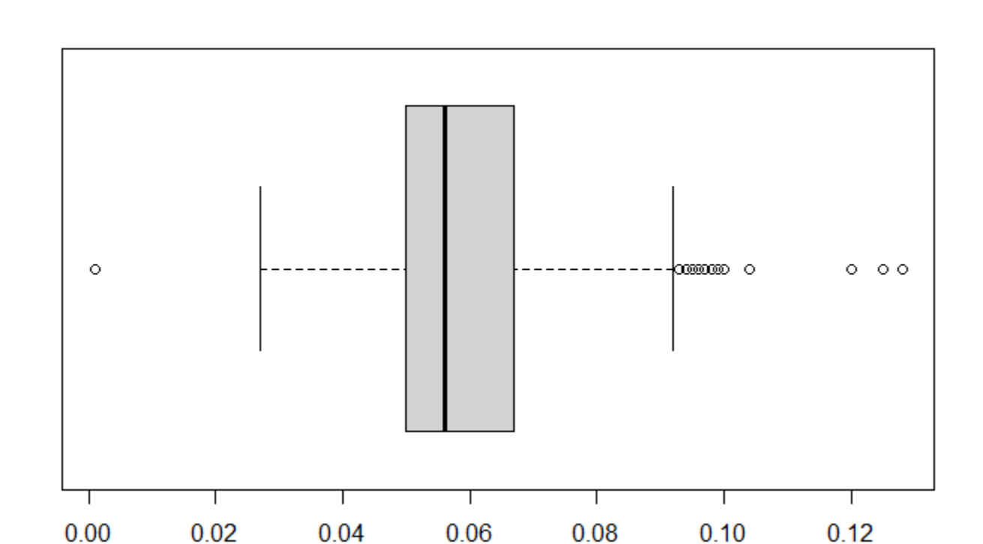
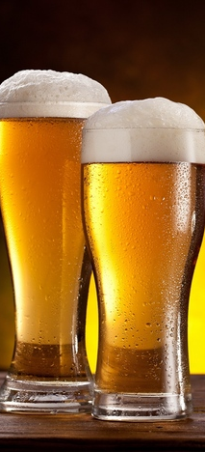
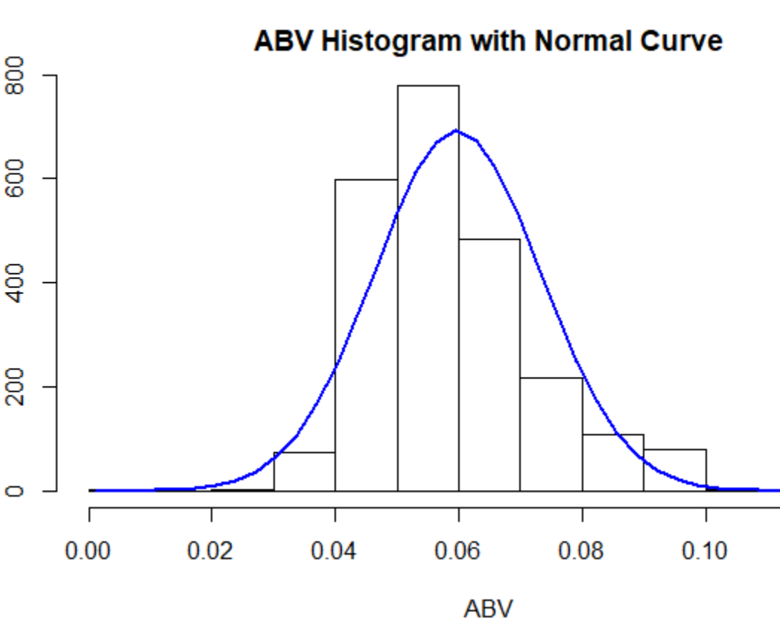
ABV Summary
ABV Boxplot
Min : 0.00100
Mean : 0.05977
Max : 0.12800
Standard Deviation : 0.01354
Variance : 0.00018
Target underrepresented markets
Increase production in the Southeastern US
Maintain average alcohol content
Notes:
We found that the average and median values were almost exactly the same, meaning that the distribution of data is symmetrical. The histogram shows a normal curve, and the majority of beers fall within the 5-6% ABV range.

Slide 6
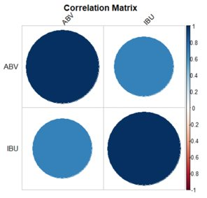
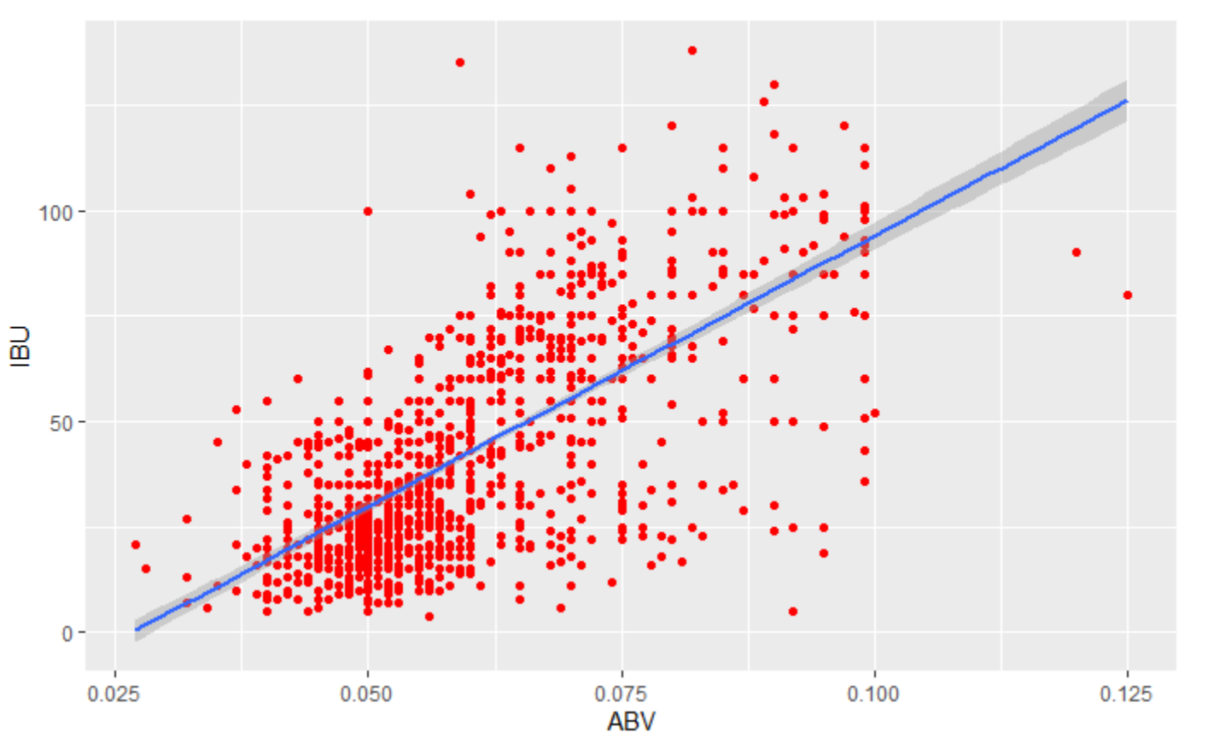
ABV & IBU Relationship
Strong evidence of a positive relationship between ABV and IBU metrics
Increased ABV = decreased serving volume
Manufacturing and distribution costs decrease
High IBUs indicative of PNW, not as desirable in Southeastern US
Notes:
Positive correlation between ABV and IBU; as ABV increases, so too does IBU and vice versa.

Slide 7
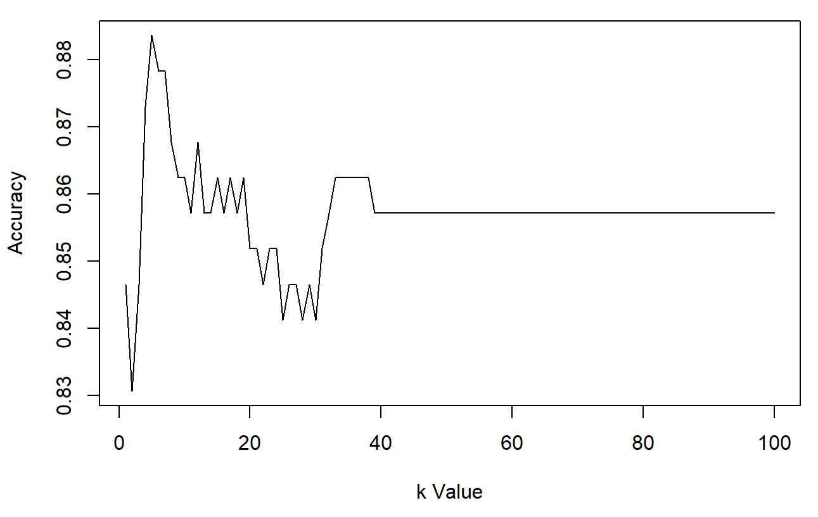
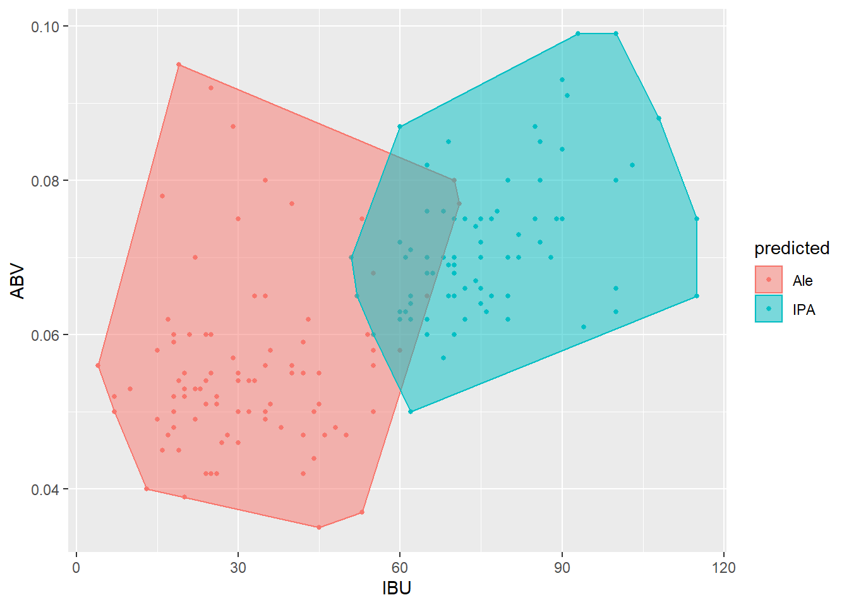
KNN: Classifying IPAs & Ales via ABV & IBU Content
Model accuracy: 88%
Model sensitivity: 93%
Model specificity: 83%
Optimal K value: 5
Error Rate: 12%
Notes:
KNN showed that ales and IPAs could be differentiated with an accuracy of 88% based on IBU and ABV.

Slide 8
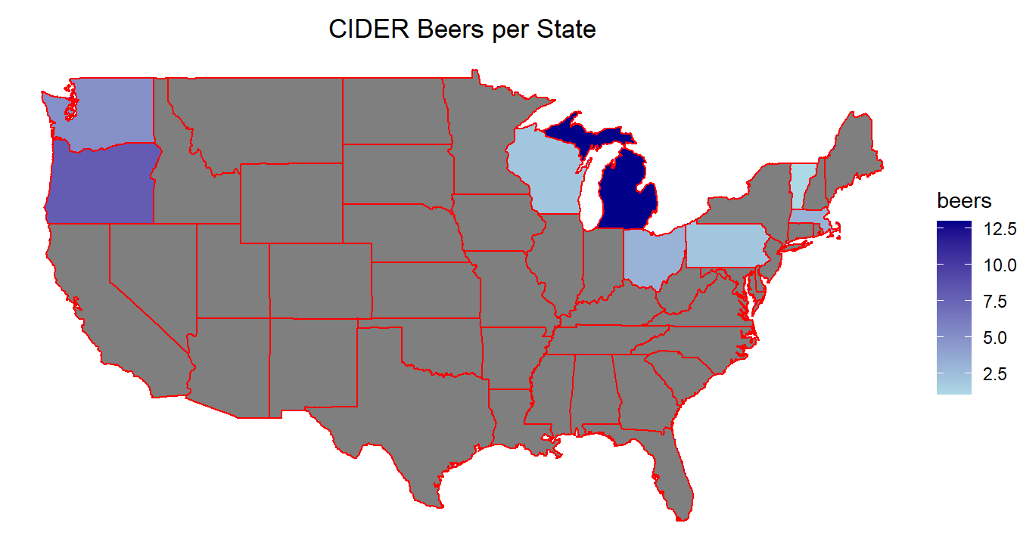
Underrepresented Market: Ciders
Very few ciders outside of OR, WA, and MI
Market strategy:
Advertise existing ciders to these regions
Market test for popularity
Notes:
Ciders are underrepresented in every state, with exceptions for Oregon, Washington, and Michigan. Test the market waters by advertising existing Budweiser ciders to these regions and increasing distribution to these areas. If revenue increases, consider creating a brewery focused on cider production.

Slide 9
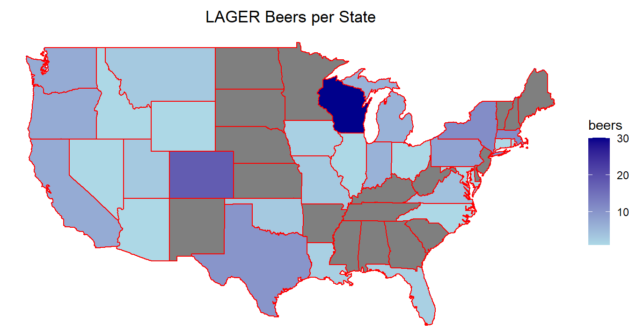
Underrepresented Market: Lagers
Very few lagers in Southeastern US
Market strategy:
Build brewing facility in Georgia
Advantages include low corporate tax rate
Existence of port eases shipping costs
Notes:
Lager is the Budweiser standby, the SE states have few lager beers

Slide 10
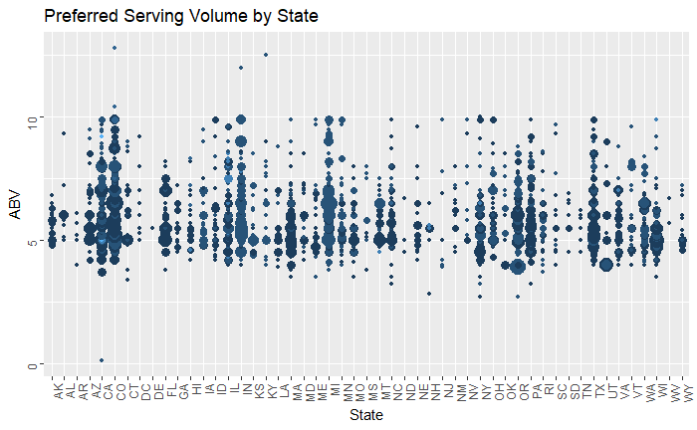
Trends in Serving Sizes & ABV Content: Southeastern US
Serving volumes are small: 4-8 oz
Preferred ABV content compatible with Budweiser lagers: 4-7%
Notes:
This figure shows the preferred bottle, or serving sizes, for each state. Here we see that the preferred serving sizes for those states that have few brewing facilities, such as Georgia, is 4-8 oz. By comparing the serving size to the ABV percentage, we see that Georgia would benefit from having a Budweiser brewery as the ABV is between 4-7%.

Slide 11
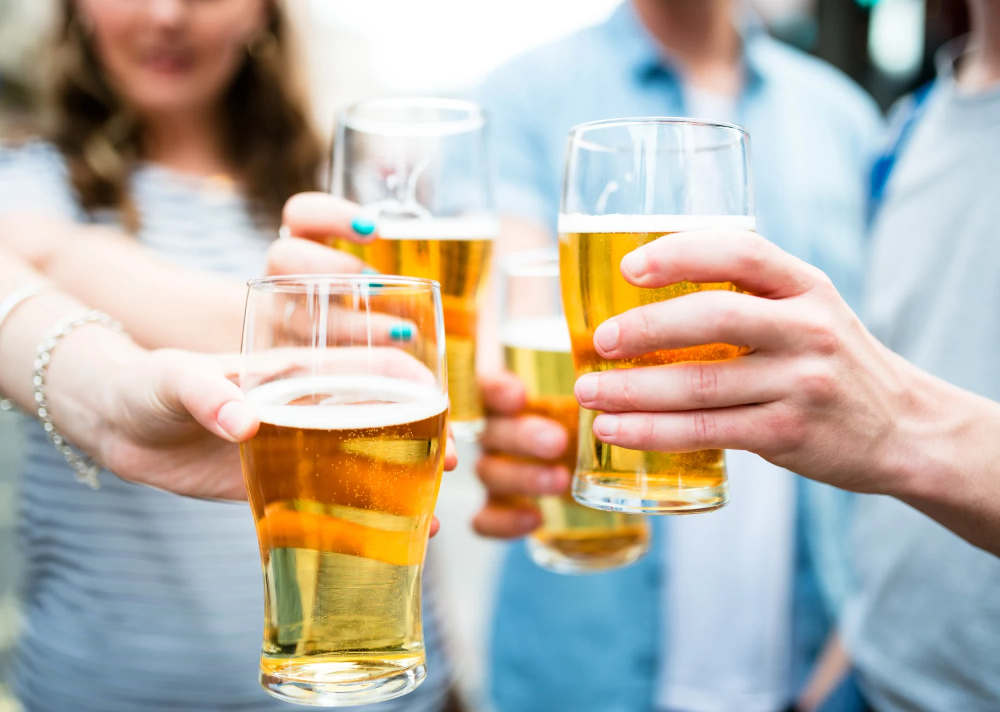
Conclusions
Several states have few existing breweries
Create facilities in these underrepresented regions
Increase sales, revenue
Next steps:
Expand target base
Produce beers in agreement with current preferences
Proposed areas for expansion:
Southeastern states
Proposed strategy
Target Georgia
Major port: Savannah, GA
Significant cost savings for production and transportation
Low cost of living = increased potential for higher sales
Small beverage size = lower distribution costs
Tax rate of 6% offset by lower shipping and distribution costs

