Slide 1




Slide 2
What is a SIEM?
Log management
- Collects log data from various sources (servers, endpoints, firewalls, etc.)
Real time threat detection
- Uses predefined rules, correlation, and analytics to detect suspicious behavior or security incidents
Alerting and Notification
- Triggers alerts when specific events or patterns are detected
Forensic and incident investigation
- Stores historical logs and provides search tools for investigating past incidents
Dashboard and visualization
- Offers a web interface to monitor events, alerts, and system health in real time.
Active response capabilities
- Can execute automated responses (e.g., block IPs) when a threat is detected.

Slide 3
Siem Options
Splunk: High scalability, advanced analytics, premium pricing.
IBM QRadar: Strong threat intelligence, ideal for large enterprises.
Elastic Security (ELK Stack): Open source, flexible, good for custom setups.
Wazuh: Open source, lightweight
Microsoft Sentinel: Cloud-native, easy Azure integration, good for hybrid environments.
LogRhythm: All-in-one security platform, strong compliance tools.
AlienVault (now AT&T Cybersecurity): Good threat intelligence, beginner-friendly.

Slide 4
Why SIEM?
Cyber threats are increasing in frequency and complexity
(e.g., brute-force SSH attacks, malware infections, port scans)
Traditional security tools (like firewalls or antivirus) often detect threats after damage is done
Lack of centralized visibility into logs and system behavior delays threat response
Manual log analysis is time-consuming and prone to human error
Coordinated attacks across multiple systems are hard to detect without correlation tools

Slide 5
Wazuh
Wazuh is a free and open-source SIEM platform
Unlimited amount of customizability to fit your needs
In the context of security software, open source is super important for code auditability

Slide 6
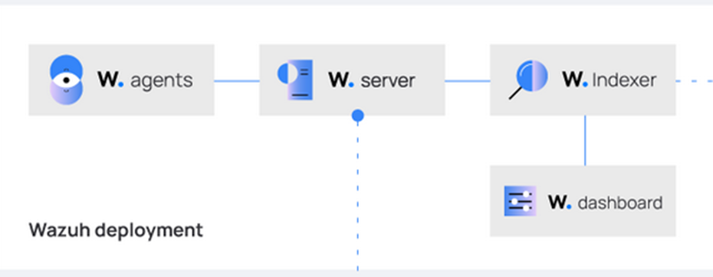
Wazuh Architecture
Dashboard
- Web-based interface for interacting with Wazuh
- Lets users filter, search, and monitor security events in real time
Agent
- Installed on monitored endpoints (e.g., servers, workstations)
- Sends collected data securely to the Wazuh Manager
Manager
- Core processing engine of Wazuh
- Matches logs against rule sets to detect threats
Indexer
- Stores log data and security events in a searchable format
- Handles data indexing, querying, and storage optimization
[Agent] → [Manager] → [Indexer] → [Dashboard] Logs

Slide 7
Detecting port scanning
Port scanning is when someone systematically sends messages to different ports on a computer or server to find out:
- Which ports are open (accepting connections)
- Which ports are closed (rejecting connections)
- What services (like SSH, web servers, FTP) are running on those ports
I configured Wazuh to monitor its agents to detect when a potential attacker is scanning it

Slide 8
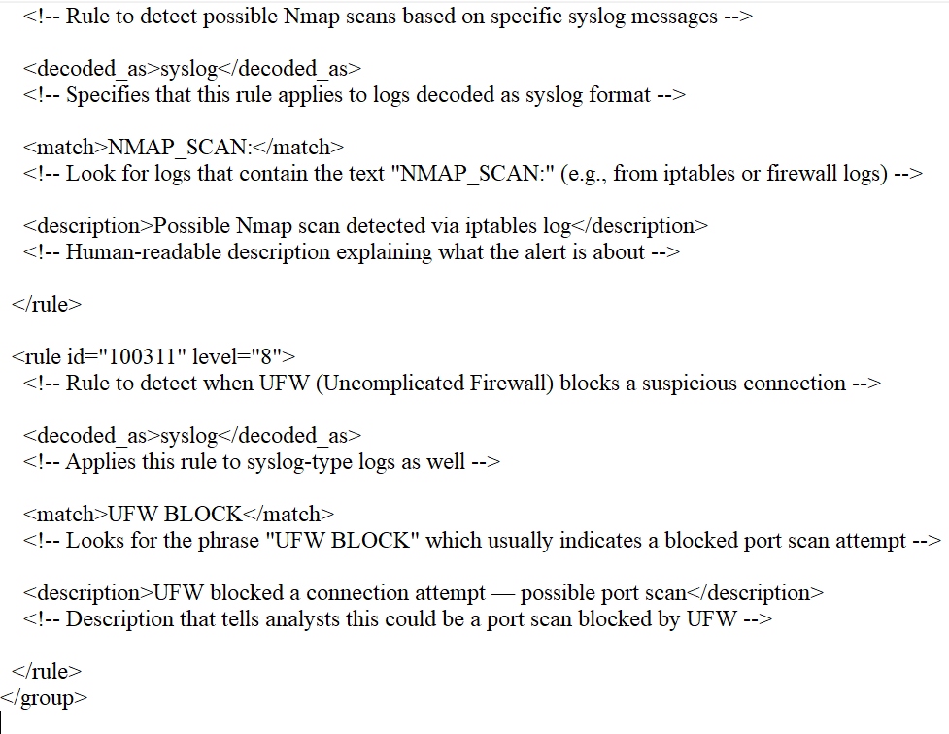
Detecting port scanning
Configuration in rules file

Slide 9
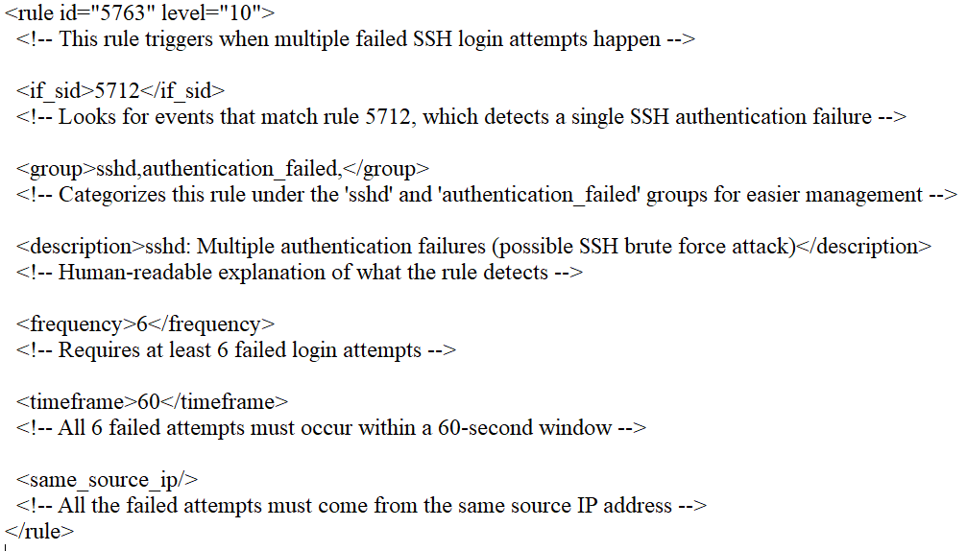
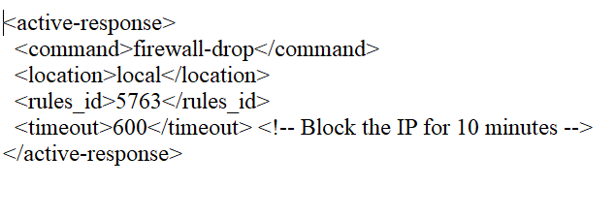
SSH Brute-Force Detection & Active Response
Configuration to detect SSH brute-force attacks by monitoring failed login attempts
[Agent] ⤳ Sends logs → [Manager]
[Manager] ⤳ Detects brute force with Rule 5763 ⤳ Sends active response command
[Agent] ⤳ Executes firewall-drop → Blocks attacker

Slide 10
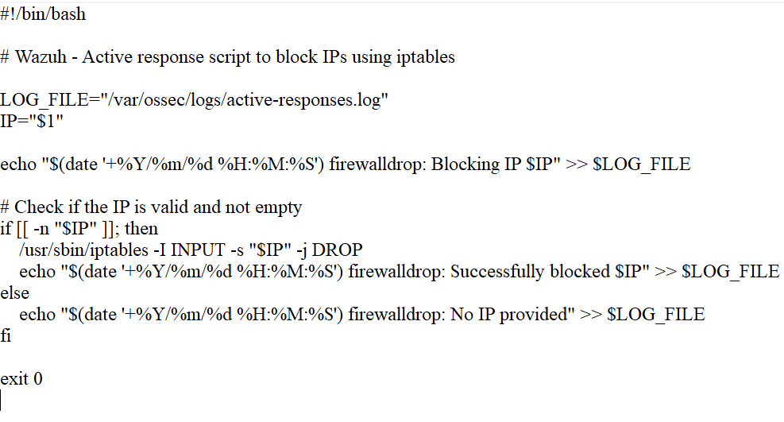
SSH Brute-Force Detection & Active Response
When the threshold is exceeded, Wazuh triggers an Active Response running a firewall drop bash script

Slide 11
Building on top of Wazuh with YARA
YARA is another open-source tool
It is used to identify and classify malware based on patterns in files (string signatures, byte sequences, etc.)
Wazuh can integrate YARA rules to scan files and directories in real-time or on a schedule
Free to use platforms like Valhalla have over 20,000 YARA rules to detect malware
When a YARA rule matches a suspicious file, Wazuh can:
- Generate an alert
- Trigger an Active Response (e.g., delete the file or quarantine it)
- Send rule info to ChatGPT or other tools for analysis

Slide 12
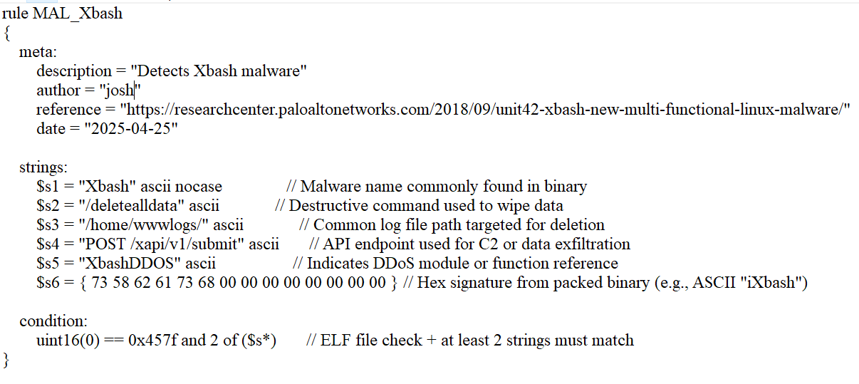
YARA rule for xbash malware
Xbash: Hybrid Malware: Combines features of a botnet, ransomware, cryptominer, and worm → All-in-one attack tool.

Slide 13
Building on top of Wazuh with YARA and Chat- GPT
Once a YARA rule matches a known piece of malware, I configured Wazuh to send it to Chat GPT for further analysis
With all the different types of malware out there its hard to memorize them all and AI models can help us understand faster a potential threat

Slide 14
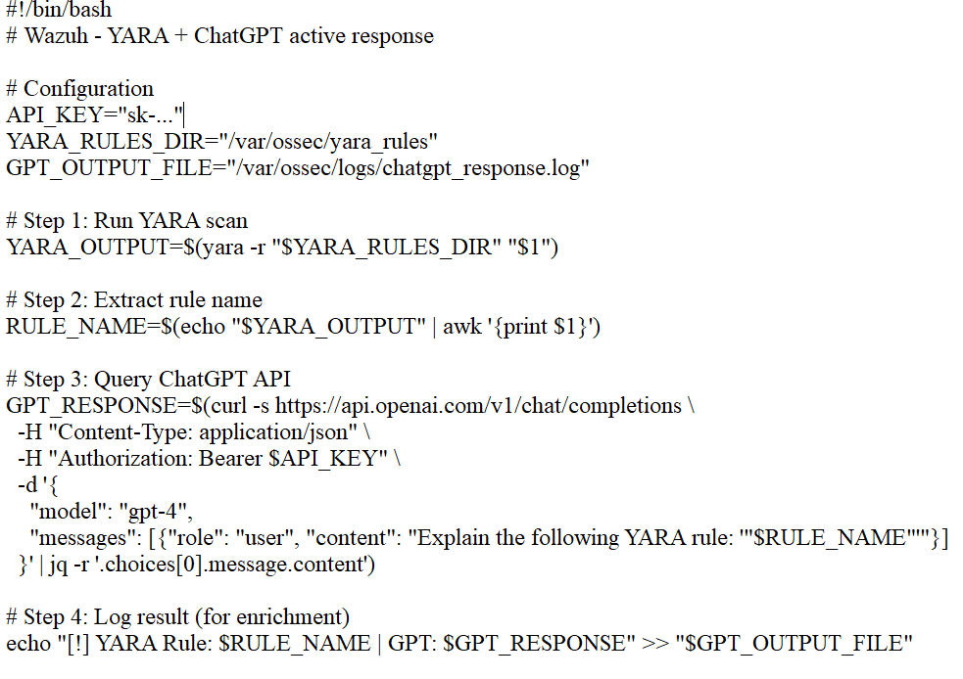
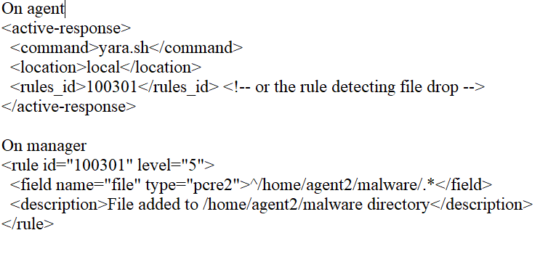
Building on top of Wazuh with YARA and Chat- GPT
Configurations

Slide 15
Demonstration Video
https://youtu.be/7J-VBG9ozDE

Slide 16
Next steps
Integrate a local LLM to replace ChatGPT API to keep analysis offline
Expand to detect other attack types (SQLi, reverse shells, etc)
Separate Wazuh components manager, indexer, and dashboard to different machines for better security
Publish a guide or Github repo for other to easily replicate and contribute

