Slide 1
EV Range Prediction & Gemini Chatbot
Presented by:-Gudiguntal joshna
Department of Computer science(CSM)

Slide 2
Introduction:-
> This project integrates an Electric Vehicle (EV) Range Prediction Model with a Gemini AI Chatbot.The app allows users to interact with the chatbot and predict their vehicle’s range in a single Streamlit interface.

Slide 3
Objectives:-
To predict EV driving range using machine learning.
To develop a chatbot using the Gemini API
To create a user-friendly web interface with Streamlit
To demonstrate real-time AI interaction and prediction.

Slide 4
Tools and Technologies:-
Programming Language: Python
Framework:Streamlit
Libraries: pandas, numpy, scikit-learn
API Used: Google GeminiModel
File: ev_model.pkl---

Slide 5
System Architecture:-
Flow:
User → Streamlit Web App → EV Model + Gemini API → Output
> >The system takes user input for EV parameters, predicts the range, and interacts with the chatbot for assistance.

Slide 6
Working of EV Range Prediction
Inputs: Battery capacity, Speed, Distance, Temperature, etc.
Model processes input using a trained dataset.
Output: Predicted driving range in kilometers.

Slide 7
Gemini chatbot
Uses Gemini API to generate intelligent responses.
Provides real-time interaction inside the app.
Accepts user text input.

Slide 8
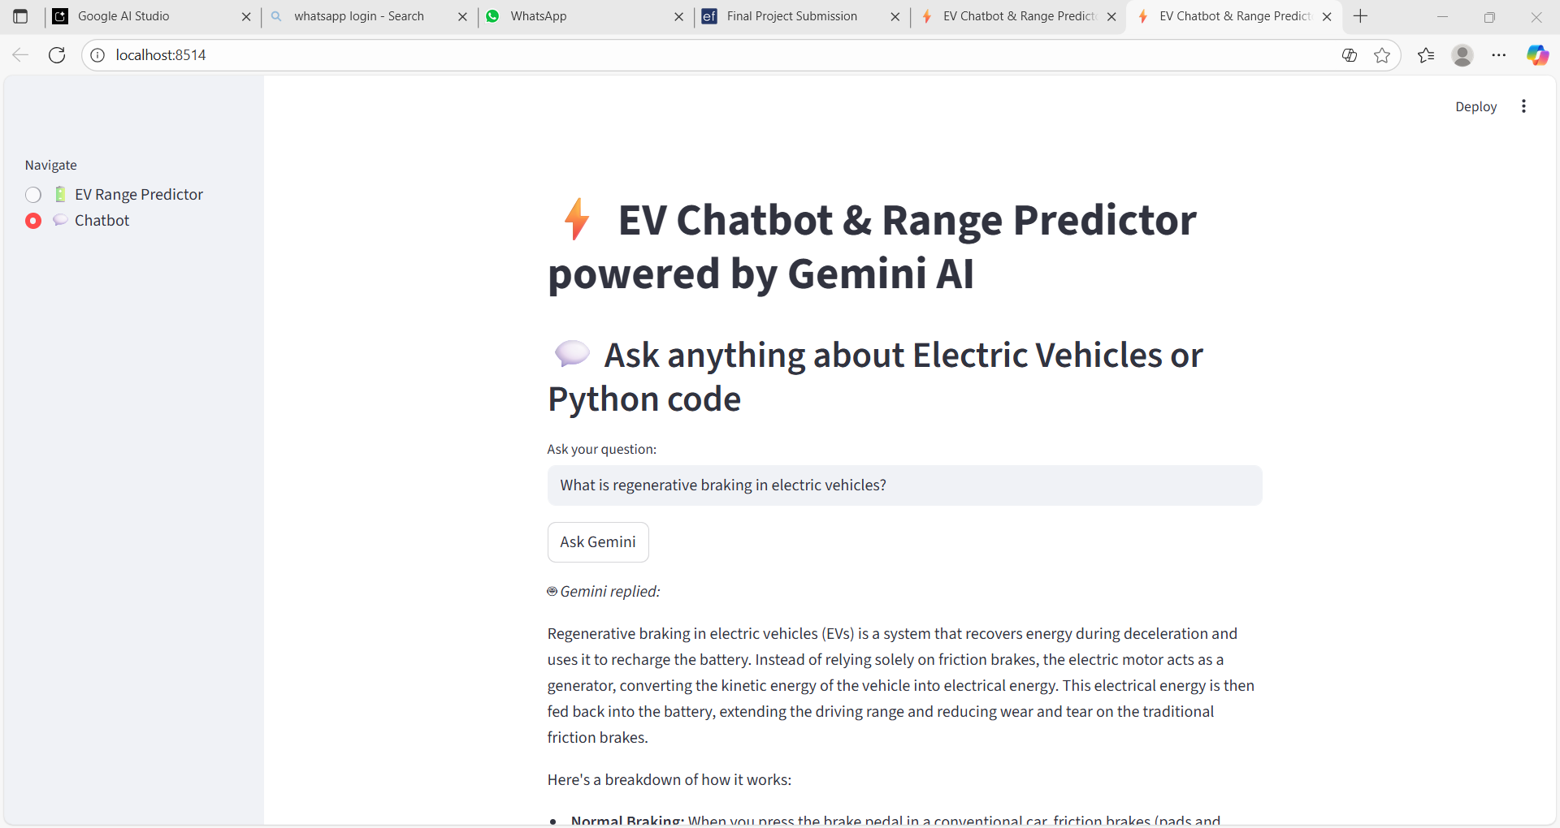
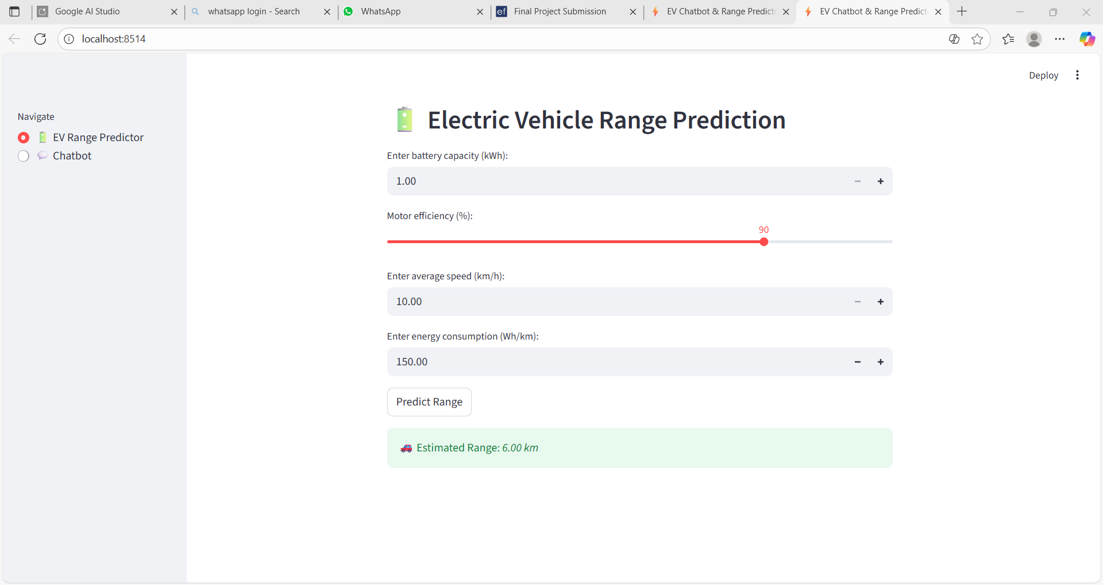
Output Screenshots:-

Slide 9
Conclusion:-
> The project successfully combines predictive analytics and conversational AI.
It demonstrates how EV technology can be enhanced with machine learning and chatbots for better user experience.

