Slide 1
DevOps in Healthcare
Joshna Mariya Jose

Slide 2
Assignment 1: Problem Statement
Implementing DevOps in Healthcare
The healthcare industry has grown by leaps and bounds over the past few decades. The paper-loaded clinics and hospitals have been replaced by tech-savvy smart data applications. Data lies at the key of the healthcare industry and this data needs to be easily accessible and adhere to the relevant security protocols.
This is where DevOps in healthcare weighs in. It is the answer to gaining a competitive edge through responsive, data-driven, and superior care-giving.

Slide 3
Assignment 1: Step 2 : Technology Identification.
By practicing Continuous Integration (CI) and Continuous Delivery (CD), and leveraging a microservices architecture, solutions and/or features desired most by patients are able to be deployed in a timely fashion.
Continuous Integration – Jenkins. Focus on continually merging changes in the code to the central repository, before building and testing. Deploy CI tools toward the efficient management of the healthcare application development to ensure the accuracy of the configuration and integration.
Cloud - AWS
Containerization - Kubernetes
Bring automation toward integrated care solutions, wherein scripting and automated retrieval of the code are deployed. This recovery should be enabled from the code repository and is then compiled into a binary artifact to allow for periodic testing.
Automated Release through Continuous Deployment (CD): This step toward delivery and deployment of custom medical solutions involves the delivery of the software and regular updates in an automated and continual fashion.

Slide 4
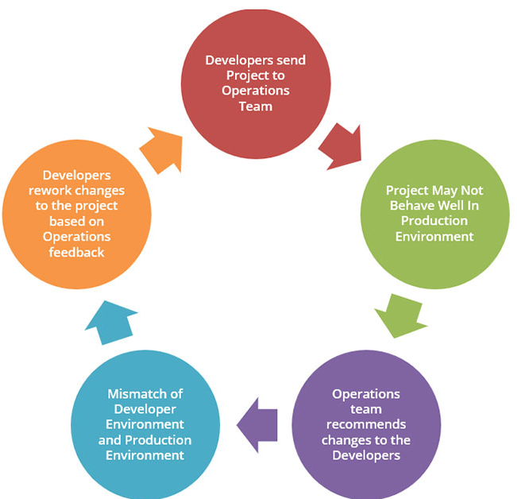
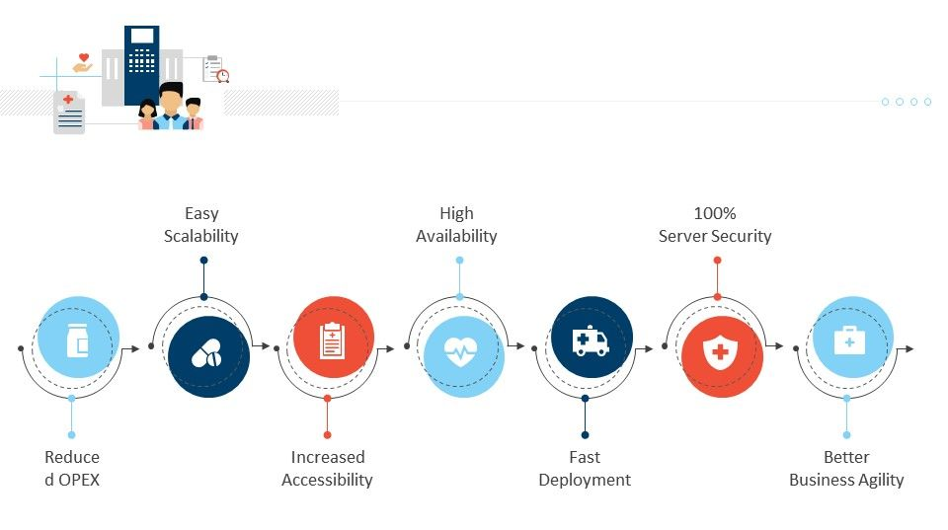
Assignment 1: Step 3 : A little brief on design of application.

Slide 5
Assignment 1: Step 4 : How do you intend to gauge the output.
From faster delivery to higher quality, the benefits of DevOps in healthcare are many. Listed below are the key ones:
Reduced OPEX: Operational expenses are considerably reduced since there are no initial investments in purchases and training, along with reduced operational resources.
Improved Infrastructure Efficiency: The ease of accessibility to resources and data, along with automation, improves the overall efficiency of the infrastructure. DevOps provides integrated healthcare solutions through higher-quality infrastructure.
Increased Patient Engagement and Satisfaction: The DevOps tools are designed to minimize time and effort toward patient engagement, through check-in systems, etc. It further increases overall satisfaction through CI and CD tools for appointment scheduling, patient security, etc.

Slide 6
Your Top 3 Level 1 Learnings
Learning 1: Learn working with Docker, Jenkins, UiPath.​​
Learning 2: Finding solution for real life problem using AWS and devOps​​
Learning 3: Creating Instance in AWS and hosting the services in it will reduce the overall infra cost and increases security and reliability for the business​

Slide 7
Thank you

