Slide 1
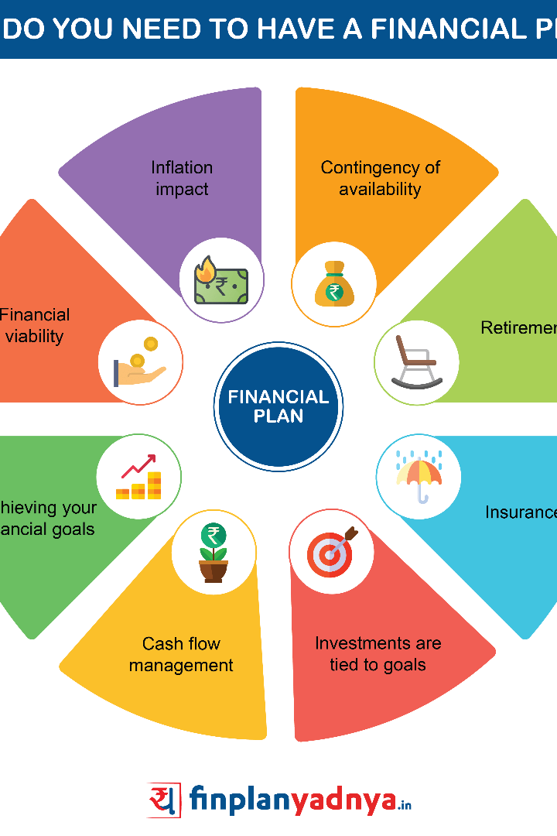

Creating Loan Calculator Using Tkinter in Python
Welcome to a guide on creating a loan calculator using Tkinter, a powerful Python library for building graphical user interfaces. In this presentation, we will explore the importance of loan calculators and dive into the process of building one using Tkinter.

Slide 2

Introduction
Loan calculators are valuable tools for financial planning and decision-making. They enable individuals to accurately estimate loan repayments, interest rates, and overall affordability. In this section, we will provide an overview of Tkinter and understand why it is a popular choice for creating interactive loan calculators.

Slide 3
What is Tkinter?
Tkinter is a Python library that enables the creation of Graphical User Interfaces (GUIs) for desktop applications. It provides a comprehensive set of user interface components and tools that simplify the development process. This section will explore the features and functionalities of Tkinter in more detail.

Slide 4
Steps to Create a Loan Calculator Using Tkinter
1
Step 1: Importing Tkinter and Other Necessary Libraries
Begin by importing the Tkinter library and any additional libraries required for the logic and calculations involved in the loan calculator.
Step 2: Creating the Main Window and Layout
2
Create the main window for the loan calculator application and design the layout using Tkinter's built-in layout managers.
3
Step 3: Designing and Adding Input Fields
Design and incorporate input fields for users to enter the required loan details such as principal amount, interest rate, and loan term.
Step 4: Implementing the Loan Calculation Logic
4
Write code to perform the loan calculation logic, which involves computing loan repayments, interest, and other relevant information.
5
Step 5: Displaying the Results
Finally, display the calculated results in a visually appealing format on the loan calculator interface, allowing users to make informed decisions.

Slide 5
Code:
import tkinter as tk from tkinter import ttk
def calculate_loan(): try: principal = float(principal_entry.get()) interest_rate = float(interest_rate_entry.get()) / 100.0 time_period = float(time_period_entry.get())
# Formula to calculate monthly payment monthly_payment = (principal * interest_rate / 12) / (1 - (1 + interest_rate / 12) ** (-12 * time_period)) result_label.config(text=f"Monthly Payment: ${monthly_payment:.2f}") except ValueError: result_label.config(text="Please enter valid numeric values.")
Create the main window
window = tk.Tk() window.title("Loan Calculator")
Create and place widgets
principal_label = ttk.Label(window, text="Loan Amount:") principal_label.grid(row=0, column=0, padx=10, pady=10)
principal_entry = ttk.Entry(window) principal_entry.grid(row=0, column=1, padx=10, pady=10)
interest_rate_label = ttk.Label(window, text="Annual Interest Rate (%):") interest_rate_label.grid(row=1, column=0, padx=10, pady=10)
interest_rate_entry = ttk.Entry(window) interest_rate_entry.grid(row=1, column=1, padx=10, pady=10)
time_period_label = ttk.Label(window, text="Loan Term (years):") time_period_label.grid(row=2, column=0, padx=10, pady=10)
time_period_entry = ttk.Entry(window) time_period_entry.grid(row=2, column=1, padx=10, pady=10)
calculate_button = ttk.Button(window, text="Calculate", command=calculate_loan) calculate_button.grid(row=3, column=0, columnspan=2, pady=10)
result_label = ttk.Label(window, text="") result_label.grid(row=4, column=0, columnspan=2, pady=10)
Start the Tkinter event loop
window.mainloop()

Slide 6
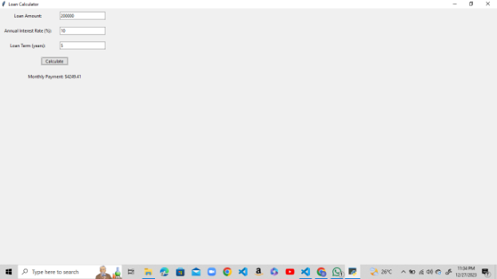
Output:

Slide 7

Conclusion
Benefits of Using Tkinter for Creating Loan Calculators
Recap of the Steps Discussed
We highlighted the essential steps required to create a loan calculator using Tkinter, empowering you to try it yourself.
Using Tkinter offers numerous advantages, including its simplicity, cross-platform compatibility, and extensive documentation and community support.
Encouragement to Explore and Experiment with Tkinter
Tkinter's versatility extends beyond loan calculators. Experiment with the library to build various other GUI-based applications!

