Slide 1
Cyclistic Report: Casual and Member Users
Joshua Ndala • October 29, 2023

Slide 2
Agenda
Project overview and goals
Data and analysis
Recommendations

Slide 3
Overview

Slide 4
Overview
Project Overview
Flexibility in pricing plan
Casual: single-ride or full-day passes
Member: purchased annual memberships
Annual members are more profitable
Goal
Develop strategies to convert casual riders to members
Notes:
Casual Riders: Customers who purchase single-ride or full-day passes
Cyclistic Members- Customers who purchase annual memberships

Slide 5
How do members and casual riders use Cyclistic bikes differently?

Slide 6
Data and Analysis

Slide 7
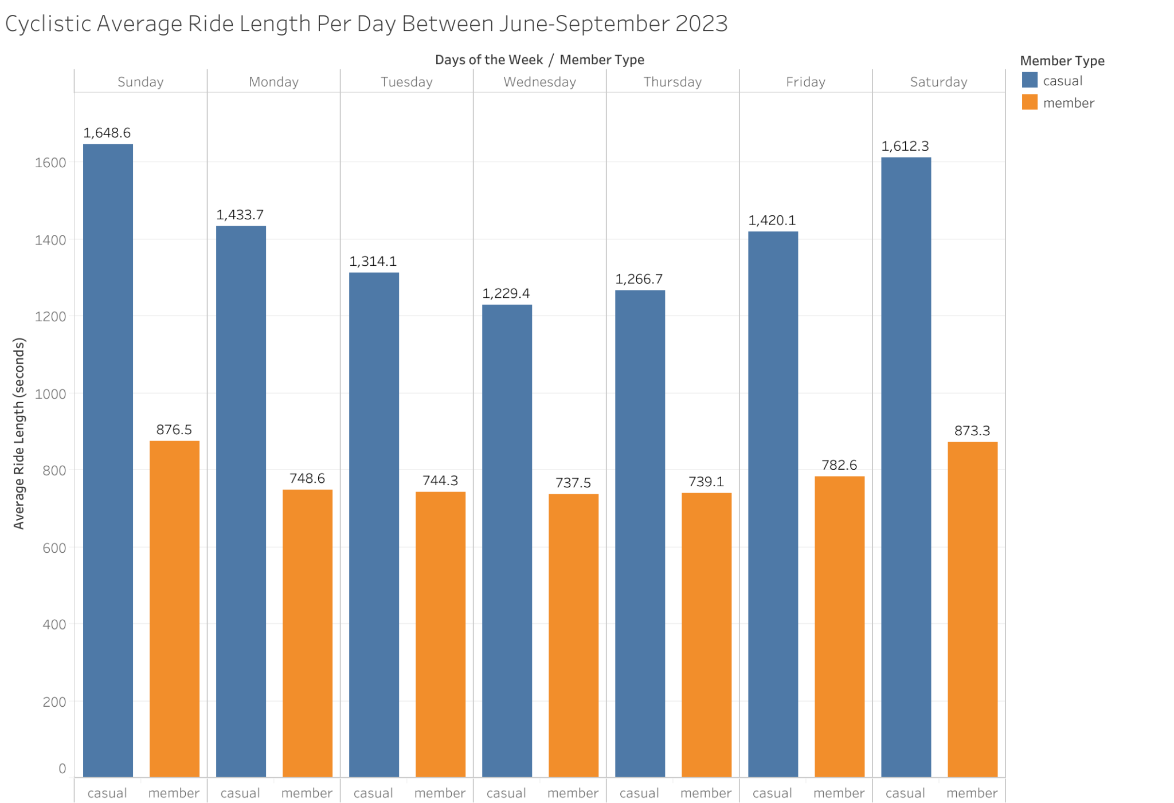
Average Ride Time Per Day
Summer data; between June and September 2023
There’s more casual riders than members
Both casual riders and members have bike increase usage in the weekend
Dashboard with filter available here

Slide 8
Recommendations

Slide 9
Recommendations
Collect More Data
To gain a deeper understanding, collect data regarding the purpose of the rides
Weekend Promotion for Members
This is due to the spike in bike usage during weekends
Weekday Commuter Promotion
Incentivize more users to use Cyclistic for their daily commutes

Slide 10
Thank You!

