Slide 2
The WENET Project
Data Integration and The Criminal Justice System in Whatcom County
Whatcom County Law & Justice Council
MIS Committee

Slide 3
So, you want to share law and justice data across organizational, jurisdictional and technology boundaries.
Sure, we can do that ☺

Slide 4
Audience?
“There are only 10 types of people in this world, those that know binary and those that do not.”
“Management by Objective”

Slide 5
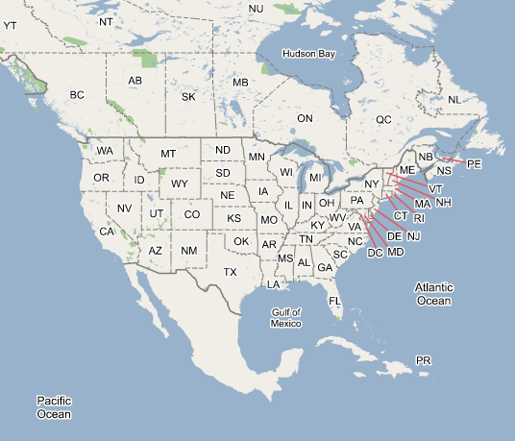

Slide 6
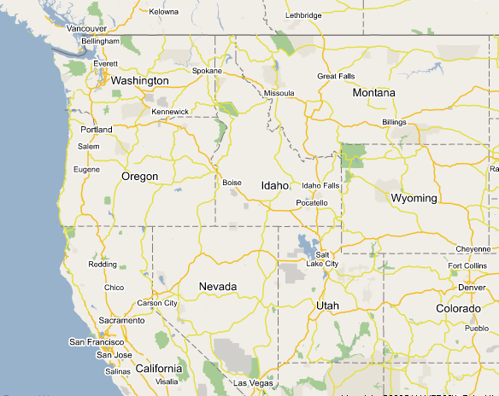

Slide 7
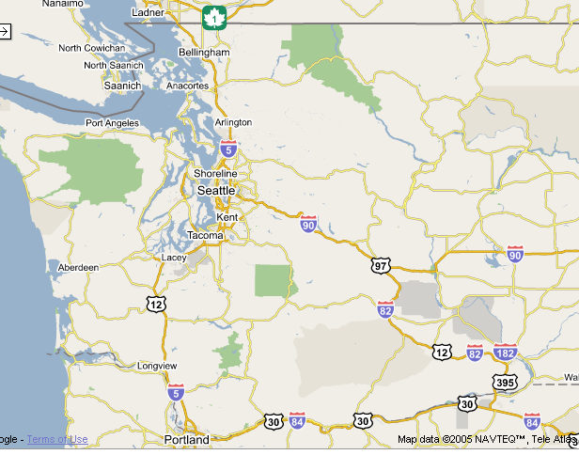

Slide 8
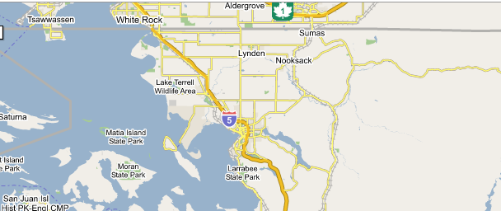

Slide 9
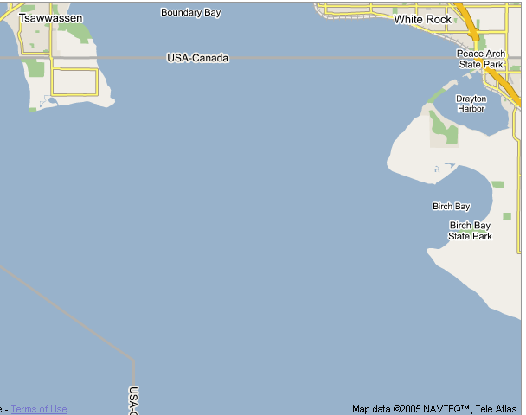

Slide 10
Whatcom County
Second busiest northern land border crossing (Blaine) (large DHS presence)
Point Roberts, only land access is through Canada
Two Tribal states, Lummni Nation and the Nooksack Nation
Western Washington University

Slide 11
Agenda
Case Study (Incomplete)
  History
  User Requirements
  Technology Choices
  GJXDM
  WENET Protocol
    SOA upside down
Lessons Learned, Random Thoughts
Questions, if you are nice to me, some answers ☺

Slide 12
How:
Research
Commitment to sharing
Write up plan
Find a million bucks
Assemble a team
Create a working technical plan

Slide 13
Problem
Share data across boundaries
Share as much data as possible, securely
Be able to dramatically expand the scope of sharing in the future
Finish quickly and for little money

Slide 14
History
Originally started in 1993 as interdepartmental integration
In 2000 MIS Committee formed under county-wide Law and Justice Council to be chaired by long time integration advocate, Kathy Walker of the Prosecutor’s Office
November 2002 MIS Committee Report released, conceptualizes and recommends WENET
October of 2003 Federal grant funding secured by County Executive Pete Kremen

Slide 15
Additional User Requirements
“Keep our existing records management systems”
“Own our data”
“Control the security of our data”
“Reduce data duplication effort”
“Field and context sensitive security”
“Utilize established technologies”
“Survive political instability”

Slide 16
Why a simplistic approach
Expandability
Fast implementation
Low cost (relative)
Minimize risk of failure…

Slide 17
What is a simplistic approach
Flexible project plan
Uses well known/used technologies:
  HTTP
  CGI/ASP/JSP
  XML
  SSL and Digital Certificates
Query only
Use an off the shelf data dictionary

Slide 18
Currently…
Whatcom (AS400)
  Developed over 15 years ago for Whatcom County by CompuTech Inc.
  Consists of a loose collection of programs and applications for use in the Prosecuting Attorney’s Office, Jail, Sheriff’s office
  Runs on IBM iSeries (AS400) in DB2
  Originally shared with BPD

Slide 19
Currently…
LongArm
  Began development in 1996 by Bellingham Police Department (BPD) as their new records management system (RMS)
  Went live July 1st of 1999
  Runs against a MS SQL Server
  Developed in MS Visual Basic and .Net
  Custom developed for BPD by CompuWorks Pacific Inc.

Slide 20
Currently…
Whatcom County Sheriff/Jail
  Evidence OnQ on MS SQL (OTS)
  Some broken mugshot system on Access
Blain PD
  “Justice” on MS SQL (OTS)
  Evidence OnQ on MS SQL (OTS)
Sumas PD, Nooksack Tribal PD, Everson PD
  CrimeStar on Foxpro (migrate to MS SQL version) (OTS)
Lummi Tribal PD
  NetRMS on MS SQL (OTS)

Slide 21
Currently..
Lynden PD
  Aegis MSP on MS SQL (OTS)
WWU PD
  ARMS on MS SQL (OTS)
Ferndale PD
  In transition

Slide 22
Currently…
Users must check both systems to research information
Most users do not have ready access to both systems
Different data models, data integrity rules, and definitions
Each of the other local law enforcement agencies have their own RMS which are unavailable to other agencies

Slide 23
Three Phases to WENET Project
Connect Whatcom County (PA, SO, Jail) with Bellingham Police Dept.
Connect with other local jurisdictions
Connect with non-local jurisdictions and systems

Slide 24
Notable Dates
December of 2003 kick off meeting
January of 2004, GJXDM released
Febuary of 2004, staff hired
December of 2004, contracts approved with vendors for Phase 1 work

Slide 25
Four Parts to Phase 1
1. Define a technical specification and means to inquire disparate law and justice records management systems.
2. Implement services using the technical specification for the Longarm RMS and the AS400 RMS and connect the two services.
3. Create clients that take advantage of the shared data. Extend Longarm and the AS400 applications to allow searching of shared data.
4. Develop methods to import retrieved data into Longarm and the AS400 and to better utilize data.

Slide 26
Part 1- Technical Concept
WENET will allow inquiry of XML data based on the Justice XML Data Dictionary 3.0 via HTTP utilizing XPath queries and secured using client authenticated SSL.
FOR MORE INFO...
Project specifications can be found at:
http://www.whatcomcounty.us/apps/wenet/

Slide 27
AOS

Slide 28
Query vs Publish

Slide 29
Write the specs
Develop a technical specification and plan:
  WENET Protocol
  WENET Schema

Slide 30
Technology
Use existing technologies
  HTTP
  XML
  XPath
  SSL/TLS
  Digital Certificates

Slide 31
Technology cont…
Save time, borrow someone else's work:
  GJXDM v3.x

Slide 32
Clients and Services
Services
  A service is an inquiry point to a law and justice records management system (RMS).
  Each agency with a RMS will implement at least one service.
  An agency may have multiple services, each accessing a different RMS. Ex. Currently Jail mug shots exist in a separate RMS and may be exposed by a separate and limited service.
  Primary focus of Part 2.

Slide 33
Clients and Services
Clients
  A client may be part of an existing application. Ex. An expanded names search on the AS400 that shows all names known and if the name is not local, imports it.
  May be a new application. Ex. A web browser based person profile application that allows search by name and shows all associated events. Such an application may be shared with state/federal law enforcement agencies.
  Primarily the focus of Parts 3 and 4.

Slide 34
XML
GJXDM v3.x
WENET Schema 1.x
Persons, Property, Court Orders and Warrants, Arrests, Events, Jail Booking, Citations, Dispatch Events, Prosecutor pre-charging info and Prosecutor Cases.

Slide 35
Query

Slide 36
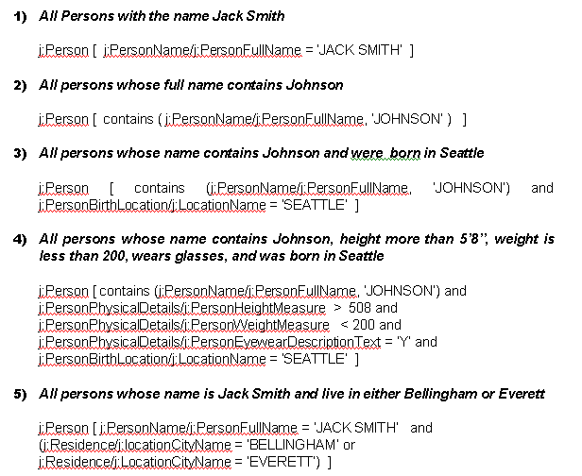
Sample XPath queries

Slide 37
Parse Results List

Slide 38
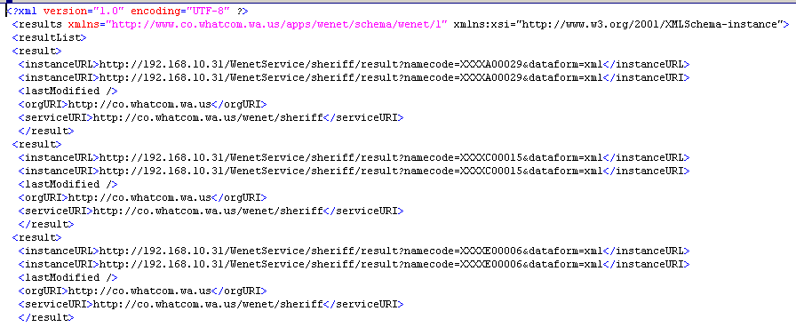
Sample wenet:results document

Slide 39
Retrieve Individual Records

Slide 40
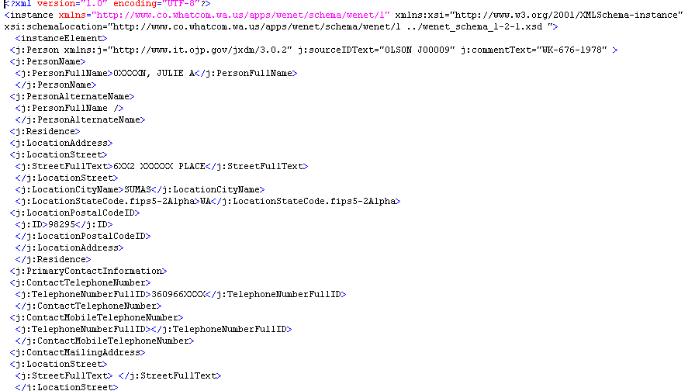
Sample wenet:instance document

Slide 41
Security
RMS Security
Transport
Authentication
Access
Auditing
Security Review

Slide 42
WENET Phase 1, Part 2
AS400
HTTP Server
Internet
HTTP GET
XML response
Client
HTTP GET
Whatcom County
BPD
Longarm
HTTP Server

Slide 43
WENET
AS400
HTTP Server
Internet
Client
HTTP GET
HTTP GET
Whatcom County
BPD
XML
response
XML
response
Longarm
Proxy /
HTTP Server
HTTP Server

Slide 44
WENET Part 3
Develop client software development kits for:
  Java
  Java on AS400
  Visual Basic
  Microsoft .Net / C#

Slide 45
WENET Part 3
Create a Web Based Client (WBC) to query services and provide user friendly results aimed at law enforcement officers.
Connect WBC to Internet and provide secured access to users.

Slide 46
WENET Part 4
Modify LongArm to use new data sources
Modify Whatcom (AS400) to use new data sources
Implement smart Agent software for data mining, notification and export.

Slide 47
WENET Part 4
AS400
HTTP Server
Internet
Client
Whatcom County
BPD
Longarm
Proxy /
HTTP Server
HTTP Server
Client

Slide 48
WENET Phase 2
Phase 2 expands data sharing to other local law enforcement agencies by working with their existing RMS systems, developing services to expose their data and extending them to use the newly available data.

Slide 49
WENET Phase 2
Internet
RMS
Client
Client
RMS
RMS
Client
Proxy /
HTTP Server
RMS

Slide 50
WENET Phase 3
Phase 3 explores other possible sharing partners and how to develop services to query their data and clients so they can make use of our data.
Phase 3 of WENET is not funded but is the logical outcome of the project.

Slide 51
So that was/is the Plan, how are we doing?
Two vendors, CompuTech Inc. and CompuWorks Pacific Inc. are nearing completion of the first two service points each with one data type.
Java toolkit is being refined while work on the web browser based client is in the first stage.

Slide 52
Related Documents / Further Info
WENET Technical Specifications
  http://www.whatcomcounty.us/apps/wenet/
  http://www.whatcomcounty.us/boards/lawjustice/mis/
This Presentation:
  http://www.whatcomcounty.us/apps/wenet/gjxdmpresentation.jsp

Slide 53
Related Documents / Further Info
Project Coordinator
  Ron Peterson
  (360) 676-7684
  rpeterso@co.whatcom.wa.us
MIS Committee Chair
  Kathy Walker
  (360) 676-6784
  kwalker@co.whatcom.wa.us
Technical Coordinator
  Josh Nylander
  (360) 676-7684
  rnylande@co.whatcom.wa.us

