Slide 1
WENET Technical Plan - Part 1
Whatcom County Law & Justice Council
MIS Committee

Slide 2
So, you want to share law and justice data across organizational, jurisdictional and technology boundaries.
Sure, we can do that ☺

Slide 3
Project Goal
Design and deploy a computerized process that allows the sharing and/or exchanging of information between all law and justice practitioners, within the county’s justice enterprise, that tracks offenders from the moment they enter the system until re-integrated back into the community.

Slide 4
Technical Project Objectives
1. Share law and justice data across organizational, jurisdictional and technology boundaries.
2. Initially share between Whatcom County Sheriff, Jail and Prosecutor’s Office and the Bellingham Police Department.
3. Expand sharing to other local jurisdictions.
4. Expand sharing to state and federal jurisdictions.

Slide 5
Description
Provide a method to inquire in a standard fashion the different law and justice records management systems used in Whatcom County.
Develop and deploy such a method between the County and BPD.
FOR MORE INFO...
The Nov. 2002 MIS report is available at:
http:// www.co.whatcom.wa.us/boards/lawjustice/mis/

Slide 6
Description cont…
This network of shared systems shall be called WENET for Whatcom Exchange Network.

Slide 7
Four Parts to Technical Objectives 1 and 2
1. Define a technical specification and means to inquire desperate law and justice records management systems.
2. Implement services using the technical specification for the Longarm RMS and the AS400 RMS and connect the two services.
3. Create clients that take advantage of the shared data. Extend Longarm and the AS400 applications to allow searching of shared data.
4. Develop methods to import retrieved data into Longarm and the AS400.

Slide 8
Schedule
Four Parts
Part 1
Part 2
Part 3
Part 4
Q1
Q2
Q3
Q4
Q5
Q6
Q7
Q8
FOR MORE INFO...
See MIS report, page 25

Slide 9
Part 1-Define Technical Methods
Develop a technical specification and plan:
  WENET Technical Specification 1.0
  WENET Schema 1.0

Slide 10
Many Methods
There are many different ways to accomplish this.
The simpler the method the greater the likelihood of success.
At some point we just need to do it.
New skill areas for many vendors.

Slide 11
Many Methods
Necessary Attributes:
  Simplicity
  Expandability
  Flexibility
  Ability to break project down into small pieces
  Forward thinking
“import and inquiry via web services”

Slide 12
“import and inquiry via web services”
1. Create services that provide methods for inquiring into local law and justice data store (RMS). Standardize the query method and results.
2. Build client applications to query one or more of the services and display the results to end users.

Slide 13
“import and inquiry via web services”
3. Provide client functionality and engineer workflow processes to utilize importation of queried data into the local law and justice data store (RMS).

Slide 14
Technical Concept
WENET will allow inquiry of XML data based on the Justice XML Data Dictionary 3.0 via HTTP utilizing XPath queries and secured using client authenticated SSL.
FOR MORE INFO...
Project specifications can be found at:
http://www.whatcomcounty.us/apps/wenet/

Slide 15
Technology
Use existing technologies
  HTTP
  XML
  XPath
  SSL/TLS
  Digital Certificates

Slide 16
Technology cont…
Standards used
  Justice XML Data Dictionary v3.0
Standards and technologies not used:
  SOAP (immature and added complexity)
  LDAP (adds unnecessary complexity)

Slide 17
Web Services
Web Services has broad meaning and includes:
  SOAP; both RPC and Messaging style
  XML-RPC
  REST (HTTP/XML)
  others
WENET uses REST, specifically HTTP GET.

Slide 18
Resources
Project Resources
  Project Coordinator
  Technical Coordinator
  County Java programmer
  RMS Vendors
    Compu-Tech (AS400)
    CompuWorks (Longarm)
  Agency IT resources

Slide 19
Clients and Services
Services
  A service is an inquiry point to a law and justice records management system (RMS).
  Each agency with a RMS will implement at least one service.
  An agency may have multiple services, each accessing a different RMS. Ex. Currently Jail mug shots exist in a separate RMS and may be exposed by a separate and limited service.
  Primary focus of Part 2.

Slide 20
Clients and Services
Clients
  A client may be part of an existing application. Ex. An expanded names search on the AS400 that shows all names known and if the name is not local, imports it.
  May be a new application. Ex. A web browser based person profile application that allows search by name and shows all associated events. Such an application may be shared with federal law enforcement agencies.
  Primarily the focus of Parts 3 and 4.

Slide 21
XML
Justice XML Data Dictionary 3.0
WENET Schema 1.0
Persons, Property, Court Orders and Warrants, Arrests, Events, Jail Booking, Citations, Dispatch Events, Prosecutor pre-charging info and Prosecutor Cases.

Slide 22
Justice XML Data Dictionary 3.0
Currently pre-release status but expected to be official shortly without major changes
Based on experience around the country but not tied to any specific implementation
A (soon to be) standard

Slide 23
Justice XML Data Dictionary 3.0
Flexible:
  Built on a “world view” of concepts that transcend any one organization.
  Almost all elements and attributes are optional. Services implement what that they have data for.
  WENET can pick and choose types we implement.

Slide 24
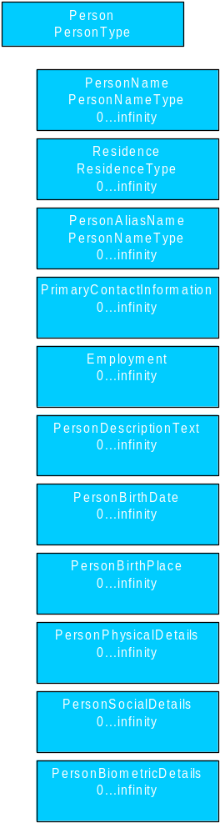
PersonType
The person type is the foundation of much of the Justice Dictionary. It has 18 sub elements (not all shown) all of which are optional. Services should implement as much as they have data available for.

Slide 25
<xsd:complexType name='PersonType'>
<xsd:complexContent>
<xsd:extension base='SuperType'>
<xsd:sequence>
<xsd:element minOccurs='0' maxOccurs='unbounded' ref='PersonName' />
<xsd:element minOccurs='0' maxOccurs='unbounded' ref='PersonAliasName' />
<xsd:element minOccurs='0' maxOccurs='unbounded' ref='Residence' />
<xsd:element minOccurs='0' maxOccurs='unbounded' ref='PrimaryContactInformation' />
<xsd:element minOccurs='0' maxOccurs='unbounded' ref='Employment' />
<xsd:element minOccurs='0' maxOccurs='unbounded' ref='PersonDescriptionText' />
<xsd:element minOccurs='0' maxOccurs='unbounded' ref='PersonBirthDate' />
<xsd:element minOccurs='0' maxOccurs='unbounded' ref='PersonBirthPlace' />
<xsd:element minOccurs='0' maxOccurs='unbounded' ref='PersonBirthPlaceCode' />
<xsd:element minOccurs='0' maxOccurs='unbounded' ref='PersonDeathDate' />
<xsd:element minOccurs='0' maxOccurs='unbounded' ref='PersonAgeMeasure' />
<xsd:element minOccurs='0' maxOccurs='unbounded' ref='PersonAgeDescriptionText' />
<xsd:element minOccurs='0' maxOccurs='unbounded' ref='PersonLivingIndicator' />
<xsd:element minOccurs='0' maxOccurs='unbounded' ref='PersonAssignedIDDetails' />
<xsd:element minOccurs='0' maxOccurs='unbounded' ref='PersonPhysicalDetails' />
<xsd:element minOccurs='0' maxOccurs='unbounded' ref='PersonSocialDetails' />
<xsd:element minOccurs='0' maxOccurs='unbounded' ref='PersonBiometricDetails' />
<xsd:element minOccurs='0' maxOccurs='unbounded' ref='PersonMedicalDetails' />
</xsd:sequence>
</xsd:extension>
</xsd:complexContent>
</xsd:complexType>

Slide 26
WENET Schema 1.0
A XML schema that wraps around the Justice XML Data Dictionary to define standard types available and to provide security data types.
Specification and documentation
Primary elements:
  document
  results
  auditlog
  authlist
  service

Slide 27
WENET Schema 1.0
Current version conceptually frozen, future changes will add/modify supported Justice data types, refining of restrictions and fixes to grammar/spelling/format.
http://www.co.whatcom.wa.us/apps/wenet/wenet_schema_1.xsd

Slide 28
document
The document is a container for a top level Justice data type, ex. jxdd:Person or jxdd:Warrant.
Defines WENET supported Justice data types
Provides information useful in document identification and caching

Slide 29
document
<?xml version=“1.0” ?>
<wenet:document xmlns:wenet=‘http://www.co.whatcom.wa.us/apps/wenet/wenet_schema_1’
type=‘Person’
updated=‘197812252136’
orgURI=‘urn:co.whatcom.wa.us’
documentURI=‘https://wenet.co.whatcom.wa.us/as400/person?id=12’>
<jxdd:Person …….
</jxdd:Person>
</wenet:document>

Slide 30
results
The results is a container for a list of XML documents that match the XPath query
By returning a list of documents and not the complete documents we encourage client side document caching
Each document is retrieved individually, possibly in parallel to decrease overall retrieval time.

Slide 31
results
<?xml version=“1.0” ?>
<wenet:results xmlns:wenet=‘http://www.co.whatcom.wa.us/apps/wenet/wenet_schema_1’
types=‘Person’
updated=‘2003070101235’
serviceURI=‘urn:wenet.co.whatcom.wa.us/as400/’
requestURI=‘https://wenet.co.whatcom.wa.us/as400/Person?xpath=document/person/name/lastname=doe*’>
<wenet:result updated=‘200303071445’ orgURI=‘urn:co.whatcom.wa.us’>
https://wenet.co.whatcom.wa.us/as400/Person?id=DOEJOHN0002
</wenet:result>
<wenet:result updated=‘200111251036’ orgURI=‘urn:co.whatcom.wa.us’>
https://wenet.co.whatcom.wa.us/as400/Person?id=DOEJACOB0001
</wenet:result>
</wenet:results>

Slide 32
HTTP GET
A HTTP GET request is the standard web browsing request. It takes a URL and returns a file, in our case a custom generated XML file containing data from the backend RMS.
Examples:
  https://wenet.co.whatcom.wa.us/as400/Person?xpath=document/person/name/lastname=doe*
  https://wenet.bpd.cob.org/sql/longarm/Arrest.xml/document/Arrest/ArrestRecordID=325
  https://wenet.co.whatcom.wa.us/proxy/Person?xpath=document[@updated>200307031105]
  https://wenet.co.whatcom.wa.us/as400/Person?id=DOEJOHN%1%2344
  https://wenet.bpd.cob.org/sql/longarm/Person.xml?id=5248728

Slide 33
HTTP GET
Use standard HTTP 1.1 including support for headers, cookies and status codes.
Use HTTP status codes including 200, 301, 305, 307, 400, 401, 408, 410, 500, 501, and 503. (see RFC2616)

Slide 34
XPath
XPath is an XML query language
WENET currently uses v1.0
When in doubt request more data and limit results at the client
XPath provides for a database structure neutral method of query

Slide 35
URIs
Uniform Resource Identifiers
URLs and URNs are all URIs
URL: https://wenet.co.whatcom.wa.us/as400/person.xml/personid=34566
URN: urn:co.whatcom.wa.us

Slide 36
URIs
URLs used to identify documents
URNs used to identify organizations and other non-changing identifiers

Slide 37
URLs
URLs to documents must include transport method, ex. https as URI schema
URLs to documents must include a fully qualified DNS name for the server providing the service

Slide 38
URLs
documentURI = A URL to retrieve an XML representation of type “document” as defined by WENET Schema which contains a specific. For example a document describing a specific person, specific warrant or other superType as defined in the Justice XML Data Dictionary and as allowed by the WENET Schema. Ex.:
  https://wenet.co.whatcom.wa.us/as400/Person?id=DOEJOHN%1%2344
  https://wenet.bpd.cob.org/sql/longarm/Person.xml?id=5248728

Slide 39
URNs
URNs currently only used for organization and service identifiers.
orgURI = “urn:” plus fully qualified dns name of organization and department. Ex. Whatcom County Sheriff orgURI = “urn:co.whatcom.wa.us/sheriff”, BPD orgURI=“urn:cob.org/police”
serviceURI = “urn:” plus service name. Service name may be based on the URLs returned by the service by including a server DNS name and URL directory style naming. Ex. Whatcom County AS400 = “urn:wenet.co.whatcom.wa.us/as400/”

Slide 40
Security
RMS Security
Transport
Authentication
Access
Auditing
Security Review

Slide 41
RMS Security
Firewalls to limit access to specific services
Internal RMS security
HTTP server security
  Latest patches
  Remove unnecessary services

Slide 42
Transport
Use of 128 bit SSL/TLS to secure HTTP packets.
Initial use of highly secured network, especially during development. This fiber optic network connects City of Bellingham (BPD), WWU PD and Whatcom County. Called the Extranet, it is currently used to share AS400 green screen.

Slide 43
Authentication
Industry standard SSL Client/Server authentication where both parties have digital certificates and are verified as current, signed and valid.
Users (or client software) and servers are issued digital certificates, preferably same as used by Transact Washington.
Certificate policy part of inter-local agreements.

Slide 44
Access
Each organization provides a service (may be part of the document service) that returns an XML list of users, their digital certificate identifier and a list of document types that the user is authorized for.
Services contact other services to retrieve a copy of the users list and keeps a local copy of this list to verify users against.
Services verify that authenticated user has access to document type (may be controlled via URL filter).
If user not on list or not authorized for document type return standard HTTP error code.

Slide 45
Access
<?xml version=“1.0” ?>
<wenet:authlist xmlns:wenet=‘http://www.co.whatcom.wa.us/apps/wenet/wenet_schema_1’
updated=‘2003070101235’
serviceURI=‘urn:wenet.co.whatcom.wa.us/as400/’>
<wenet:authorizedUser updated=‘200303071445’ orgURI=‘urn:co.whatcom.wa.us’ certDN=‘123248758725’
fullname=‘Robert Joshua Nylander’ email=‘rnylande@co.whatcom.wa.us’ auditlogaccess=‘true’ authlistaccess=‘true’>
<wenet:authorizedDocuments>Person</wenet:authorizedDocuments>
<wenet:authorizedDocuments>Warrant</wenet:authorizedDocuments>
</wenet:authorizedUser>
<wenet:authorizedUser> ,,,, </wenet:authorizedUser>
</wenet:authlist>

Slide 46
Auditing
The ability to audit the system is an essential part of system security.
Every request received by a service is logged with requester, request and timestamp.
Every request made by a client is logged with requester, service and timestamp.
Log is available for download by clients to verify integrity with local log.

Slide 47
Auditing
<?xml version=“1.0” ?>
<wenet:auditlog xmlns:wenet=‘http://www.co.whatcom.wa.us/apps/wenet/wenet_schema_1’
start=‘300301010000’
end=‘2003070101235’
serviceURI=‘urn:wenet.co.whatcom.wa.us/as400/’>
<wenet:auditentry>
<wenet:who>rnylande@co.whatcom.wa.us</wenet:who>
<wenet:what>https://wenet.co.whatcom.wa.us/as400/Person?xpath=
document/person/name/lastname=doe*</wenet:what>
<wenet:when>2003-07-10T11:44:33-08:00</wenet:when>
<wenet:where>urn:co.whatcom.wa.us</wenet:where>
</wenet:auditentry>
</wenet:auditentry> … </wenet:auditentry>
</wenet:auditlog>

Slide 48
Security Review
Security review performed Whatcom County’s CISSP
Possible outside security auditing
Security part of inter-local

Slide 49
Services Discovery
The service document describes the data that a service is making available and how to make requests.
Consists of URLs with “!XPATH!” place holders where the query goes. Ex. https://wenet.co.whatcom.wa.us/as400/Person/person.xml?xpath=!XPATH!
It is envisioned that simple string replacement will provide a flexible means of having loosely defined URLs.

Slide 50
Services Discovery
Sharing partners exchange service discovery URLs (ex. http://wenet.co.whatcom.wa.us/as400/service.xml) and clients use the URL to retrieve a service XML document.
XML document, service, tells the client what data is available and how to make requests.
Clients check service discovery every so often for changes.
Services are self describing.

Slide 51
Services Discovery
<?xml version=“1.0” ?>
<wenet:service
xmlns:wenet=‘http://www.co.whatcom.wa.us/apps/wenet/wenet_schema_1’
serviceURI=‘urn:wenet.co.whatcom.wa.us/as400/’>
TO BE DONE
</wenet:service>

Slide 52
Part 2
WENET will allow inquiry of XML data based on the Justice XML Data Dictionary 3.0 via HTTP utilizing XPath queries and secured using client authenticated SSL.

Slide 53
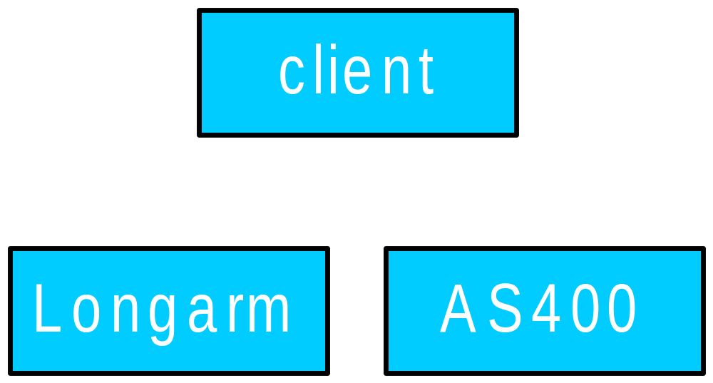
WENET

Slide 54
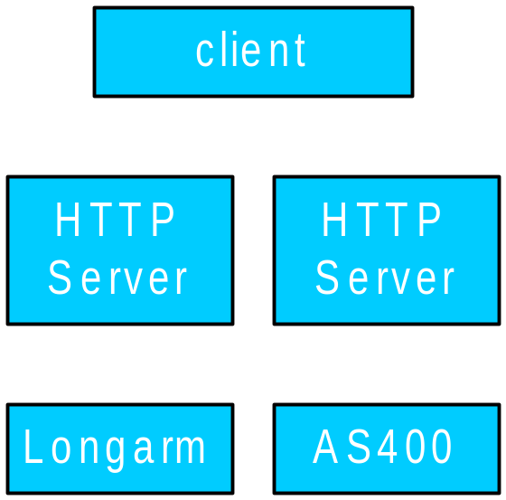
WENET

Slide 55
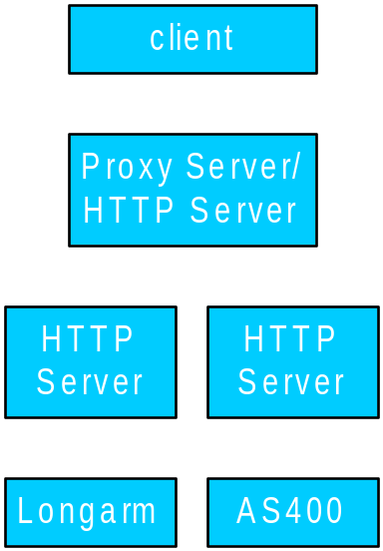
WENET

Slide 56
WENET
AS400
HTTP Server
Private
Extranet
Client
Whatcom County
BPD
Longarm
HTTP Server

Slide 57
WENET
AS400
HTTP Server
Private
Extranet
HTTP GET
XML response
Client
HTTP GET
Whatcom County
BPD
Longarm
HTTP Server

Slide 58
WENET
AS400
HTTP Server
Private
Extranet
Client
HTTP GET
Whatcom County
BPD
XML
response
Longarm
Proxy /
HTTP Server
HTTP Server

Slide 59
WENET
AS400
HTTP Server
Private
Extranet
Client
HTTP GET
HTTP GET
Whatcom County
BPD
XML
response
XML
response
Longarm
Proxy /
HTTP Server
HTTP Server

Slide 60
WENET
AS400
HTTP Server
Private
Extranet
HTTP GET
XML response
Client
HTTP GET
Whatcom County
BPD
XML
response
Longarm
Proxy /
HTTP Server
HTTP Server

Slide 61
WENET
AS400
HTTP Server
Private
Extranet
XML response
Client
HTTP GET
Whatcom County
BPD
XML
response
Longarm
Proxy /
HTTP Server
HTTP Server

Slide 62
WENET
AS400
HTTP Server
Private
Extranet
HTTP GET
XML response
Client
HTTP GET
Whatcom County
BPD
Longarm
Proxy /
HTTP Server
HTTP Server

Slide 63
WENET
AS400
HTTP Server
Private
Extranet
HTTP GET
XML response
Client
HTTP GET
Whatcom County
BPD
XML
response
Longarm
Proxy /
HTTP Server
HTTP Server

Slide 64
WENET - Expanded
IGN
or
Internet
RMS
Client
Client
RMS
RMS
Client
Proxy /
HTTP Server
RMS

Slide 65
Construction
Prep current RMS implementations for sharing
  Determine what data is to be shared
  Fix/establish identifiers (AS400 person ID needs to be random/un-changing)
  Prep tables
Build views/tables
  Build SQL views organizing current data around Justice XML concepts of data
  Build tables to store audit and access lists

Slide 66
Construction …
Add new RMS features as it makes sense:
  mug shots
  fingerprints
Connect HTTP server to RMS
Establish business logic to respond to HTTP requests

Slide 67
Construction …
Acquire digital certificates for servers and possibly users.
Establish business logic to authenticate, check access and log requests
Establish automatic mechanism to update authlist data.

Slide 68
Construction …
Connect HTTP servers to the current Extranet
Test with basic web browser client
Develop more advanced client to facilitate testing
Integrate with WASPC Jail Booking Reporting System

Slide 69
Construction …
Build proxy server
  Whatcom County IS staff construct proxy server, DNS server and other services for the Extranet

Slide 70
Tools/Options
MS SQL Server 2K
  Executing XPath Queries Using HTTP
  (http://msdn.microsoft.com/library/en-us/xmlsql/ac_xml_0n70.asp?frame=true)
  XDR schema over views
  Integration with IIS
  Possibility of using SQL linking capability to use this method against AS400 data

Slide 71
Tools/Options
Java Servlet
  Xalan XSLT processor with SQL access via JDBC
  Custom code to parse XPath, convert to SQL and format JDBC result set to XML
Net.Data
  Custom code to parse XPath, convert to SQL and format results into XML

Slide 72
Tools/Options
ASP/ASP.Net
  Custom code converts XPath to SQL and passes via ADO to database, result set formatted to XML.
  MSXML XPath tools including those part of MS SQL 2K but with custom ASP processing
Some combination of the above…

Slide 73
Related Documents / Further Info
MIS Nov. 2002: Data Integration and The Criminal Justice System in Whatcom County
  http://www.co.whatcom.wa.us/boards/lawjustice/mis/
HTTP
  RFC 2616
XML
  http://www.w3.org/TR/REC-xml
XPath
  http://www.w3.org/TR/xpath
Justice XML Data Dictionary 3.0
  http://it.ojp.gov/jxdd/prerelease/3.0.0.0/index.html

Slide 74
Related Documents / Further Info
URIs
  http://www.w3.org/Addressing/
  http://www.ietf.org/rfc/rfc2396.txt
WENET Technical Specifications
  http://www.whatcomcounty.us/apps/wenet/
  http://www.whatcomcounty.us/boards/lawjustice/mis/

Slide 75
Related Documents / Further Info
Project Coordinator
  Ron Peterson
  (360) xxx-xxxx
  ron@something.com
Committee Chair
  Kathy Walker
  (360) 676-6784
  kwalker@co.whatcom.wa.us
Technical Coordinator
  Josh Nylander
  (360) 676-7684
  rnylande@co.whatcom.wa.us

Slide 76
Discussion…
Concepts
Technical Points
Timelines
Bids/Contracts

