Slide 1
PowerShell for MIP Developers
Josh Hendricks
Principal Engineer | Microsoft MVP

Slide 2

Who am I Josh Hendricks / Principle Engineer
Software engineer based in Oregon
Microsoft MVP, Azure / PowerShell
Joined Milestone in 2006
Built and maintains MilestonePSTools
On LinkedIn, GitHub, and Bluesky as @joshooaj

Slide 3
Agenda
Introduction
Hands-on Excercise
Why PowerShell?
Introduction to MilestonePSTools
What kind of developer tasks is this good for?
Install MilestonePSTools
Add cameras in bulk
Configure streams
Add/configure roles
Generate reports
Export/import cameras

Slide 4

So, why PowerShell? (why not bash, zsh, nushell, or… cmd?)
It’s an object-oriented shell / scripting language
Windows PowerShell is based on .NET Framework
Milestone offers an SDK based on .NET Framework
We wrapped the MIP SDK in a PowerShell module
Use and explore the MIP SDK on any computer…
You don’t need Visual Studio
Rapidly prototype, or build tools/solutions directly in PowerShell
PowerShell also works on Linux & Mac (but not MilestonePSTools… yet)

Slide 5
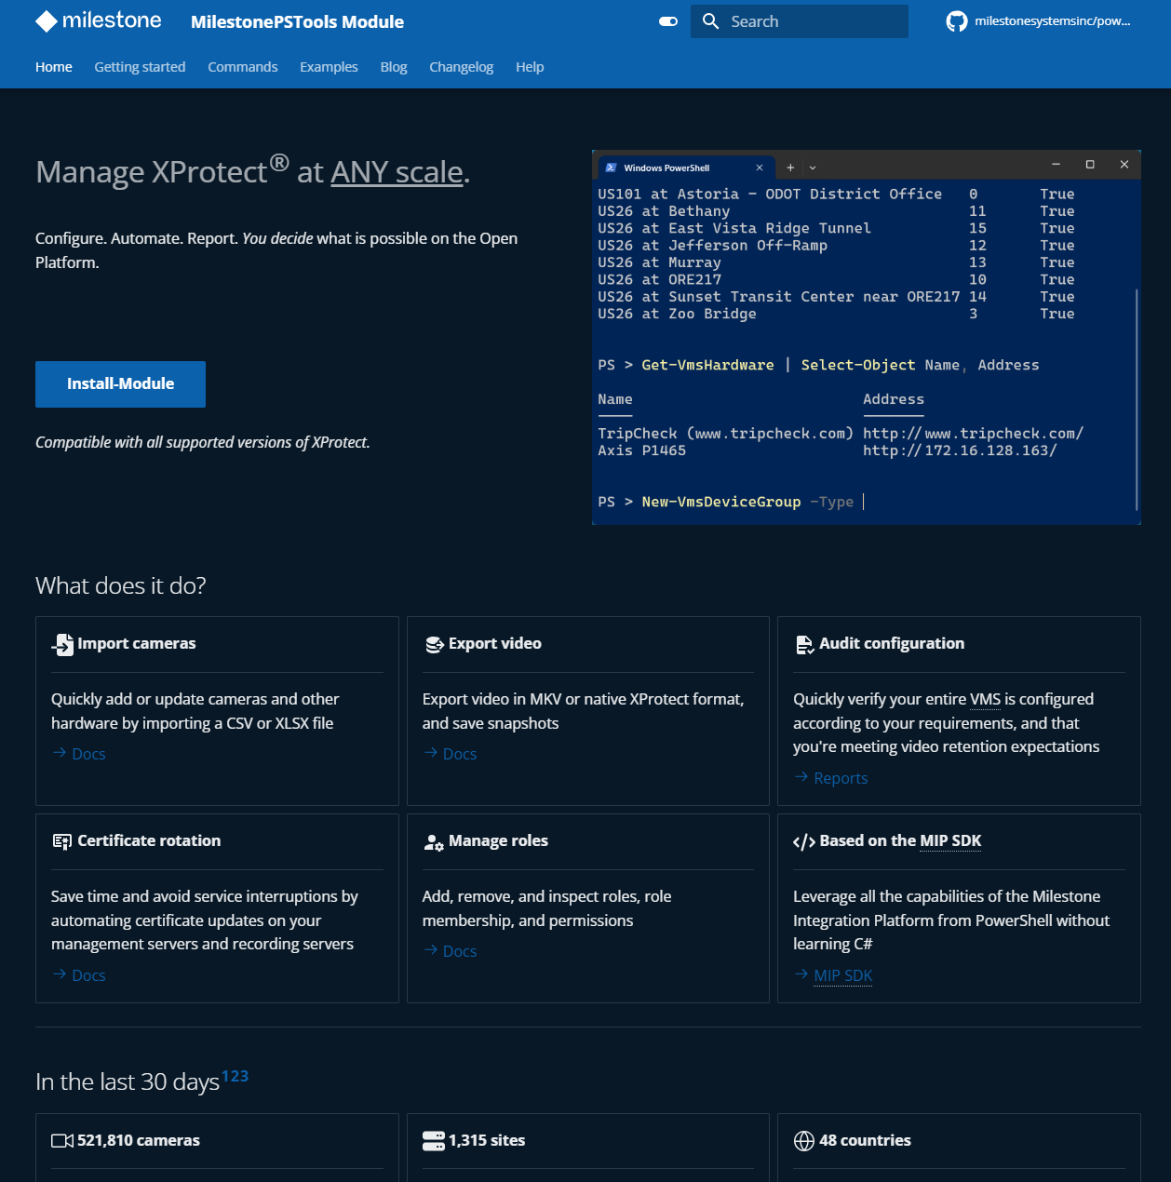
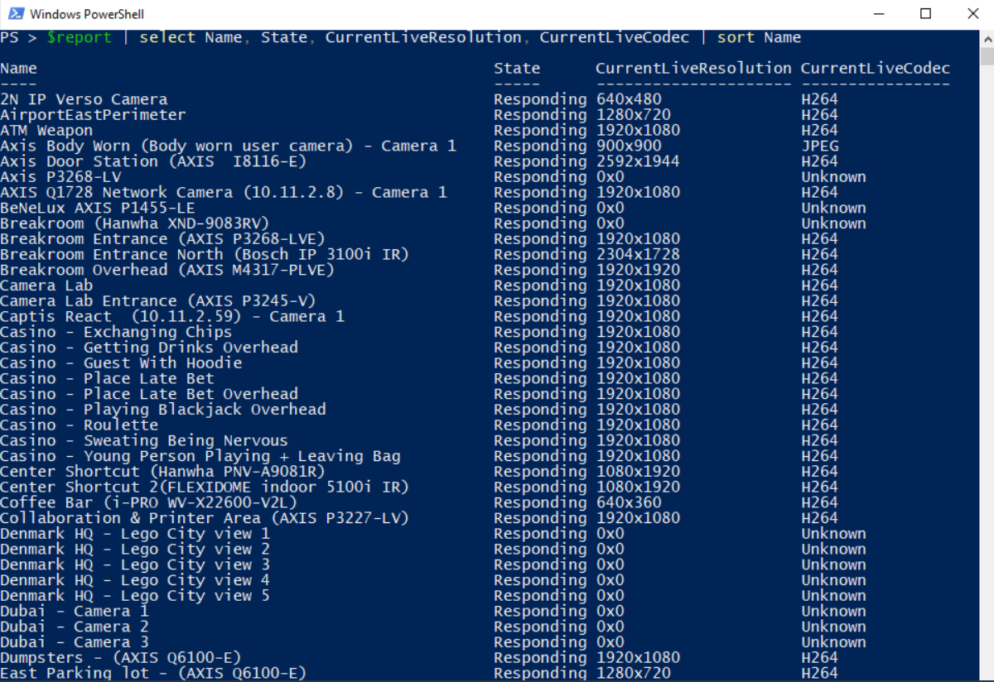
MilestonePSTools
milestonepstools.com

Slide 6
Value for Developers?
Explore the Configuration API interactively (also see ConfigAPIClient sample for a GUI option)
Quickly configure a consistent, reproducible XProtect test environment
Automate the configuration of XProtect in your end-to-end tests
Troubleshoot some types of integration issues
Generate a report documenting important aspects of your customer’s environment for support/troubleshooting purposes
One more tool in your belt

Slide 7
Demos & Exercise Time!
Open session repo in Visual Studio Code (or your editor/IDE of choice) github.com/joshooaj/pwshmipsession

